Slide 1
Where does Toronto
Need a Greek Grocery store?

Slide 2
Problem Statement
We are Tasked by the client, OPA Ltd to find the ideal location for starting a new greek grocery store chain in Toronto
The challenge is to find the ideal location which is moderate in dense population, but busy enough to secure success.
Client wants a location with the prospect of opening up a chain, not a single one-off shop.

Slide 3
Data Acquisition
Data on Toronto Boroughs to be sought from: https://en.wikipedia.org/wiki/List_of_postal_codes_of_Canada:_M
Geospatial co-ordinates from: http://cocl.us/Geospatial_data
3. Processing Performed in py, using jupyder notebooks and using essential analysis and plotting packages.

Slide 4
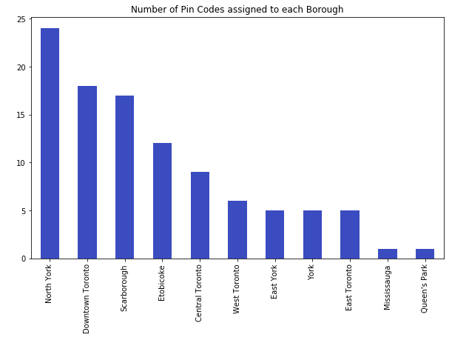
Primitive Analysis
Downtown Toronto seems to be
the obvious choice with highest number of landmarks.
2. However, it is densely populated, with high competition expected.
3. More suitable alternatives Sought.

Slide 5
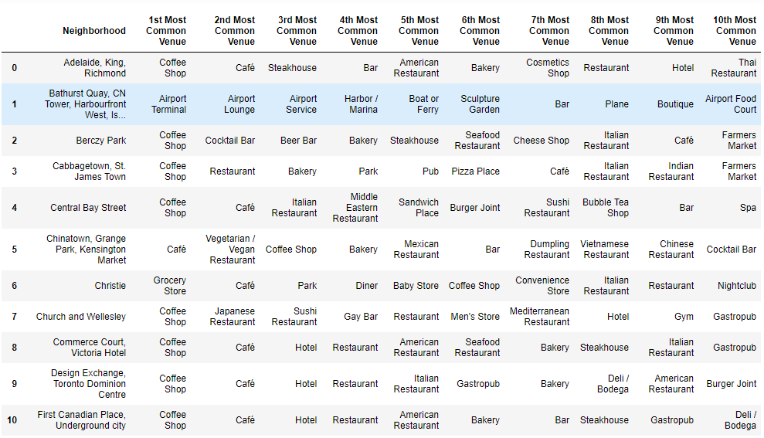
Overview
Venue Frequency by Neighborhood.

Slide 6
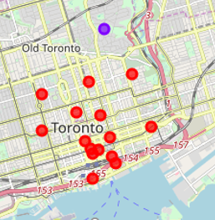
Refining Choices
Clustering Neighborhoods by commonality of venues.

Slide 7
Pattern Recognition
The clusters with pin codes M4W and M5V fit the
client’s requirements best
2. M4W seems the dominating choice; M5V also
good choice but somewhat isolated from downtown Toronto

Slide 8
Conclusion
The best location given initial inputs can be identified.
2. However model can be improved by:
a. Considering Crime Data
b. Per Capital income per Neighbourhood
should that be available
The above are complimentary inputs to refining the model

