Slide 1
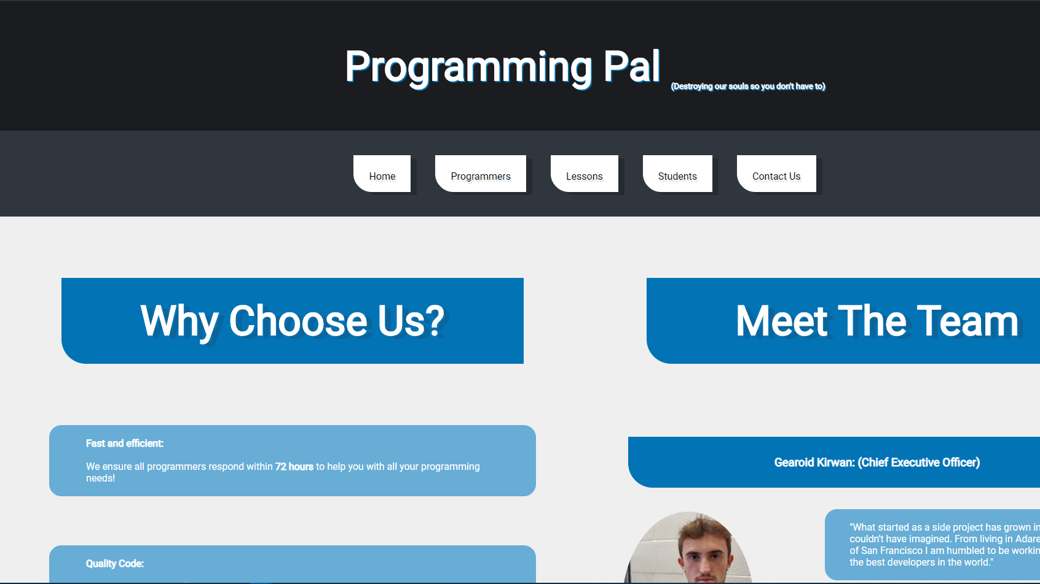
Programming Pal
Luke O’Sullivan Griffin/Mike Vriesema
(17184614)/(17212359)

Slide 2
Programming Pal
We chose the concept of a programming pal hire/teaching system as the fundamental base for our company.
If this was a real company, it would be a very useful service to struggling computer science students.
The company would provide services that allow you to hire a programmer in a particular language at a set rate to design an application or hire a programmer to assist in the teaching and learning of new skills in a chosen programming language or from scratch.

Slide 3

Homepg
Index.php
http://localhost/project/index.php
HTML/CSS

Slide 4
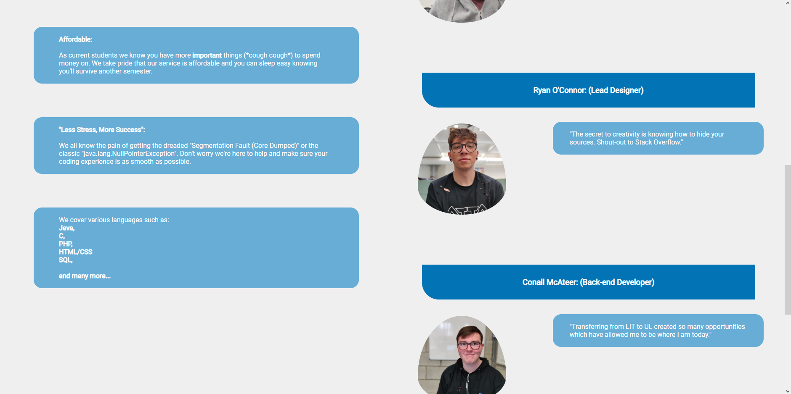
Homepg
Index.php

Slide 5
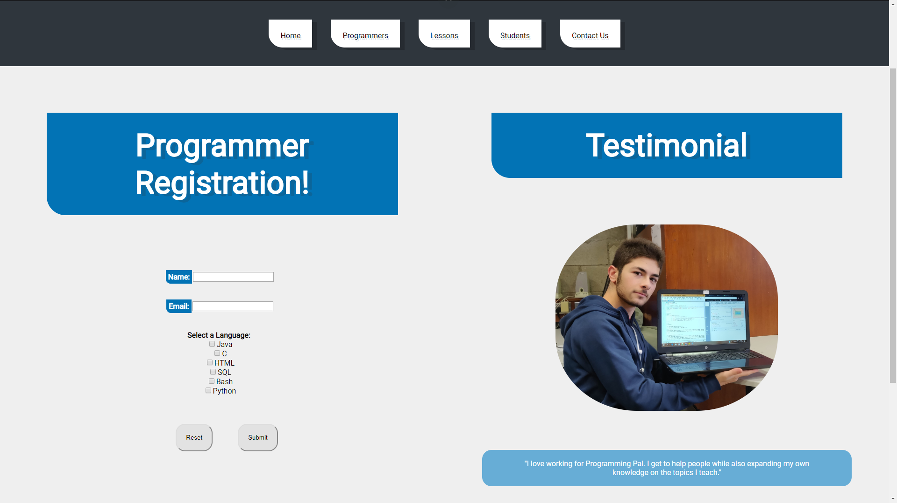
FORM.php
http://localhost/project/form.php

Slide 6
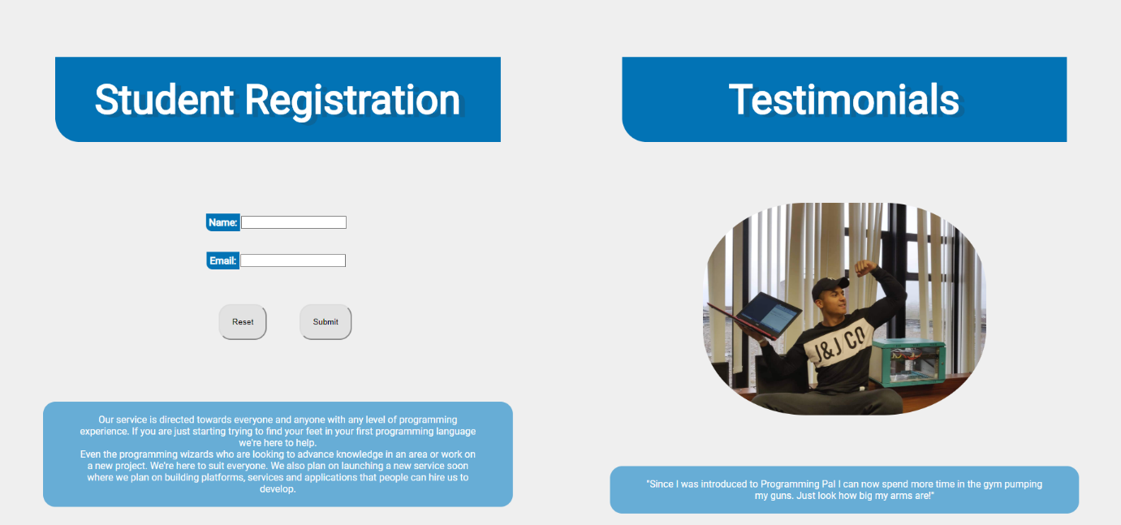
STUDENTFORM.php
http://localhost/project/studentForm.php

Slide 7
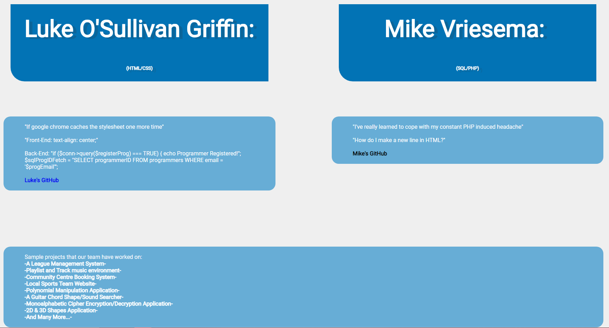
CONTACT.php
http://localhost/project/contact.php

Slide 8
HTML/CSS
We decided to go for a simple design approach with minimalistic colours (shades of grey, white and blue).
The header consists of a h1 heading and a subscript for smaller text.
The nav bar is located underneath with customised links to each webpage.
The main body is split into two divs (content and content 2), allowing us to easily place content on either side of the page. The divs are identified in the stylesheet using ID’s and Classes where appropriate.
A footer is included which includes the address, a mailto link and links to other pages (for ease of access).

Slide 9
HTML/CSS
Two stylesheets were created: indexStyle.css and formStyle.css.
IndexStyle is used as the main template. FormStyle is used for pages that contain forms.
We decided to do this as it reduced clutter and made it far easier to adjust certain elements without affecting other pages without forms.

Slide 10
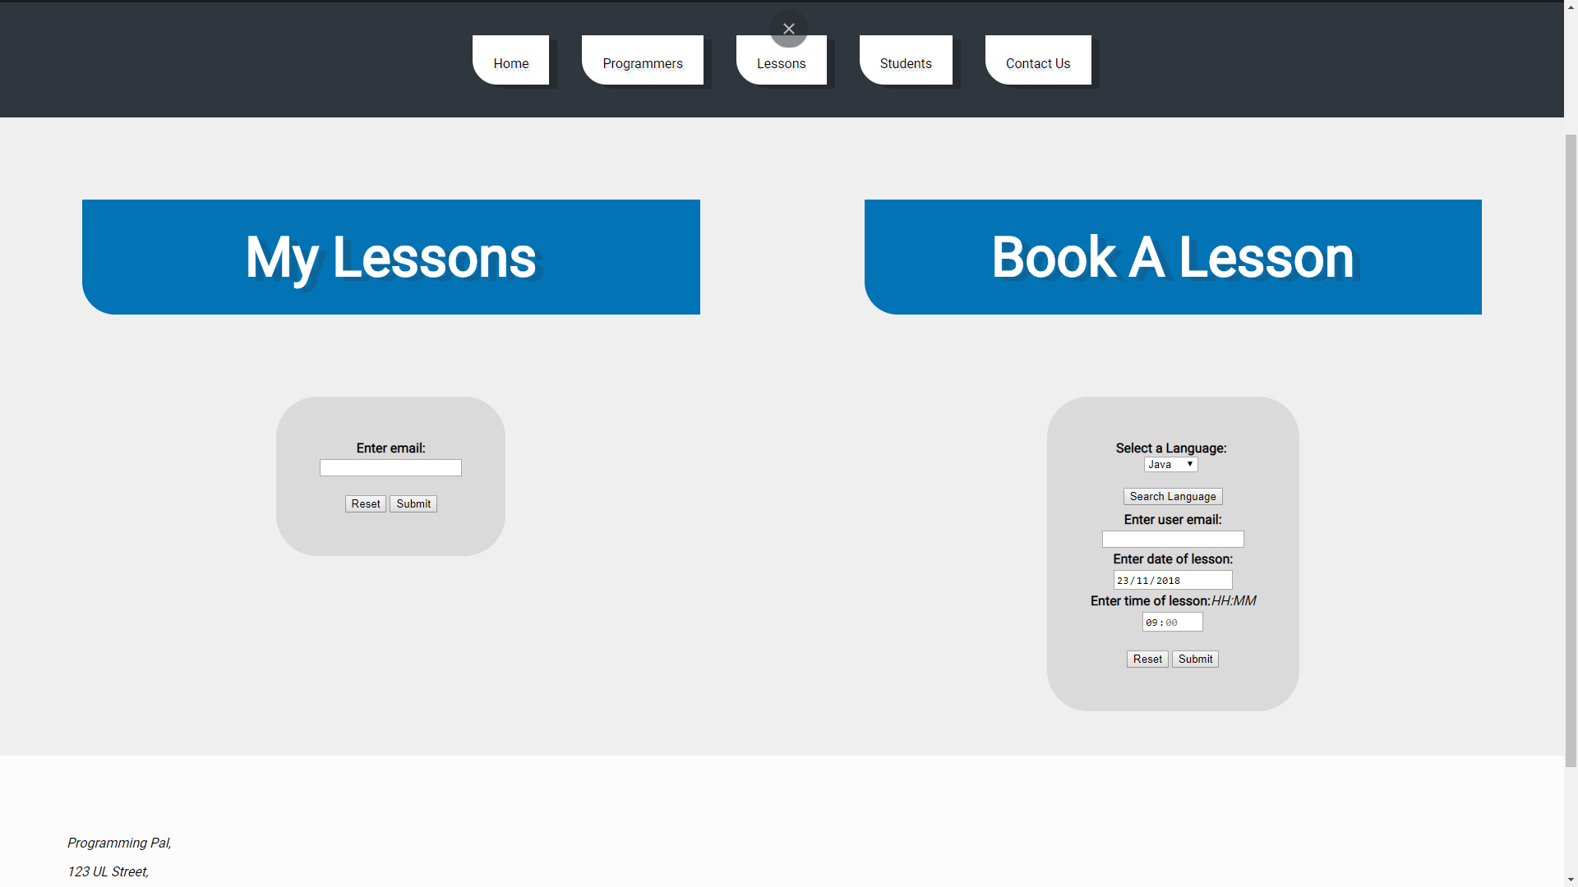
Homepg
LESSONS.php
http://localhost/project/lessons.php
HTML/CSS

Slide 11
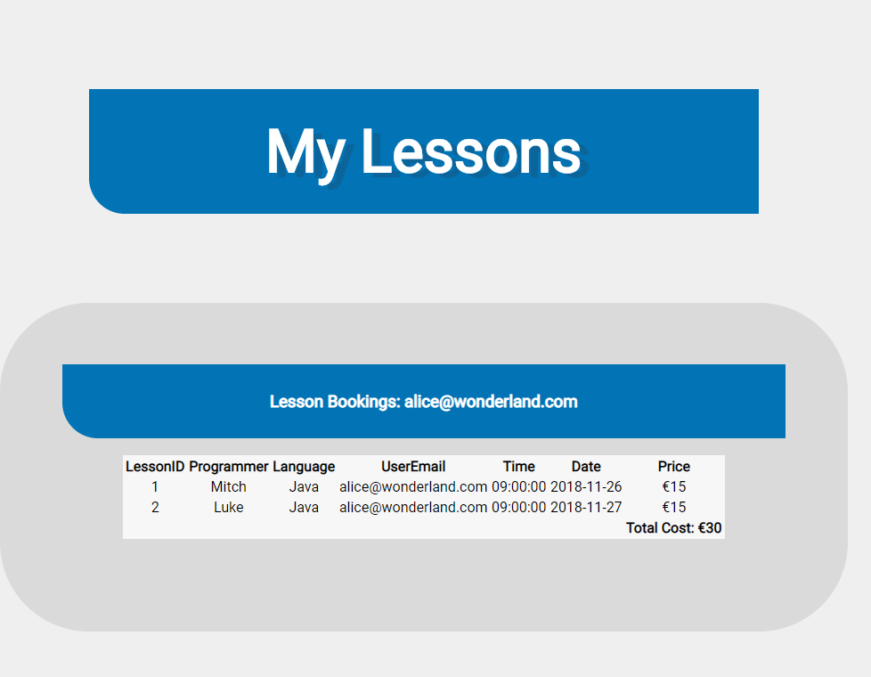
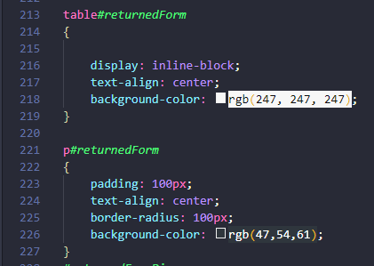
Lessons Table
The returned data from the lessons table is echoed in the html.
It Is placed into a new div (which contains the heading and table itself)
The table is then formatted in formStyle.css

Slide 12
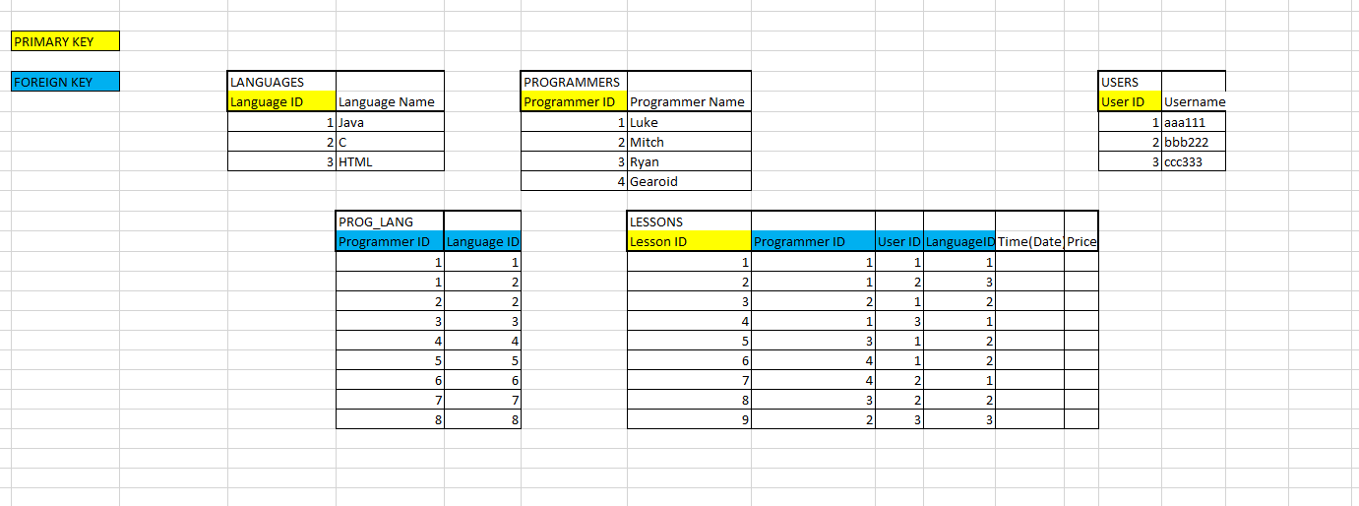
SQL/PHP
Within a day we had devised a basic concept for our database in excel and implemented it to begin testing.
This was later refined using our commands document.
The draft was a key component in our design as we began thinking of the forms we would need on the webpage.

Slide 13
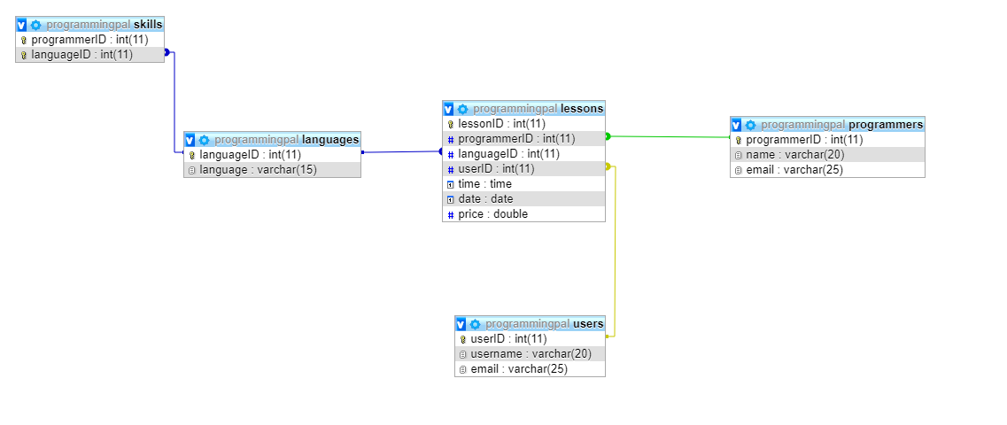
SQL DATABASE

Slide 14
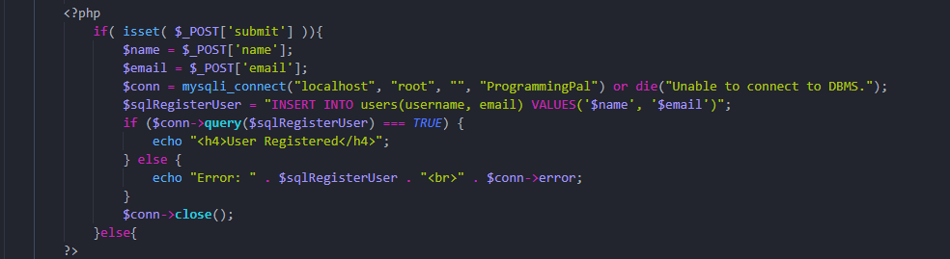
SQL/PHP
Connecting the database to the website through PHP happened naturally enough starting with the simplest form for register users.
This was the beginning of a very enjoyable relationship with PHP.

Slide 15
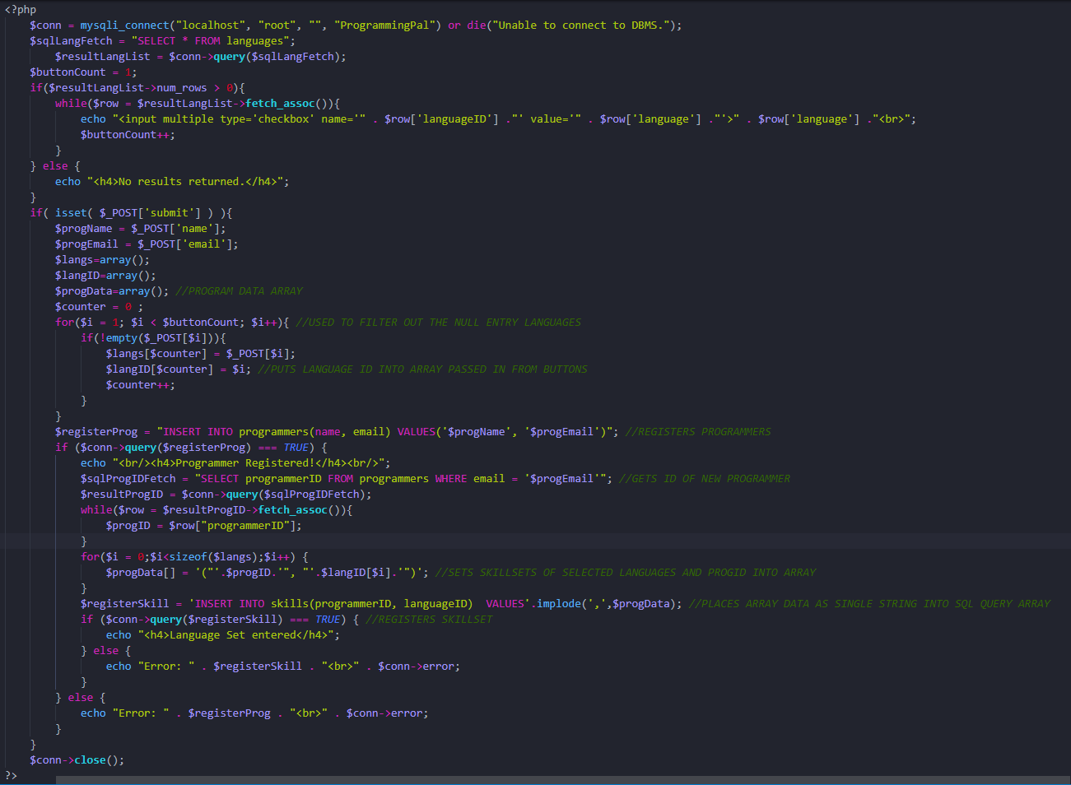
SQL/PHP

Slide 16
SQL/PHP
Significant challenges included the programmer registration where the dynamically filled checkboxes get sent to the form with null values if not selected.
Key points here are that we may not know how many languages there are total (unless hardcoded) and we do not know how many will be selected by the programmer.
To overcome this, we use a variable to keep track of how many languages enter the checkboxes.
We also use this to take their ID values also.
When the form is submitted, we use a for loop to filter out null values from the post array and carry the selected languages’ IDs into a separate array for processing later.
We then register the programmer using the inputted email and name and retrieve the new ID for the programmer.
Then we are able to build the skillset array. We use a for loop to input the programmerID and the unique languageID for each language selected and add it to the new data array.
All the programmer skillset information is now in this array occupying separate elements.
To minimise slow down caused by repetitive database access and putting an insert command with a loop we use the .implode command to issue the contents of the array as a single entry so we can enter all values in one SQL query.

Slide 17
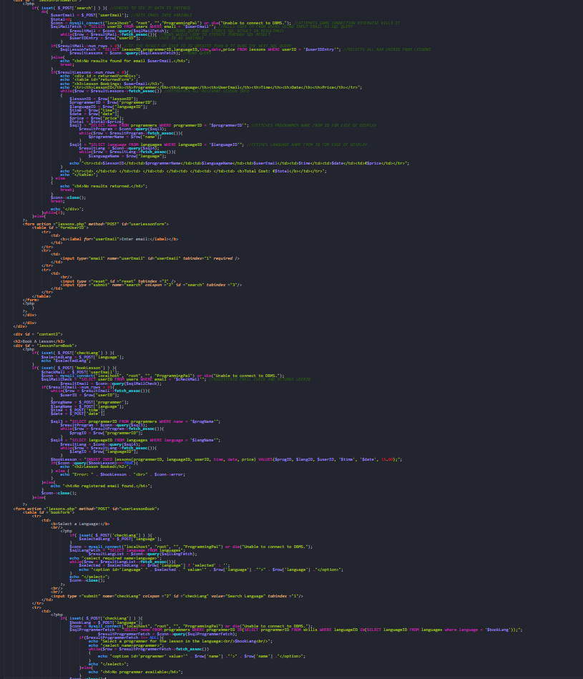
SQL/PHP

Slide 18

SQL DATABASE

Slide 19
SQL/PHP
We dynamically pulled values from the database to select the language skillset and desired language and programmer in form.php and lessons.php respectively.
We looked at keeping code compact and efficient, doing most verification in the HTML forms with a few email verifications in the lessons.php webpage.
To make all desired output more user friendly we had to fetch most values, names and emails using the primary key systems in each of the corresponding tables. This is most evident in view lessons.

Slide 20
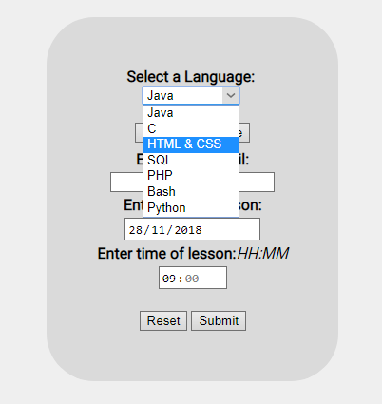
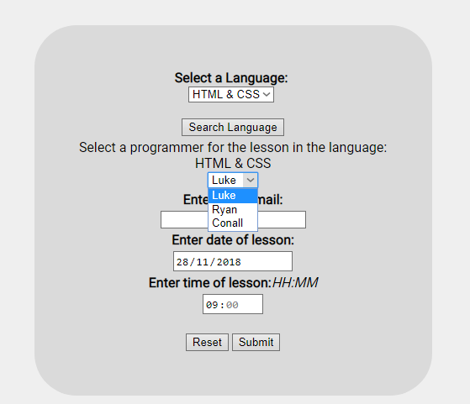
SQL DATABASE

Slide 21
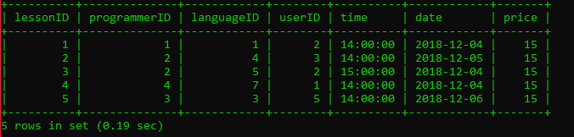
SQL DATABASE

Slide 22
CONCLUSION
The simplistic and “less is more” design approach resulted in a cleaner webpage.
The database is suitable for a small start up company like the one we chose for the project and allows easy storage of various form inputs and user data.
It was an enjoyable project that enabled us to use our creativity and challenged us to blend functionality and design.

