Slide 1
SDB Predicting Energy Usage at 88acres
Mike Wise

Slide 2
SDB Business Goals
Energy Usage Prediction
Planning and Hedging Energy Purchasing Strategies
Predicting and Mitigating Peak Energy usage to reduce Demand Charges
Predictive Maintenance
Recalibrating fault importance
Measuring impact of equipment performance on Energy and Indoor Climate
Predicting equipment outages
Locating underperforming building regions

Slide 3
Project Resources
1 TB of data – HVAC, Energy Usage, and some temperature data
Azure Account
SQL VM
Hadoop cluster
AML Workspace
1 full-time MCS DS Resource
1 part-time (1.5 d/w) AML PG DS Resource

Slide 4
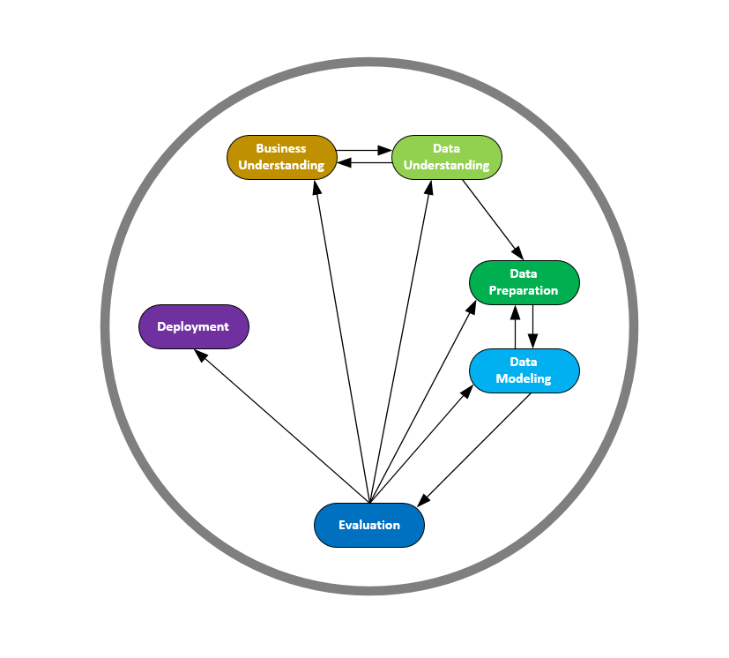
SDB – The Data Science
CRISP-DM – best developed DS methodology
Little competition
6 Phases
Business Understanding
Data Understanding
Data Preparation
Data Modelling
Evaluation
Deployment

Slide 5
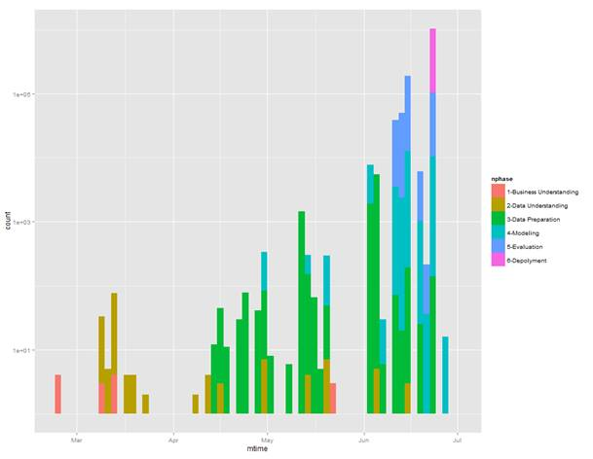
Time Line
4-5 months on project so far
Main project directory has 6000+files in 62 folders

Slide 6
SDB Business Understanding
Actual Business Benefits articulated
Revisited at least twice during project
Initial focus was Pred.Maint. oriented, shifted to an Energy Focus
Energy Consumption underlies and prioritizes most other costs
Energy requires less data to understand (3-4 data streams per building)
Desire for quick-wins shifted focus again, to creation of a “demo”

Slide 7
SDB Data Understanding - Overview
Acquisition of data took time
Used R and Excel (in places)
Delivered 1.5 TB of data in 9 SQL DBs
Approximately 500k data streams in around 100 Puget Sound buildings
Data range was from 1 Jan 2013 to 31 Dec 2014
All streams were missing data, up to 3 month gaps existed, most streams have between 50 and 80 percent coverage
Weather Data from Weather Underground, took 4 weather stations in the Bellevue/Redmond/Kirkland area with continuous data back to 2009
Weather Data Gaps moved in the 1-2 percent range

Slide 8
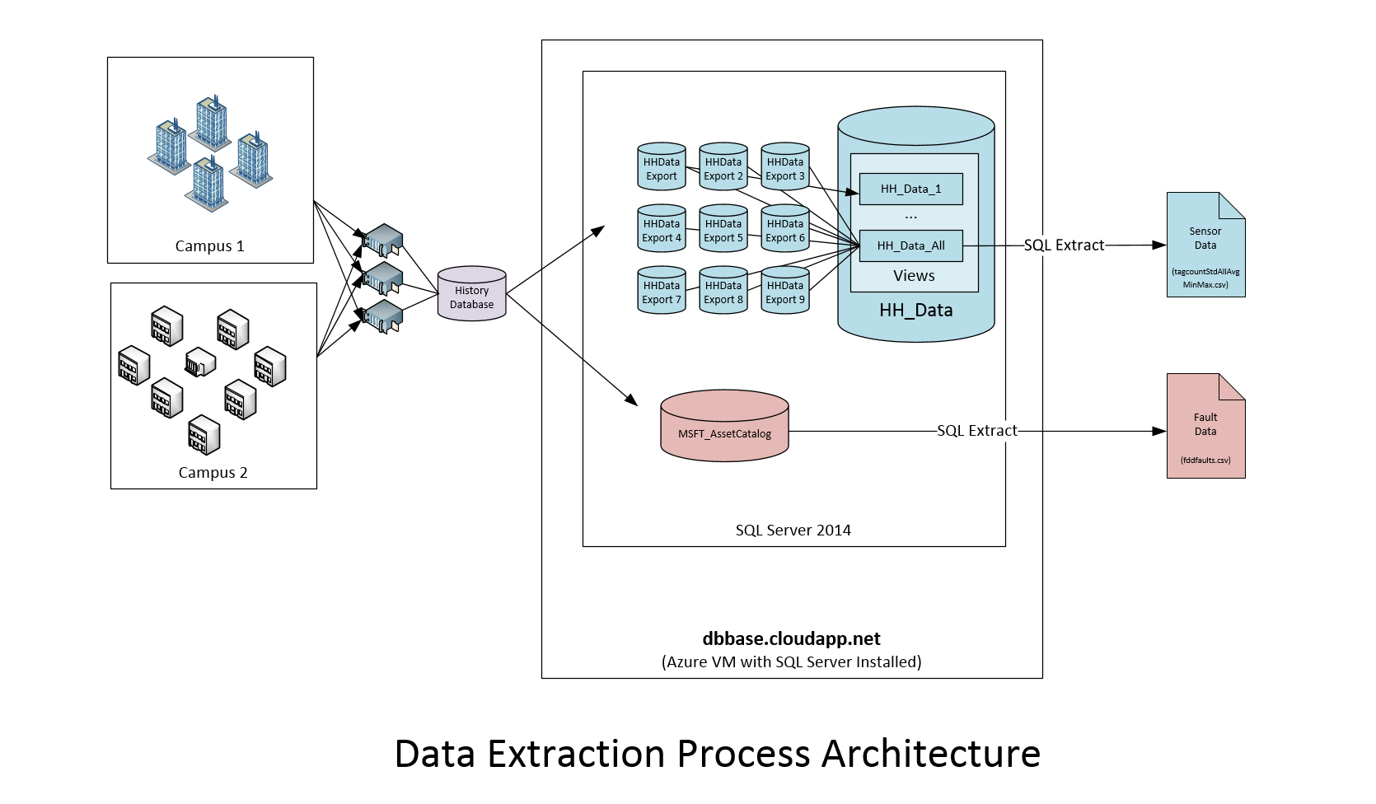
SDB - Data Understanding - Architecture

Slide 9
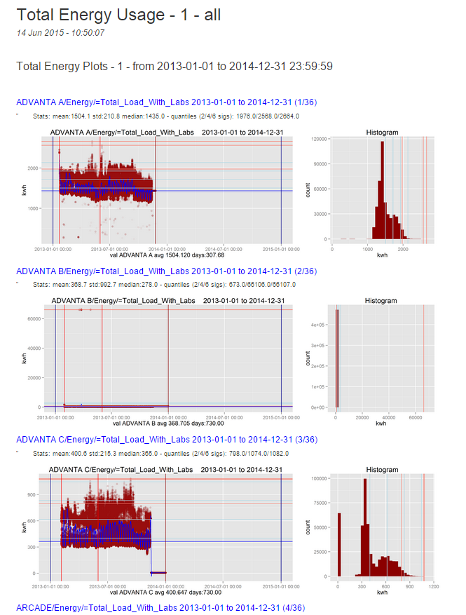
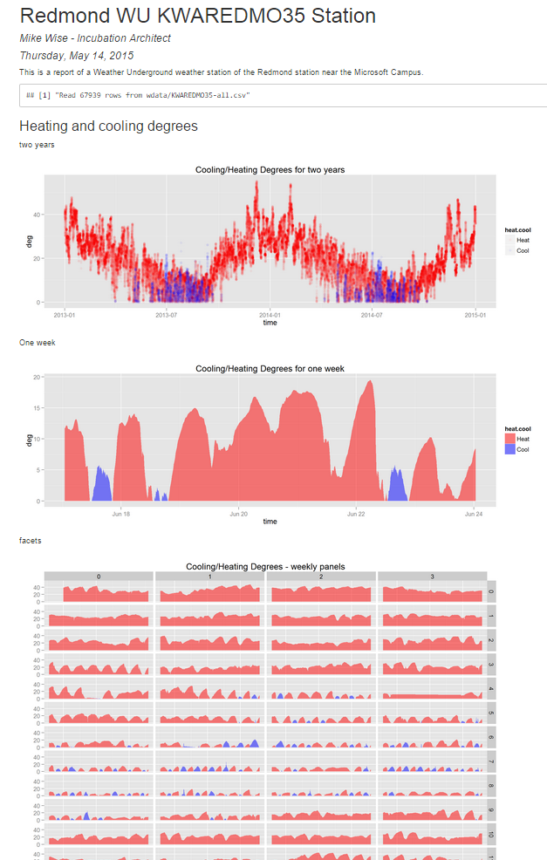
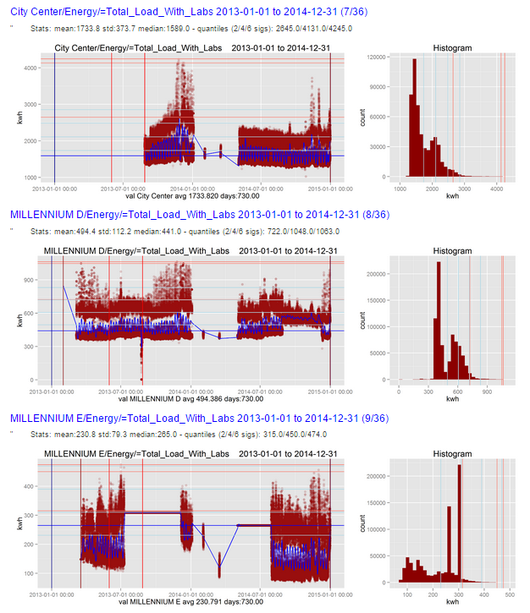
SDB - Data Understanding - Results

Slide 10
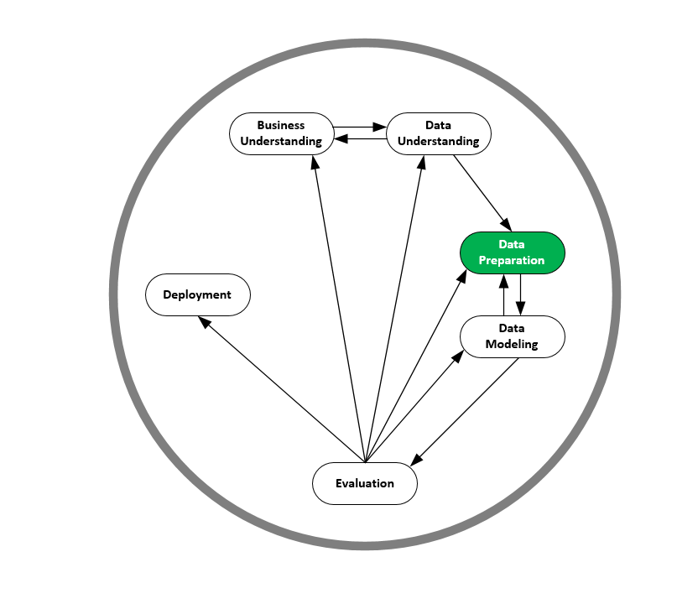
SDB – Data Preperation - Overview

Slide 11
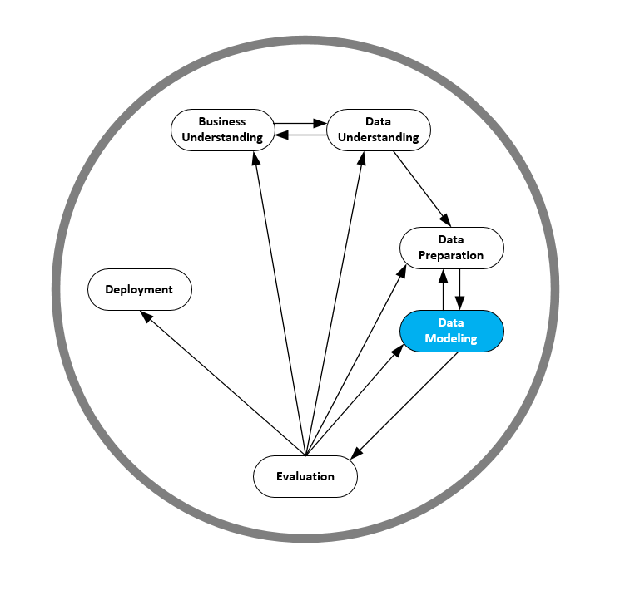
SDB Modeling - Overview
Considered different architectures
Went with Standard R and AML in the end
Many choices available today
Classic regression and optimization
Ensemble methods (Boosted Trees, Random Forests, etc.)
Other ML methods (NN, DNN, SVM, etc.)
Time Series forecasting (ARIMA)

Slide 12
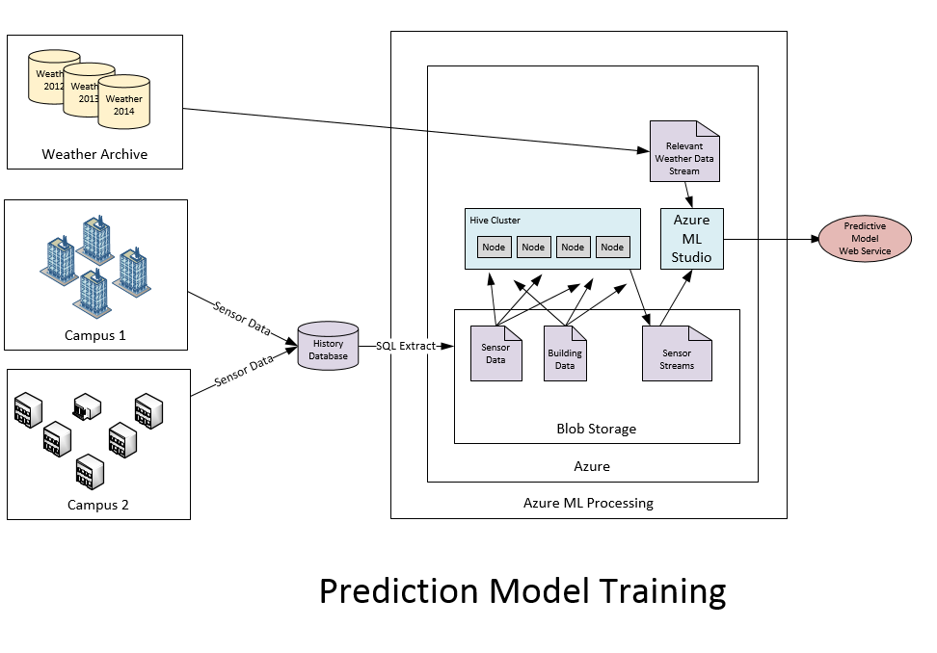
SDB – Modeling - Architecture

Slide 13
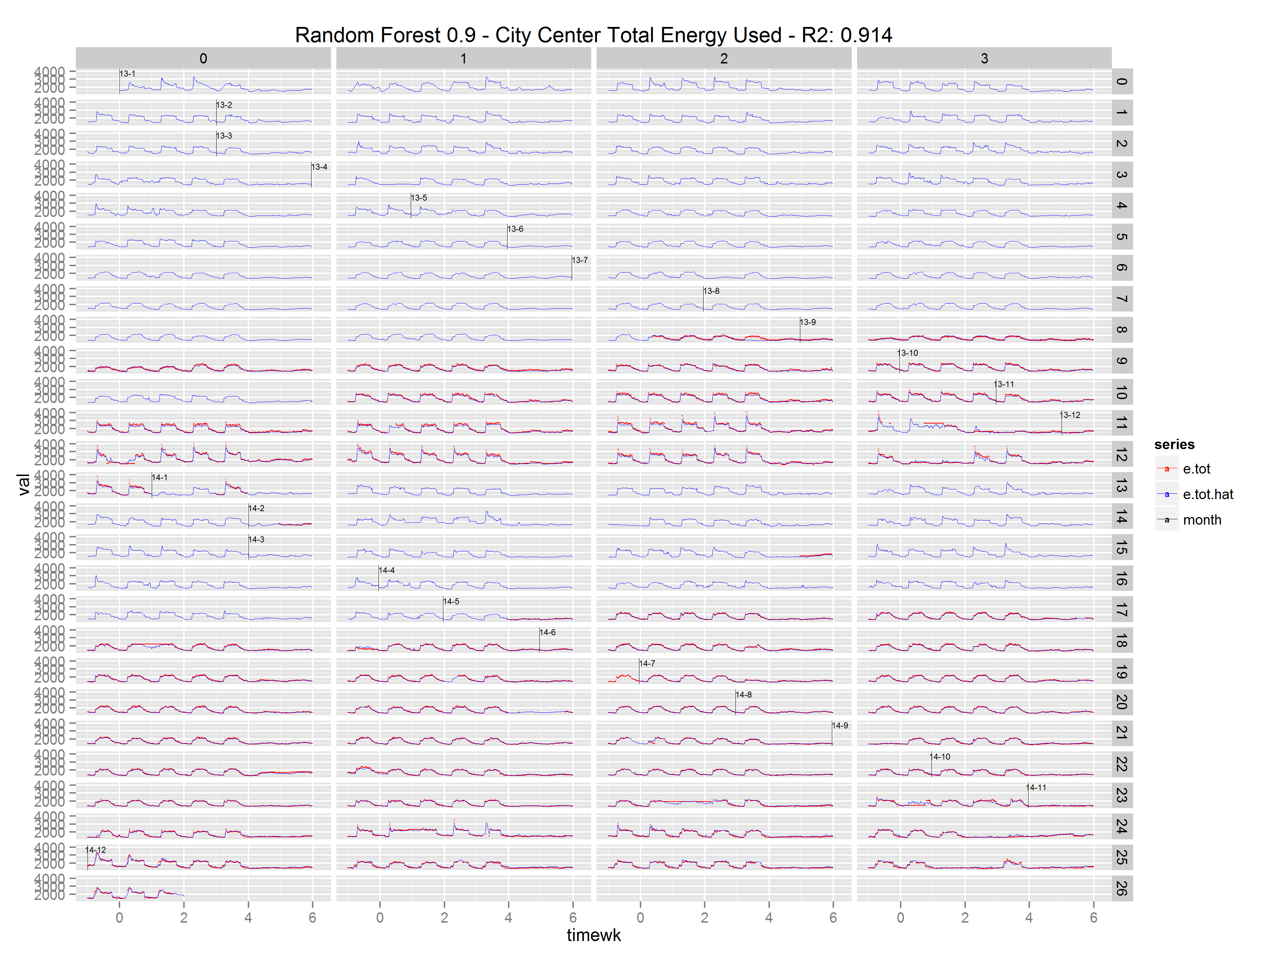
SDB – Modeling - Results

Slide 14
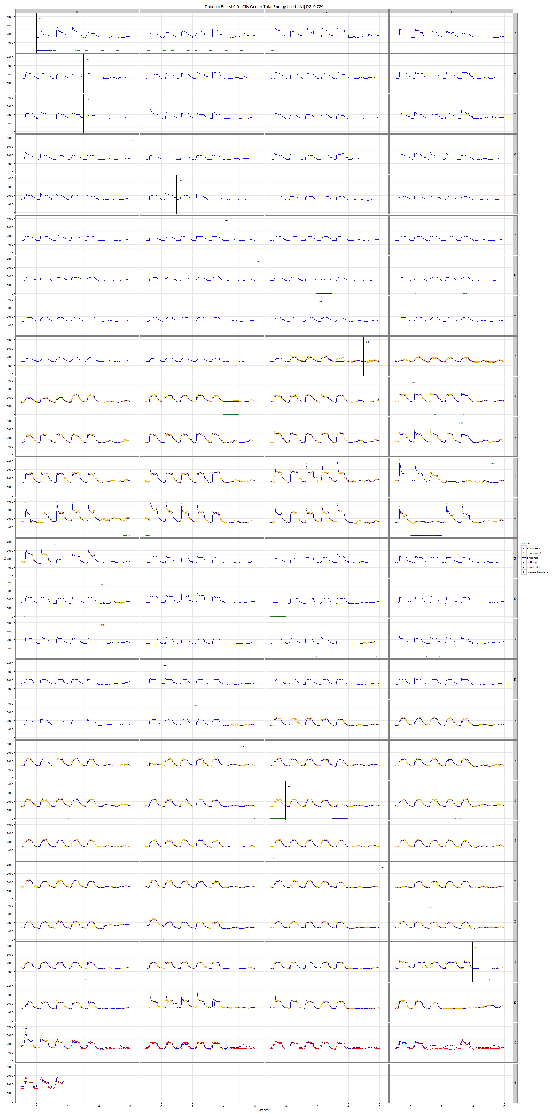
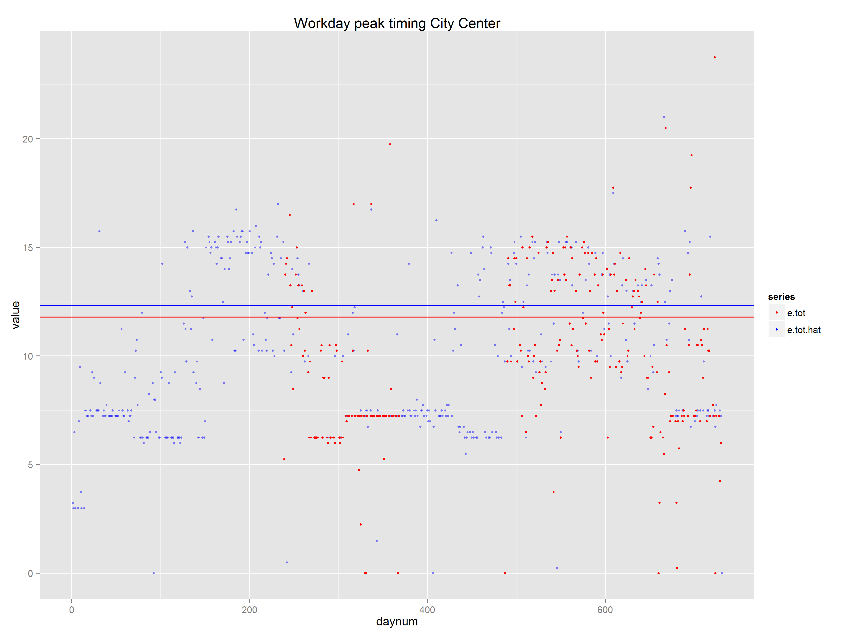
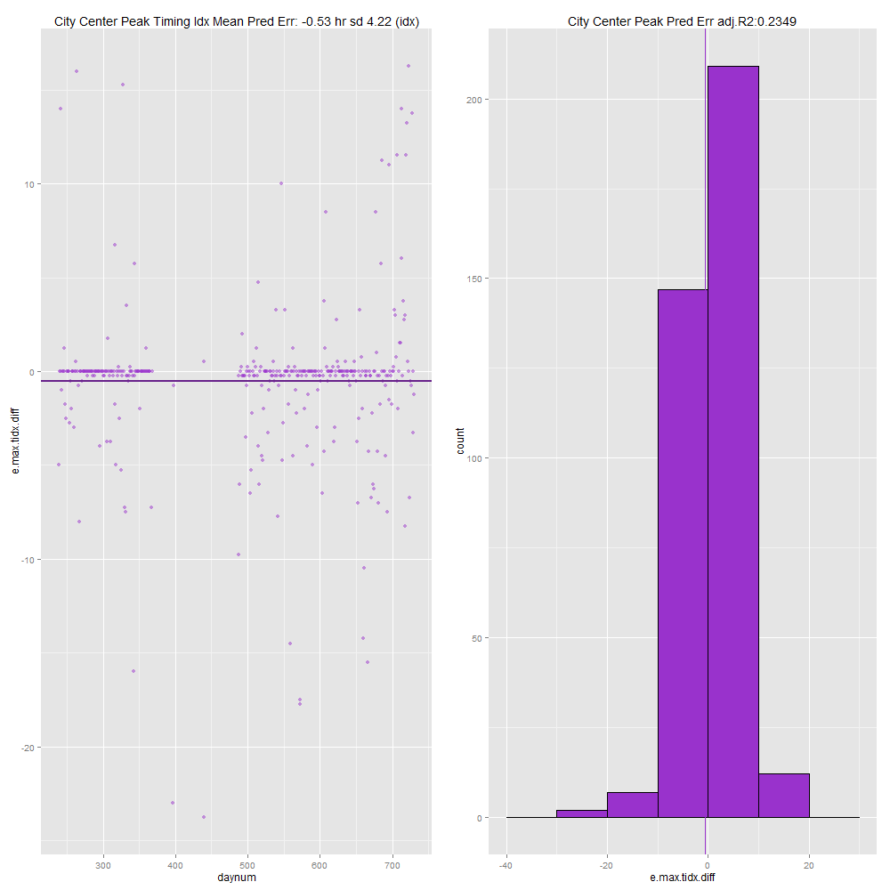
SDB Evaluation - Overview

