Slide 1


Discover, Design and Realize
A lifecycle approach to customer value
The aim of this presentation is to look at how we can bring together a number of value frameworks and approaches around the full relationship life cycle
We must understand focus on what the customer sees as value at all stages of a relationship
Include all potential value (cost saving, revenue increase, risk reduction, benefit, cost avoidance, revenue protection, …)
Understand the information required and what counts as value when a customer makes a “buy” decision
Design-in the realization of benefits to ensure the customer stays happy (leading to further investment)
Base everything around MSSP (Discover, Design, Realize) language as this is what EPG are being taught …

Slide 2
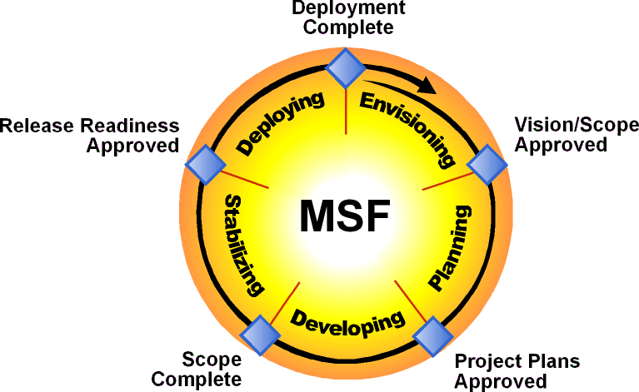
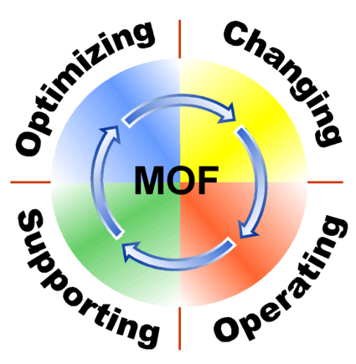
Making Sense of Phase Models
Solution Selling
Engagement Delivery
Operations
Qualify
Develop
Solution
Proof
Close
DISCOVER
PLAN
BUILD
DEPLOY
OPERATE

Slide 3
Framework alignment
My first attempt was a simple alignment of REJ and Benefits Management language and process steps but
  they are trying to do different things
  and they are sufficiently apart that any mapping is not simple
The key turned out to be Rudyard’s honest men, which has endured for years.
REJ is using some of them to define a “4W value proposition”
If we create a consistent representation of a value statement we can
  Discover pieces of value, store them and build on them (alignment, quantification, realization)
  Justify the project using a sound business case based on those elements that are complete and have a financial value
  Plan to monitor and review each of the benefits during realization
  Continually improve on the set of value statements, adding new statements and firming up those we may not yet have been able to use through out the life cycle

Slide 4
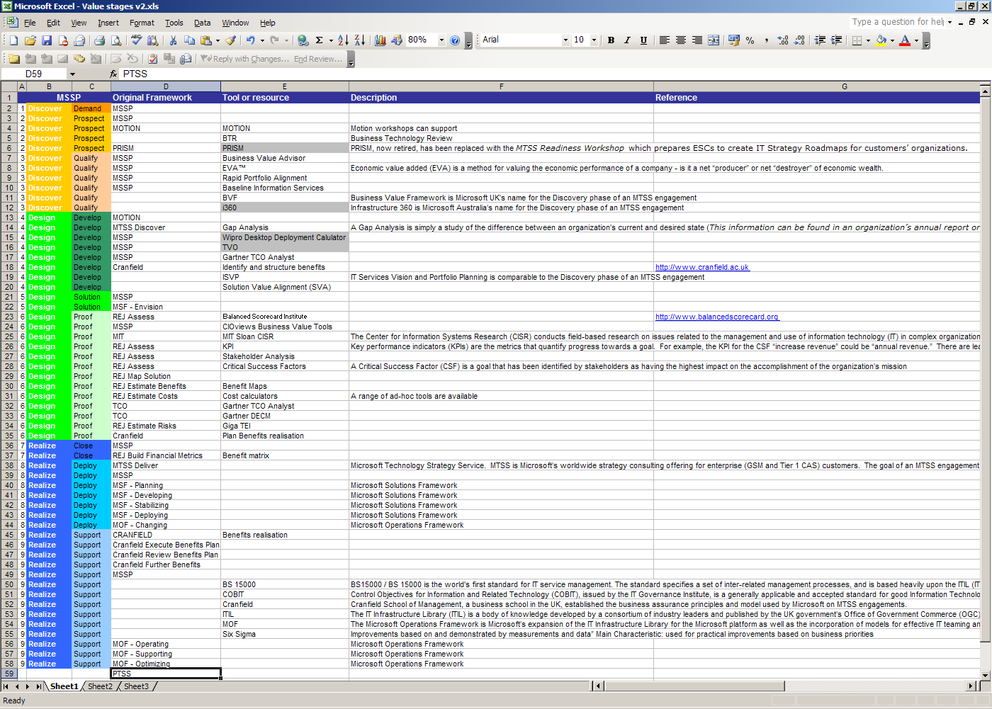

Slide 5
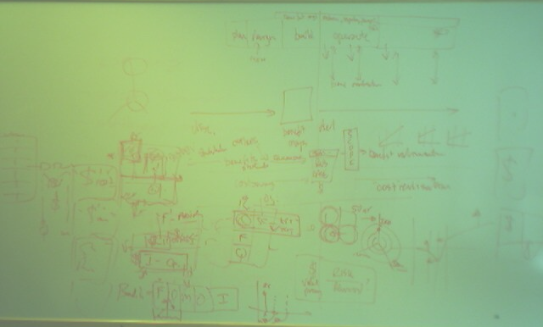

Business decision has to be financial except for Strategic projects where the hurdle rate may be less …
Investment Strategic
F
F,Q
Demand
Prospect
Qualify
Develop
Solution
Prove
Close
Deploy
Support
Discover
Design
Realize
F
F
Work to quantify the
benefits during discovery
using REJ or similar
Regularly review the benefits
during Realize
Infrastructure Operational
Benefit management plan
Who | Stakeholder | Feels
Where | Location | Finds
What | Activity | Sees
When | Plan | Times
Why | Change | Measures
How much | Business Case | Costs
✓ | ✓ | ✓ | ✓ | ✓
 | ✓ | ✓ | ✓ | ✓
 | ✓ | ✓ | ✓ | ✓
 |  | ✓ | ✓ | ✓
 |  | ✓ | ✓ | ✓
 |  |  | ✓ | $$$
I
Cost savings realization plan
O
M
Q
F
Continually improve value statements for the Business Case
Continue to improve value statements for CPE
Use the appropriate tools but maintain a single list of “benefits” including those that are incomplete or intangible; and work with them throughout the life of the relationship. And as we always have done, feed them back into the generic benefit maps.

Slide 6
We need to be specific about “value”
Value is not always well defined; it can be
Financial: the CFO will invest the shareholders money
Quantified: we have a hard measure in some accepted unit but have not translated or associated this with monetary units (Dollars!)
Measurable: we know how to measure it and can track progress but it is expressed as a percentage, by a survey or as “traffic lights”
Observable: we can see the results of change but don’t know how to measure it: “the customers look happier”
Intangible: we know that things are better … “I can feel it in my bones”

Slide 7
The six honest men
 |  |  | Intangible | Observable | Measurable | Quantifiable | Financial
Who | Stakeholder | Feels | ✓ | ✓ | ✓ | ✓ | ✓
Where | Location | Finds |  | ✓ | ✓ | ✓ | ✓
What | Activity | Sees |  | ✓ | ✓ | ✓ | ✓
When | Plan | Times |  |  | ✓ | ✓ | ✓
Why | Change | Measures |  |  | ✓ | ✓ | ✓
How much | Business Case | Costs |  |  |  | ✓ | $$$
As we discover, we learn more and the benefits become more real
and more useful in supporting the financial decision

Slide 8
Conclusions … so far
We need a formal definition of a value statement that includes a classification of its completeness
Both REJ and BM can use the same format
We need to know when (and to whom) to talk about F, Q, M and O type benefits
Marketing can use Q, M and O for Demand Generation but we need to be real sure our sales propositions are F -- hard core about financial value
We need BV teams to be able to “improve” or quantify the less specific statements to help projects over the Proof hurdle
And for CPE, we need to build in benefits management to make sure the customer realizes the benefits we propose

