Slide 1
IT 101 Computer Fundamentals
Mike Yeager
mikeyeager@unm.edu

Slide 2
Data
Data is nothing but a huge pile of 0s and 1s
Data is only meaningful in context
One way to put data in context is to organize it into a “File System”
Provided by the Operating System (Windows, Mac, Linux, etc.)
An index that points to the beginning of the file and give it:
Name
Date
Size
Attributes such as read-only

Slide 3
Files
A file system points to the beginning of a file on disk
The file may be stored in non-contiguous areas of the disk
They type of files is often denoted by the filename “extension” e.g.
Pdf
Docx
Txt
Jpg
Gif
The actual type of the file is defined by arranging the 0s and 1s into an accepted format

Slide 4
Files cont’d
Files could contain programs or data
Files are often written to a specified format and named with a corresponding standard extension, but you can create your own formats and extensions if you like

Slide 5
Compression
Raw data can be HUGE
Compression lets us store the data in a much smaller space
Compressed data can be transferred much faster (especially over the internet)
Data typically has to be de-compressed into its original form before it can be used
Lossy vs. Lossless Compression

Slide 6
Basic Compression Techniques
Tokenizing (aka symbol replacement) example pg. 67
Resolution (aka dots per inch or DPI)
Color Reduction (# of colors available)
Sample Rate (frames per second for video / sample rate for audio)
ZIP files

Slide 7
Networks
Connect devices (such as computers) together so they can communicate
Transmission Control Protocol (TCP) de facto standard for communication between devices
Is a “Network Protocol”
Groups data into bundles or “packets”
Handles speed differences between devices
Fault tolerant – if a packet isn’t received, it’s sent again

Slide 8
Networks cont’d
Internet Protocol (IP)
Is also a “Network Protocol”
Routable – tcp packets are sent over known paths to the destination
Addressable – each sending/receiving device has an address
Your home address may be 115 Kit Carson Road Taos, NM 87571
Your IP address may be 60.126.14.7
IP v4 addresses are made up of 4 bytes
Each byte can have a value 0 – 255
Each byte is separated by a period
IP v6 addresses are made up of 16 bytes
Are newer and not as widely used
Can be more secure
Many more addresses available (4.3 Billion vs. 7.9 x 10²⁸)
E.g. 3ffe:1900:4545:3:200:f8ff:fe21:67cf

Slide 9
The Internet
Computers have been networked together long before the internet
Most businesses of any size have their own computer network
You home probably has a computer network
The Internet attaches these computer networks to one another
The internet provides multiple paths to each destination
On your own network, you can take whatever IP address you want
On the internet you have to purchase an IP address; This is how we prevent 2 people from using the same IP address

Slide 10
Networks cont’d
Remembering IP addresses is not as convenient as remembering phone numbers
Internet Addresses can be mapped to names such as your computer name or a web address such as google.com
Domain Name System (DNS) servers are computers that store the mapping between addresses and names
By pointing your computer to a DNS server, you can send a message to a name and when your message is sent out, it first asks the DNS server what the IP address for that name and then send the message to the IP address
For instance google.com is 216.58.217.206
Try browsing to http://129.24.168.32

Slide 11
Network Tools
At a command prompt (Windows) type:
ipconfig
ipconfig /? to see all available options
ping google.com
ping -4 google.com
ping –a 216.158.248.187
ping /? to see all available options
Google “my public ip address”
https://www.showmyipaddress.eu/
https://www.whatismypublicip.com/
https://www.whatismyip.com/what-is-my-public-ip-address/

Slide 12
How does my computer get an IP address?
On most internet connections the router has a public IP address assigned to it temporarily by the internet service provider (ISP)
The ISP purchases a range of IP addresses and assigns them to its customer’s routers
The router then assigns every device attached to it an “internal”, “non-routable” IP address such as 192.168.1.xxx
This cuts down on the number of public IP addresses needed in the world
You can (but probably do not want to) purchase your own fixed IP address

Slide 13
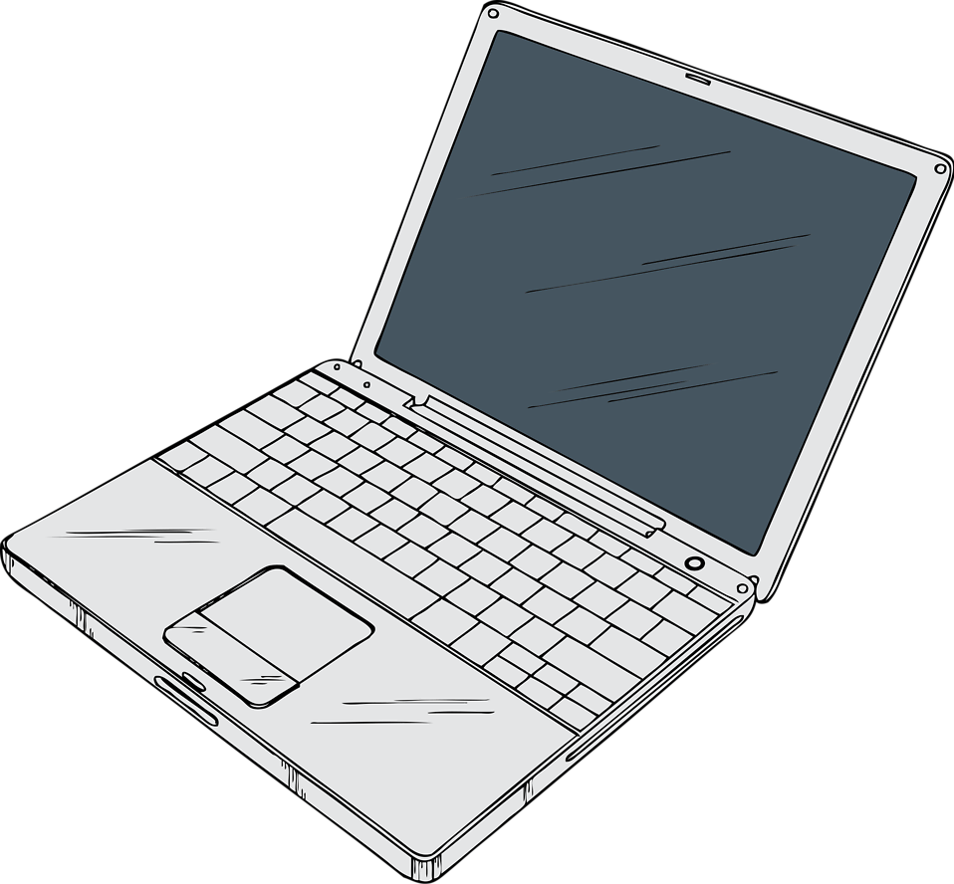
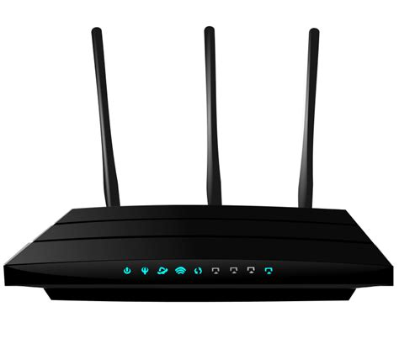

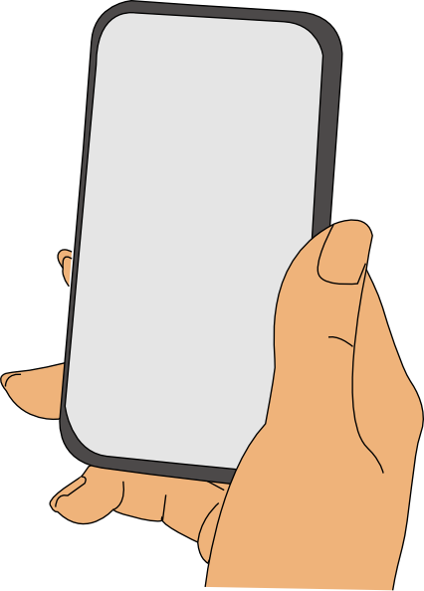
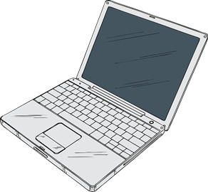
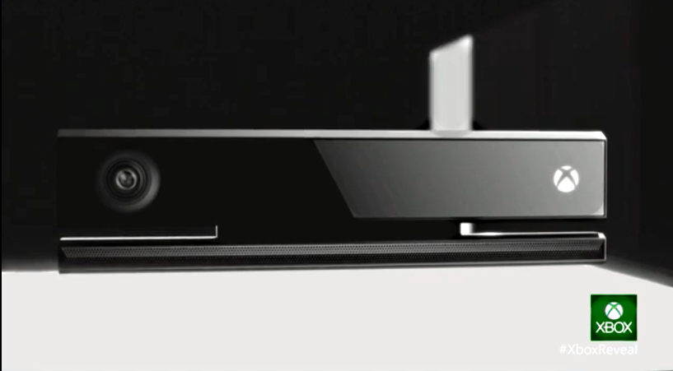
Network Router
192.168.1.0
216.158.248.187
192.168.1.3
192.168.1.4
Internet
192.168.1.4
192.168.1.7

Slide 14
TCP Ports
Each IP address has 65,535 “ports” (16 bit number)
Ports allow up to 64k connections to a single address
Only 1 app at a time can use a port
The default port for HTTP (web sites) is port 80
www.unm.edu is the same as www.unm.edu:80
The default port for HTTPS (encrypted) is port 443
The default ports for email are 25, 587 (TLS) and 465 (SSL)

Slide 15
WiFi
It doesn’t stand for anything, it rhymes with HiFi
It’s not a network, it’s radios
Replaces a cable with radio signals
You still need a router
It’s not all that secure
HILTON Pool may not be run by Hilton at all!
Encryption is not that hard to break
Whoever owns the router can see all of your traffic and they can route your calls wherever they want – not necessarily where you want.

Slide 16
Common Application Layer Protocols
Ride on a Network Protocol
Optimized for certain payloads and features
HTTP:// HyperText Transfer Protocol
HTTPS:// Secure HTTP (typically using SSL encryption)
FTP:// File Transfer Protocol
FTPS:// Secure FTP
FILE:// Local File (not on the internet)
NET.TCP://IP Address or Server Name:Port/…

Slide 17
HTML
HyperText Markup Language (aka web pages)
Web pages and sending messages (email of a sort) were the first uses of the internet and still the most popular
Indicates that the content of the file is intended to be displayed in a browser
HTML files generally have extensions of .HTM or .HTML
“Tags” are used to enhance the text:
<b>This is bold text</b>
<br> line break
<a href=http://google.com>This is a hyperlink to Google</a>

