Slide 1
IT 101 Computer Fundamentals
Mike Yeager

Slide 2
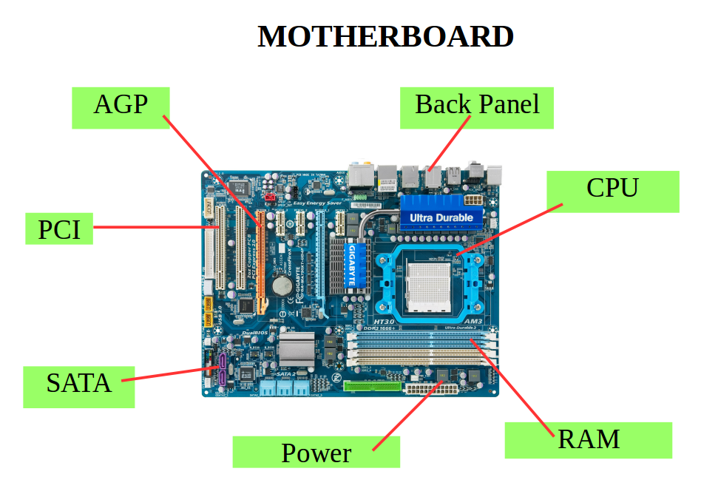
Components of a computer

Slide 3
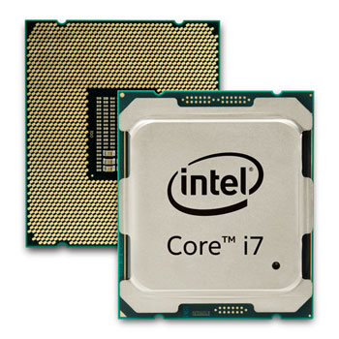
Central Processing Unit (CPU)

Slide 4
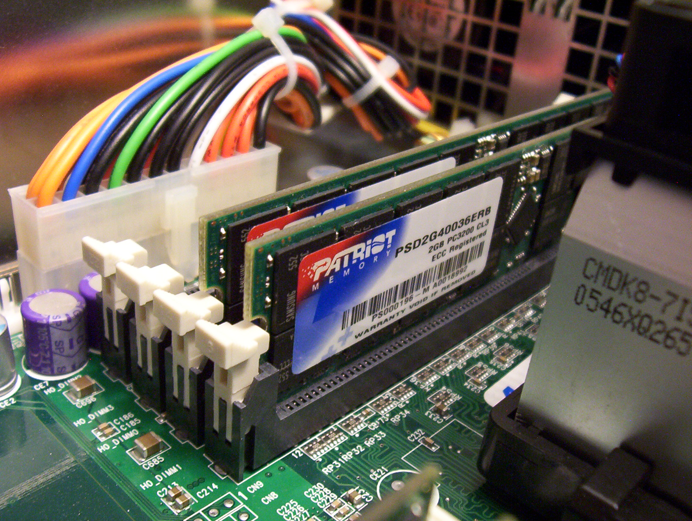
Random Access Memory (RAM)

Slide 5
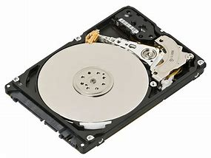
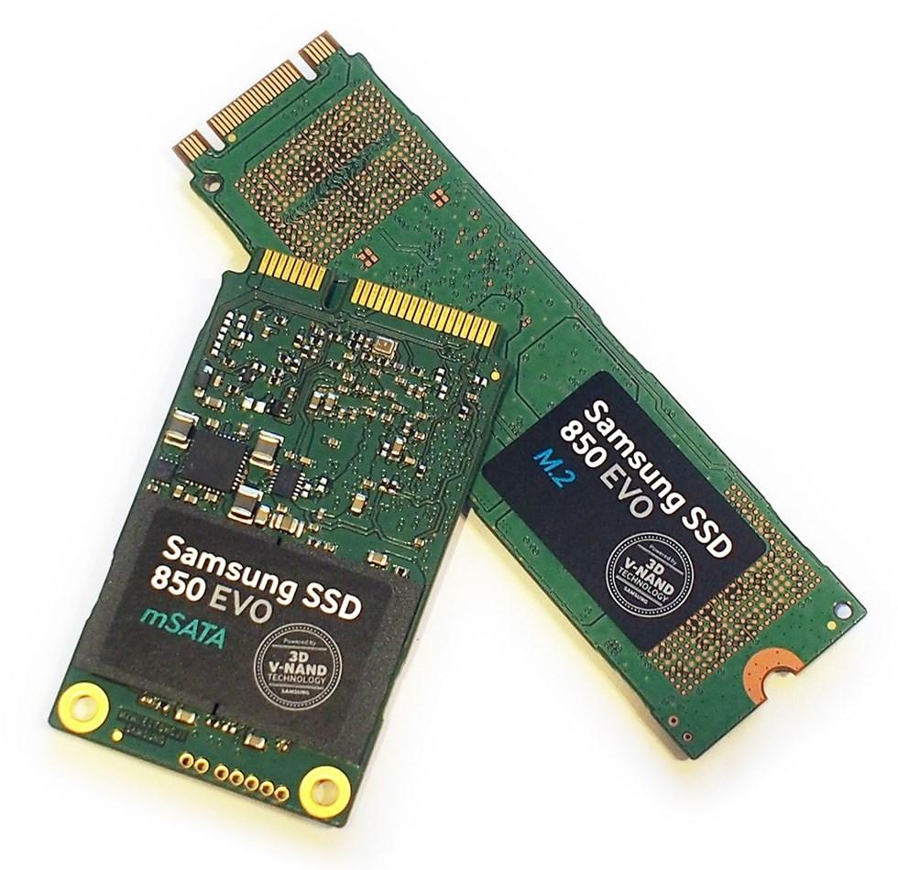
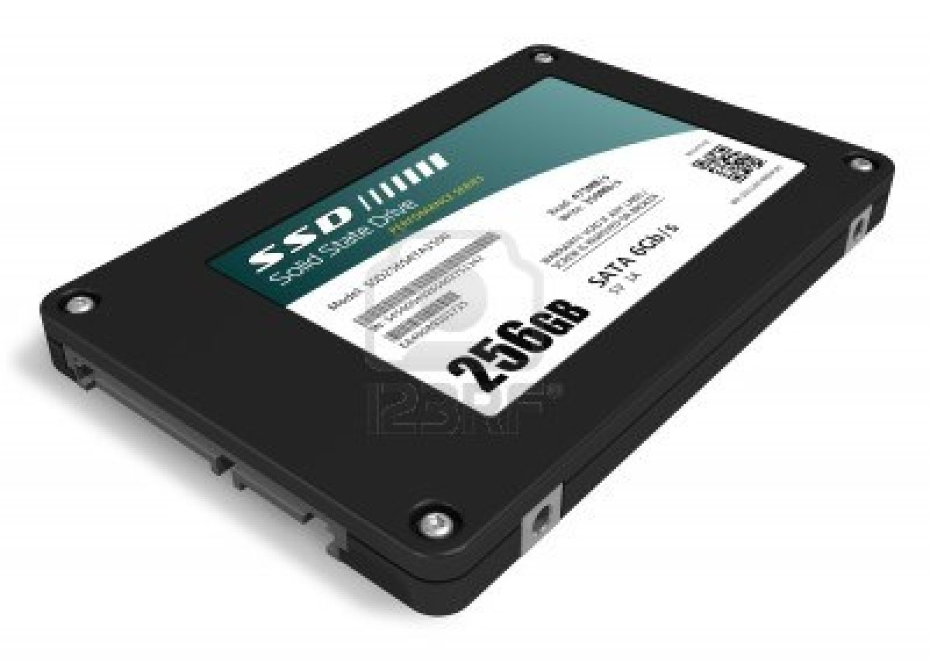
Disk Drive (Hard Drive)

Slide 6
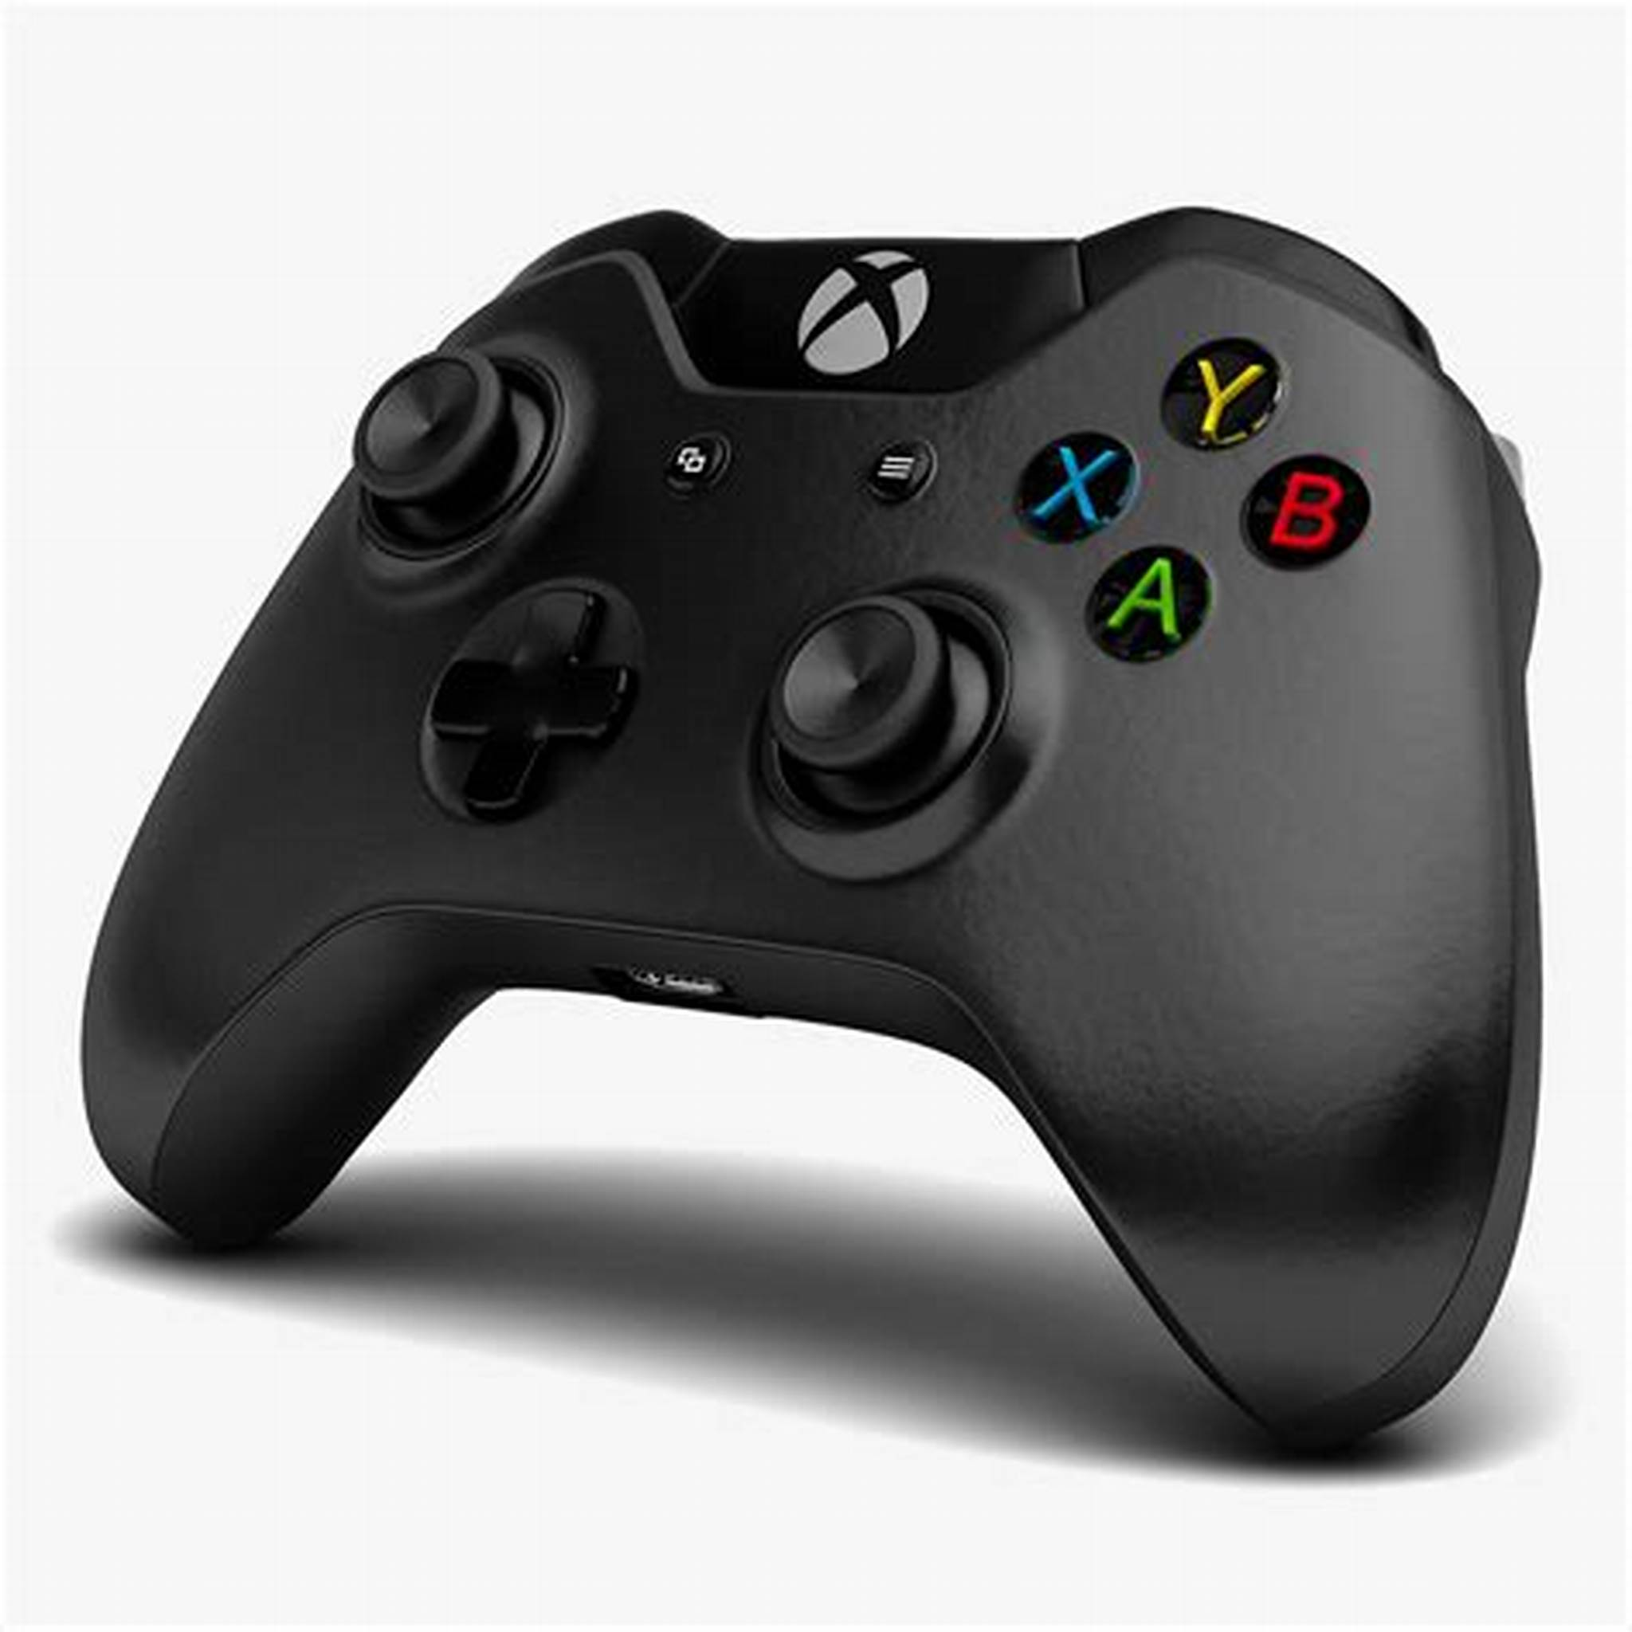
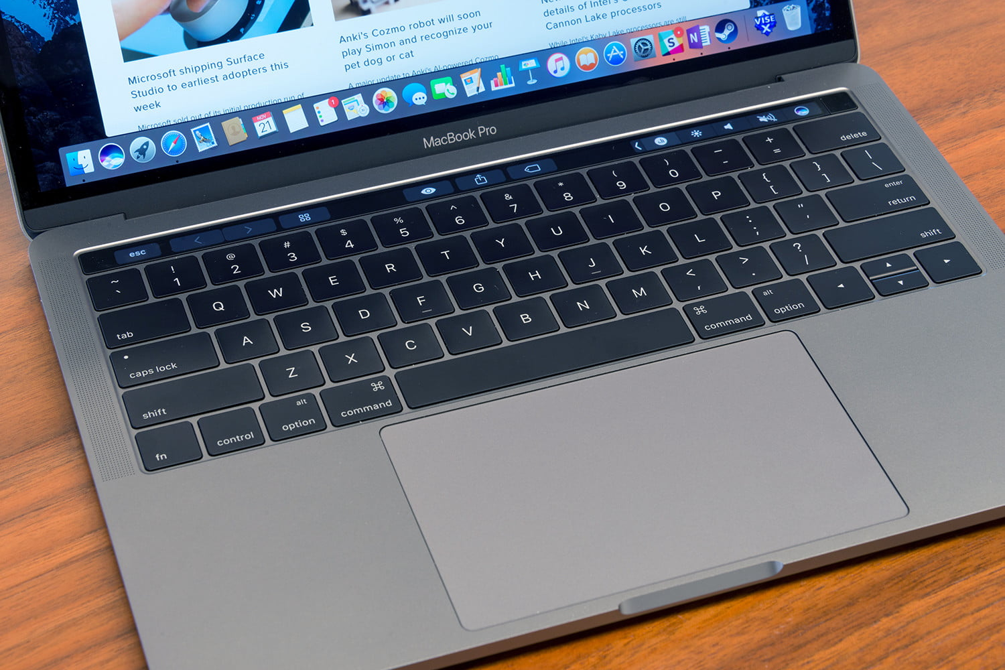
Input

Slide 7
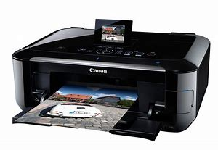
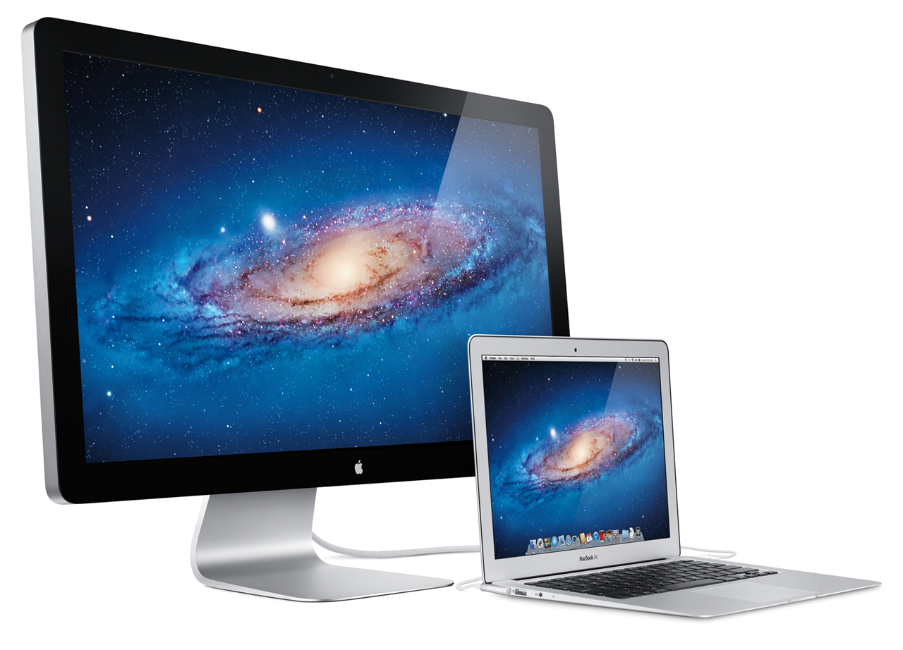
Output

Slide 8
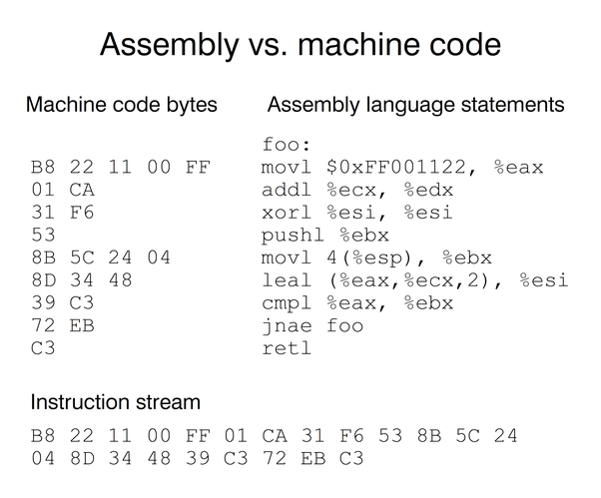
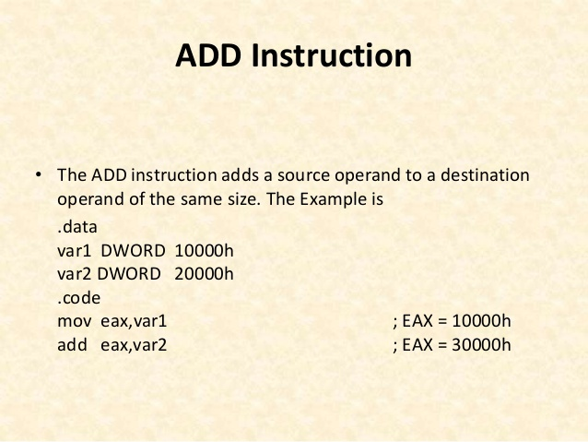
Assembly Language

Slide 9
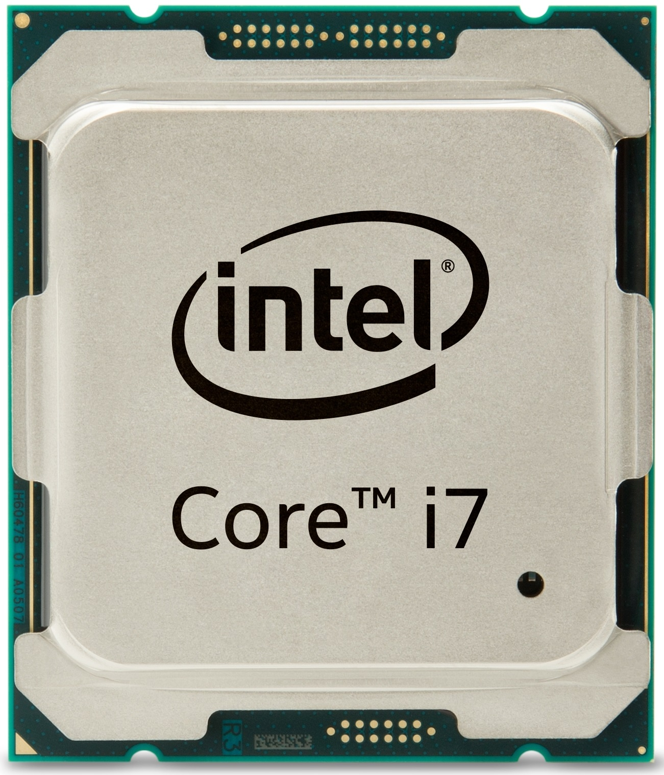
What the CPU Sees
0 | 0 | 0 | 1
0 | 0 | 0 | 0
0 | 0 | 0 | 0
0 | 0 | 0 | 0
1 | 0 | 0 | 0
0 | 0 | 0 | 0
0 | 0 | 0 | 0
0 | 0 | 0 | 1 | 0 | 0 | 1 | 1
0 | 0 | 0 | 0 | 0 | 0 | 1 | 0
0 | 0 | 0 | 0 | 0 | 0 | 1 | 0
1 | 1 | 0 | 0 | 1 | 1 | 0 | 1
Notes:
Instruction Set

Slide 10
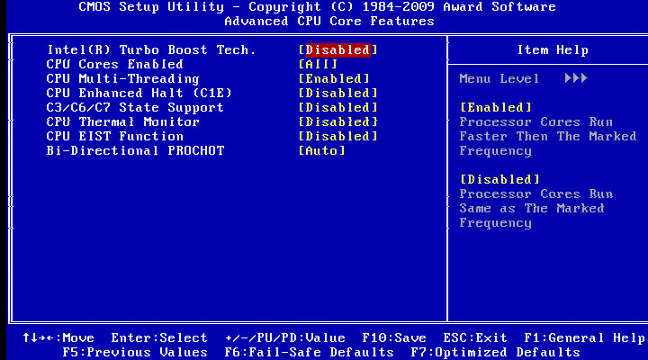
Basic Input Output System (BIOS)

Slide 11

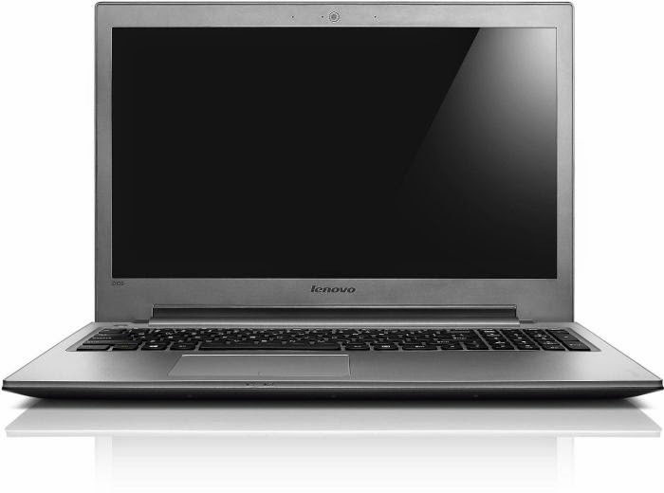
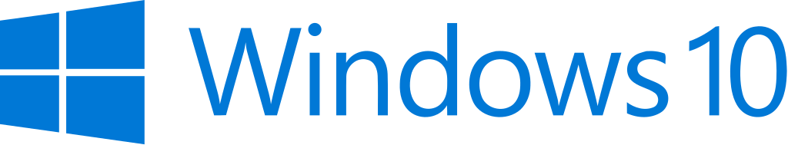

Operating System

