Slide 1
IT 101 Computer Fundamentals
Mike Yeager
mikeyeager@unm.edu

Slide 2
There are 10 kinds of people in the world. Those who understand binary, and those who don’t. -Anonymous

Slide 3
Binary
0000 0000
1s
2s
4s
8s

Slide 4
0000 0011
128
64
32
16
8
4
2
1
1 x 1 = 1
1 x 2 = 2
0 x 4 = 0
0 x 8 = 0
0 x 16 = 0
0 x 32 = 0
0 x 64 = 0
0 x 128 = 0
3

Slide 5
0101 1111
128
64
32
16
8
4
2
1
1 x 1 = 1
1 x 2 = 2
1 x 4 = 4
1 x 8 = 8
1 x 16 = 16
0 x 32 = 0
1 x 64 = 64
0 x 128 = 0
95

Slide 6
Binary Addition
0000 0000
0101 0101
0000 0111
0101 0101
1111 0111
0101 0101
0101 0101
0101 1100
1 0100 1100
85
92
332

Slide 7
There are 10 kinds of people in the world. Those who understand binary, and those who don’t. -Anonymous

Slide 8
Hexadecimal (16)
=
10,632,703
00 A2 3D FF
1s
16s
256s
4,096s

Slide 9
Octal (8)
=
261,938
000 777 462
1s
8s
64s
000 111 111 111 100 110 010
0011 1111 1111 0011 0010

Slide 10
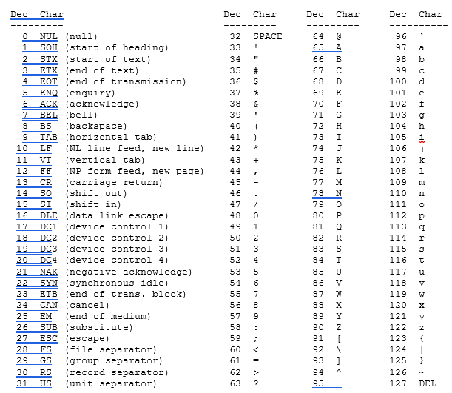
ASCII

Slide 11
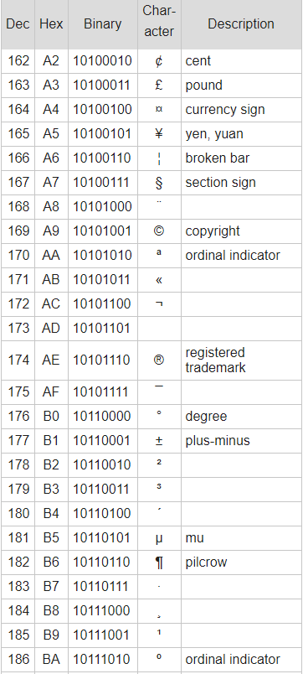
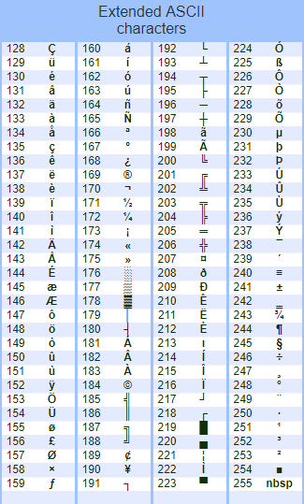
ASCII

Slide 12
UNICODE
Version 11
137,439 characters
146 languages, plus symbols, plus emojis
Version 12
Will be release on March 5, 2019
137,929 characters
150 languages, plus symbols, plus 61 new emojis
Right to left languages such as Hebrew
UTF-8 is similar to ASCII, it uses 1 byte (8 bits) 0-255
UTF-16 up to 65,536 characters – 2 bytes 1-65,535
UTF-32 up to 4,294,967,296 characters – 4 bytes

Slide 13
Colors (RGBA)
1111 1111 0000 0000 0000 0000 0000 0000
Red
R = 255
G = 0
B = 0
A = 0
FF
00
00
00

Slide 14
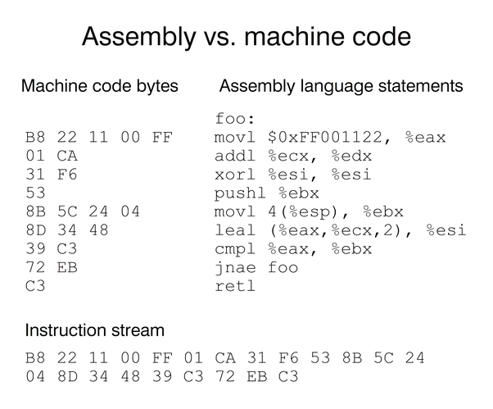
CODE (Instructions)
1011 1000

Slide 15
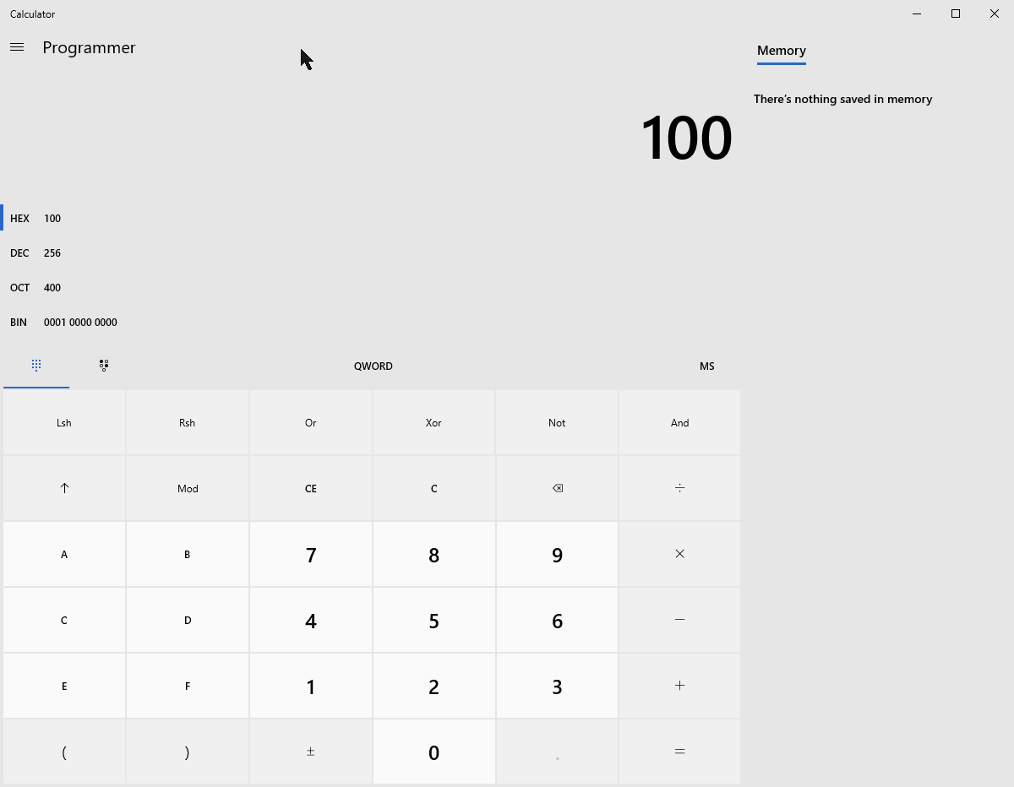
Windows 10 Programmer Calculator

