Slide 1


Web Development
BSc in Applied Computing
Produced
by
Eamonn de Leastar (edeleastar@wit.ie)
Department of Computing, Maths & Physics
Waterford Institute of Technology
http://www.wit.ie
http://elearning.wit.ie

Slide 2
Semantic UI Usage

Slide 3
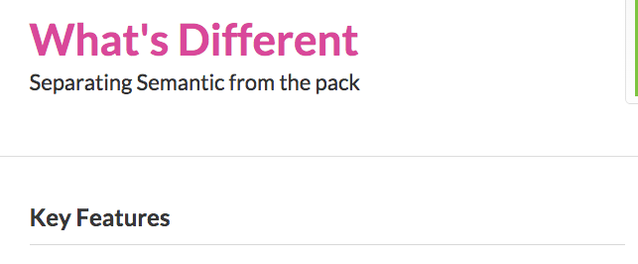
Key Features
http://learnsemantic.com/preface/whats-different.html

Slide 4
Build Responsive Layouts Easier
Designed Completely with EM
Every component is defined using em and rem so that components can be resized simply on the fly.

Slide 5
Easy to Learn
Descriptive not Prescriptive
Writing front end code shouldn't require learning the naming or programming conventions of a particular developer.
Instead of using short-hand, or codifying naming conventions, Semantic uses simple, common language for parts of interface elements, and familiar patterns found in natural languages for describing elements.

Slide 6
Tag Agnostic
Use whatever html tags you please.
Interface definitions in Semantic are tag ambivalent.
That means you can use div, article, section, span without affecting the display of the element.
Special tags like a, table, td still carry special meaning in certain circumstances however.

Slide 7
Concise & Expressive
Don't repeat yourself
In English it's much easier to say "There are three tall men" than "There is a tall man, a tall man and a tall man".
Semantic elements use principles of plurality to express similarities across groups to avoid repetitive declarations.

Slide 8
High-Level Theming
All UI components share site-wide defaults which let you quickly change the look and feel of components.
High level variables make sure you aren't specifying one to one matches with CSS properties.

Slide 9
Componentized UI
Using Semantic doesn't mean adopting an entire framework, or rewriting your code base
Semantic components are written in a singular style, but are not part of mandated overarching library. Only like a couple components? No problem, use only what you need.
UI components in Semantic also define optional and required couplings with other components where their usage intersect. That means for example, a popup can check for the existence of CSS animation component before using the fallback javascript animations.

Slide 10
Develop Once, Redesign Infinitely
Creating a site in Semantic means you never have to rewrite your codebase from scratch.
Redesigning means retooling your UI toolkit, adjusting UI definitions, not creating entirely new HTML layouts.

Slide 11
Using Semantic UI

Slide 12
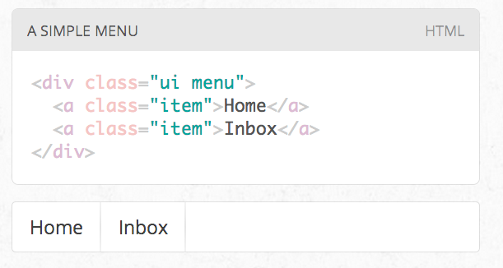
“UI” Class
UI definitions in Semantic are given the class name ui.
This is to help tell the difference between ui elements and parts of the definition of an element.
This means any element with the class name UI has a corresponding UI definition.

Slide 13
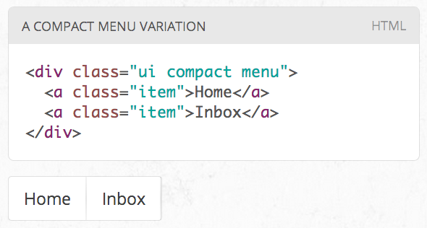
Class Names
Class names in Semantic always use single english words.
If a class name is an adjective it is either a type of element or variation of an element.
CSS definitions always define adjectives in the context of a noun. In this way class names cannot pollute the namespace.

Slide 14
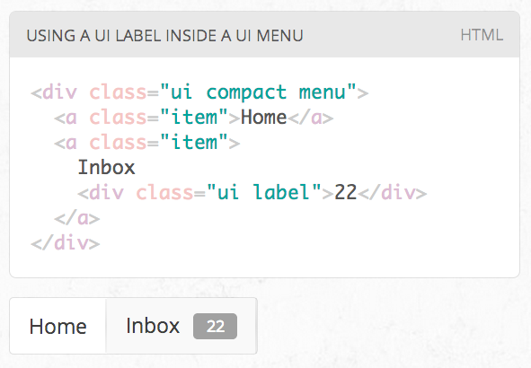
Combining Classes
All UI definitions in semantic are stand-alone, and do not require other components to function.
However, components can choose to have optional couplings with other components.
For example you might want to include a badge inside a menu. A label inside of a menu will automatically function as a badge

Slide 15
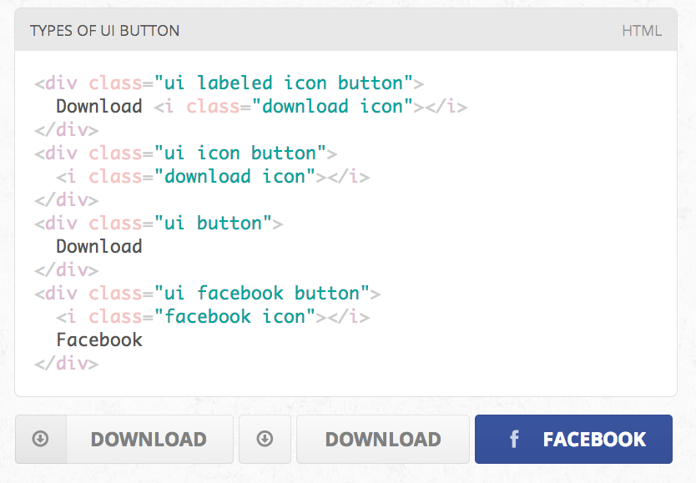
Variations
A ui definition in Semantic usually contains a list of mutually exclusive variations on an element design.
A type is designated by an additional class name on a UI element

Slide 16
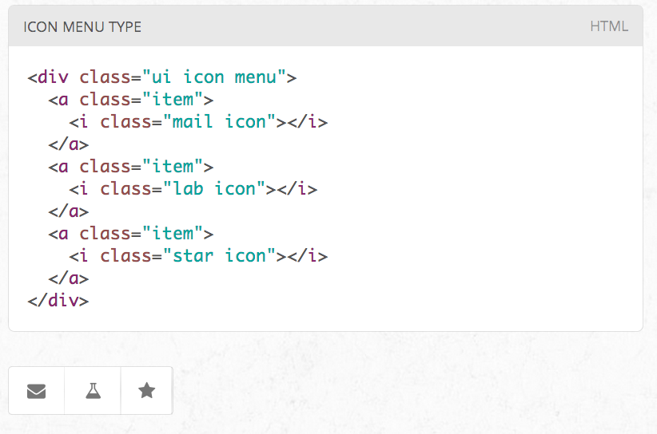
Content/Structure
Types may require different html structures to work correctly.
For example, an icon menu might expect different content like icons glyphs instead of text to be formatted correctly

Slide 17
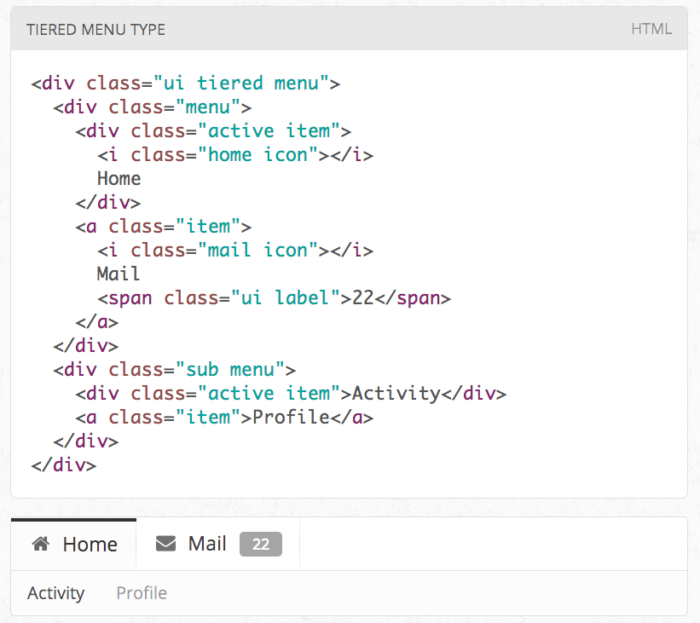
HTML Variations
Types may also each require slightly different html.
For example, a tiered menu needs html specified for a sub menu to display itself correctly

Slide 18
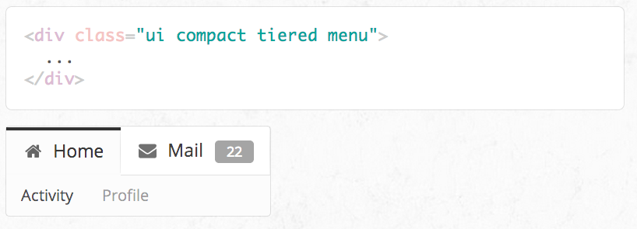
More Variations
A variation alters the design of an element but is not mutually exclusive.
Variations can be stacked together, or be used along with altering an element's type.
For example, having wide menus that take up the full width of its parent may sometimes be overwhelming. You can use the compact variation of a menu to alter its format to only take up the necessary space.

Slide 19
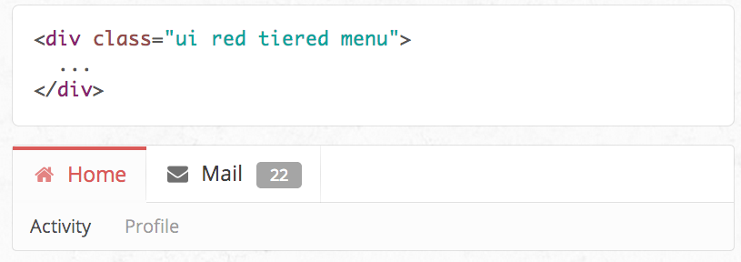
Intersecting Variations
The definition for the variation red contains css specifically for describing the intersection of both red and inverted.

Slide 20

Except where otherwise noted, this content is licensed under a Creative Commons Attribution-NonCommercial 3.0 License.
For more information, please see http://creativecommons.org/licenses/by-nc/3.0/

