Slide 1
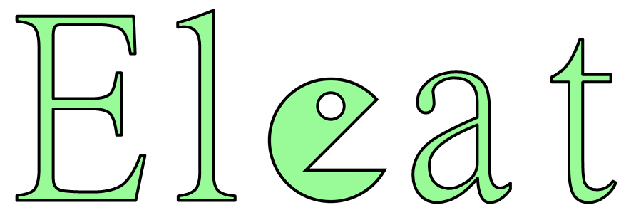
An Android Application Created By: Jared Thomas,
Michael Zurlo,
Rachel Lee,
Jeffry Lew

Slide 2
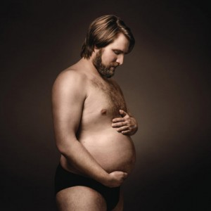
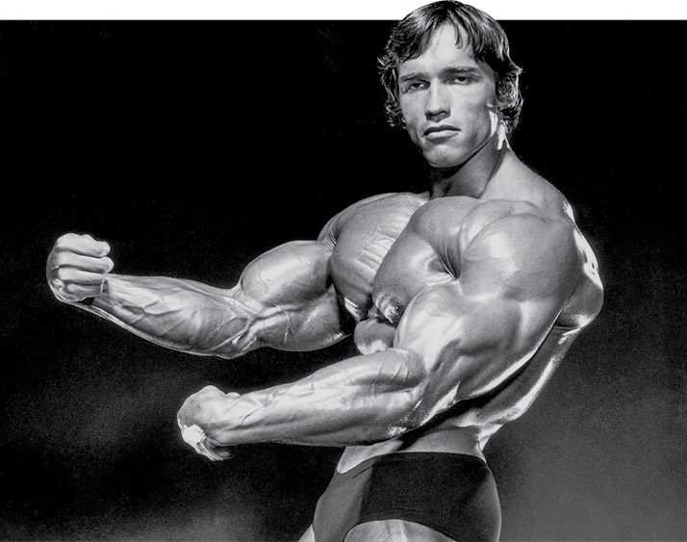
Is this transition possible?

Slide 3
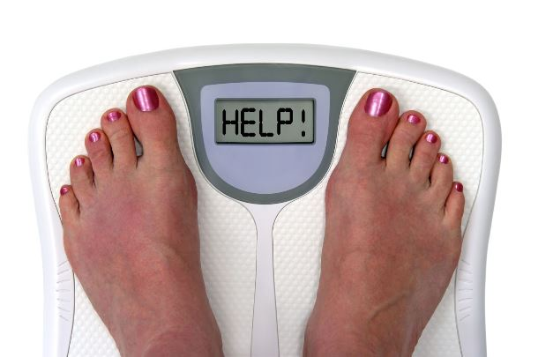
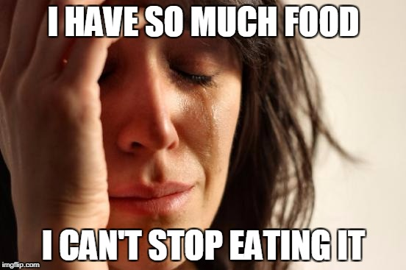
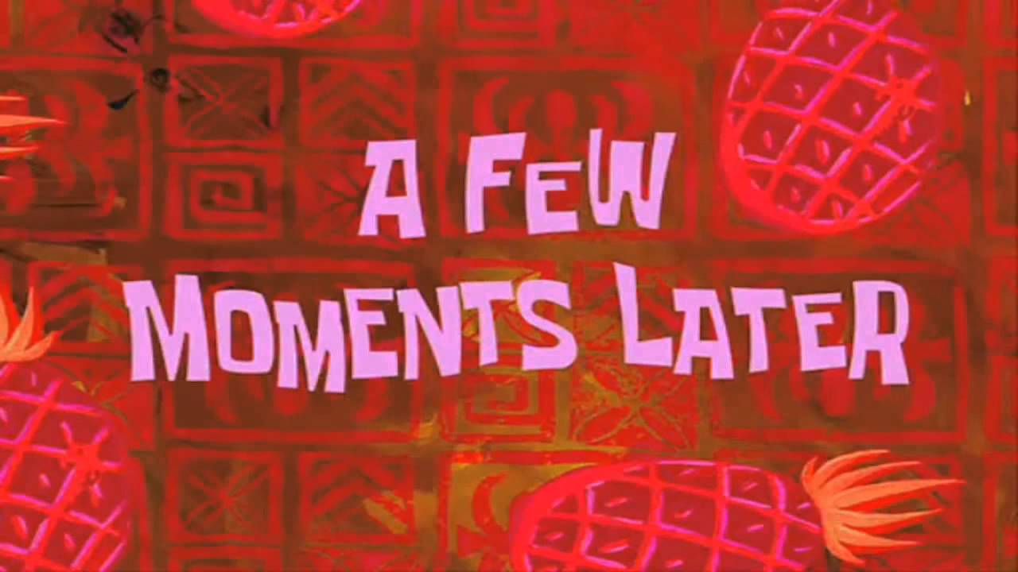
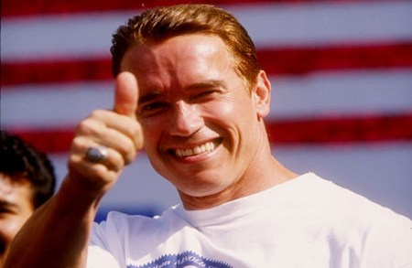
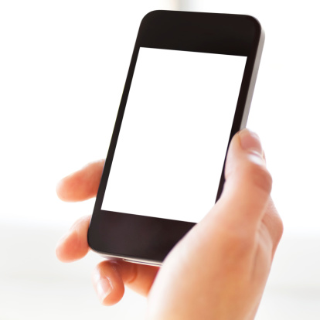

Of course it is! Using our app, Eleat.

Slide 4
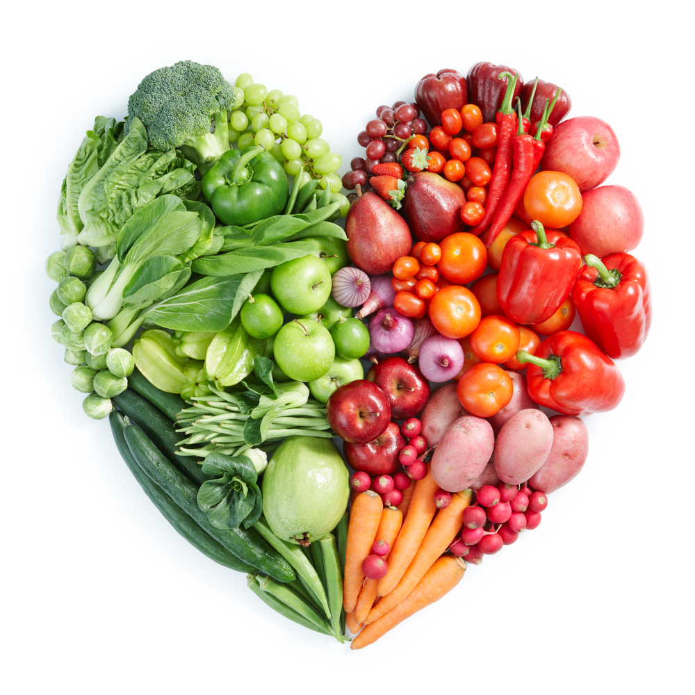

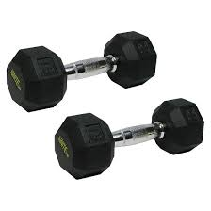
Originality
We are the first group to develop an app that takes a picture of food and the app then provides nutritional info for the food item captured. We also have created a nutritional calculator to find what your ideal calorie goal is based on weight, sex, and fitness level.

