Slide 1
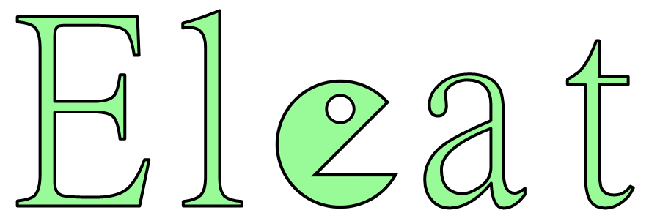
Jared Thomas
Michael Zurlo
Rachel Lee
Jeffry Lew

