Slide 1
UCS503P · SOFTWARE ENGINEERING LAB
Deadstock Management System
A Verified Retail Deadstock Marketplace
PROTOTYPE PRESENTATION
Abhilakshya Puri (1024030445) · Aryan Gupta (1024030455) · Farhan Kansal (1024030451)

Slide 2
AGENDA
What we will walk through
▸ The problem: why retail deadstock stays unsold today
▸ Our solution: the list, verify, publish, purchase loop
▸ System design: actors, use case diagram, and data flow diagrams
▸ What is actually built: authentication, lifecycle automation, the rule based verification engine, and the marketplace
▸ A live walkthrough of the working prototype
▸ Automated testing and continuous integration
▸ Scope, limitations, and what comes next
Deadstock Management System · UCS503P Prototype
1

Slide 3
THE PROBLEM
Retail deadstock has no trusted recovery channel
▸ Vendors write off surplus at a steep loss because there is no verified channel to resell it.
▸ Buyers have no way to trust that a deadstock listing is actually what it claims to be.
▸ Regulated goods such as medical, food, pharmaceutical, alcohol, and tobacco items need compliance review before resale, and most platforms do not enforce this at all.
▸ The result: recoverable inventory value is destroyed instead of being redirected to a buyer who wants it.
20 to 30%
of retail inventory value sits idle every year as slow moving or dead stock
Deadstock Management System · UCS503P Prototype
2

Slide 4
OUR SOLUTION
One auditable workflow, four stages
List → Verify → Publish → Purchase
▸ List. A vendor logs surplus inventory as soon as it stops moving.
▸ Verify. A deterministic rule engine checks every submission, escalating regulated categories to a human reviewer instead of guessing.
▸ Publish. Only inventory with a VERIFIED record can ever become a public listing.
▸ Purchase. Buyers browse a marketplace where every visible item already has a checked provenance trail.
▸ Why this matters. The design is deliberately rule based rather than machine learning driven, so every accept, reject, or escalate decision stays explainable to a compliance reviewer.
Deadstock Management System · UCS503P Prototype
3

Slide 5
SYSTEM DESIGN
Actors and technology stack
Vendor
Registers, logs inventory, receives aging alerts, and submits deadstock items for verification with proof.
TECHNOLOGY STACK
Backend
Compliance Reviewer / Admin
Node.js, Express, TypeScript, Prisma ORM, PostgreSQL, JWT authentication, bcrypt, Zod validation
Applies rule based checks and manually reviews items escalated from regulated categories.
Frontend
React 18, Vite, TypeScript, Tailwind CSS, React Router, TanStack Query
Buyer
Testing and CI
Browses and searches only verified, published listings in the public marketplace.
Vitest, Supertest, React Testing Library, GitHub Actions
Demo mode
In memory data store so the prototype runs standalone for a live walkthrough, with no database setup required
Deadstock Management System · UCS503P Prototype
4

Slide 6
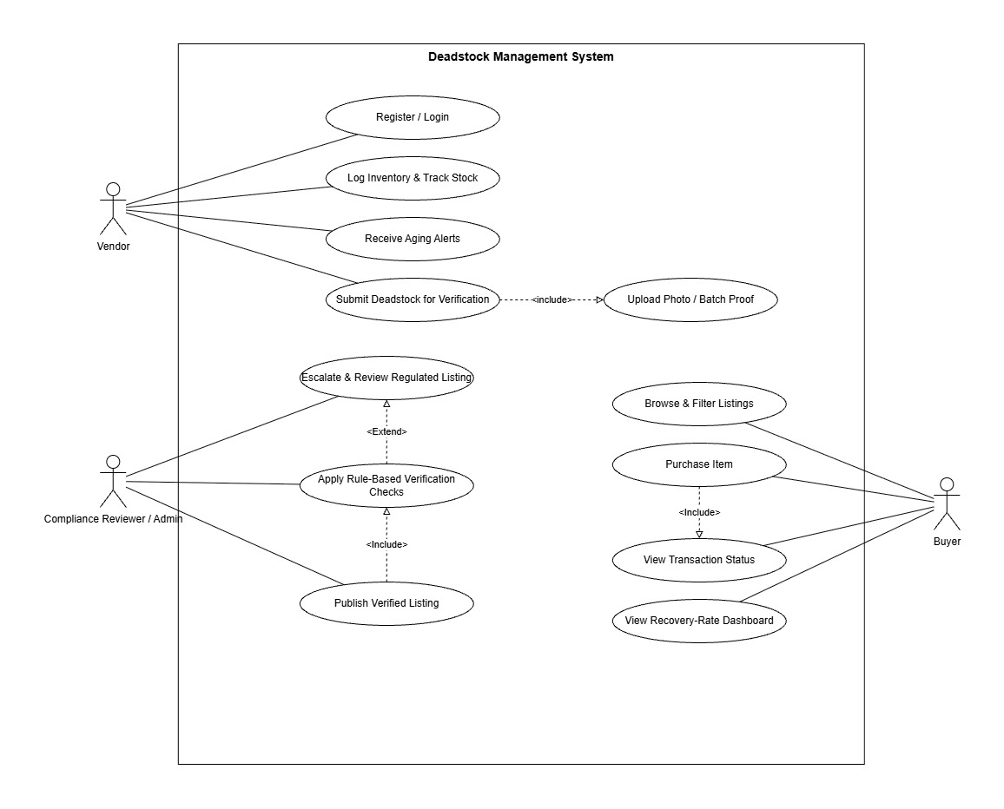
SYSTEM DESIGN
Use case diagram
Deadstock Management System · UCS503P Prototype
5

Slide 7
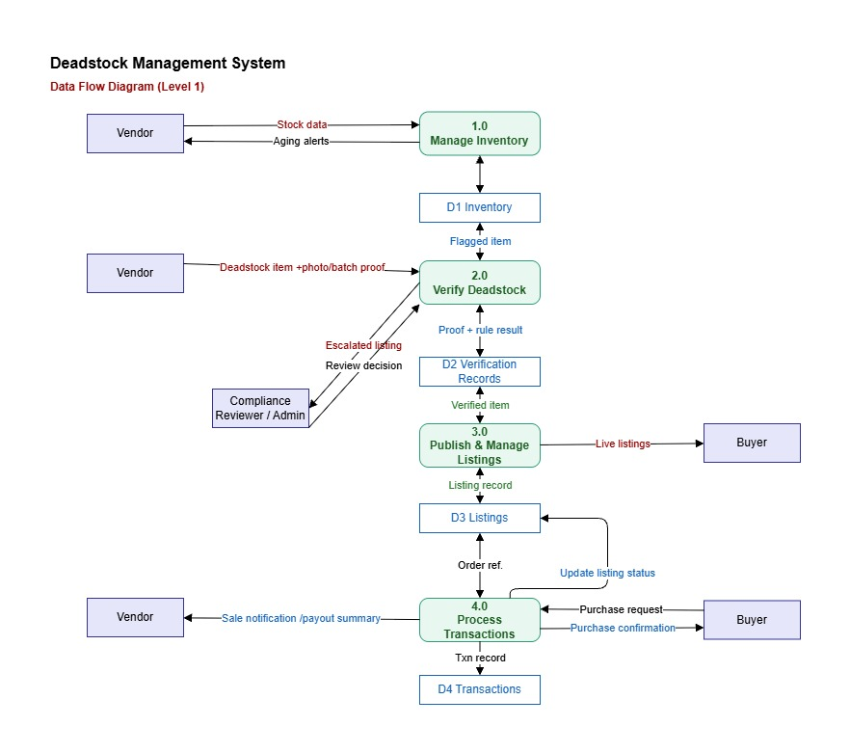
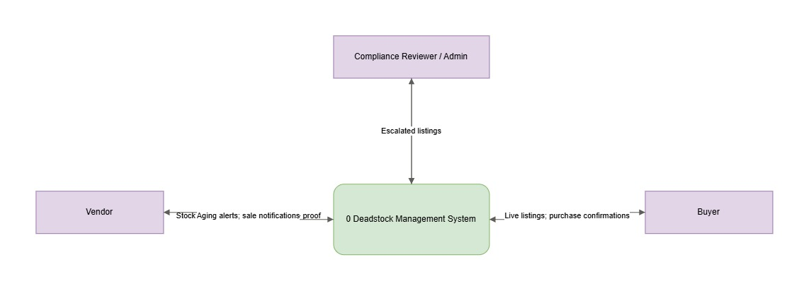
SYSTEM DESIGN
Data flow diagrams: level 0 and level 1
Deadstock Management System · UCS503P Prototype
6

Slide 8
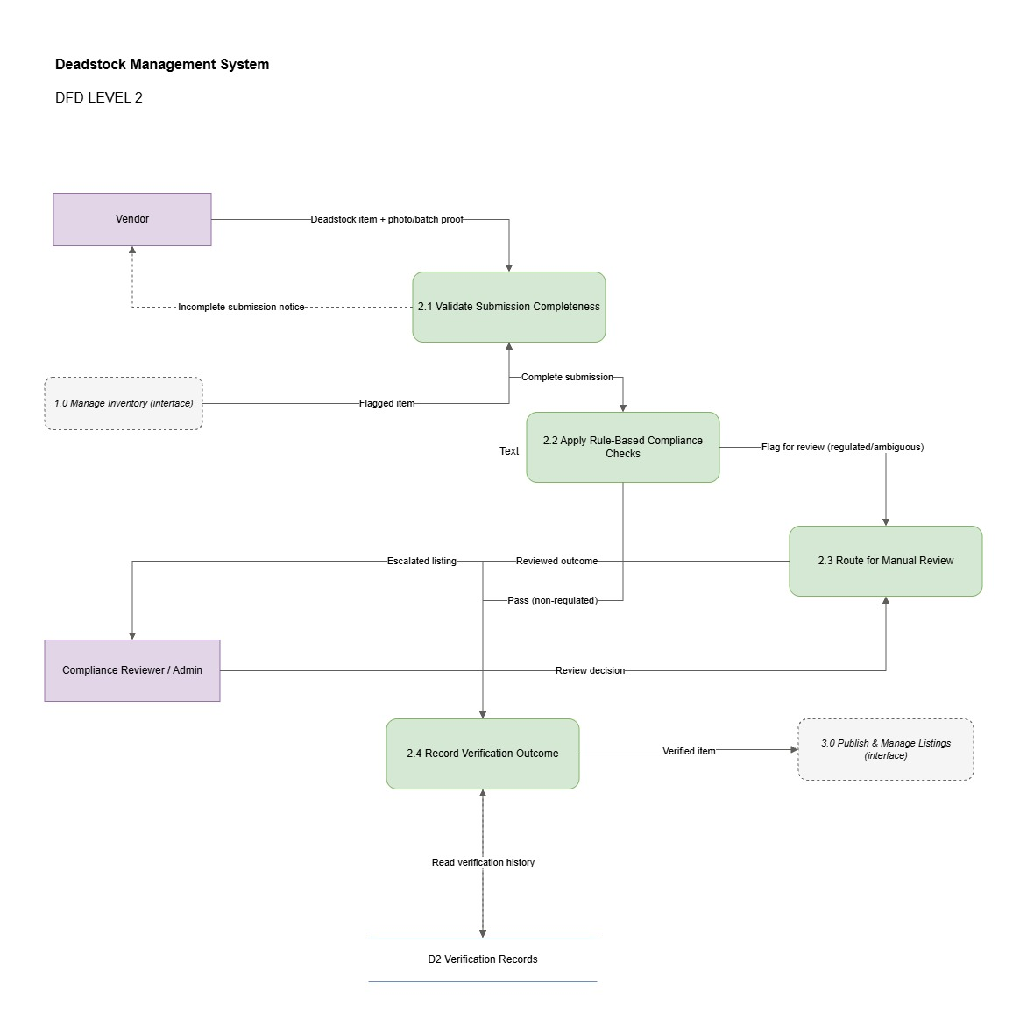
SYSTEM DESIGN
Data flow diagram: level 2, verification process
Deadstock Management System · UCS503P Prototype
7

Slide 9
WHAT IS BUILT
Data model: four models, five enums
users
id, name, email, password_hash, role
inventoryItem
vendor_id, product_name, category, quantity, purchase_date, expiry_date, condition, status
verificationRecord
inventory_id, proof_url, verification_status, rule_result (JSON), reviewer_id, reviewed_at
listing
inventory_id, title, price, quantity, listing_status, published_at
Five enums encode every lifecycle state used across the diagrams: Role, InventoryStatus, VerificationStatus, ListingStatus.
Deadstock Management System · UCS503P Prototype
8

Slide 10
WHAT IS BUILT
Automated inventory lifecycle
▸ Four states, driven purely by dates. ACTIVE moves to AGING, then to DEADSTOCK_FLAGGED, then to SUBMITTED_FOR_VERIFICATION once a vendor submits it.
▸ No cron jobs. evaluateInventoryLifecycle() recomputes status from purchase and expiry dates on every read, so there is no background worker to keep in sync.
▸ Two configurable thresholds. AGING_THRESHOLD_DAYS and DEADSTOCK_THRESHOLD_DAYS drive every transition, set through environment variables rather than hard coded values.
▸ Expiry aware. An item is flagged as deadstock immediately if its expiry date has already passed, even if it has not crossed the age threshold yet.
▸ Zero manual bookkeeping for vendors. Aging alerts and deadstock flags appear automatically on the vendor dashboard the moment the thresholds are crossed.
Deadstock Management System · UCS503P Prototype
9

Slide 11
WHAT IS BUILT
Rule based verification engine
▸ Seven deterministic checks run on every submission: product name, category, quantity, condition, proof, deadstock eligibility, and regulated category.
▸ REJECT if any of the first six mandatory checks fail.
▸ MANUAL_REVIEW if every mandatory check passes but the category is regulated: medical, pharmaceutical, food, alcohol, or tobacco.
▸ PASS only when every one of the seven checks clears.
▸ Every outcome is stored with its full rule_result so a reviewer can see exactly why an item passed, failed, or was escalated.
WHY RULE BASED, NOT ML
Every decision is explainable to a compliance reviewer instead of hiding behind a trained model. The project is deliberately scoped as a workflow and marketplace system, matching the report's non research constraint, and it keeps the audit trail simple enough for a human to check by hand.
Deadstock Management System · UCS503P Prototype
10

Slide 12
WHAT IS BUILT
Verified marketplace and listings
▸ Publish only when verified. A listing can only go live if its verification record status is exactly VERIFIED, enforced in one small policy function that the whole publish flow depends on.
▸ Inventory backed quantities. The requested listing quantity can never exceed the vendor's available inventory, so a listing cannot oversell stock that does not exist.
▸ Public search stays clean. The marketplace search endpoint only ever surfaces PUBLISHED listings, so draft, pending, or rejected items are never visible to a buyer.
▸ Single source of truth. Because publishing is gated by one policy check, the guarantee holds no matter which part of the app calls it.
Deadstock Management System · UCS503P Prototype
11

Slide 13
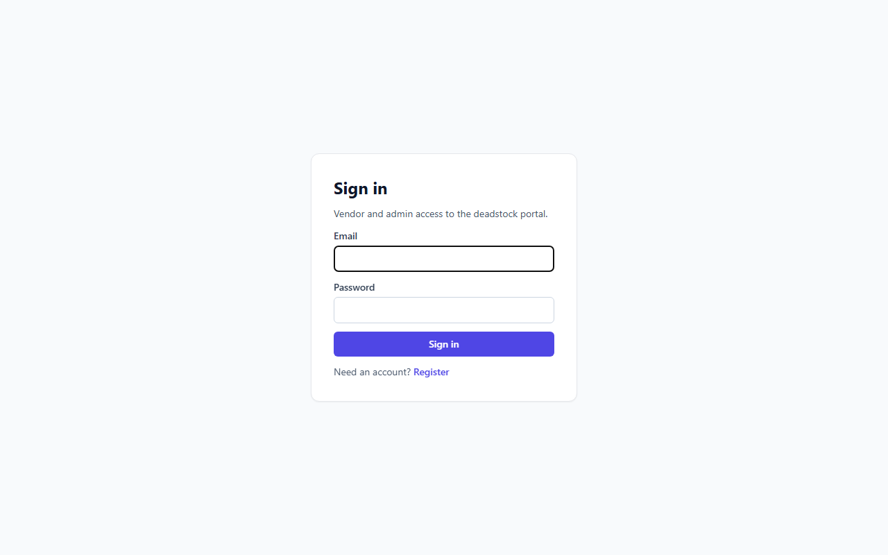
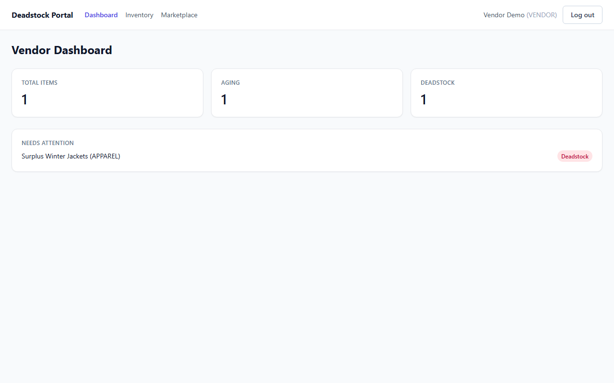
LIVE PROTOTYPE
Vendor portal
Deadstock Management System · UCS503P Prototype
12

Slide 14
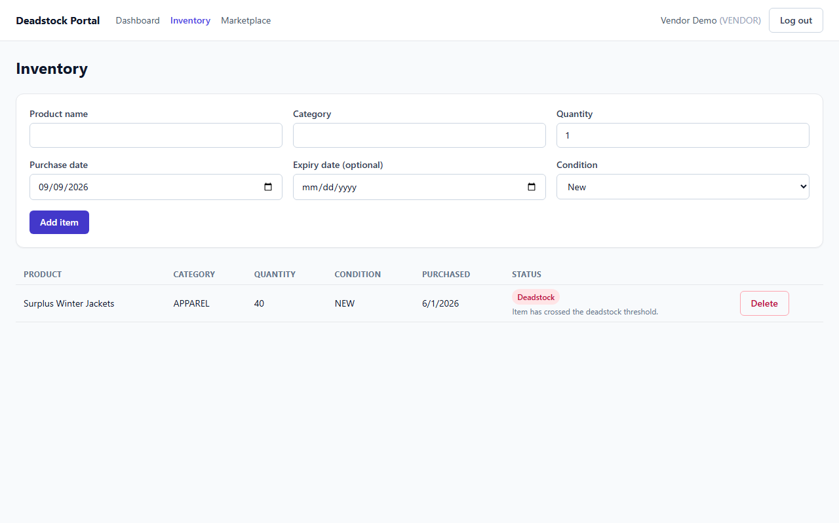
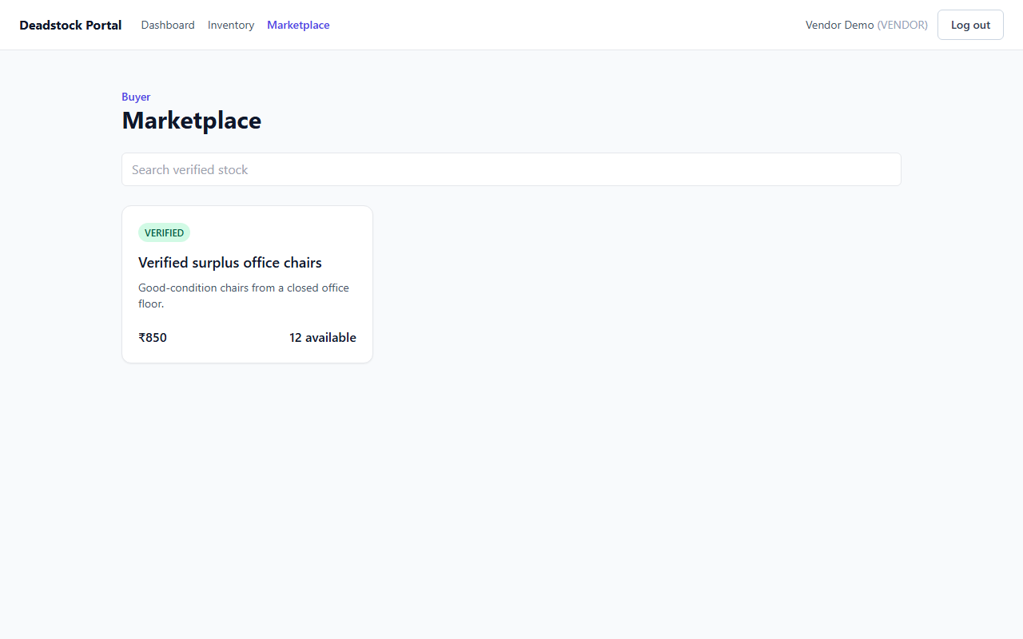
LIVE PROTOTYPE
Inventory and marketplace
Deadstock Management System · UCS503P Prototype
13

Slide 15
LIVE DEMO
Let's run it live
▸ Open the marketplace signed out to show the public verified listing and search.
▸ Sign in as the vendor, then walk through the dashboard and the inventory list.
▸ Add an item with a purchase date more than sixty days old and watch it auto flag as deadstock.
▸ Submit that item for verification using the demo proof image that is supplied automatically.
▸ Sign in as the admin and approve the pre seeded medical kit record from the manual review queue.
▸ Return to the marketplace to show the newly verified listing now live for buyers.
Deadstock Management System · UCS503P Prototype
14

Slide 16
QUALITY
Testing and continuous integration
▸ Vitest and Supertest cover the backend API.
▸ React Testing Library covers the frontend.
▸ Strict TypeScript typecheck runs with zero errors.
▸ A production build is required to pass.
▸ GitHub Actions runs the full pipeline on every push.
18 / 18
6 / 6
backend tests passing
frontend tests passing
▸ The backend suite covers auth token issuance, vendor registration, aging and deadstock thresholds, rule engine outcomes, listing policy, and the verification plus marketplace API together.
▸ The frontend suite covers the status to label and tone mapping plus inventory table rendering, its empty state, and delete gating.
Deadstock Management System · UCS503P Prototype
15

Slide 17
SCOPE
What this prototype does and does not cover
▸ In memory demo store. Restarting the API resets state back to the seeded demo accounts, by design, for a repeatable live walkthrough.
▸ Proof upload uses a data URL fallback. There is no real object storage wired up in demo mode.
▸ Payments, purchase transactions, analytics, and deployment are intentionally out of scope for this prototype stage.
▸ Verification is rule based, not machine learning based, which is a deliberate design decision rather than a limitation.
▸ Everything shown today runs against a real, live Express API, not a static mockup, so the behaviour on screen is the actual system behaviour.
Deadstock Management System · UCS503P Prototype
16

Slide 18
TEAM
Contributions
Aryan Gupta
LaTeX proposal and report authoring, plus the backend foundation: Prisma schema, JWT authentication, inventory CRUD, aging and deadstock logic, and the backend test suite.
1024030455
Farhan Kansal
Built the verification, admin-review, and prototype-devops .Use case diagram and two level DFD design and revision, keeping the compliance escalation path modelled as a distinct flow across both diagrams.
1024030451
Abhilakshya Puri
Report and deck consolidation and review, weekly journals, and the CI pipeline setup covering build, test, and typecheck.
1024030445
Deadstock Management System · UCS503P Prototype
17

Slide 19
NEXT
Roadmap to final submission
▸ Persistence. Move from the in memory demo store to PostgreSQL or Supabase, plus real object storage for proof uploads.
▸ Transactions. Implement the purchase and transaction flow, including the fourth data store the level one DFD already reserves space for.
▸ Feedback loop. Add buyer rating and feedback, and settle whether it lives inside verification records or a separate store.
▸ Test coverage. Extend the automated test suite to the new transaction flow as it is built.
▸ Documentation. Finalize the project report and consolidate documentation ahead of the final submission stage.
Deadstock Management System · UCS503P Prototype
18

Slide 20
Thank You
Questions?
github.com/Mikean0524/Deadstock-Management-Stock

