Slide 1


HINDUSTHAN INSTITUTE OF TECHNOLOGY
Department of Artificial Intelligence and Data Science
AI-POWERED PETTITION CLASSIFICATION
AND TRACKING SYSTEM
Project Guide: Dr.V.Balaji Shanmugam, Associate Professor/CSE Hindusthan Institute of Technology | Batch Details : B.Mike Benis (720822108037) C.Logeshwaran (720822108034) K.Naveen (720822108042) S.Gokulakrishnan (720822108020)

Slide 2

CONTENTS
Abstract
Objective
Introduction
Literature Survey
Proposed System
Conclusion
Reference

Slide 3

Abstract
The study presents NyayaSetu, an AI-powered civic petition classification and tracking system designed to automate grievance triage in e-governance platforms.
Key techniques such as SentenceTransformer embeddings, Support Vector Classification, language detection, and translation were used to process multilingual petition text and extract semantic meaning.
Machine learning models classified petitions into Urgent Action, Fast Action, and Normal Action categories for intelligent prioritization and departmental routing.
Experiments achieved 93% cross-validation accuracy and 100% held-out test accuracy, demonstrating strong performance in urgency prediction across diverse civic complaint categories.
The findings confirm that AI-based petition triage is feasible for real-world government grievance redressal, improving transparency and enabling faster response to critical public issues.

Slide 4
Objective
To develop an AI-powered system that can accurately classify civic petitions based on urgency using natural language processing and machine learning techniques.
To extract and analyze semantic textual features from petition descriptions using SentenceTransformer embeddings, along with language detection and translation for multilingual support.
To train and evaluate machine learning models such as Support Vector Classification (SVC) for categorizing petitions into Urgent Action, Fast Action, and Normal Action levels.
To deploy the system on a real-time web platform with automated routing and tracking capabilities for improved grievance redressal, transparency, and practical e-governance usability.

Slide 5
Introduction
Advances in natural language processing and machine learning now enable intelligent automation of text-based decision-making in governance systems.
Citizen grievance platforms generate large volumes of petitions daily, making manual classification and prioritization time-consuming and inefficient.
The urgency and context of civic complaints can be identified through semantic analysis of petition text, allowing automated and objective triage.
However, challenges such as multilingual inputs, varying complaint structures, contextual ambiguity, and limited labeled datasets make petition classification difficult.
This research aims to overcome these limitations by using transformer-based embeddings, advanced machine learning models, and multilingual processing techniques to achieve more accurate and reliable civic petition classification.

Slide 6


LITERATURE SURVEY
S.No | Author et al. | Year | Paper Title | Advantage | Disadvantage | Technology Used
1 | Sebastiani, F. | 2002 | Machine Learning in Automated Text Categorization | Improved text classification accuracy | Cannot capture semantic meaning | TF-IDF, Naïve Bayes, Machine Learning
2 | Reimers, N. and Gurevych, I. | 2019 | Sentence-BERT: Sentence Embeddings using Siamese BERT-Networks | Improves sentence similarity and classification tasks. | High memory and computational requirements | SBERT, Siamese Networks, Transformer Models
3 | European Commission. | 2022 | European Citizens’ Initiative Platform | Enhanced digital citizen engagement and petition clustering. | Lacks urgency-based triage | NLP, Topic Modeling, Web-based Governance Systems
4 | Sharma et al. | 2023 | Automated Wind Analysis Systems | Reduces manual errors | No financial evaluation | Software Models

Slide 7
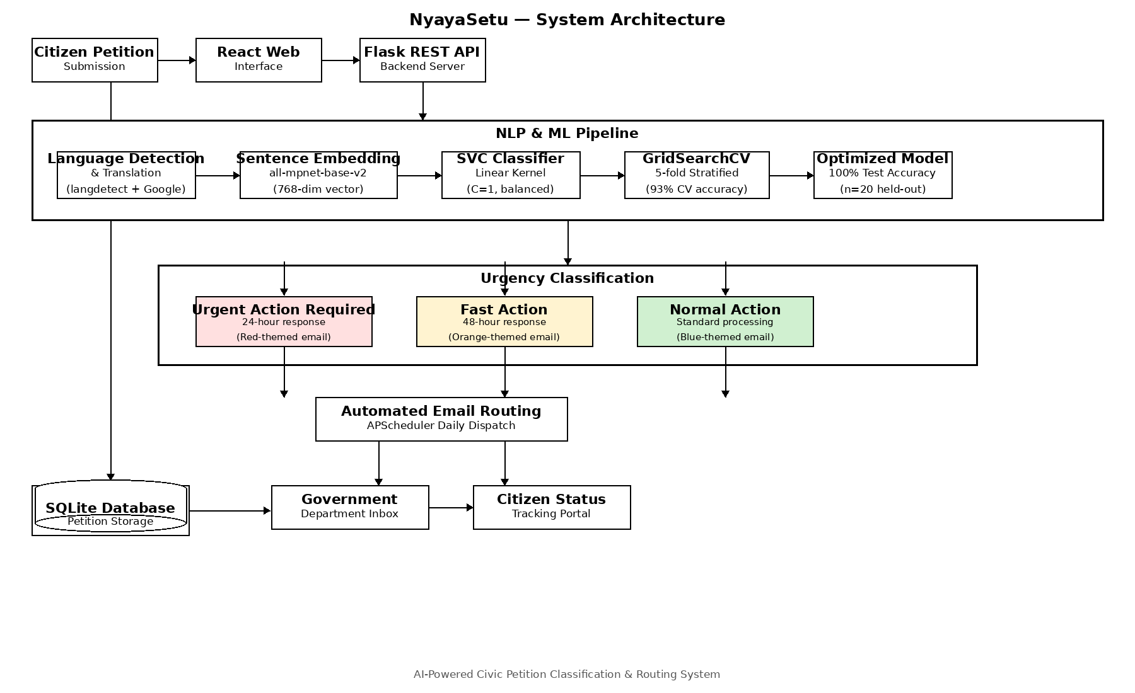
Proposed System

Slide 8
Modules Decription
Input Module
Allows citizens to submit grievance petitions through a user-friendly web-based interface.
Captures petition details such as complaint description, category, and language input for processing.
API Module
Processes submitted petition text through backend Flask APIs for classification and routing.
Performs language detection, translation, and semantic embedding generation using NLP libraries and ML models.
Calculation Module
Analyzes processed text embeddings using the trained Support Vector Classification model.
Determines petition urgency level and maps the complaint to the appropriate government department accurately.

Slide 9
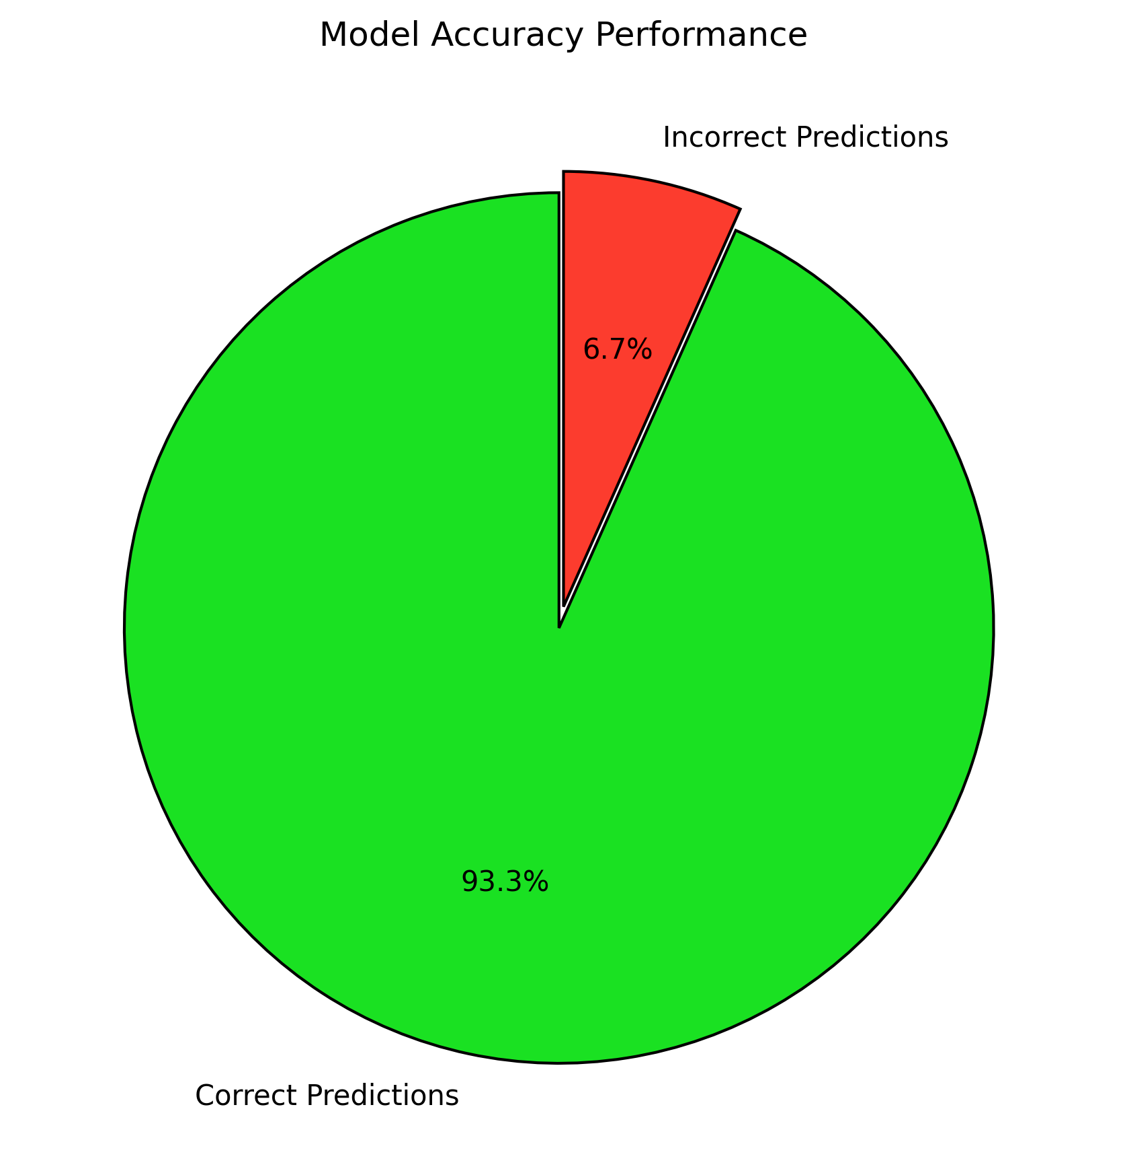
Results and Discussion
Classification Report
 | Precision | Recall | f1-score | Support
Fast Action | 0.75 | 1.00 | 0.86 | 6
Normal Action | 1.00 | 1.00 | 1.00 | 12
Urgent Action | 1.00 | 0.83 | 0.91 | 12
Accuracy |  |  | 0.93 | 30
Macro Avg | 0.92 | 0.94 | 0.92 | 30
Weigtd Avg | 0.95 | 0.93 | 0.94 | 30

Slide 10
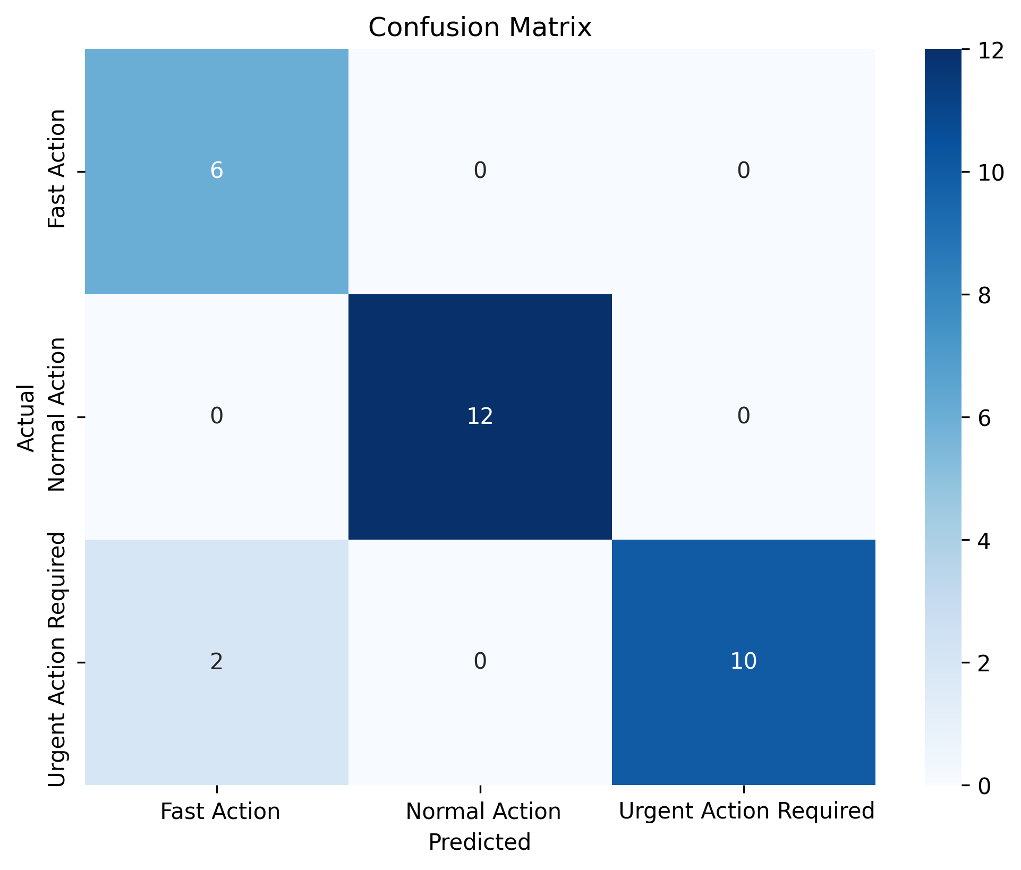
Confusion Matrix

Slide 11
Conclusion
The proposed system effectively classifies civic petitions by combining semantic text embeddings, multilingual processing, and machine learning–based urgency prediction models.
Experiments show about 93% classification accuracy, outperforming traditional keyword-based and manual triage approaches.
The integration of SentenceTransformer embeddings with Support Vector Classification (SVC) improves both prediction accuracy and robustness across diverse petition categories and linguistic variations.
The framework supports real-time petition classification and automated routing, making it suitable for large-scale e-governance and grievance redressal applications.
Challenges remain regarding dataset scalability, handling ambiguous complaint contexts, and improving model generalization, which require future research and larger, more diverse civic datasets.

Slide 12
References
N. Reimers and I. Gurevych, “Sentence-BERT: Sentence embeddings using Siamese BERT-networks,” Proc. Empirical Methods in Natural Language Processing (EMNLP-IJCNLP), pp. 3982–3992, 2019.
T. Joachims, “Text categorization with Support Vector Machines: Learning with many relevant features,” Proc. European Conf. Machine Learning (ECML), pp. 137–142, 1998.
F. Sebastiani, “Machine learning in automated text categorization,” ACM Computing Surveys, vol. 34, no. 1, pp. 1–47, 2002.
J. Devlin, M. Chang, K. Lee, and K. Toutanova, “BERT: Pre-training of deep bidirectional transformers for language understanding,” Proc. NAACL-HLT, pp. 4171–4186, 2019.
K. Song, X. Tan, T. Qin, J. Lu, and T. Liu, “MPNet: Masked and permuted pre-training for language understanding,” Advances in Neural Information Processing Systems (NeurIPS), vol. 33, pp. 16857–16867, 2020.
S. Dumais, J. Platt, D. Heckerman, and M. Sahami, “Inductive learning algorithms and representations for text categorization,” Proc. Int. Conf. Information and Knowledge Management (CIKM), pp. 148–155, 1998.
European Commission, “European Citizens’ Initiative: Official Register,” 2012. [Online]. Available: europa.eu/citizens-initiative
Government of India, “MyGov Citizen Engagement Platform,” Ministry of Electronics and Information Technology, 2014. [Online]. Available: mygov.in
A. Vaswani et al., “Attention is all you need,” Advances in Neural Information Processing Systems (NeurIPS), vol. 30, pp. 5998–6008, 2017.
T. Mikolov, K. Chen, G. Corrado, and J. Dean, “Efficient estimation of word representations in vector space,” Proc. Int. Conf. Learning Representations (ICLR), 2013.

Slide 13

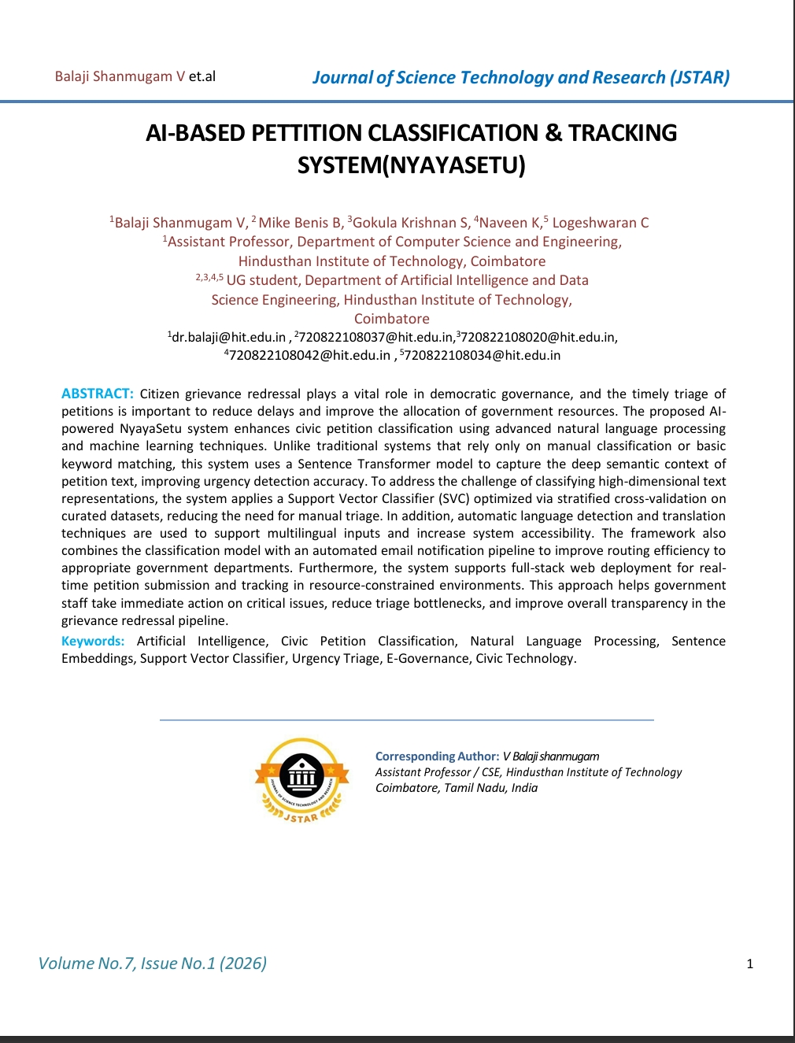
RESEARCH PAPER PUBLICATION
Paper Title:
AI-BASED PETTITION CLASSIFICATION & TRACKING SYSTEM(NYAYASETU)
Journal Name:
Journal of Science Technology and research(JSTAR)
Publication Details:
Volume 7,Issue1,2026
Authors:
B.MikeBenis, C.Logeshwaran,
S.Gokulakrishnan, K.Naveen
Project Mentor:
Dr.V.BalajiShanmugam
Publication Link:
https://journalstar.in/wp-content/uploads/2026/04/202671015.pdf

Slide 14
THANK Y☺U

