Slide 1
Unsupervised learning

Slide 2
Introduction
The main property of a neural network is an ability to learn from its environment, and to improve its performance through learning. So far we have considered supervised or active learning - learning with an external “teacher” or a supervisor who presents a training set to the network. But another type of learning also exists: unsupervised learning.

Slide 3
Introduction
In contrast to supervised learning, unsupervised or self-organised learning does not require an external teacher. During the training session, the neural network receives a number of different input patterns, discovers significant features in these patterns and learns how to classify input data into appropriate categories. Unsupervised learning tends to follow the neuro-biological organisation of the brain.
Unsupervised learning algorithms aim to learn rapidly and can be used in real-time

Slide 4
Introduction
Unsupervised learning
Training samples contain only input patterns
No desired output is given (teacher-less)
Learn to form classes/clusters of sample patterns according to similarities among them
Patterns in a cluster would have similar features
No prior knowledge as what features are important for classification, and how many classes are there.

Slide 5
Unsupervised learning
Types to be covered:
Hopfield Neural Network
Hebbian learning
Competitive networks and competitive learning

Slide 6
Hopfield Neural Network

Slide 7
Hopfield Neural Network
Unlike a regular Feed-forward NN, where the flow of data is in one direction. A hopfield network, is one in which all the nodes are both inputs and outputs, and are all fully interconnected.
This is super useful, if your data is noisy, or partial. Since the network can store patterns, and retrieve those patterns based on partial input, due to the interconnections.
But, the only problem, being that they are very computationally expensive, due to every node being N²
Usually employed in binary-logic tasks: e.g. pattern completion and association

Slide 8
Hopfield Neural Network
Hopfield Nets are fully connected, symmetrically-weighted networks that extended the ideas of linear associative memories by adding cyclic connections
You construct a hopfield net in the following way. Each input i has a weight w_{i} associated with it. They also have an output, whose state is maintained until the neuron gets updated.

Slide 9
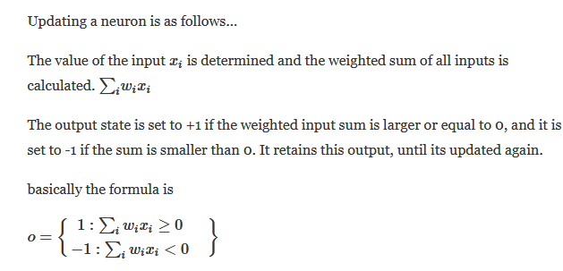
Hopfield Neural Network

Slide 10
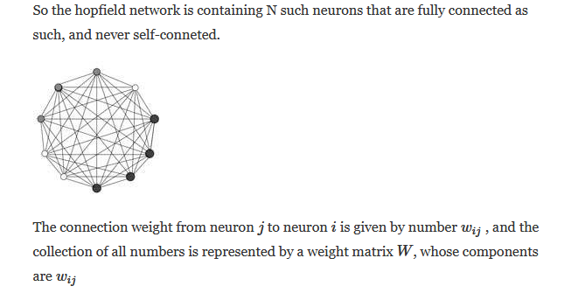
Hopfield Neural Network

Slide 11
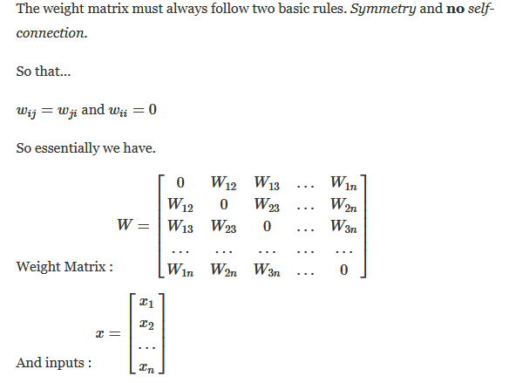
Hopfield Neural Network

Slide 12
Hopfield Neural Network
How to update the neurons.
We can do either an asynchronous, or synchronous update. With an async update, we choose a neuron at random, and calculate the weighted input sum, and update that neuron immediately. Then move to the next neuron, either in order, or randomly.
If we choose synchronous updating, we calculate the input sums of all the neurons without updating the neurons. Then once calculated, we set them all to their new value, at the same time.

Slide 13
Hopfield Neural Network
Training:
To start the network off, we have to give it a pattern. A pattern is entered into the network by setting all nodes to a specific value, or by setting only some of the nodes. Then you let the pattern evolve, under iterations of either async or sync updating, and after some time, you stop, and read the pattern in the network.
The patterns are stored in the weight matrix.
The input must contain part of these patterns (Content Addressable Memory).
The patterns that are stored in the network and divided into two parts. Cue and association.
By entering the cue, we can retrieve the entire association/pattern or partial (auto-associator), which is stored in the weight matrix. In this way the network restores the association given by a cue.

Slide 14

Hopfield Neural Network
“Energy” of a hopfield net:
Because the neurons are so interconnected, that they may cause oscillation, or instability.
The energy is defined as …
and it decreases each time a neuron fires. The energy needs to settle into stability, in order for the network to converge on an answer.

Slide 15
Hebbian learning
In 1949, Donald Hebb proposed one of the key ideas in biological learning, commonly known as Hebb’s Law.
Hebb’s Law states that if neuron i is near enough to excite neuron j and repeatedly participates in its activation, the synaptic connection between these two neurons is strengthened and neuron j becomes more sensitive to stimuli from neuron i.

Slide 16
Hebb’s Law can be represented in the form of two rules:
If two neurons on either side of a connection are activated synchronously, then the weight of that connection is increased.
If two neurons on either side of a connection are activated asynchronously, then the weight of that connection is decreased.
Hebb’s Law provides the basis for learning without a teacher. Learning here is a local phenomenon occurring without feedback from the environment.

Slide 17
Hebbian learning in a neural network
O u t p u t S i g n a l s
I n p u t S i g n a l s

Slide 18
Using Hebb’s Law we can express the adjustment applied to the weight w_{ij} at iteration p in the following form:
As a special case, we can represent Hebb’s Law as follows:
where a is the learning rate parameter. This equation is referred to as the activity product rule.

Slide 19
Hebbian learning implies that weights can only increase. To resolve this problem, we might impose a limit on the growth of synaptic weights. It can be done by introducing a non-linear forgetting factor into Hebb’s Law:
where j is the forgetting factor.
Forgetting factor usually falls in the interval between 0 and 1, typically between 0.01 and 0.1, to allow only a little “forgetting” while limiting the weight growth.

Slide 20
Hebbian learning algorithm
Step 1: Initialisation. Set initial synaptic weights and thresholds to small random values, say in an interval [0, 1 ].
Step 2: Activation. Compute the neuron output at iteration p
where n is the number of neuron inputs, and P_{j} is the threshold value of neuron j.

Slide 21
Step 3: Learning. Update the weights in the network:
where Δw_{ij}(p) is the weight correction at iteration p. The weight correction is determined by the generalised activity product rule:
Step 4: Iteration. Increase iteration p by one, go back to Step 2.

Slide 22
Competitive learning
In competitive learning, neurons compete among themselves to be activated.
While in Hebbian learning, several output neurons can be activated simultaneously, in competitive learning, only a single output neuron is active at any time.
The output neuron that wins the “competition” is called the winner-takes-all neuron.

Slide 23
The basic idea of competitive learning was introduced in the early 1970s.
In the late 1980s, Teuvo Kohonen introduced a special class of artificial neural networks called self-organizing feature maps. These maps are based on competitive learning.

Slide 24
What is a self-organizing feature map?
Our brain is dominated by the cerebral cortex, a very complex structure of billions of neurons and hundreds of billions of synapses.
The cortex includes areas that are responsible for different human activities (motor, visual, auditory, somatosensory, etc.), and associated with different sensory inputs.
We can say that each sensory input is mapped into a corresponding area of the cerebral cortex. The cortex is a self-organizing computational map in the human brain.

Slide 25
Feature-mapping Kohonen model

Slide 26
The Kohonen network
The Kohonen model provides a topological mapping. It places a fixed number of input patterns from the input layer into a higher- dimensional output or Kohonen layer.
Training in the Kohonen network begins with the winner’s neighborhood of a fairly large size. Then, as training proceeds, the neighborhood size gradually decreases.

Slide 27
Architecture of the Kohonen Network

Slide 28
The lateral connections are used to create a competition between neurons. The neuron with the largest activation level among all neurons in the output layer becomes the winner. This neuron is the only neuron that produces an output signal. The activity of all other neurons is suppressed in the competition.
The lateral feedback connections produce excitatory or inhibitory effects, depending on the distance from the winning neuron. This is achieved by the use of a Mexican hat function which describes synaptic weights between neurons in the Kohonen layer.

Slide 29
The Mexican hat function of lateral connection

Slide 30
In the Kohonen network, a neuron learns by shifting its weights from inactive connections to active ones. Only the winning neuron and its neighbourhood are allowed to learn. If a neuron does not respond to a given input pattern, then learning cannot occur in that particular neuron.
The competitive learning rule defines the change Δ w_{ij} applied to synaptic weight wij as
where x_{i} is the input signal and α is the learning rate parameter.

Slide 31
The overall effect of the competitive learning rule resides in moving the synaptic weight vector W_{j} of the winning neuron j towards the input pattern X. The matching criterion is equivalent to the minimum Euclidean distance between vectors.
The Euclidean distance between a pair of n by 1 vectors X and W_{j} is defined by
where x_{i} and w_{ij} are the ith elements of the vectors X and W_{j}, respectively.

Slide 32
To identify the winning neuron, j_{X}, that best matches the input vector X, we may apply the following condition:
where m is the number of neurons in the Kohonen layer.

Slide 33
Suppose, for instance, that the 2-dimensional input vector X is presented to the three-neuron Kohonen network,
The initial weight vectors, W_{j,} are given by

Slide 34
We find the winning (best-matching) neuron j_{X} using the minimum-distance Euclidean criterion:
Neuron 3 is the winner and its weight vector W₃ is updated according to the competitive learning rule.

Slide 35
The updated weight vector W₃ at iteration (p + 1) is determined as:
The weight vector W₃ of the wining neuron 3 becomes closer to the input vector X with each iteration.

Slide 36
Competitive Learning Algorithm
Step 1: Initialization.
Set initial synaptic weights to small random values, say in an interval [0, 1], and assign a small positive value to the learning rate parameter α.

Slide 37
Step 2: Activation and Similarity Matching.
Activate the Kohonen network by applying the
input vector X, and find the winner-takes-all (best
matching) neuron j_{X} at iteration p, using the
minimum-distance Euclidean criterion
where n is the number of neurons in the input
layer, and m is the number of neurons in the
Kohonen layer.

Slide 38
Step 3: Learning.
Update the synaptic weights
where Δw_{ij}(p) is the weight correction at iteration p.
The weight correction is determined by the
competitive learning rule:
where α is the learning rate parameter, and Λ_{j}(p) is
the neighborhood function centered around the
winner-takes-all neuron j_{X} at iteration p.

Slide 39
Step 4: Iteration.
Increase iteration p by one, go back to Step 2 and continue until the minimum-distance Euclidean criterion is satisfied, or no noticeable changes occur in the feature map.

