Slide 1
Radial Basis Function (RBF) Networks
Introduction
Architecture
Learning algorithm (Gaussian Function)
Euclidian Distance
Example
RBF Slides

Slide 2
Radial Basis Function Network
Design of NN as curve-fitting problem
Learning
  find surface in multidimensional space best fit to training data
Generalization
  Use of this multidimensional surface to interpolate the test data
RBF Slides

Slide 3
RBF network
The basic architecture for a RBF is a 3-layer network, as shown in the next slide
The input layer is simply a fan-out layer and does no processing.
The second or hidden layer performs a non-linear mapping from the input space into a (usually) higher dimensional space in which the patterns become linearly separable.
RBF Slides

Slide 4
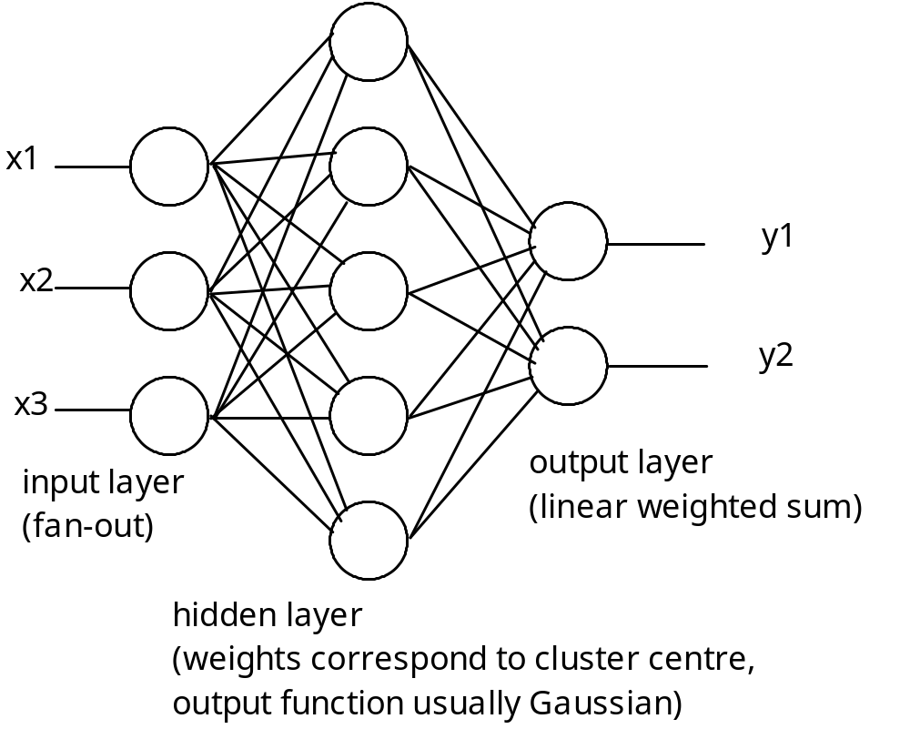
RBF Slides

Slide 5
architecture
x₁
h₁
W₁
h₂
x₂
W₂
h₃
x₃
W₃
f(x)
W_{m}
x_{n}
h_{m}
RBF Slides
Input layer
Hidden layer
Output layer

Slide 6
Radial Basis Function Network
Approximate function with linear combination of Radial basis functions
F(x) = Σ w_{i} h(x)
h(x) is mostly Gaussian function
RBF Slides

Slide 7
Three layers
Input layer
  Source nodes that connect to the network to its environment
Hidden layer
  Hidden units provide a set of basis function
  High dimensionality
Output layer
  Linear combination of hidden functions
RBF Slides

Slide 8
Output layer
The final layer performs a simple weighted sum with a linear output.
If the RBF network is used for function approximation (matching a real number) then this output is fine.
However, if pattern classification is required, then a hard-limiter or sigmoid function could be placed on the output neurons to give 0/1 output values.
RBF Slides

Slide 9
Clustering
The unique feature of the RBF network is the process performed in the hidden layer.
The idea is that the patterns in the input space form clusters.
If the centres of these clusters are known, then the distance from the cluster centre can be measured.
Furthermore, this distance measure is made non-linear, so that if a pattern is in an area that is close to a cluster centre it gives a value close to 1.
RBF Slides

Slide 10
Clustering
Beyond this area, the value drops dramatically.
The notion is that this area is radially symmetrical around the cluster centre, so that the non-linear function becomes known as the radial-basis function.
RBF Slides

Slide 11
Gaussian function
The most commonly used radial-basis function is a Gaussian function
In a RBF network, r is the distance from the cluster centre.
The equation represents a Gaussian bell-shaped curve, as shown in Fig.
RBF Slides

Slide 12
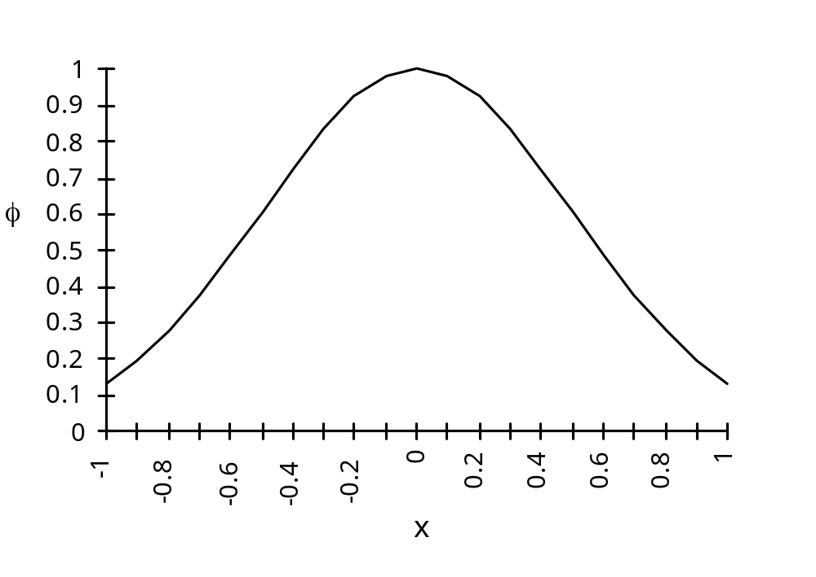
RBF Slides

Slide 13
Distance measure
The distance measured from the cluster centre is usually the Euclidean distance.
For each neuron in the hidden layer, the weights represent the co-ordinates of the centre of the cluster.
Therefore, when that neuron receives an input pattern, X, the distance is found using the following equation:
RBF Slides

Slide 14
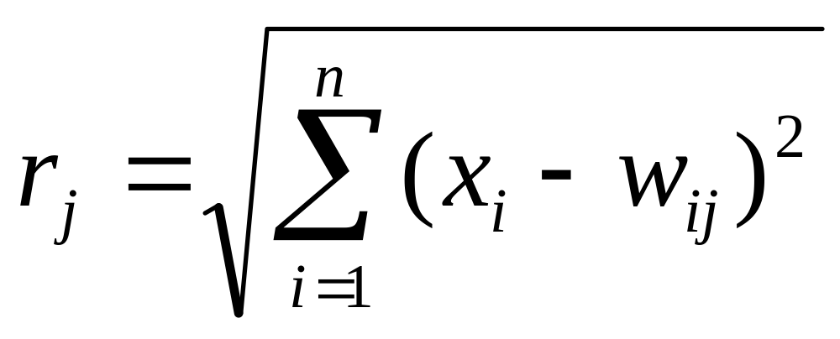
Distance measure
RBF Slides

Slide 15
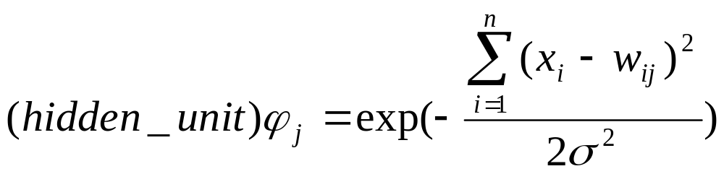
Width of hidden unit basis function
The variable sigma, σ, defines the width or radius of the bell-shape and is something that has to be determined empirically. When the distance from the centre of the Gaussian reaches σ, the output drops from 1 to 0.6.
RBF Slides

Slide 16
Example
An often quoted example which shows how the RBF network can handle a non-linearly separable function is the exclusive-or problem.
One solution has 2 inputs, 2 hidden units and 1 output.
The centres for the two hidden units are set at c1 = 0,0 and c2 = 1,1, and the value of radius σ is chosen such that 2σ² = 1.
RBF Slides

Slide 17
Example
The inputs are x, the distances from the centres squared are r, and the outputs from the hidden units are ϕ.
When all four examples of input patterns are shown to the network, the outputs of the two hidden units are shown in the following table.
RBF Slides

Slide 18
x₁
x₂
r₁
r₂
ϕ₁
ϕ₂
0
0
0
2
1
0.1
0
1
1
1
0.4
0.4
1
0
1
1
0.4
0.4
1
1
2
0
0.1
1
RBF Slides

Slide 19
Example
Next Fig. shows the position of the four input patterns using the output of the two hidden units as the axes on the graph - it can be seen that the patterns are now linearly separable.
This is an ideal solution - the centres were chosen carefully to show this result.
Methods generally adopted for learning in an RBF network would find it impossible to arrive at those centre values - later learning methods that are usually adopted will be described.
RBF Slides

Slide 20
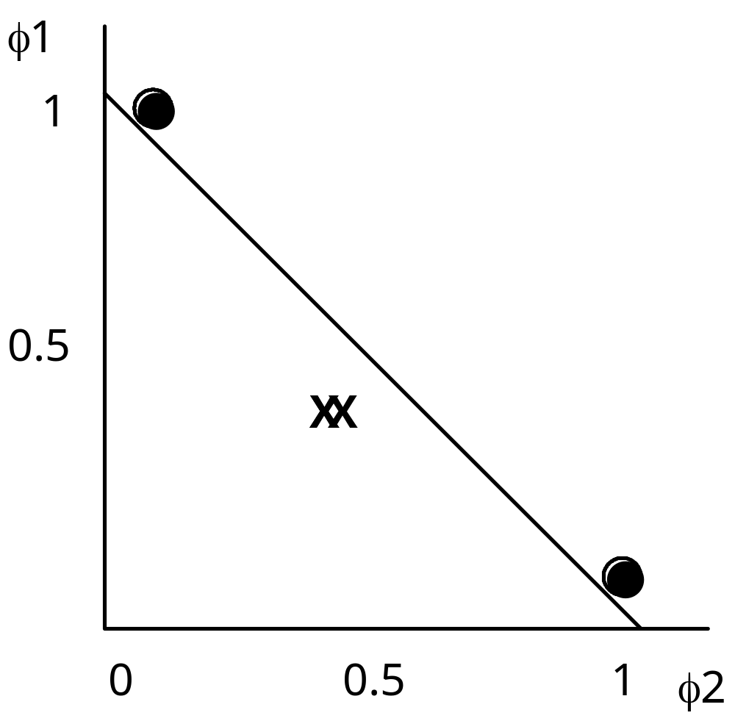
RBF Slides

Slide 21
Training hidden layer
The hidden layer in a RBF network has units which have weights that correspond to the vector representation of the centre of a cluster.
These weights are found either using a traditional clustering algorithm such as the k-means algorithm, or adaptively using essentially the Kohonen algorithm.
RBF Slides

Slide 22
Training hidden layer
In either case, the training is unsupervised but the number of clusters that you expect, k, is set in advance. The algorithms then find the best fit to these clusters.
The k -means algorithm will be briefly outlined.
Initially k points in the pattern space are randomly set.
RBF Slides

Slide 23
Training hidden layer
Then for each item of data in the training set, the distances are found from all of the k centres.
The closest centre is chosen for each item of data - this is the initial classification, so all items of data will be assigned a class from 1 to k.
Then, for all data which has been found to be class 1, the average or mean values are found for each of co-ordinates.
RBF Slides

Slide 24
Training hidden layer
These become the new values for the centre corresponding to class 1.
Repeated for all data found to be in class 2, then class 3 and so on until class k is dealt with - we now have k new centres.
Process of measuring the distance between the centres and each item of data and re-classifying the data is repeated until there is no further change – i.e. the sum of the distances monitored and training halts when the total distance no longer falls.
RBF Slides

Slide 25
Adaptive k-means
The alternative is to use an adaptive k -means algorithm which similar to Kohonen learning.
Input patterns are presented to all of the cluster centres one at a time, and the cluster centres adjusted after each one. The cluster centre that is nearest to the input data wins, and is shifted slightly towards the new data.
This has the advantage that you don’t have to store all of the training data so can be done on-line.
RBF Slides

Slide 26
Finding radius of Gaussians
Having found the cluster centres using one or other of these methods, the next step is determining the radius of the Gaussian curves.
This is usually done using the P-nearest neighbour algorithm.
A number P is chosen, and for each centre, the P nearest centres are found.
RBF Slides

Slide 27
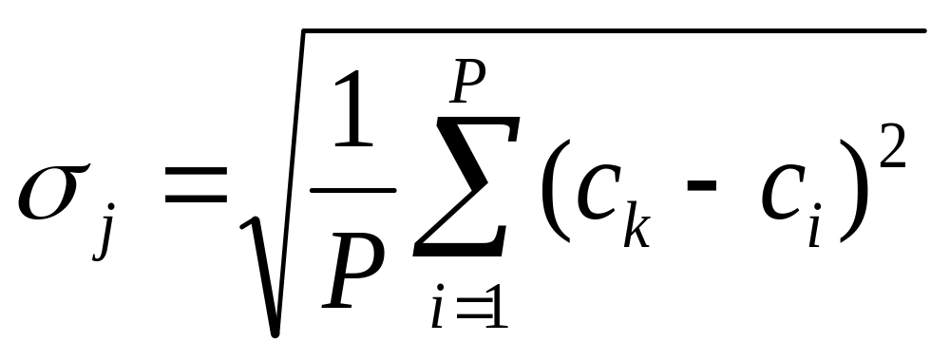
Finding radius of Gaussians
The root-mean squared distance between the current cluster centre and its P nearest neighbours is calculated, and this is the value chosen for σ.
So, if the current cluster centre is c_{j}, the value is:
RBF Slides

Slide 28
Finding radius of Gaussians
A typical value for P is 2, in which case σ is set to be the average distance from the two nearest neighbouring cluster centres.
RBF Slides

Slide 29
XOR example
Using this method XOR function can be implemented using a minimum of 4 hidden units.
If more than four units are used, the additional units duplicate the centres and therefore do not contribute any further discrimination to the network.
So, assuming four neurons in the hidden layer, each unit is centred on one of the four input patterns, namely 00, 01, 10 and 11.
RBF Slides

Slide 30
XOR example
The P-nearest neighbour algorithm with P set to 2 is used to find the size if the radii.
In each of the neurons, the distances to the other three neurons is 1, 1 and 1.414, so the two nearest cluster centres are at a distance of 1.
Using the mean squared distance as the radii gives each neuron a radius of 1.
Using these values for the centres and radius, if each of the four input patterns is presented to the network, the output of the hidden layer would be:
RBF Slides

Slide 31
input
neuron 1
neuron 2
neuron 3
neuron 4
00
0.6
0.4
1.0
0.6
01
0.4
0.6
0.6
1.0
10
1.0
0.6
0.6
0.4
11
0.6
1.0
0.4
0.6
RBF Slides

Slide 32
Training output layer
Having trained the hidden layer with some unsupervised learning, the final step is to train the output layer using a standard gradient descent technique such as the Least Mean Squares algorithm.
In the example of the exclusive-or function given above a suitable set of weights would be +1, –1, –1 and +1. With these weights the value of net and the output is:
RBF Slides

Slide 33
input
neuron 1
neuron 2
neuron 3
neuron 4
net
output
00
0.6
0.4
1.0
0.6
–0.2
0
01
0.4
0.6
0.6
1.0
0.2
1
10
1.0
0.6
0.6
0.4
0.2
1
11
0.6
1.0
0.4
0.6
–0.2
0
RBF Slides

Slide 34
Radial basis function
m
f(x) = ∑ w_{j}h_{j}(x)
j=1
h_{j}(x) = exp( -(x-c_{j})² / r_{j}² )
Where c_{j} is center of a region,
r_{j} is width of the receptive field
RBF Slides

Slide 35
Designing
Require
  Selection of the radial basis function width parameter
  Number of radial basis neurons
RBF Slides

Slide 36
Selection of the RBF width para.
Not required for an MLP
smaller width
  alerting in untrained test data
Larger width
  network of smaller size & faster execution
RBF Slides

Slide 37
Number of radial basis neurons
By designer
Max of neurons = number of input
Min of neurons = ( experimentally determined)
More neurons
  More complex, but smaller tolerance
RBF Slides

Slide 38
Supervised selection of centers
All free parameters of the network are changed by supervised learning process.
Error-correction learning using Least-Mean-Square (LMS) algorithm.
RBF Slides

Slide 39
Least-Mean-Square (LMS) Algorithm
The LMS Algorithm consists of two basic processes
  Filtering process
    Calculate the output of FIR filter by convolving input and taps
    Calculate estimation error by comparing the output to desired signal
  Adaptation process
    Adjust tap weights based on the estimation error
RBF Slides

Slide 40
RBF: Advantages/Disadvantages
RBF trains faster than a MLP
Another advantage that is claimed is that the hidden layer is easier to interpret than the hidden layer in an MLP.
Although the RBF is quick to train, when training is finished and it is being used it is slower than a MLP, so where speed is a factor a MLP may be more appropriate.
RBF Slides

Slide 41
Summary
Statistical feed-forward networks such as the RBF network have become very popular, and are serious rivals to the MLP.
Essentially well tried statistical techniques being presented as neural networks.
Learning mechanisms in statistical neural networks are not biologically plausible – so have not been taken up by those researchers who insist on biological analogies.
RBF Slides

