Slide 1
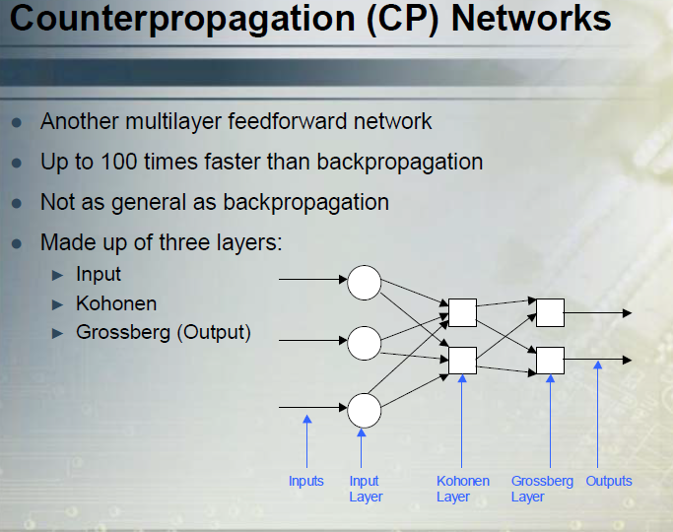

Slide 2
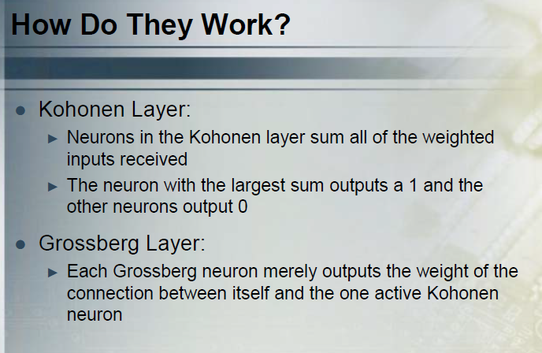

Slide 3
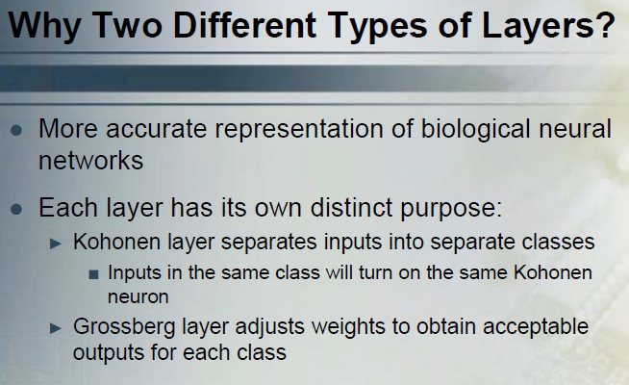

Slide 4
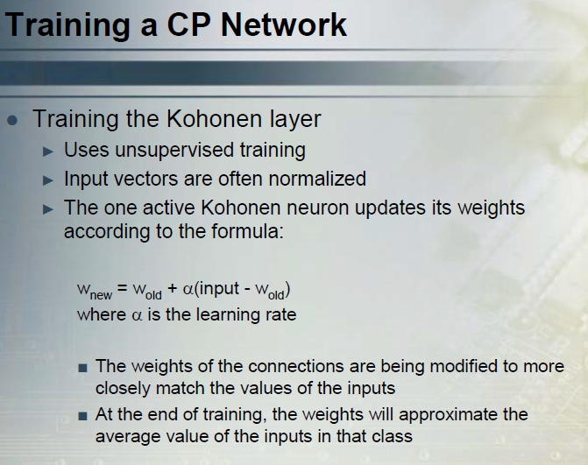

Slide 5
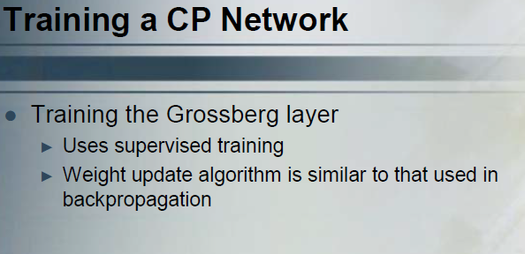

Slide 6
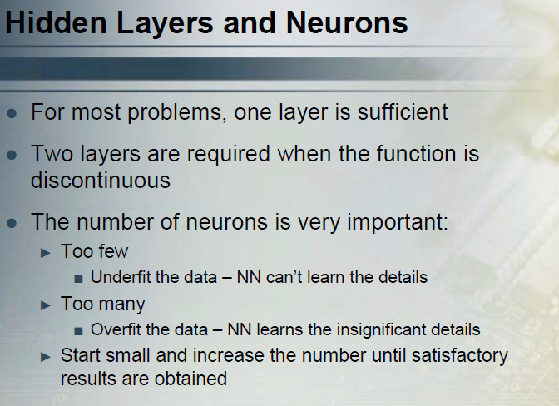

Slide 7
RECURRENT NEURAL NETWORKS

Slide 8
OUTLINE
Why use recurrent networks
Typical architectures

Slide 9
Definitions
RECURRENT NEURAL NETWORK
Subset of Artificial Neural Networks
Still use feedforward and backpropogation
Allows nodes to form cycles, creating the potentiality for storage of information within the network
Used in applications such as handwriting analysis, video analysis, translation, and other interpretation of various human tasks
Difficult to train

Slide 10
Simple Recurrent Network

Slide 11
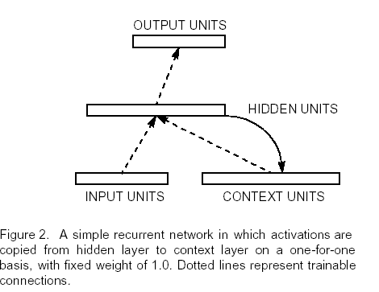
Simple Recurrent Network

Slide 12
A recurrent backpropogation network
A backpropogation network need not be strictly feedforward and can have recurrent connections.
A unit can feed to itself, to units in the same or lower levels.
A recurrent connection feeds back activation that will affect the output from the network during subsequent iterations.
For every recurrent network there is a feedforward network with identical behavior.

Slide 13
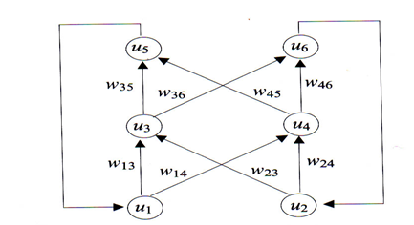
A recurrent backpropogation network (Connections from output to input layer)

Slide 14
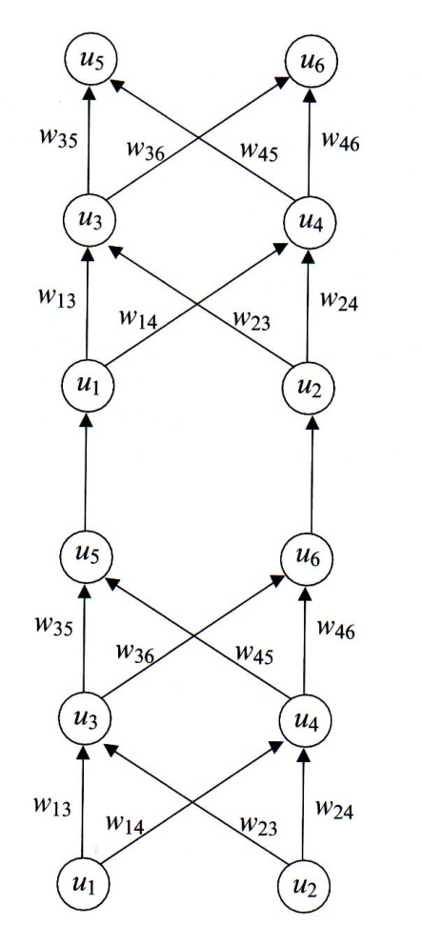
An expanded version of the network in the previous figure.

