Slide 1

Building and Analysing a Relational Database
Sparta Global – Model Data Engineering with AI
Michael Cooksley
Alina Arus
Matthew Newton
https://github.com/alina951/olist-data-engineering-project
https://github.com/Mikeecee1/BrazilianECommerce

Slide 2

Project Overview
Objective
The aim of this project was to transform the Olist Brazilian E-commerce dataset into a relational SQL database and perform business analysis using SQL.
Technologies
SQL Server
SSMS
Git & GitHub
VS Code

Slide 3
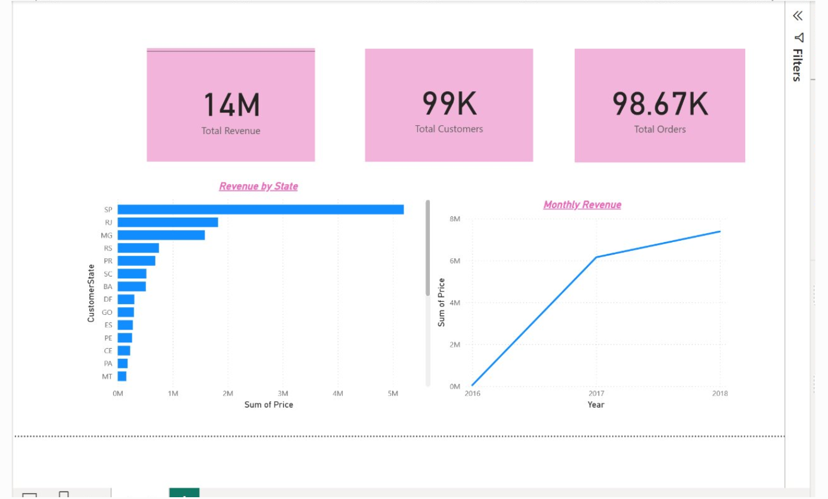

Slide 4
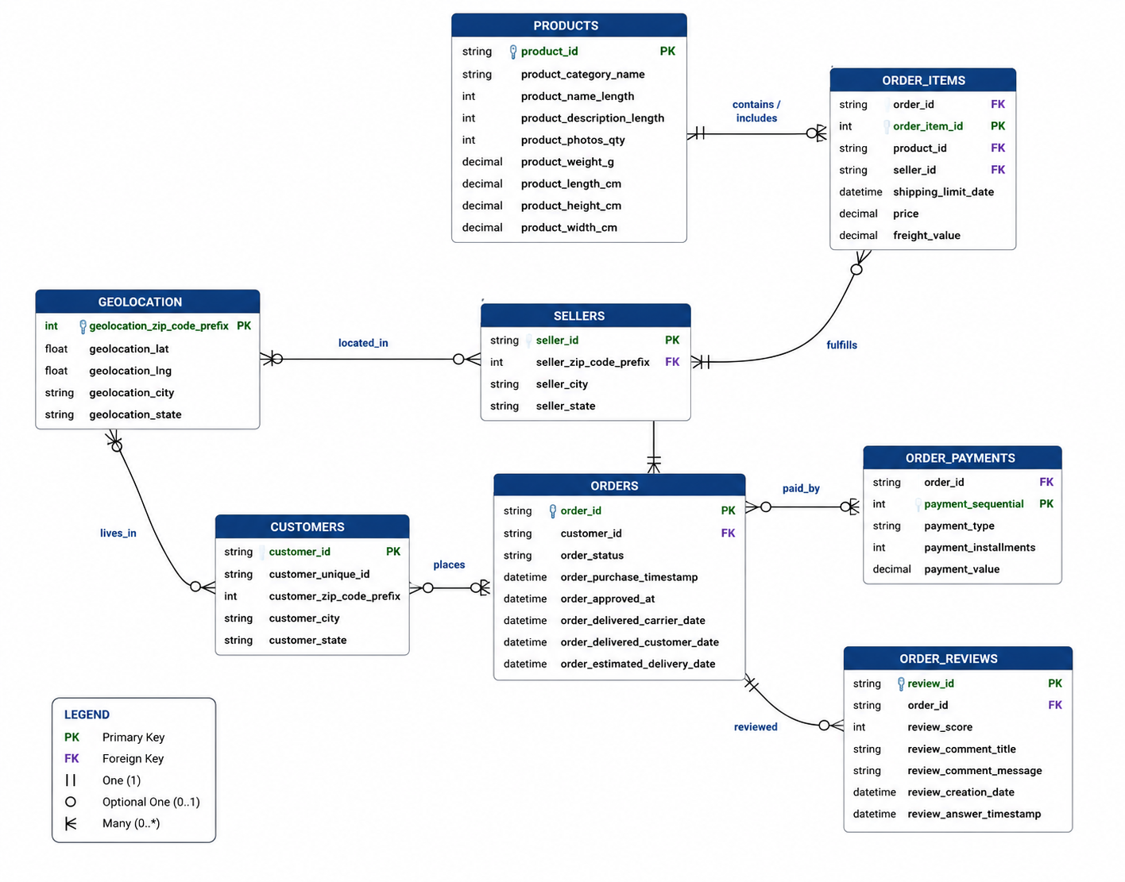
Database Design

Slide 5
Development Issues
Had issues with original database - too messy, very long strings and not appropriate for an extensive db schema
Cleaning fairly easy for second database - used pandas to replace some portuguese text with English
Had some issues with using creation script with bulk import - found a workaround (due to a bug with sql issues importing CHAR strings in bulk)
The Geolocation Table was not really in a SQL format and was not used in final database

Slide 6
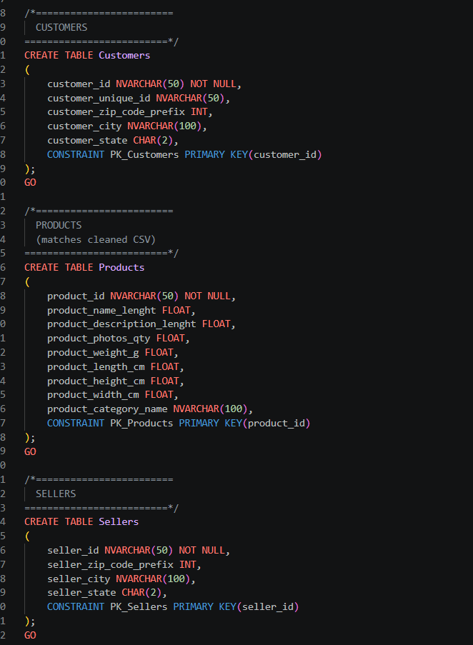
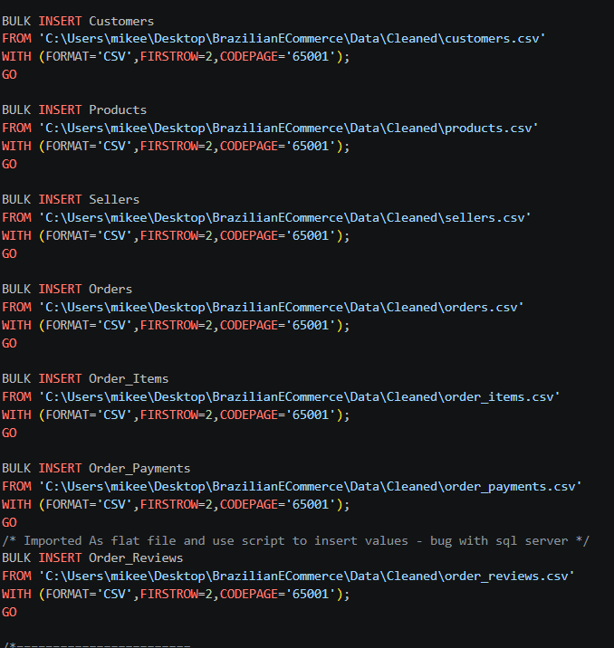
CREATION & BULK INSERTION SCRIPTS

Slide 7
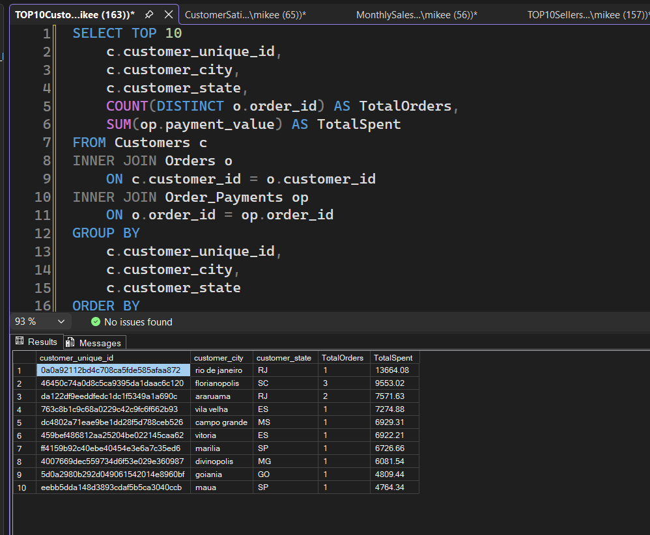

Slide 8
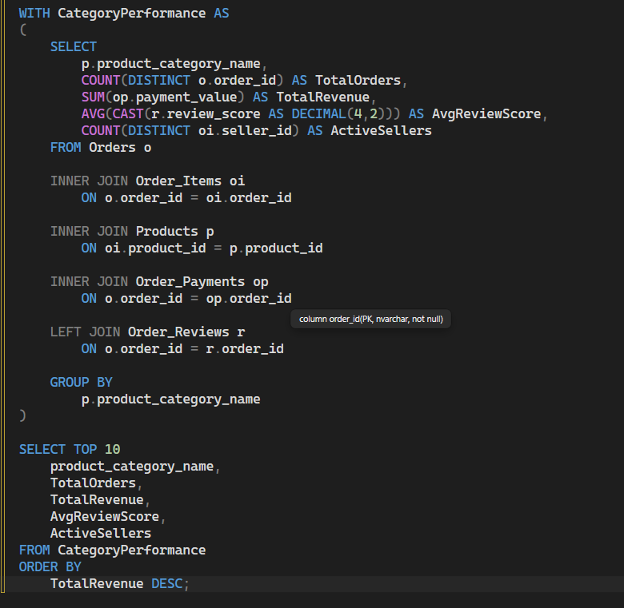

Slide 9
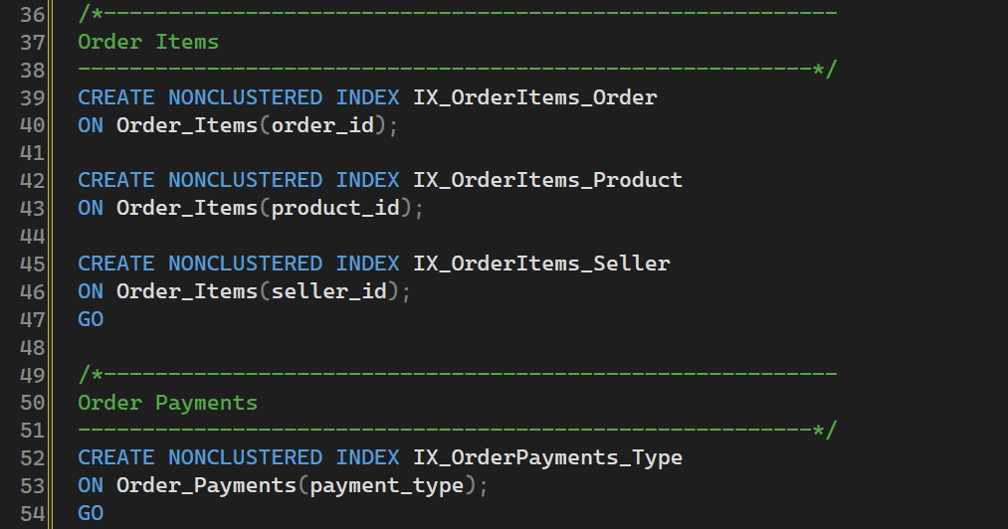
Performance Optimisation

Slide 10
Conclusion
This project demonstrated the complete lifecycle of building a relational database from raw data.
By cleaning, modelling and analysing the dataset, we created a reliable database that supports efficient querying and business decision-making.
The project strengthened our practical skills in SQL Server, database design, ETL concepts.
In future, the solution could be extended with automated ETL pipelines, dashboards and cloud-based deployment.

Slide 11

Questions?
THANK YOU

