Slide 1
Power Considerations
How is our rover powered?

Slide 2
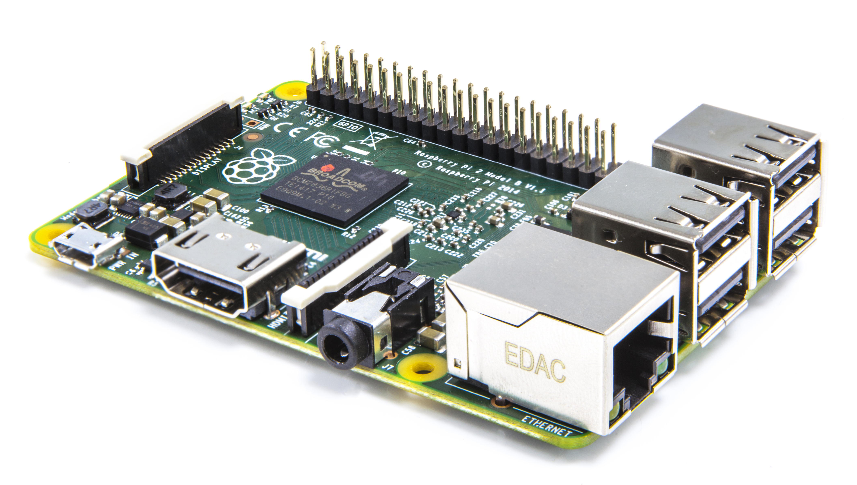
Requirements
Rover Motors: 12V
Raspberry Pi: 5V
Rover Logic: 5V
Runtime must be an hour or so

Slide 3
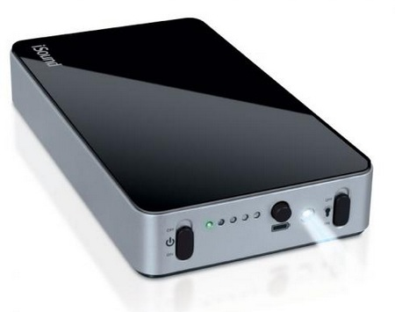
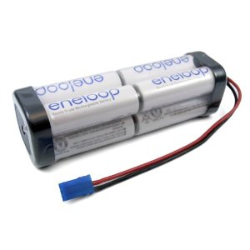
Solutions
Multi-Cell battery pack for Rover Motors
  Battery life will be low; this is okay
5V portable micro-USB charger for Raspberry Pi, Rover Logic
  Battery will last multiple days

