Slide 1
The Shallbergs
ESD2
Rover Project

Slide 2
Hardware
What do we have?

Slide 3
Hardware
Rover Chassis
  Pre-built, with four motors with feedback and rubber tracks.
Motor Controller
  Responsible for powering motors based on PWM input; supplies feedback signals
Rasperry Pi
  Runs firmware to command motors and receive input
  Runs routines for movement

Slide 4
Software / Control
What software lets us interact with the rover remotely?

Slide 5
Software / Control
Software on the desktop can communicate with the Raspberry Pi
  Ideally controlled with an opaque network protocol
    Multiple clients can be made, like a GUI in qt, or a command line interface
Optionally the Raspberry Pi may be connected to remotely to use a UI running on the device
  Less architectural overhead at the expense of performance and responsiveness

Slide 6
Software / Firmware
What commands the rover to drive?

Slide 7
Software / Firmware
Runs Raspbian (Debian Linux variant)
  Our Python code controls Raspi PWM output hardware to command motors
Networked so it may be controlled remotely

Slide 8
Power Considerations
How is our rover powered?

Slide 9
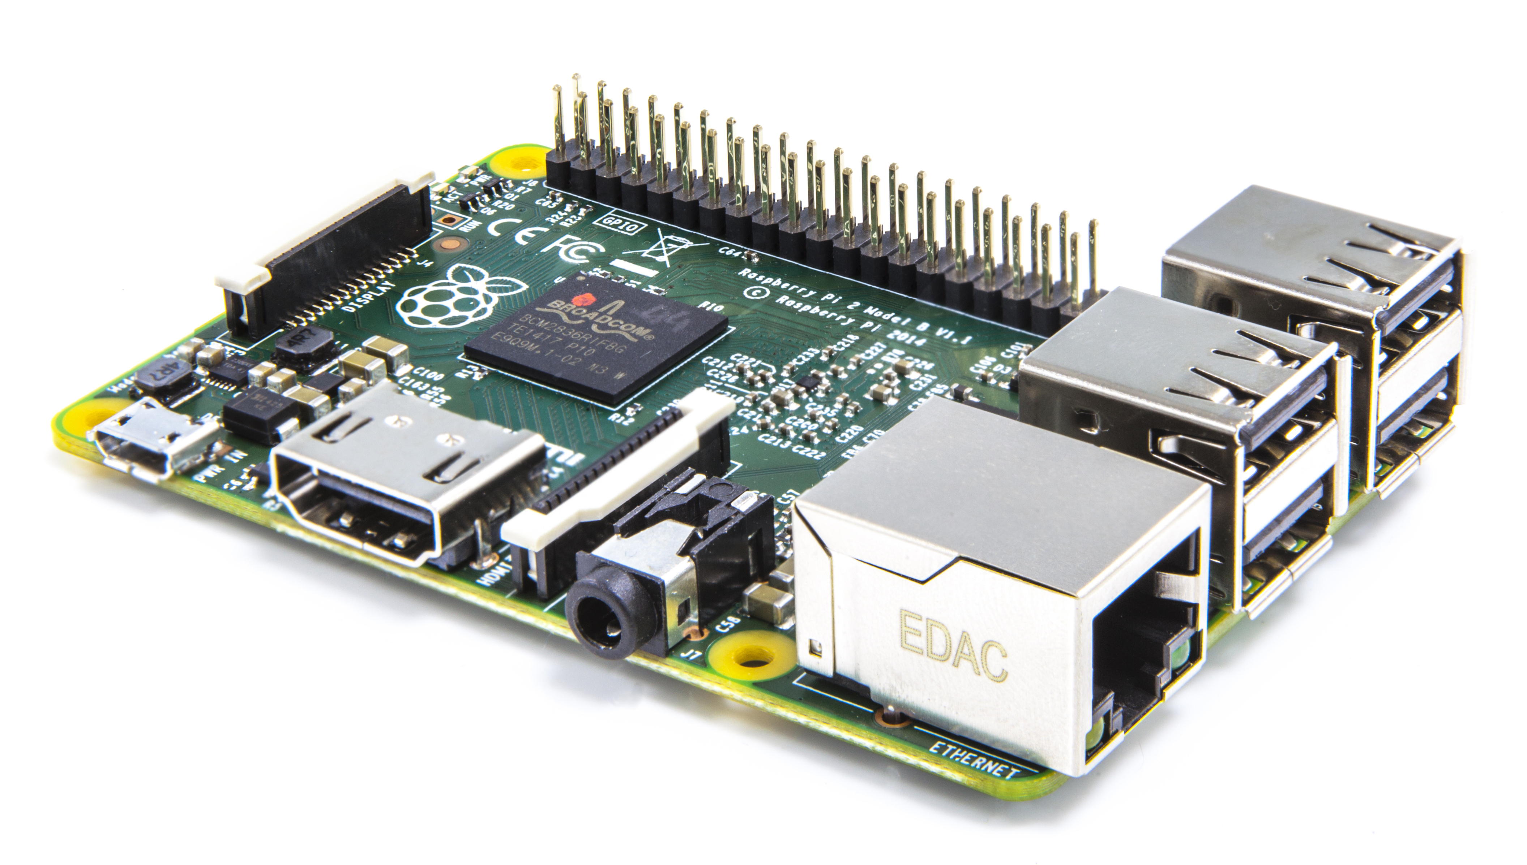
Power Requirements
Rover Motors: 12V
Raspberry Pi: 5V
Rover Logic: 5V
Runtime must be an hour or so

Slide 10
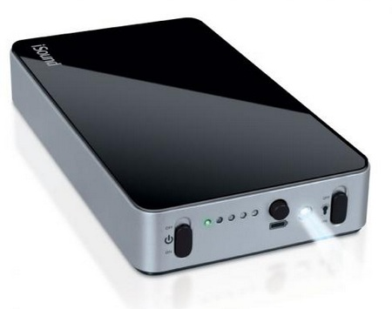
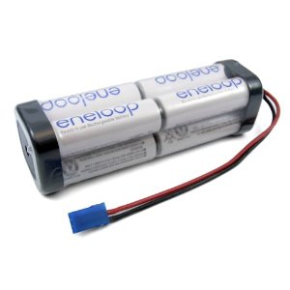
Power Solutions
Multi-Cell battery pack for Rover Motors
  Battery life will be low; this is okay
5V portable micro-USB charger for Raspberry Pi, Rover Logic
  Battery will last multiple days

