Slide 1

SAVE MONEY & SAVE THE PLANET
By: Teodora

Slide 2

Recycling is not the answer!
Instead try:
Reduce
Recycle/Upcycle
Repair
Zero Waste Alternatives
Apps

Slide 3





1.Reduce
Reduce Consumerism
Meal Prep
DIY
Reduce water and energy consumption, opt for walking and public transport
Use glasses instead of contact lenses

Slide 4
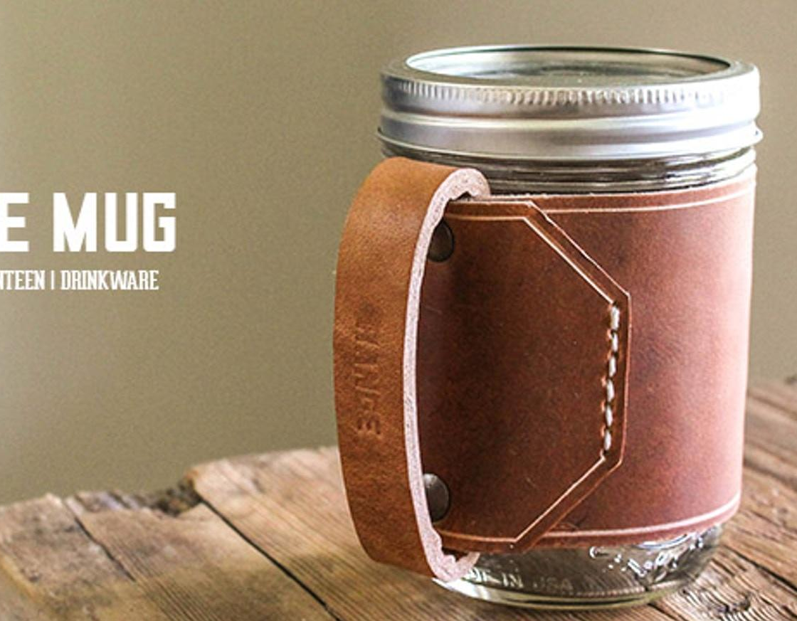




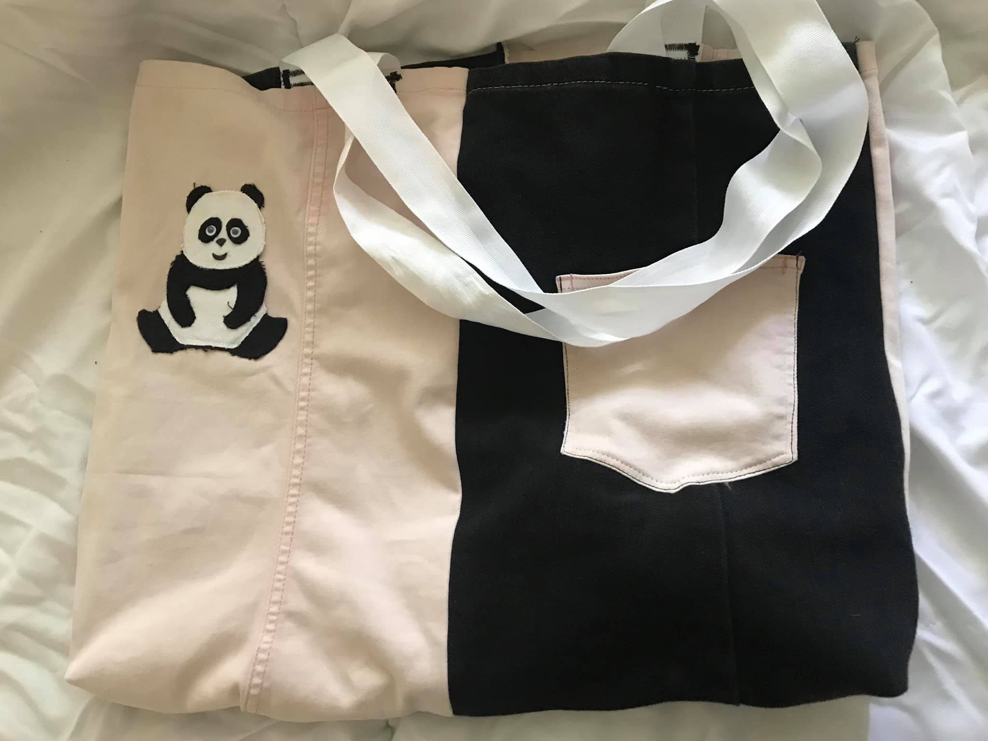
Recycle and upcycle
CLOTHES SWAP
CHARITY SHOPPING
UPCYCLE JARS AND CONTAINERS
UPCYCLE CLOTHES

Slide 5
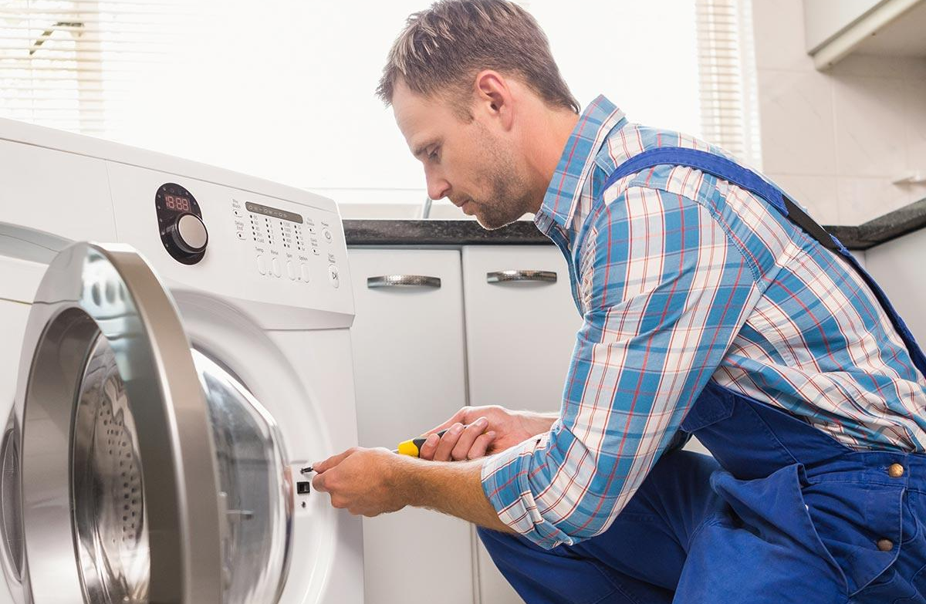
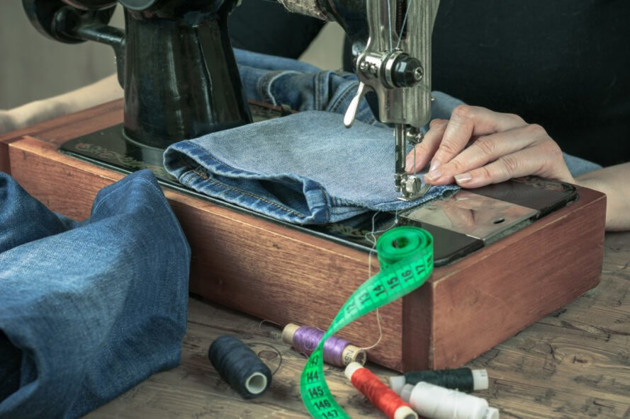
REPAIR

Slide 6
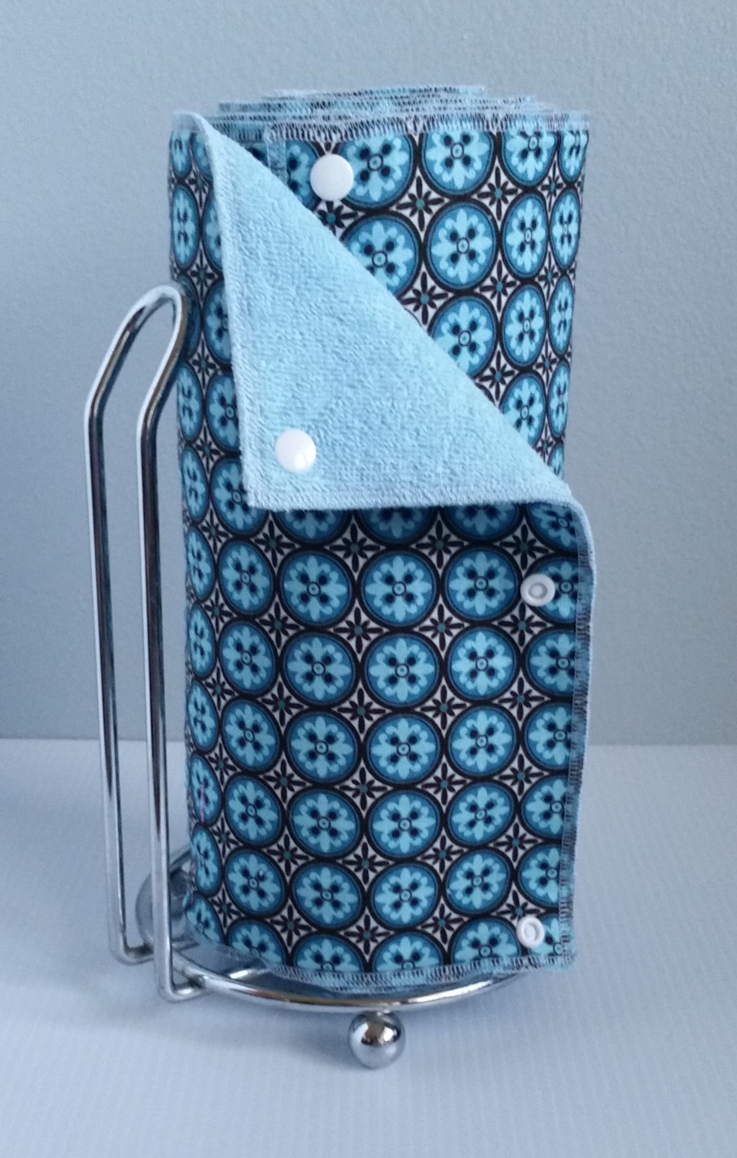
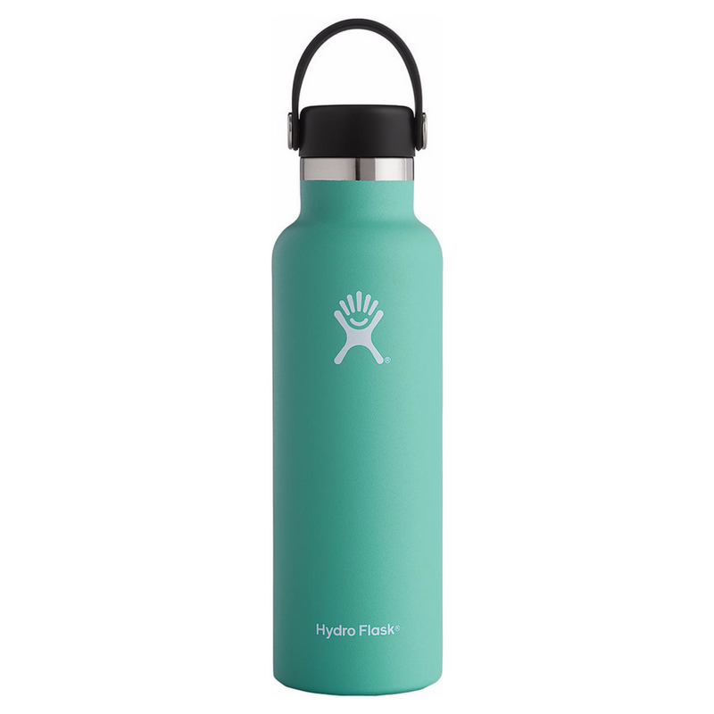
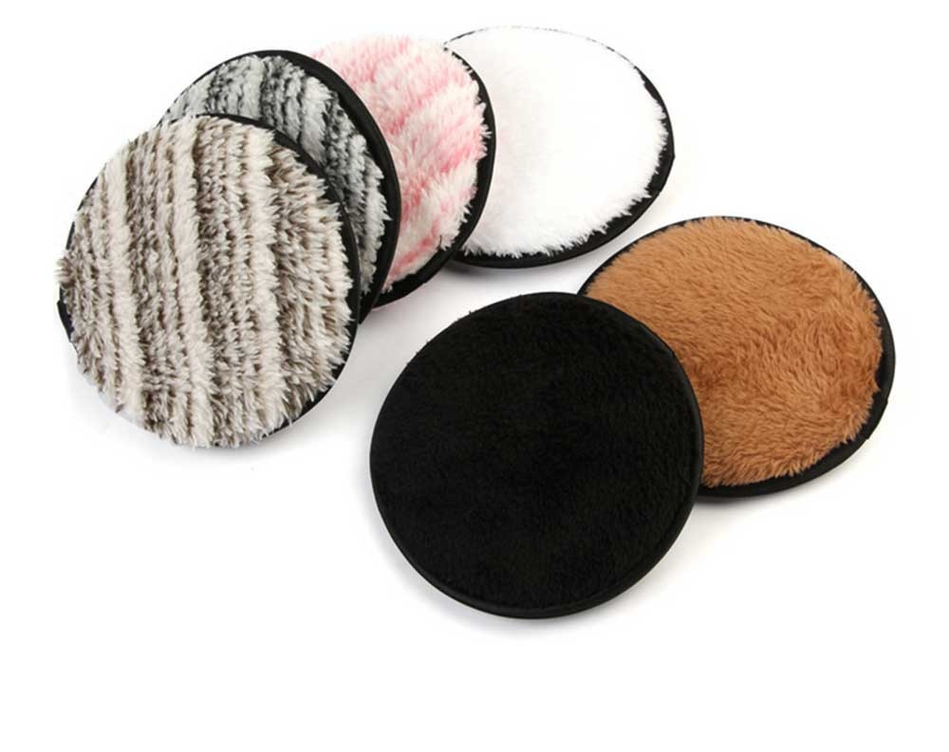
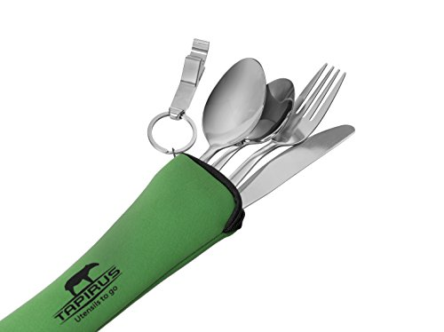
ZERO-WASTE ALTERNATIVES

Slide 7



APPS

Slide 8
Plant-based diet
Meat and dairy consumption contributes for 51% of the world’s greenhouse gas emissions which is more than what all types of transport combined produce.
1 pound of beef takes 2000 gallons of water to produce, which is equal to a 16-hour shower.

Slide 9

Q&A! Ask away!

