Slide 1

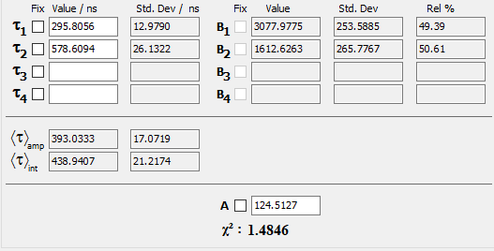
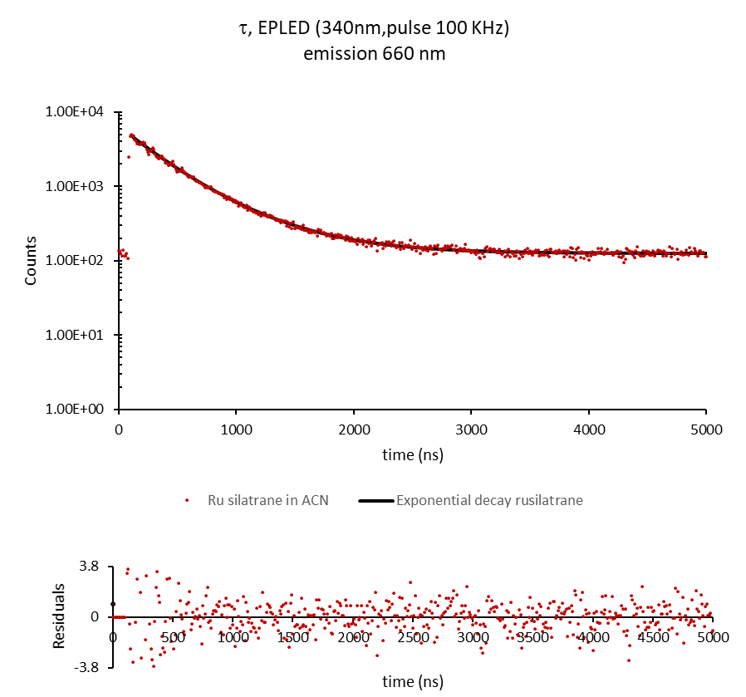
Excitation EPLED-340 nm MCS at 100 KHz,
Emission 660 nm stop condition 5000 counts

