Slide 1
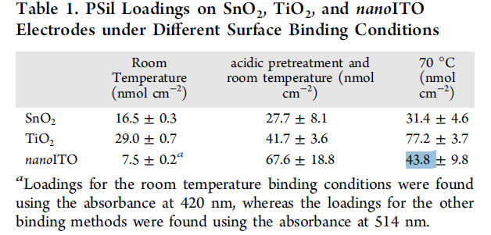
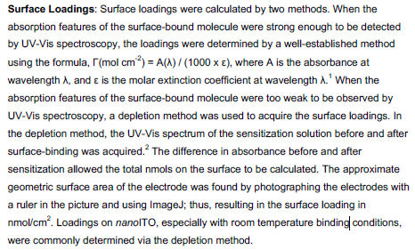
Materna, K. L.; Jiang, J.; Crabtree, R. H.; Brudvig, G. W., Silatrane Anchors for Metal Oxide Surfaces: Optimization for Potential Photocatalytic and Electrocatalytic Applications. ACS Applied Materials & Interfaces 2019, 11 (6), 5602-5609.
1 nmol/cm2 = 6.023E14 molecules/cm2
Coverage (mol/cm2) = A/(ε*1000)

Slide 2
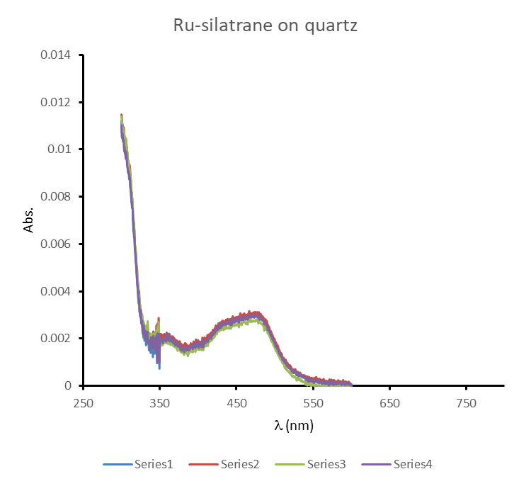
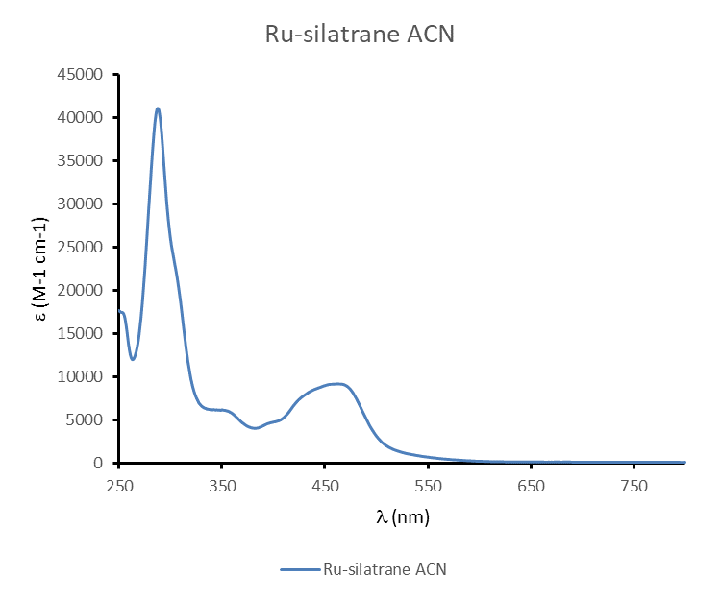
Ru-silatrane on quartz
ε (469 nm)=8801.47 M⁻¹cm⁻¹
A (469 nm)=0.00291299
Coverage = A/(ε*1000) = 3.31E-10 mol/cm2 = 1.99E14 molecules/cm2

Slide 3
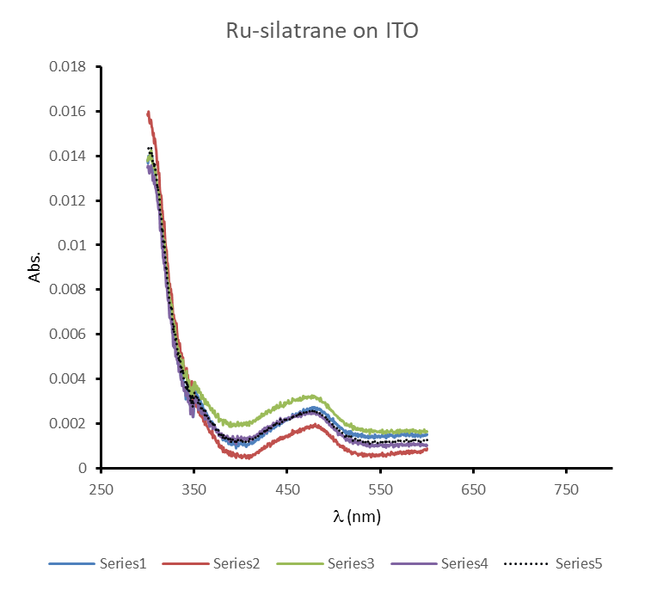
Ru-silatrane on ITO
ε (469 nm)=8801.47 M⁻¹cm⁻¹
A (469 nm)=0.00247252
Coverage = A/(ε*1000) = 2.81E-10 mol/cm2 = 1.69E14 molecules/cm2

Slide 4
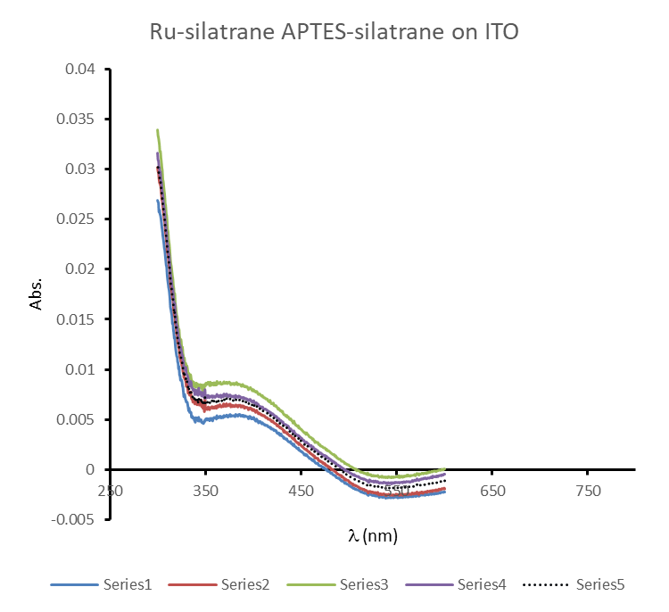
Ru-silatrane/APTES-silatrane (1/1) on ITO
ε (469 nm)=8801.47 M⁻¹cm⁻¹

Slide 5
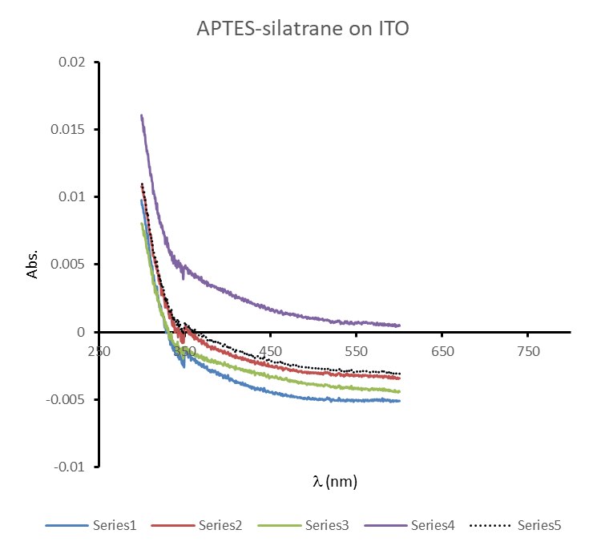
Ru-silatrane/APTES-silatrane (1/1) on ITO
ε (469 nm)=8801.47 M⁻¹cm⁻¹

Slide 6
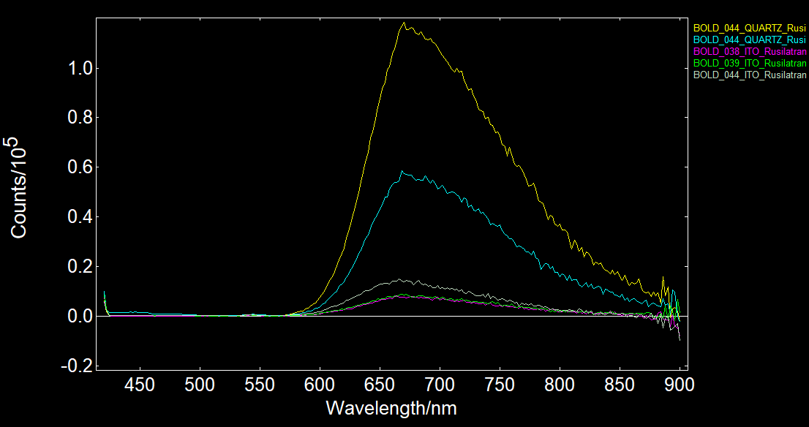
Ru-silatrane on quartz
Ru-silatrane on quartz
Ru-silatrane/PTES silatrane 1/10 on ITO
Ru-silatrane PTESsilatrane 1/1 on ITO
Ru-silatrane on ITO

