Slide 1
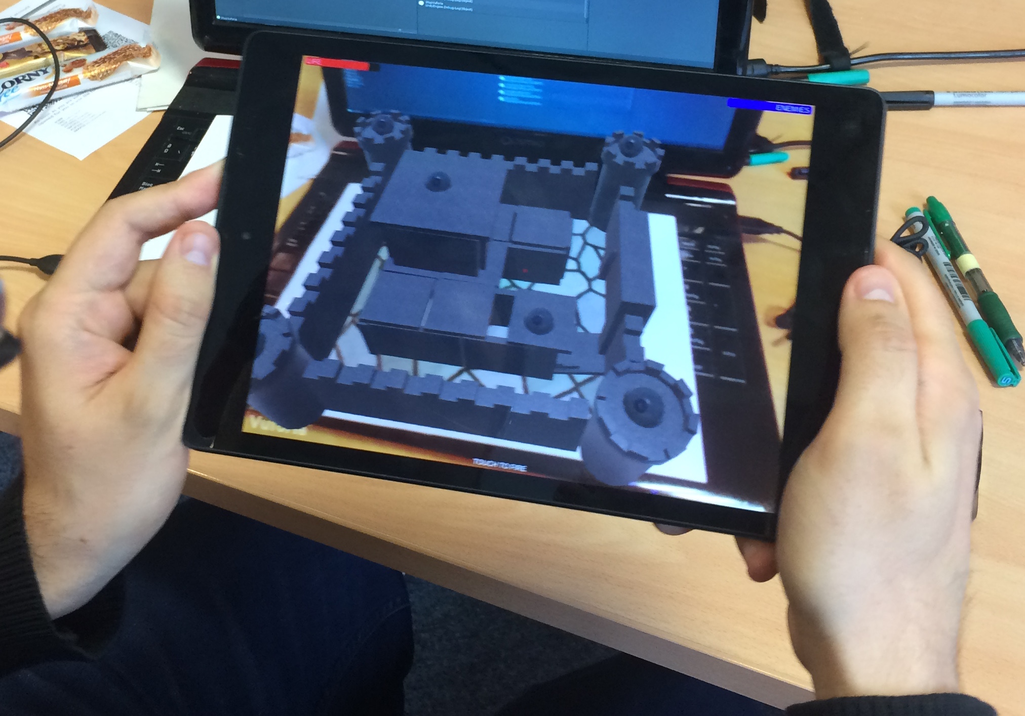
Cyclops
AR hackathon

Slide 2
Team Members
Mikel Salazar: UI/UX and general coding
Jingjing Wang: 3D modelling and “tiny tips providing”
Adam Gavronek: MIA

Slide 3
Basic Idea
A FPS game for current See-through HMDs
There is a castle with some enemies (cannons).
Cannons track your position and shoot at you.
You need to move in order to avoid the bullets.
You must shoot the castle to destroy the enemies.

Slide 4
CHALLENGES
Current See-through HMDs: Limited FOV and input devices
AR Tracking while standing with the marker on the floor
Destructible game scenario (complex physics)

Slide 5
Technologies
Vuforia: “Extended” Tracking of AR Marker
Unity: Physics, UI, Basic AI
Visual Studio: Scripting
3D Studio Max: 3D Modelling

Slide 6
NEXT STEPS
Try the demo with different HMDs
Allow different ways to shoot bullets (e.g., use the microphone to shoot when the user says “piu, piu”)
Add more EXPLOSIONS!!!

Slide 7
Demo

Slide 8
tHANKS!

