Slide 1


Predicting AFL Match winners 2009-2024
Michael Le

Slide 2

Purpose
The goal for this project, is to predict Australian Football League (AFL) matches with machine learning involves using historical data, statistical models, and advanced algorithms to forecast game outcomes. This task is a classic example of a binary classification problem in machine learning, where the objective is to predict discrete results, such as win/loss, victory margins, or specific in-game events (e.g., goals scored, behinds, Bookmakers Surveyed, Team Odds). Additionally, these predictive models have significant applications in sports betting, where betting companies use them to set odds, assess potential risks, and optimize their strategies to maximize profitability while managing uncertainties.

Slide 3
Data Collection
Data Source: http://www.aussportsbetting.com/data/¶
Only showcases match data from Round 12 2009 afterwards.
Note that I have transformed the dataset myself, unfortunately I can not release the transformed dataset.
\

Slide 4
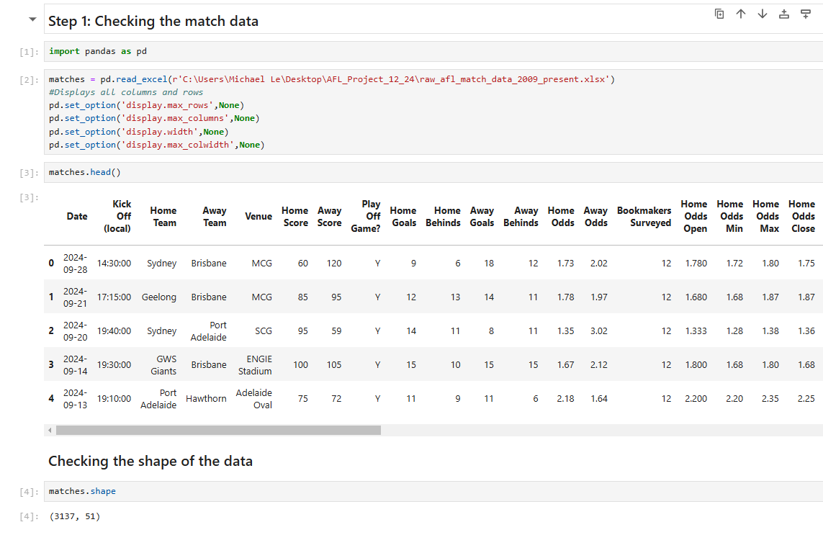
Procedure
The procedure to start the analysis, I have use technologies such as Python one of the programming languages used to performing analysis. This enables me to use library packages, such as pandas, numpy, and scikit-learn to collect the data to perform predictive modelling.

Slide 5
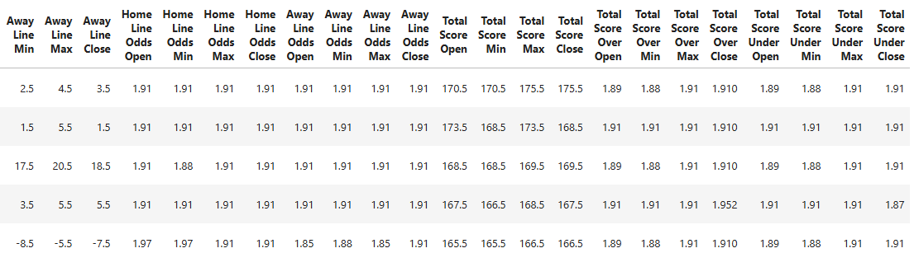
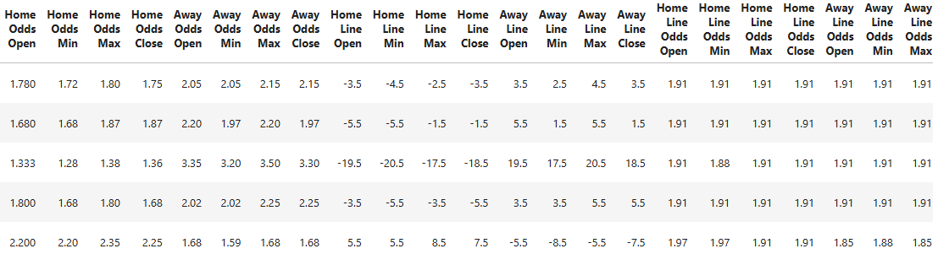
Procedure part 2
In the next step, we need to clean our match data. Removing row entries that contain empty or missing data entry and remove duplicate rows and columns.
To keep track for each distinct match that has occurred. After cleaning the data, we check the first 5 entries in our desired final data-frame with 3137 rows and 51 columns consists of team and betting metrics. To ensure we can provide further exploration, apply feature engineering and predicting modelling to provide accurate match outcomes.

Slide 6
Data Cleaning and transforming
We wanted to clean and transform our data because it ensures the
accuracy and consistency of our match dataset, allowing for reliable analysis and informed
decision making.
Refer from this link on how to clean the data
https://saturncloud.io/blog/how-to-find-all-rows-with-nan-values-in-python-pandas/
https://realpython.com/python-data-cleaning-numpy-pandas/

Slide 7
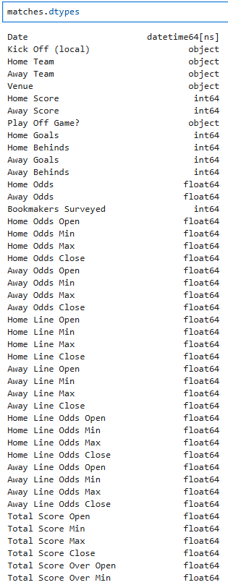
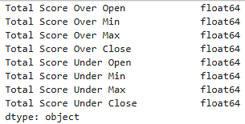
Checking our data types/formats used in the dataset.

Slide 8
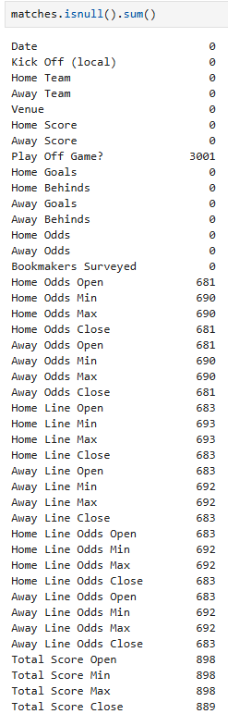
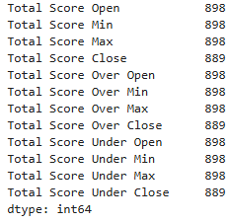
Checking HOW MANY EMPTY OR NAN VALUES IN TOTAL FOR EACH FEATURE used in the dataset.

Slide 9
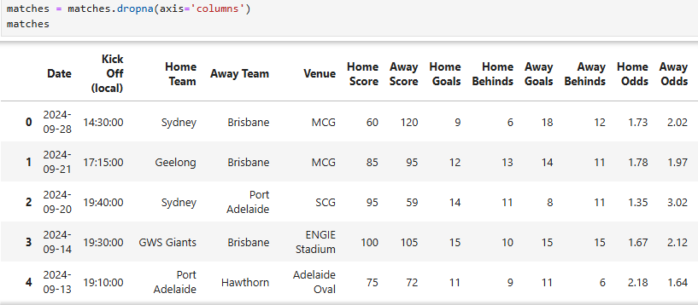

For practise, we drop the columns with missing values for this case, we left with the remaining columns
for the final data-frame.
Date
Kick Off (local)
Home Team
Away Team,
Venue
Home Score
Away Score,
Home Goals
Away Goals
Home Behinds
Away Behinds
Home Odds
Away Odds
Bookmakers Surveyed

Slide 10
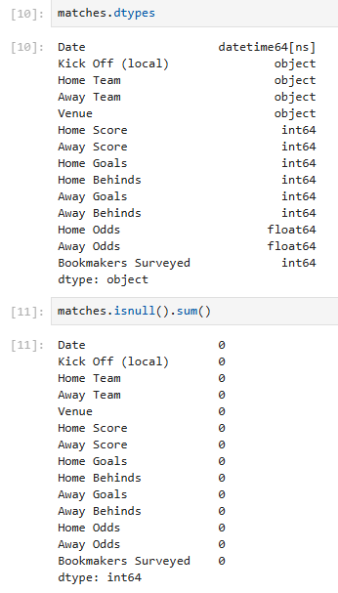
Check any more missing values to further proceed with feature engineering and modelling.

Slide 11
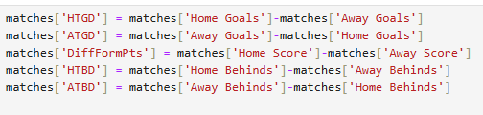
Applying Feature
Engineering
The purpose we needed to apply feature engineering is to
keep any features that are relevant when building our machine learning models. Leading to better model performance. Now were adding seven new columns shown in the code below.

Slide 12
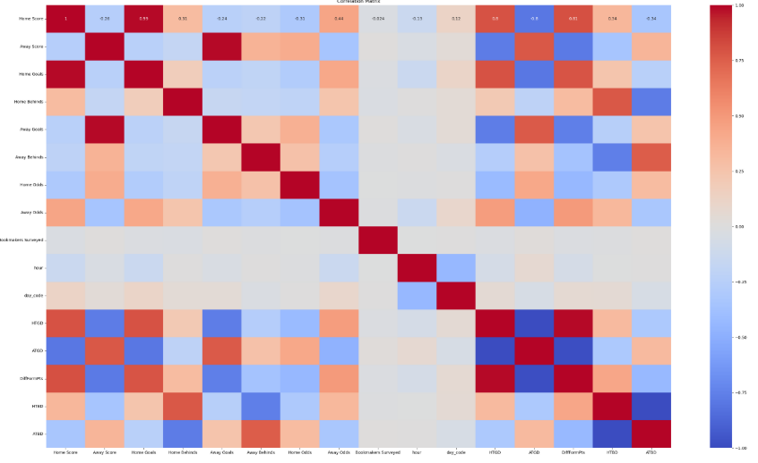
Correlation Matrix

Slide 13
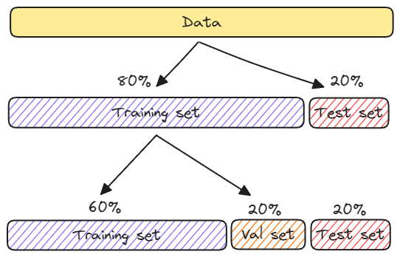
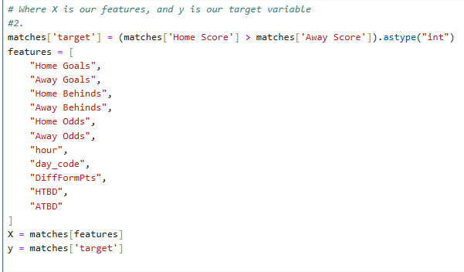
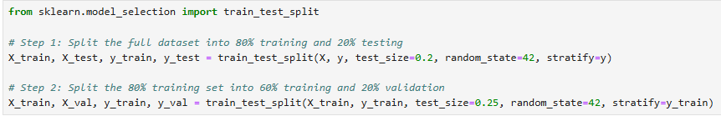
Predictive Modelling
Predictive Modelling is a statistical method that uses historical data to predict future outcomes. In addition, we achieve this by applying the The Train-Test Split is a technique
In Machine Learning where the full dataset. Is split into two subsets: The Training set and
Testing Set is used from the full dataset. Later we split into three subsets for the training, testing and validation from the Training dataset, to ensure that the data doesn’t under or overfit the model.

Slide 14
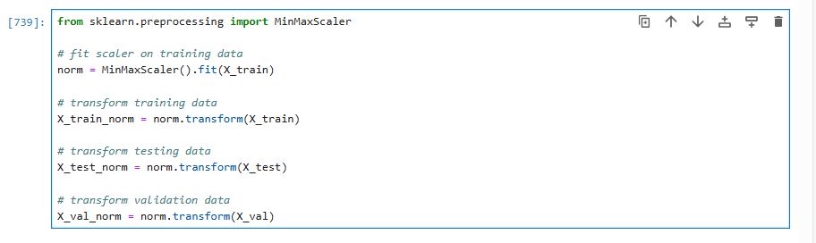
Apply normalization
One reason this is important is because the variables are multiplied by the model weights. So that the scale of the outputs and the scale of the gradients are affected by the scale of the inputs.
Although a model might converge without normalization, normalization makes training much more stable.

Slide 15
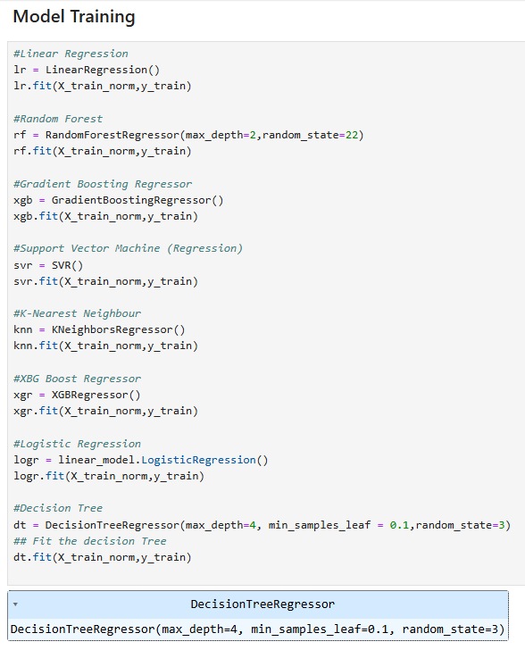
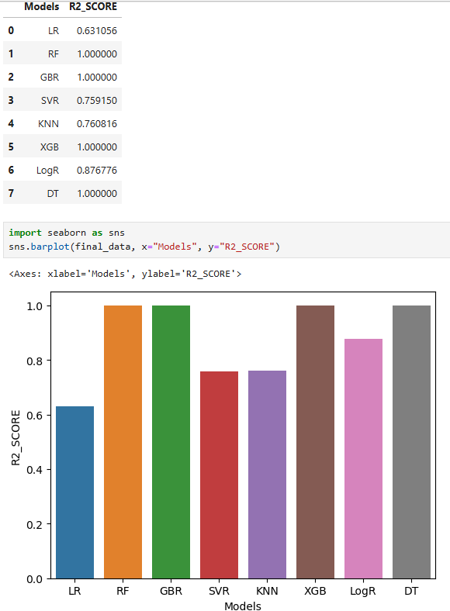
Modelling Phase on the testing data

Slide 16
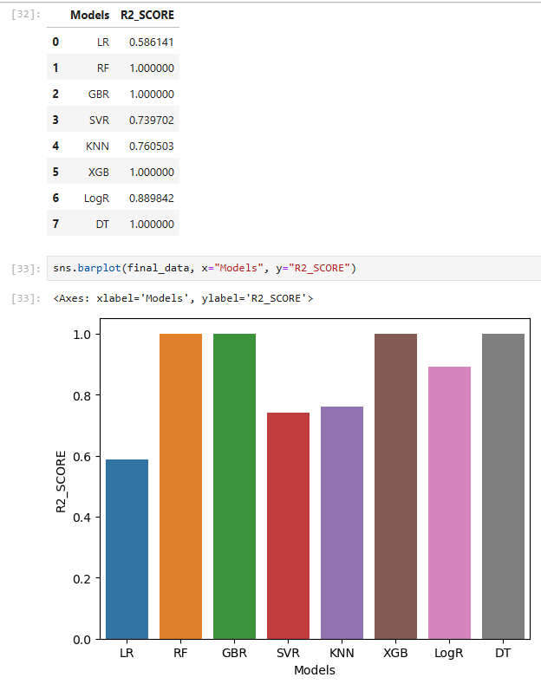
Modelling Phase on the validation data

Slide 17
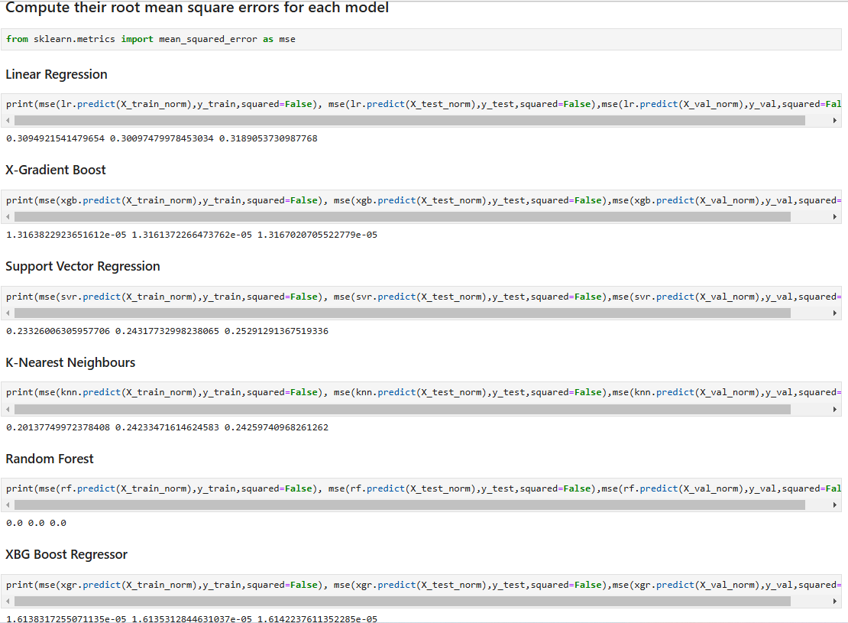
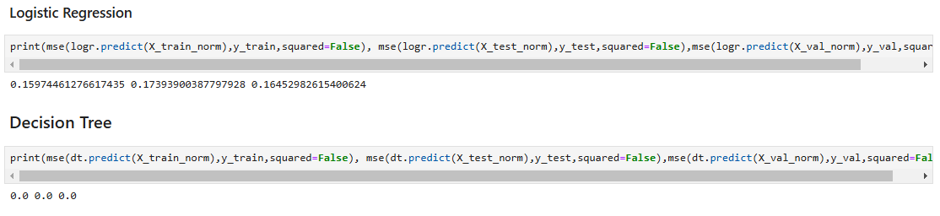
COMPARE THEIR MEAN Square errors
Mean Squared Error (MSE) is a key metric used to evaluate the accuracy of regression models by calculating the average of the squared differences between predicted values and actual target values, essentially measuring how closely a model's predictions align with the true data, with a lower MSE indicating a better fit and more accurate predictions

Slide 18
Conclusion
Model | Description
Linear Regression (LR) | Good for baseline and linear problems
Random Forest (RF) | Great for capturing feature interactions and nonlinearities, robust to overfitting.
Gradient Boosting (GBR, XGB) | Powerful but requires careful tuning.
Support Vector Regressor (SVR) | Good for smaller datasets with non-linear relationships
K-Nearest Neighbors (KNN) | Simple, works well for small datasets
XGBoost (XGB) | Usually outperforms other models on complex datasets.
The main goal of predicting AFL matches is to provide actionable insights for various stakeholders, including coaches, players, analysts, fans, and recruiters. These insights drive performance improvement, strategic planning, and fan engagement, ultimately contributing to the success and enjoyment of Australian Rules Football. Involves historical data of team and betting metrics, and relevant factors to calculate the probability of one team winning a match against another. Leads to better decision making when it comes to Sports Betting to inform their wagering decisions. The best model(s) to use for this case are Random Forest and Decision Tree. Random Forest and Decision Trees are both excellent choices for binary classification problems due to their ability to handle non-linear relationships and complex data structures.
Logistic Regression (LogR)
Struggles with complex, non-linear relationships and performs best when data is linearly separable
Decision Tree
Make overly specific predictions based on limited data, leading to inaccurate results.

Slide 19
Further Info/Links
https://www.geeksforgeeks.org/how-to-solve-overfitting-in-random-forest-in-python-sklearn/
https://www.youtube.com/watch?v=6tQhoUuQrOw&t=1536s
https://www.youtube.com/watch?v=0irmDBWLrco&t=165s
https://pandas.pydata.org/docs/reference/api/pandas.DataFrame.dropna.html
Demonstrates how to evuluate your Machine Learning models
https://www.youtube.com/watch?v=LbX4X71-TFI
More Info my source code:
Projects/Kaggle/AFL_2009_2024_Match_Winners at main · Mikele02171/Projects

