Slide 1

Predicting Property Values and EDA in Melbourne
Michael Le

Slide 2

Purpose
The Goal of this project is to employ various Machine Learning techniques including Supervised, Unsupervised Learning (if needed). Including exploration to predict house prices in Melbourne, leveraging a dataset spanning the years from 2016-2017. Including data exploration and visualizations to determine property ranges based on location and examine which features to use before predictive modelling.

Slide 3

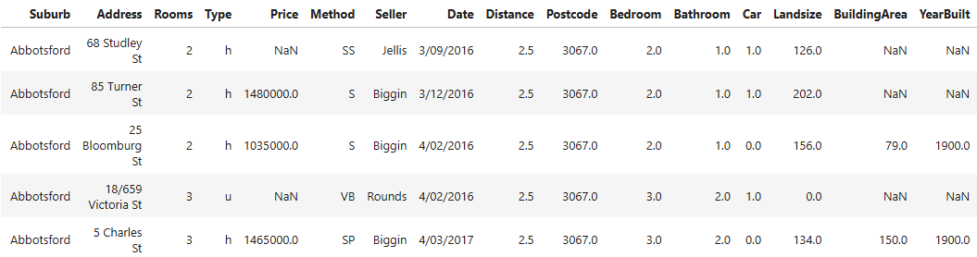
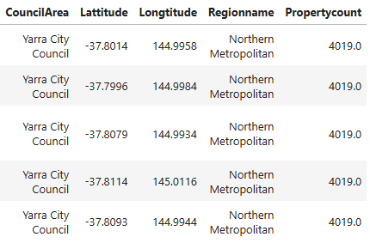
Checking the dataset
The dataset contains 34857 Properties with 21 columns in Melbourne that occurred during the 2016-2017 period. In this figure showcases the first 5 rows of the data.

Slide 4
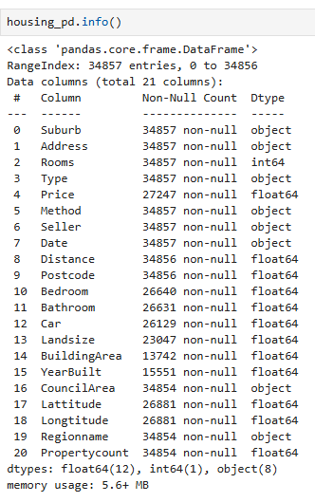
Information
Here demonstrates the rest of the additional information that contains Melbourne housing dataset including data-types and non-null values respectively for each of the features.

Slide 5
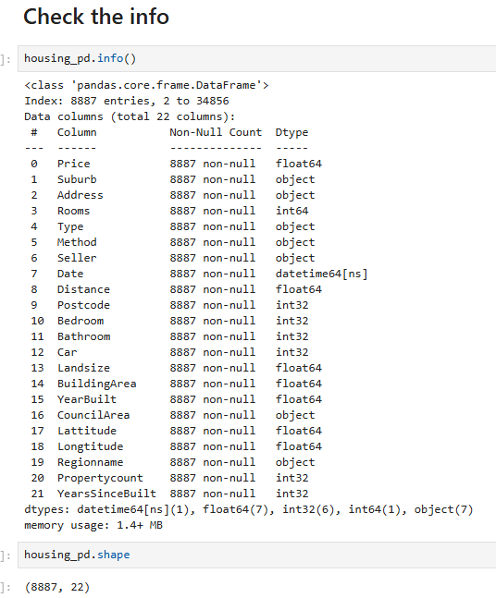
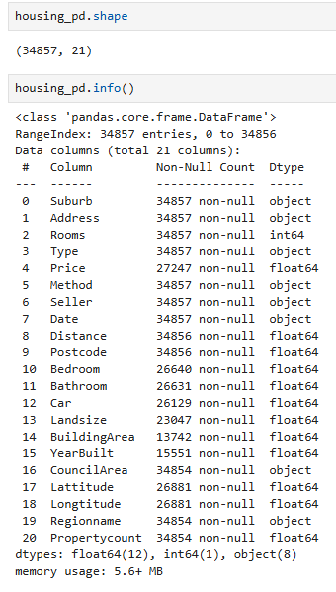
Data Cleaning
In this step, there were significant number of missing values from Price, Number of Bedrooms, Bathrooms, Cars, Land size, Building Area, Year that was built, Council Area, Latitude, Longitude, Region Name and Property Count. Our First approach was too, clear all rows that contains empty values or entities that contain NaN values. Changing some of the features to their appropriate datatypes. Thus, remaining with 8887 properties and 21 columns for the final dataset. In addition, changing Date datatype to date using pd.to_datetime() to convert to Data datatype and adding a new column from the number of years since the property was first built up to 2017.
Before transformation and cleaning
After transformation and cleaning

Slide 6

Data Exploration Analysis

Slide 7
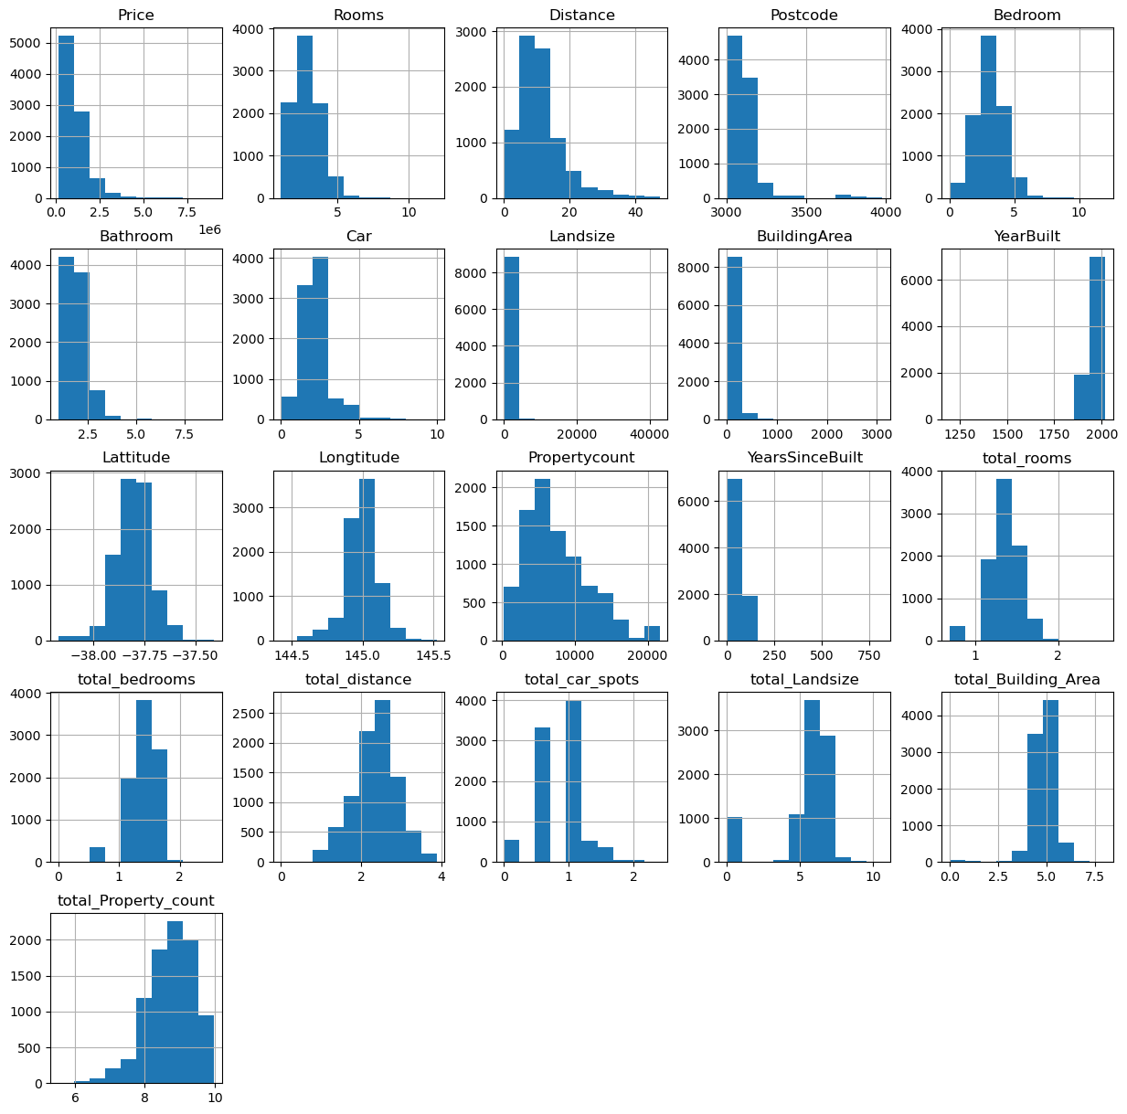
Histogram on the Distribution on Property Features including Prices

Slide 8
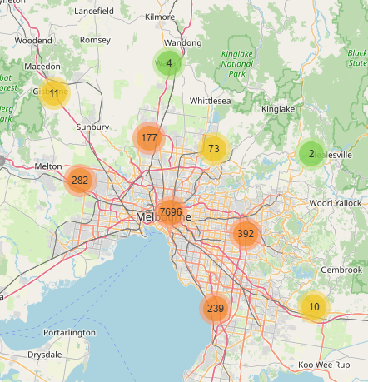
Applying Folium on Melbourne properties after cleaning and transforming raw housing data, each data-point contains valuable information including house prices. Run my code to interact with the map.

Slide 9

Melbourne Housing Market 2016-2017 Dashboards in Tableau
Link to Tableau for the interactive dashboard:
Tableau Melbourne Property 2016-2017 Design | Tableau Public

Slide 10
Feature Engineering (Correlation matrix)
 | Price | Rooms | Distance | Postcode | Bedroom | Bathroom | Car | Landsize | BuildingArea | YearBuilt | Lattitude | Longtitude | Propertycount | YearsSinceBuilt | total_rooms | total_bedrooms | total_distance | total_car_spots | total_Landsize | total_Building_Area | total_Property_count
Price | 1 | 0.475074 | -0.231212 | 0.046033 | 0.46088 | 0.463501 | 0.209464 | 0.058375 | 0.507284 | -0.313664 | -0.224255 | 0.212174 | -0.05972 | 0.313664 | 0.464807 | 0.449965 | -0.200705 | 0.192315 | 0.281927 | 0.42076 | -0.005423
Rooms | 0.475074 | 1 | 0.276585 | 0.084236 | 0.964465 | 0.62407 | 0.401423 | 0.101158 | 0.606738 | 0.006935 | 0.018758 | 0.083016 | -0.082797 | -0.006935 | 0.98244 | 0.945133 | 0.326683 | 0.409017 | 0.48954 | 0.556616 | -0.072524
Distance | -0.231212 | 0.276585 | 1 | 0.489537 | 0.28346 | 0.122132 | 0.259374 | 0.138559 | 0.135509 | 0.313383 | -0.055317 | 0.163941 | -0.003247 | -0.313383 | 0.295042 | 0.300166 | 0.927503 | 0.281084 | 0.327775 | 0.15375 | -0.032835
Postcode | 0.046033 | 0.084236 | 0.489537 | 1 | 0.087286 | 0.111617 | 0.055531 | 0.069623 | 0.077091 | 0.089913 | -0.195081 | 0.358005 | 0.032758 | -0.089913 | 0.080216 | 0.082588 | 0.349899 | 0.065178 | 0.051185 | 0.062727 | 0.053741
Bedroom | 0.46088 | 0.964465 | 0.28346 | 0.087286 | 1 | 0.626493 | 0.40557 | 0.101035 | 0.595299 | 0.01631 | 0.022745 | 0.082671 | -0.081392 | -0.01631 | 0.948771 | 0.980629 | 0.331715 | 0.411033 | 0.483408 | 0.543966 | -0.07153
Bathroom | 0.463501 | 0.62407 | 0.122132 | 0.111617 | 0.626493 | 1 | 0.310962 | 0.075939 | 0.553855 | 0.192914 | -0.041859 | 0.109268 | -0.058324 | -0.192914 | 0.591149 | 0.587451 | 0.142671 | 0.330712 | 0.240078 | 0.466096 | -0.037931
Car | 0.209464 | 0.401423 | 0.259374 | 0.055531 | 0.40557 | 0.310962 | 1 | 0.123498 | 0.317593 | 0.139255 | 0.015139 | 0.035589 | -0.031285 | -0.139255 | 0.402165 | 0.403471 | 0.308381 | 0.949871 | 0.294155 | 0.291533 | -0.034189
Landsize | 0.058375 | 0.101158 | 0.138559 | 0.069623 | 0.101035 | 0.075939 | 0.123498 | 1 | 0.083229 | 0.037753 | 0.042484 | -0.008196 | -0.032548 | -0.037753 | 0.095202 | 0.094479 | 0.101086 | 0.104635 | 0.334163 | 0.071773 | -0.061157
BuildingArea | 0.507284 | 0.606738 | 0.135509 | 0.077091 | 0.595299 | 0.553855 | 0.317593 | 0.083229 | 1 | 0.059936 | -0.034626 | 0.097635 | -0.059024 | -0.059936 | 0.587438 | 0.575446 | 0.177228 | 0.322833 | 0.331675 | 0.755142 | -0.041191
YearBuilt | -0.313664 | 0.006935 | 0.313383 | 0.089913 | 0.01631 | 0.192914 | 0.139255 | 0.037753 | 0.059936 | 1 | 0.10003 | -0.026886 | 0.017224 | -1 | -0.004237 | 0.004487 | 0.329722 | 0.209568 | -0.096747 | 0.015163 | -0.006204

Slide 11
Lattitude | -0.224255 | 0.018758 | -0.055317 | -0.195081 | 0.022745 | -0.041859 | 0.015139 | 0.042484 | -0.034626 | 0.10003 | 1 | -0.345797 | 0.029793 | -0.10003 | 0.027839 | 0.031631 | -0.011537 | 0.012077 | 0.067813 | -0.025837 | -0.028222
Longtitude | 0.212174 | 0.083016 | 0.163941 | 0.358005 | 0.082671 | 0.109268 | 0.035589 | -0.008196 | 0.097635 | -0.026886 | -0.345797 | 1 | 0.026359 | 0.026886 | 0.073559 | 0.072274 | 0.156707 | 0.055511 | 0.05591 | 0.067294 | 0.057566
Propertycount | -0.05972 | -0.082797 | -0.003247 | 0.032758 | -0.081392 | -0.058324 | -0.031285 | -0.032548 | -0.059024 | 0.017224 | 0.029793 | 0.026359 | 1 | -0.017224 | -0.088756 | -0.08722 | -0.044427 | -0.032128 | -0.078907 | -0.069363 | 0.916523
YearsSinceBuilt | 0.313664 | -0.006935 | -0.313383 | -0.089913 | -0.01631 | -0.192914 | -0.139255 | -0.037753 | -0.059936 | -1 | -0.10003 | 0.026886 | -0.017224 | 1 | 0.004237 | -0.004487 | -0.329722 | -0.209568 | 0.096747 | -0.015163 | 0.006204
total_rooms | 0.464807 | 0.98244 | 0.295042 | 0.080216 | 0.948771 | 0.591149 | 0.402165 | 0.095202 | 0.587438 | -0.004237 | 0.027839 | 0.073559 | -0.088756 | 0.004237 | 1 | 0.962704 | 0.348171 | 0.412371 | 0.524525 | 0.563576 | -0.080449
total_bedrooms | 0.449965 | 0.945133 | 0.300166 | 0.082588 | 0.980629 | 0.587451 | 0.403471 | 0.094479 | 0.575446 | 0.004487 | 0.031631 | 0.072274 | -0.08722 | -0.004487 | 0.962704 | 1 | 0.351293 | 0.412006 | 0.515978 | 0.549234 | -0.079607
total_distance | -0.200705 | 0.326683 | 0.927503 | 0.349899 | 0.331715 | 0.142671 | 0.308381 | 0.101086 | 0.177228 | 0.329722 | -0.011537 | 0.156707 | -0.044427 | -0.329722 | 0.348171 | 0.351293 | 1 | 0.344244 | 0.383323 | 0.190185 | -0.068771
total_car_spots | 0.192315 | 0.409017 | 0.281084 | 0.065178 | 0.411033 | 0.330712 | 0.949871 | 0.104635 | 0.322833 | 0.209568 | 0.012077 | 0.055511 | -0.032128 | -0.209568 | 0.412371 | 0.412006 | 0.344244 | 1 | 0.286129 | 0.296832 | -0.031207
total_Landsize | 0.281927 | 0.48954 | 0.327775 | 0.051185 | 0.483408 | 0.240078 | 0.294155 | 0.334163 | 0.331675 | -0.096747 | 0.067813 | 0.05591 | -0.078907 | 0.096747 | 0.524525 | 0.515978 | 0.383323 | 0.286129 | 1 | 0.351238 | -0.089516
total_Building_Area | 0.42076 | 0.556616 | 0.15375 | 0.062727 | 0.543966 | 0.466096 | 0.291533 | 0.071773 | 0.755142 | 0.015163 | -0.025837 | 0.067294 | -0.069363 | -0.015163 | 0.563576 | 0.549234 | 0.190185 | 0.296832 | 0.351238 | 1 | -0.054072
total_Property_count | -0.005423 | -0.072524 | -0.032835 | 0.053741 | -0.07153 | -0.037931 | -0.034189 | -0.061157 | -0.041191 | -0.006204 | -0.028222 | 0.057566 | 0.916523 | 0.006204 | -0.080449 | -0.079607 | -0.068771 | -0.031207 | -0.089516 | -0.054072 | 1

Slide 12
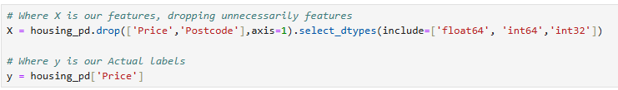
Feature Engineering is a machine learning technique is to determine which variables or features we needed to remove to improve our efficiency and accuracy of our machine learning models. In this case we try to remove PostCode, YearBulit and Date to avoid wanted bias that can impact our machine learning regression models.

Slide 13
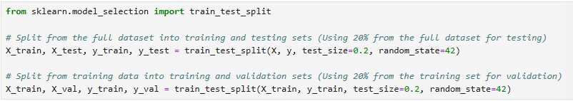
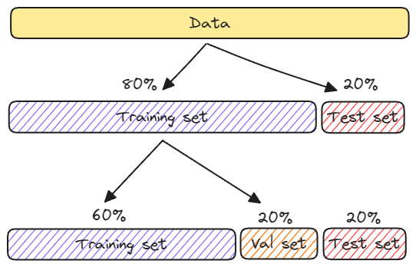
Machine Learning training and evaluation
The Train-Test Split is a technique
In Machine Learning where the full dataset
Is split into two subsets: The Training set and
Testing Set is used from the full dataset.
Later we split into three subsets for the training,
testing and validation from the Training dataset,
to ensure that the data doesn’t under or overfit the model.

Slide 14
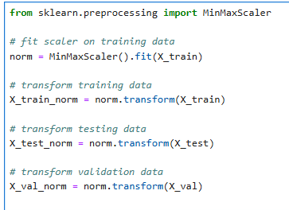
Apply normalization
One reason this is important is because the variables are multiplied by the model weights. So that the scale of the outputs and the scale of the gradients are affected by the scale of the inputs.
Although a model might converge without normalization, normalization makes training much more stable.

Slide 15
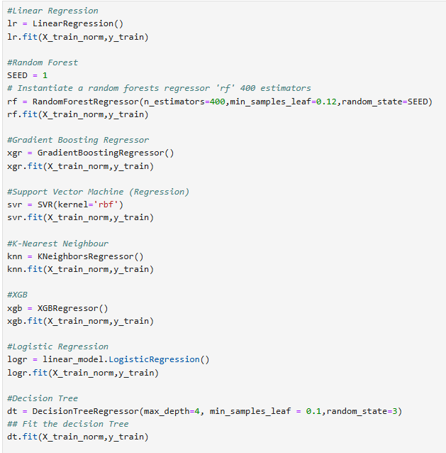

Applying different ML Models

Slide 16
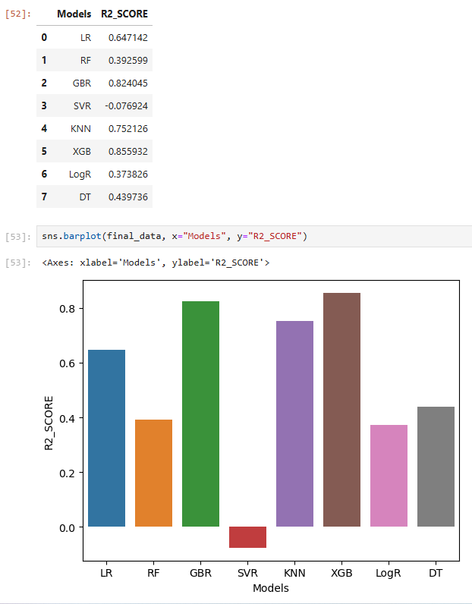
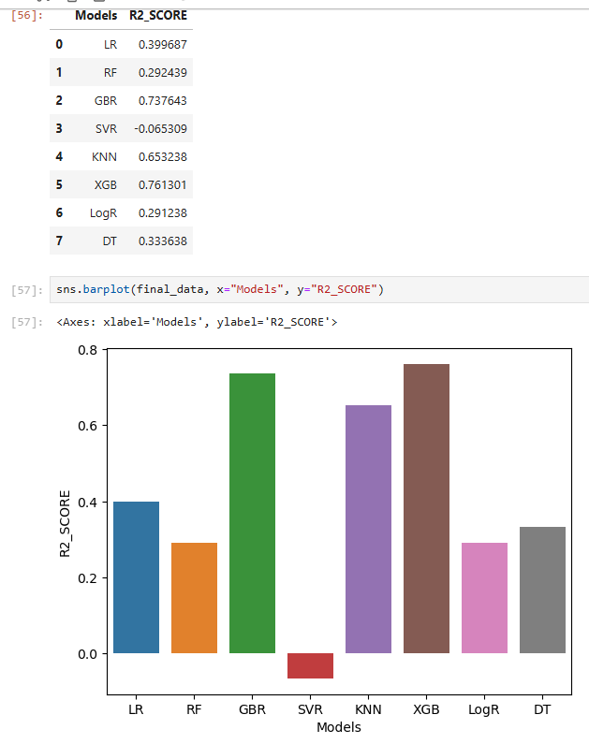
R squared Testing Data
R squared Validation Data

Slide 17
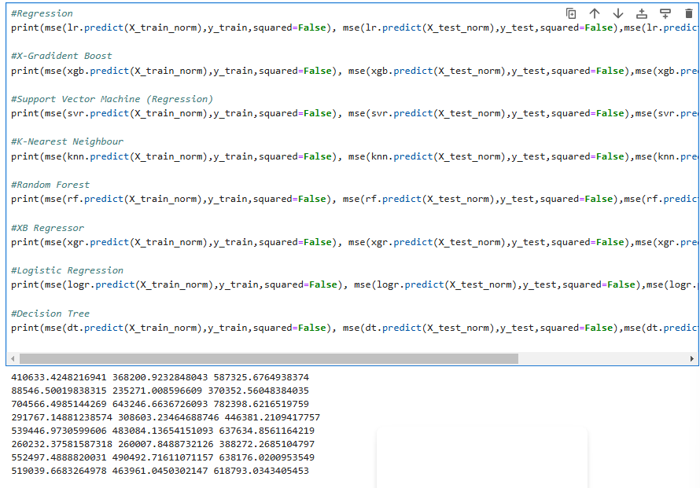
Root Mean Square Error

Slide 18

Conclusion
The best model to fit for this problem is X-Gradient Regressor since it can handle complex data and non-linear relationships to predict property prices in Melbourne.

Slide 19
Source Code + Additional Learning Material
pandas.DataFrame.copy — pandas 2.2.3 documentation
1.13. Feature selection — scikit-learn 1.6.1 documentation
SVR — scikit-learn 1.6.1 documentation
https://www.youtube.com/watch?v=Wqmtf9SA_kk&t=676s####
https://www.youtube.com/watch?v=_-UCcuB8nbw
https://learn.arcgis.com/en/projects/build-house-valuation-models-with-machine-learning/
6.3. Preprocessing data — scikit-learn 1.6.1 documentation
https://learn.arcgis.com/en/projects/build-house-valuation-models-with-machine-learning/
https://stackoverflow.com/questions/29432629/plot-correlation-matrix-using-pandas
Folium — Folium 0.19.5 documentation
seaborn.heatmap — seaborn 0.13.2 documentation
Table Visualization — pandas 2.2.3 documentation

