Slide 1
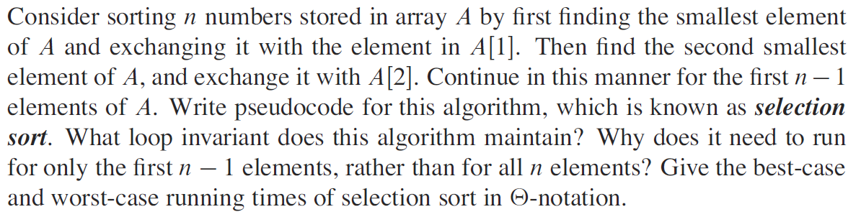

Homework on chap2
Exercise 2.2-2
2. Design an algorithm to compute Fibonacci numbers in pseudo code. Give an analysis for the time complexity of your algorithm.
3. Exercise 2.3-7
Notes:
nput: integer n
Output: number of line 5 that is executed
count=0
for i=1 to n
m=[n/i]
for j=1 to m
count=count+1`
end for
end for
return count

Slide 2
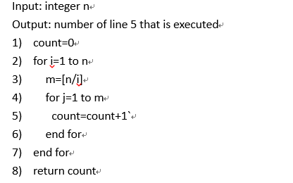
Homework
Answer the following problem and justify your answer.
第5行执行的次数： [n/1]+[n/2]+...+[n/n]
[n]表示向下取整

Slide 3
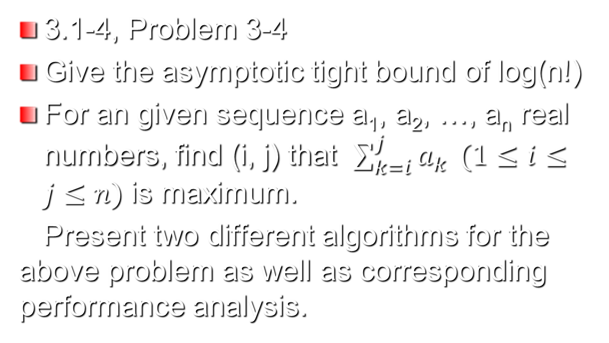
Homework on chap 3

