Slide 1
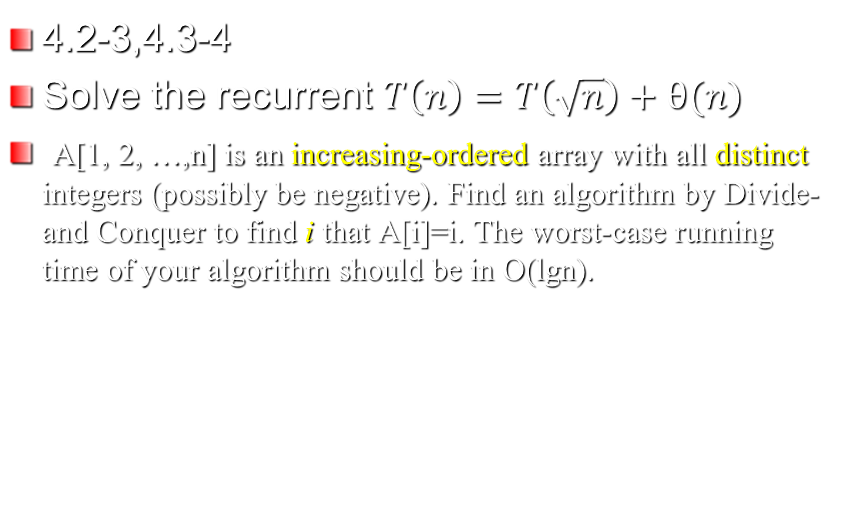
Homework on Chap4

Slide 2
Homework of Chapter 5
5.2-4, 5.3-4
Problem 5-1

