Slide 1
Chapter 3. Growth of Functions

Slide 2
Outline
Study the asymptotic efficiency of algorithms
Give several standard methods for simplifying the asymptotic analysis of algorithms
Present several notational conventions used throughout this book
Review the behavior of functions that commonly arise in the analysis of algorithms

Slide 3
Asymptotic Notation(1)
Asymptotic efficiency of algorithms: We are concern with how the running time of an algorithm increases with the size of the input in the limit, as the size of the input increases without bound
The notation we use to describe the asymptotic running time of an algorithm are defined in terms of function whose domain are the set of natural numbers N={0,1,2,…}-→T(n)
It is important to understand the precise meaning of the notation so that when it is sometimes abused, it is not misused.

Slide 4
Asymptotic Notation
Θ-notation
Θ (g(n)) = {f (n) : there exist positive constants c₁ , c₂ and n₀
such that 0 ≤ c₁ g(n) ≤ f(n) ≤ c₂ g(n) for all n ≥ n₀ }
For a given function g(n), Θ (g(n)) is set of functions.
sufficiently large n
Abuse
In stead of writing “f(n)∈Θ (g(n))”, we write f(n) = Θ (g(n))” to indicate that f(n) is a member of Θ (g(n))
Asymptoticlly tight bound
Figure 3.1(a) gives an intuitive picture of f(n) = Θ (g(n)). For all n ≥ n₀ the function f(n) is equal to g(n) within a constant factor. We say g(n) is an asymptotic tight bound for f(n)

Slide 5
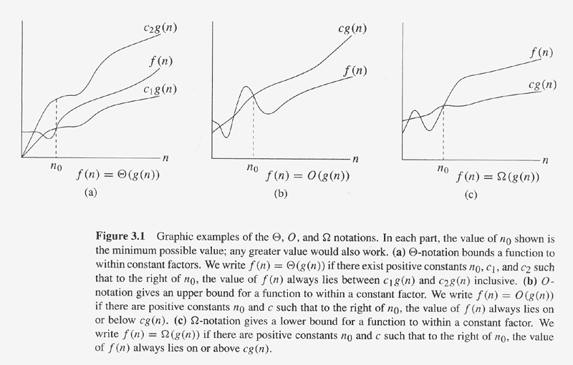

Slide 6
Θ-notation
We introduced an informal notion of Θ-notation: throwing away low-order terms and ignoring coefficient of the highest-order term. We justify this intuition:
1/2n²-3n= Θ(n² )
To do so, we must determine positive constants c₁,c₂ and n₀ such that:

Slide 7
Continue
Intuitively, the lower-order terms of an asymptotically positive function can be ignored in determining asymptotically tight bound because they are insignificant for large n.
The coefficient of the highest-order term can likewise be ignored, since it only changes c₁ and c₂ by a constant factor equal to the coefficient.

Slide 8
Asymptotic Notation(2)
The Θ -notation asymptotically bounds a function from above and below
When we have only an asymptotic upper bound, we use O-notation.
We use O-notation to give an upper bound on a function to within a constant factor. (Fig.3.1(b))
f(n)=O(g(n) also indicate f(n) is a member of set O(g(n) and

Slide 10
O-Notation(1)
O(g(n)) = {f (n) : there exist positive constants c and n₀
such that 0 ≤ f (n) ≤ c g(n) for all n ≥ n₀} .
g(n) is an asymptotic upper bound for f(n).
Example:
2n² = O(n³), with c=1 and n₀ =2.
also, 2n² = O(n²), with c=2 and n₀ =0.
Examples of functions in O(n²):
n², n² + n, n² + 1000n, 1000n² + 1000n
Also,
n, n/1000, n^{1.9999} , n²/ lg lg lg n

Slide 11
O-Notation(2)
In literature, O-notation is sometimes used informally to describe asymptotically tight bounds, however, distinguishing asymptotic upper bound from asymptotically tight bound has now become standards in literature.
Since O-notation describes an upper bound, when we use it to bound the worst-case running time of an algorithm, we have a bound on the running time of the algorithms on every input, but Θ -notation cannot guarantee this, n=O(n²).
When we say “the running time is O(n²), we mean that there is a function f(n) that is O(n²) such that for any value of n, no matter what particular input of size n is chosen, the running time on that input is bounded from above by the value f(n)

Slide 12
Asymptotic Notation(3)
Just as O-notation provides an asymptotic upper bound on a function, Ω -notation provides an asymptotic lower bound.
The intuition behind Ω-notation is shown in Fig.3.1(c) When we have only an asymptotic lower bound, we use Ω -notation.

Slide 13
Ω-notation(1)
Ω (g(n)) = {f (n) : there exist positive constants c and n₀
such that 0 ≤ c g(n) ≤ f(n) for all n ≥ n₀} .
g(n) is an asymptotic lower bound for f(n).
Example:
√n = Ω(lg n), with c=1 and n₀ =16.
Examples of functions in Ω(n²):
n², n² + n, n² - n, 1000n² + 1000n,
1000n² - 1000n,
Also,
n³, n ^{2.0000} , n² lg lg lg n,

Slide 15
Ω-notation(2)
Since Ω-notation describe a lower bound, when we use it to bound the best –case running time of an algorithm, by implication we also bound the running time of the algorithm on arbitrary input as well. (e.g. insertion sort: Ω(n))
For insertion sort, its running time falls between Ω(n) and O(n²), moreover, these bound are asymptotically as tight as possible.
When we say that the running time of an algorithm is Ω(g(n)), we mean that no matter what particular input of size n is chosen for each value of n, the running time on that input is at least a constant times g(n), for sufficiently large n

Slide 16
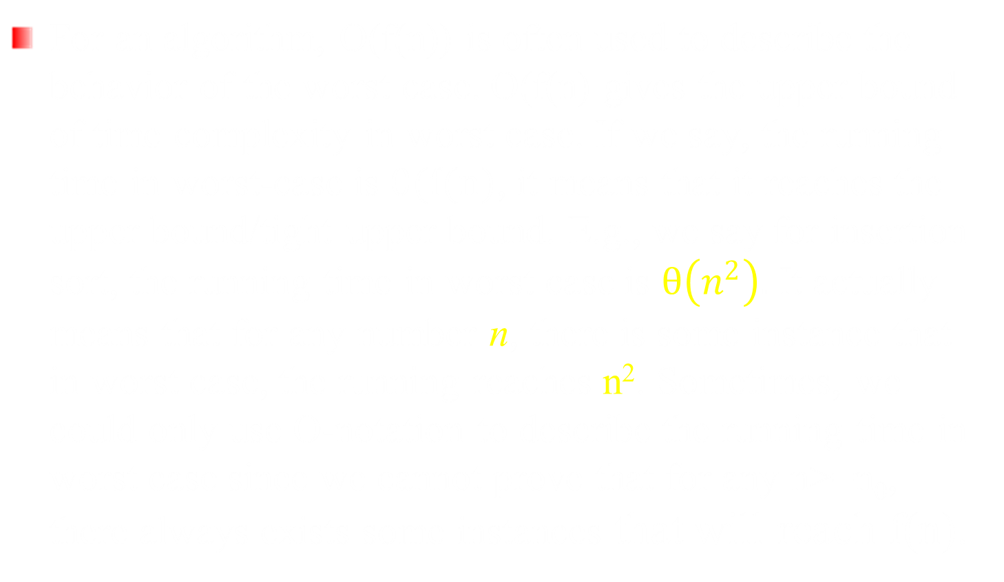
Worst-case Running Time: O vs. Θ

Slide 17
Asymptotic notation in Equations and inequalities
No matter how the anonymous functions are chosen on the left of the equal sign, there is a way to choose the anonymous functions on the right of the equal sign to make the equation valid.

Slide 18
Asymptotic Notation(4)
O-notation may or may not be asymptotically tight
We use o-notation to denote an upper bound that is not asymptotically tight
o(g(n)) = {f (n) : for all constants c > 0, there exist a constant n₀> 0 such that 0 ≤ f(n) < cg(n) for all n ≥ n0}
Example: 2n=o(n²), but 2n²≠o(n²)
1.9999n = o(n²) , n² / lg n = ο(n²),
n² ≠ ο(n²), n²/1000 ≠ ο(n²)

Slide 19
o-notation
Intuitively, in the o-notation, the function f(n) becomes insignificant relative to g(n) as n approaches infinity, like

Slide 20
Asymptotic Notation(5)
We use ω-notation to denote a lower bound that is not asymptotically tight.
By analogy, ω-notation is to Ω-notation as o-notation to O-notation
Definition
ω(g(n)) = {f (n) : for all constants c > 0, there exist a constant n₀ > 0 such that 0 ≤ cg(n) < f(n) for all n ≥ n0}

Slide 21
Growth of functions
A way to describe behavior of functions in the limit -- asymptotic efficiency
Growth of functions
Focus on what’s important by abstracting away low-order terms and constant factors.
How to indicate running times of algorithms?
A way to compare “sizes” of functions:
O ≈ ≤ Ω ≈ ≥
Θ ≈ =
o ≈ < ω ≈ >

Slide 22
Comparisons of Functions
Related Properties:
Transitivity:
f (n) = Θ(g(n)) and g(n) = Θ(h(n))⇒ f (n) = Θ(h(n)).
Same for O, Ω, o, and ω.
Reflexivity:
f (n) = Θ( f (n)).
Same for O and Ω.
Symmetry:
f (n) = Θ(g(n)) if and only if g(n) = Θ( f (n)).
Transpose symmetry:
f (n) = O(g(n)) if and only if g(n) = Ω( f (n)).
f (n) = ω(g(n)) if and only if g(n) = ω( f (n)).
Comparisons:
f (n) is asymptotically smaller than g(n) if f (n) = o(g(n)).
f (n) is asymptotically larger than g(n) if f (n) = ω(g(n)).

Slide 23
Standard notations and common functions (1)
Monotonicity:
f (n) is monotonically increasing if m ≤ n ⇒ f (m) ≤ f (n).
f (n) is monotonically decreasing if m ≤ n ⇒ f (m) ≥ f (n).
f (n) is strictly increasing if m < n ⇒ f (m) < f (n).
f (n) is strictly decreasing if m < n ⇒ f (m) > f (n).
Floor and Ceilings: x – 1 < ⎣ x ⎦ ≤ x ≤ ⎡ x ⎤ < x+1
Modular arithmetic: a mod n = a - ⎣a/n⎦ n
Polynomials:
Exponentials:

Slide 24
Standard notations and common functions (2)
Any exponential function with a base strictly greater than 1 grows faster than any polynomial function
Logarithms
Any positive polynomial function grows faster than any poly-logarithmic function

Slide 25
Standard notations and common functions (3)
Factorial (n!)
Function iteration
The iterated algorithm is a very slowly growing function
Fibonacci numbers

Slide 26
Running time (1)
Linear time: O(n)
One-pass to all numbers
Constant time to process each number
E.g. compute the maximum, merge two sorted array
O(nlogn) time
Divide-and-Conquer
merge: O(n)
Quardratic: O(n²)
Nested loop
search for all pairs of numbers of input n

Slide 27
Running time (2)
Cubic time
3-level nested loop
For a series of n Set Si, find whether some pair of these sets is disjoint
O(n^{k}) time
Finding independent set in a graph (no two nodes are connected by an edge)
Given k, whether the graph G has an independent set of size k. O(k²n^{k})
Beyond polynomial time O(2^{n}) and n!
Find an independent set of maximum size
Search for all subset of a set of n
Match up n items with n other items

