Slide 1
Chapter 4. Divide-and-Conquer

Slide 2
Outline
Offers algorithms for Maximum-subarray problem and Matrix multiplication with Divide-and-conquer paradigm
In the substitution method to solve a recurrence, we guess a bound and then use mathematical induction to prove our guess correct
The recursion-tree method converts the recurrence into a tree whose nodes represent the costs incurred at various levels
The master method provides bounds for the recurrence of the form

Slide 3
Divide-and-Conquer Paradigm
Divide and Conquer
Divide the problem into a number of subproblems.
Conquer the subproblems by solving them recursively.
Base case:
If the subproblems are small enough,
just solve them.
Combine the subproblem solutions to give
a solution to the original problem.
One advantage: Their running time is easily determined by recurrence

Slide 4
Technicalities
Assumption of integer arguments to functions
Boundary conditions we usually ignore
The recurrences that arises from the running time of algorithms generally have T(n)= Θ(1) for sufficiently small n
Changing the value of T(1), the solution typically does not change by more than a constant factor, so the order of growth is unchanged.
Often omit floors, ceilings and boundary conditions
We forge ahead without these details and later determine whether or not they matter and it is important to know when they do matter.

Slide 5
Recurrence
When an algorithm contains a recursive call to itself, its running time can often be described by a recurrence
A recurrence is a function (equation or in-equality) defined in terms of
one or more base cases, --boundary condition
itself, with smaller arguments.
Example:
T (n) = 1 if n = 1 ,
T (n-1) +1 if n > 1 .
Solution: T (n) = n.
T (n) = 1 if n = 1 ,
2T (n/2) + n if n ≥ 1 .
Solution: T (n) = n lg n + n

Slide 6
Summary
In algorithm analysis, we usually express both the recurrence and its solution using asymptotic notation
Example: T(n)=2T(n/2)+Θ(n), with solution T(n)= Θ(nlgn)
The boundary conditions are usually expressed as “ T(n)=1 for sufficiently small n”
When we desire an exact rather than asymptotic solution, we need to deal with boundary condition
In practice, we just use asymptotic notations most of the time and we ignore boundary conditions

Slide 7
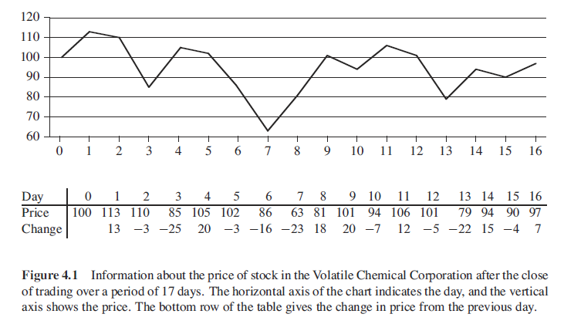
Maximum Sub-array Problem
Problem: When to buy and sell in order to make a maximum profit? (one unit)

Slide 8
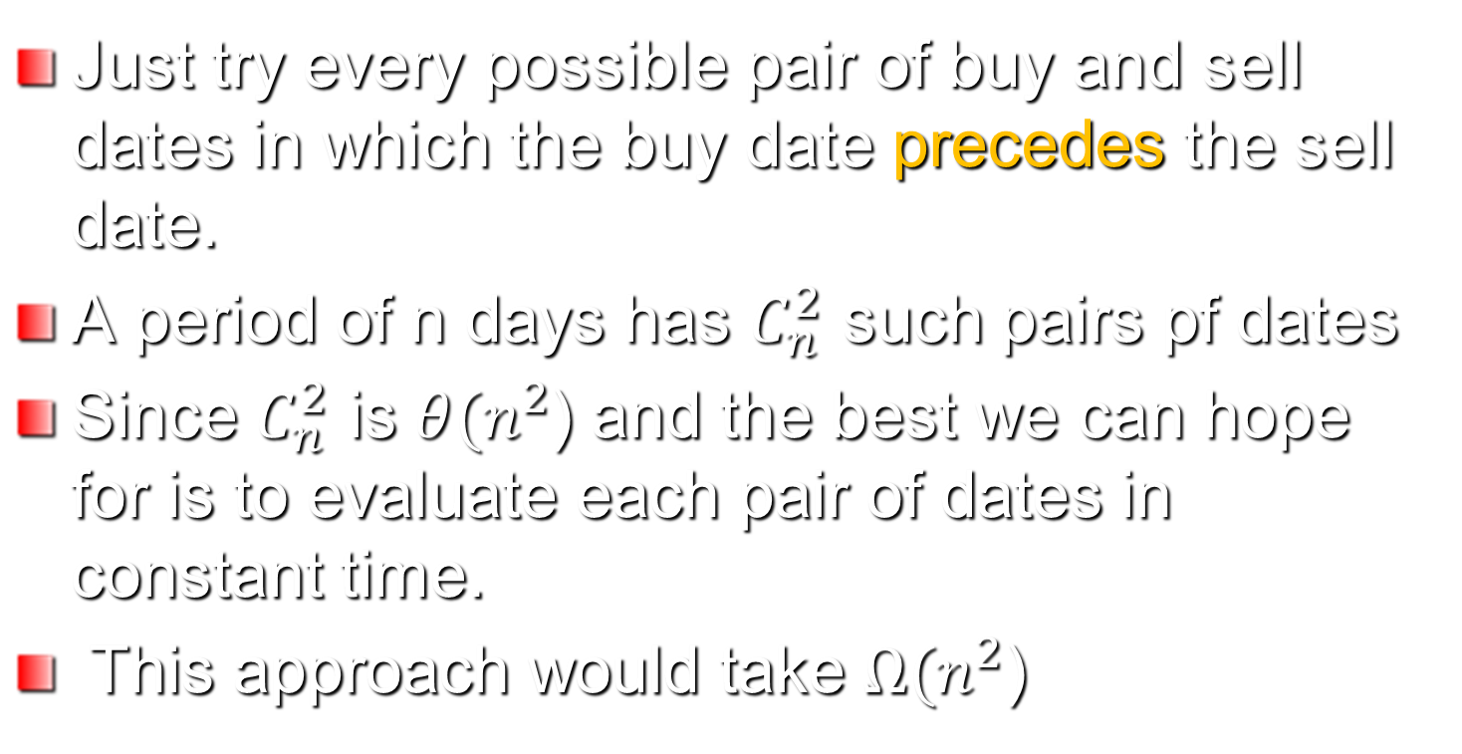
Brute-force method
Can we do better?

Slide 9
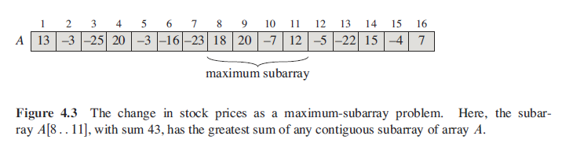
Transformation
We want to find a sequence of days over which the net change from the first day to the last is maximum
Maximum-Sub-Array problem: find the contiguous, nonempty subarray of A whose values are maximum.

Slide 10

Solution using Divide-and-Conquer
Suppose we want to find a maximum subarray of the array A[low, high], we divide the array into two subarrays of equal size: A[low, mid] and A[mid+1, high]
Any contiguous subarray A[i, j] must lie in one of the following:
We can do it recursively if A[i, j] is exactly in the subarray A[low, mid] or A[mid+1, high]
We need to handle: how about if the contiguous subarray is crossing the midpoint.

Slide 11
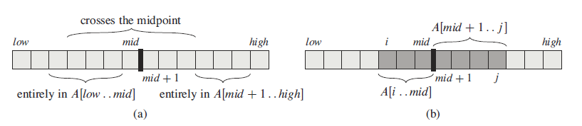
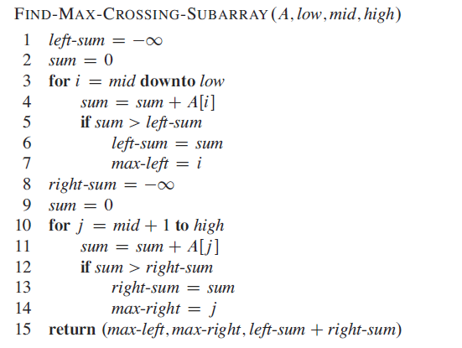
Execute high-low+1 times

Slide 12
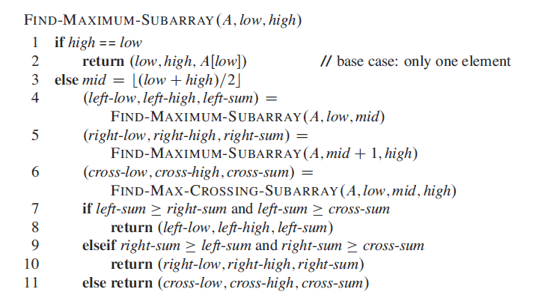
Pseudo Code
Find Maximum

Slide 13
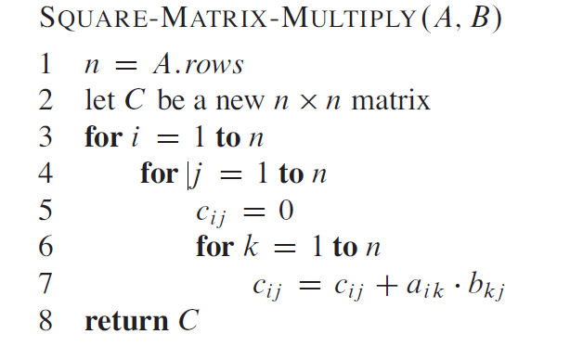
Matrix Multiplication

Slide 14
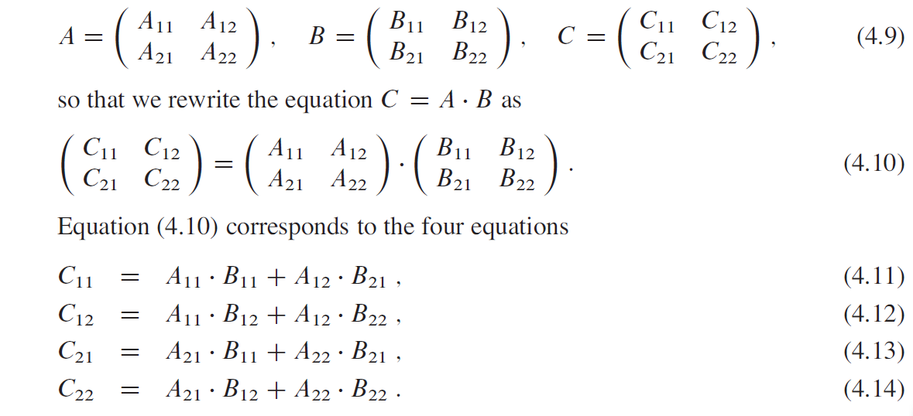
Divide-and-Conquer
Dimension of new matrices：
K_{ij}=n/2 *n/2 (K=A, B, or C; i, j=1, 2)

Slide 15
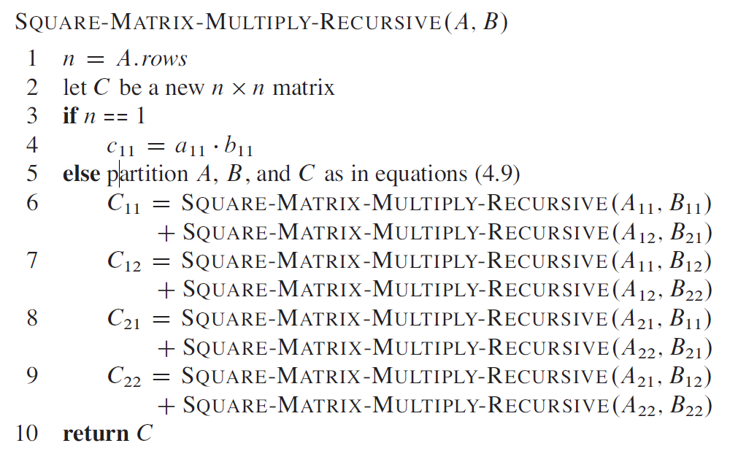
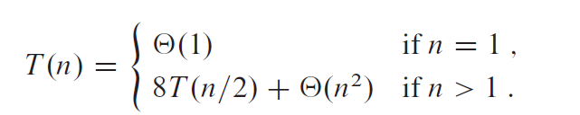
T(n)=n³
Matrix Addition

Slide 16
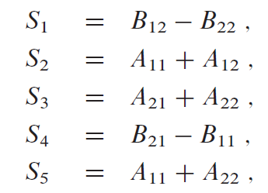
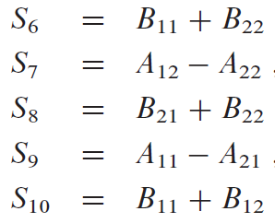
Strassen’s Method(1)
Core idea: matrix multiplication is much more costly than matrix addition. We have traded off one matrix multiplication for a constant number of matrix additions.
It costs Θ(n²) time to create 10 matrices with dimension of n/2*n/2

Slide 17
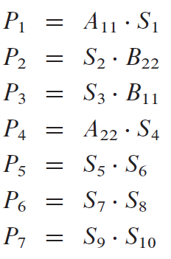
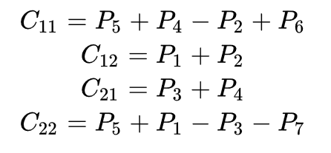
Strassen’s Method(2)
Totally 7 times matrix multiplications! The matrix C could be obtained by adding/subtracting P_{i} in Θ(n²) time.

Slide 18
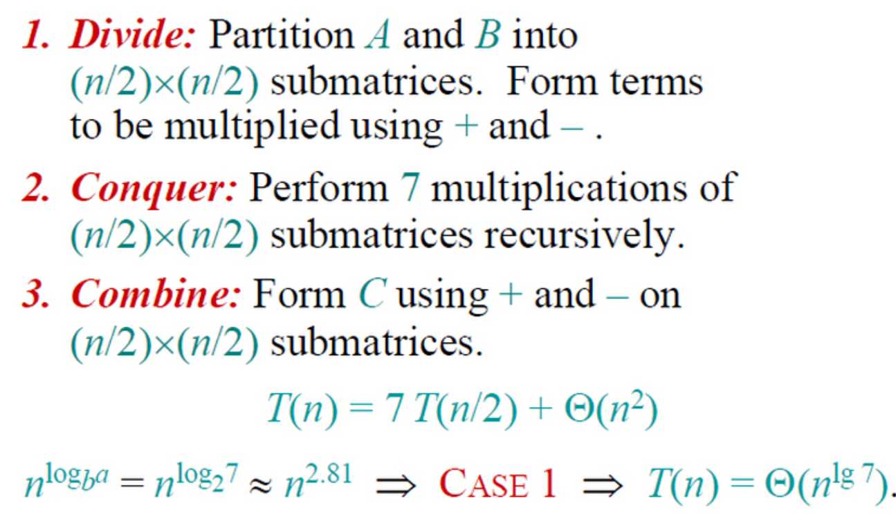
Strassen’s Method(3)

Slide 19
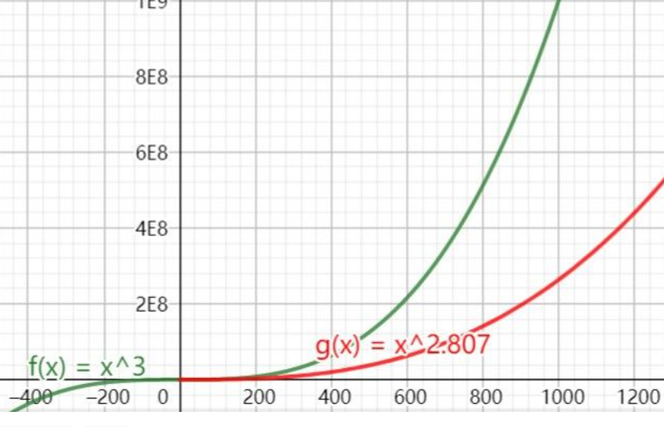
Strassen’s Method(4)
When x>300 (dimension is matrix is greater than 300, Strassen’s method is more efficient.

Slide 20
Substitution Method
The substitution method entails two steps
Guess the form of the solution
Use mathematical induction to find the constants and show that the solution works
The method is powerful but only applied to cases when it is easy to guess the form of he answer
The method can be used to establish either upper or lower bound on a recurrence.

Slide 21
The Substitution method
T(n) = 2T(n/2) + n
Guess: T(n) = O(n lg n)
Proof:
Prove that T(n) ≤ c n lg n for c>0
Assume T(n/2) ≤ c(n/2)lg(n/2) for some positive constant c
then T(n) ≤ 2(c⋅ n/2⋅ lg n/2) + n
= cn lg n – cn + n
≤ cn lg n if c≥ 1
Therefore, T(n) = O(n lg n)
Exact Form

Slide 22
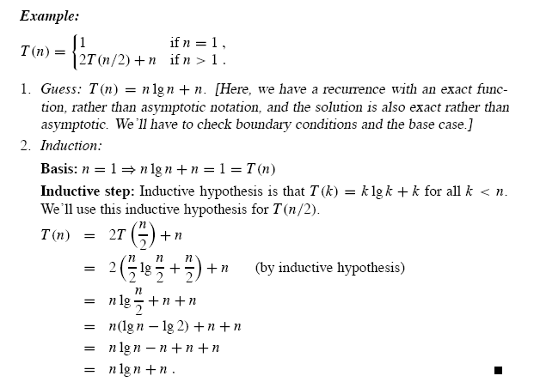

Slide 23
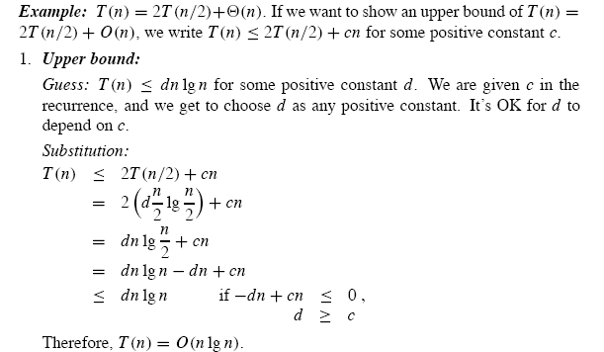

Slide 24
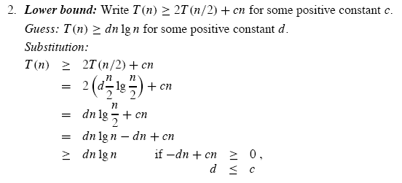

Slide 25
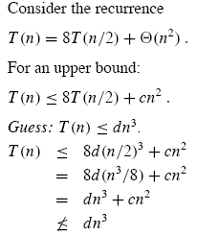
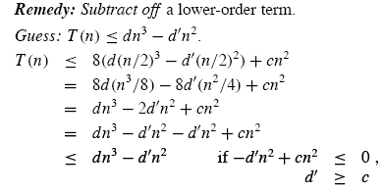
Subtleties
There are times when can correctly guess an asymptotic bound on the solution of a recurrence, but somehow the math doesn’t seem to work out in the induction
Revising the guess by subtracting a lower-order term often permits the math to go through

Slide 26
Several Points
Making good guess
Avoiding pitfalls
Changing variables

Slide 27
The Recursion-Tree method
Each code represents the cost of a single sub-problem somewhere in the set of recursive function invocations.
Sum the costs within each level of the tree to obtain a set of per-level costs.
Then sum all the per-level costs to determine the total cost of all levels of the recursion.
It’s useful to solve the recurrence which describes the running time of a divide-and-conquer algorithm.
It’s used to generate a good guess which is then verified by the substitution method.
A careful drawing of a recursion tree and summing the costs can be used as a direct proof of a solution to a recurrence.

Slide 28
Examples
T(n)=3T(n/4)+cn²
Substitution Method
Recursion Tree
T(n)=T(n/3)+T(2n/3)+O(n)

Slide 29
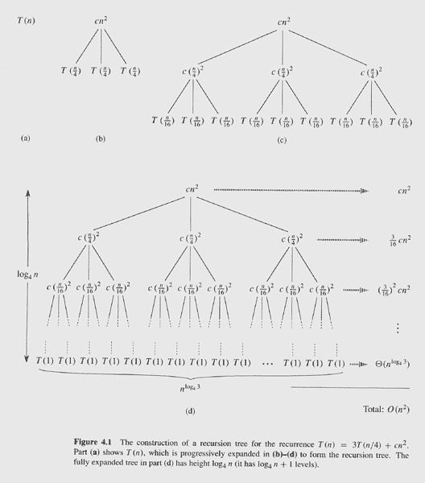
#nodes at i^{th} level: 3^{i}
Size of sub-problem at i^{th} : n/4^{i}
=>total level: log₄n

Slide 30
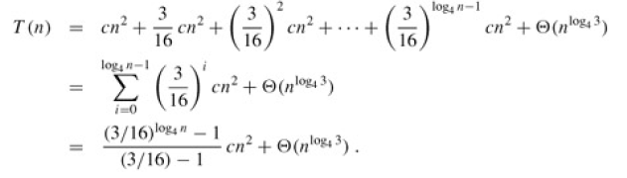
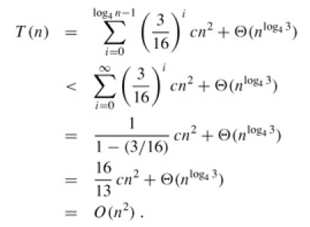

Slide 31
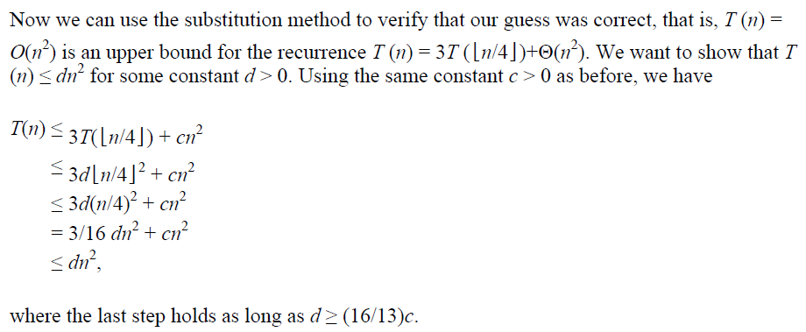
Validation

Slide 32
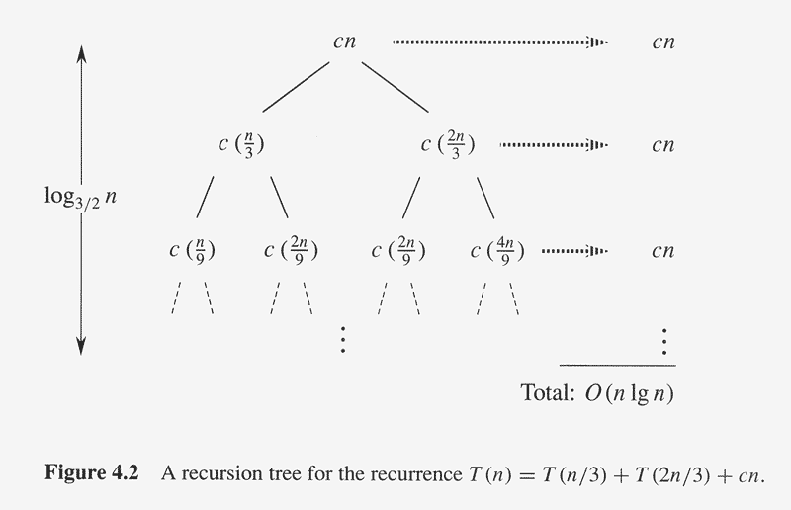
Another Example

Slide 33
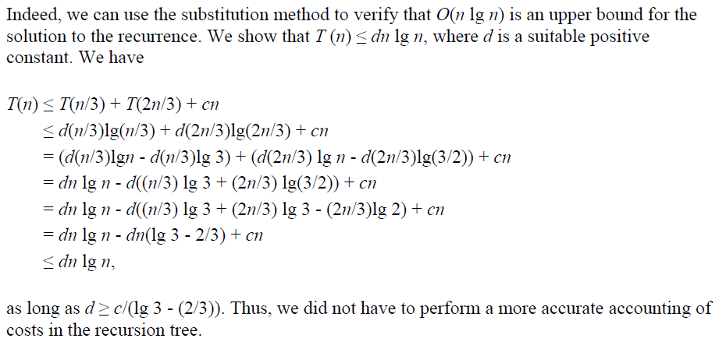
Use Substitution Method to verify

Slide 34
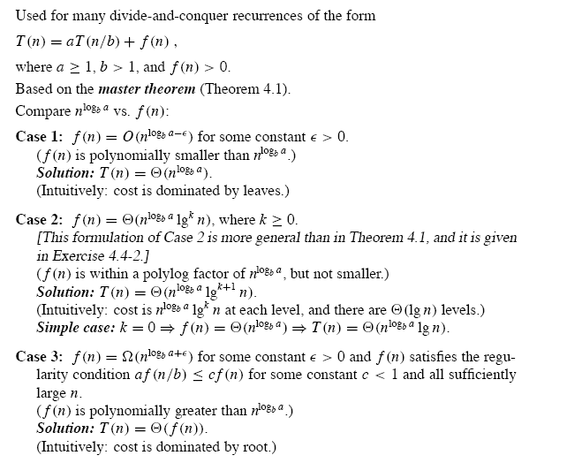

Slide 35
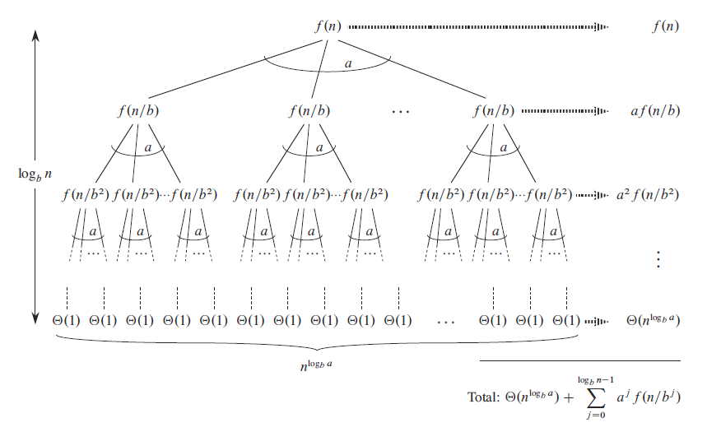
Proof of the master theorem

Slide 36
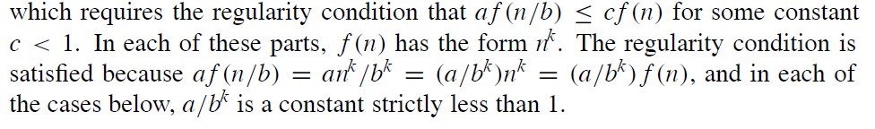
Example
1. T (n) = 5T (n/2) + Θ(n²)
vs. n²
sol.) Since log₂ 5 - ε = 2 for some constant ε > 0, use Case 1⇒ .
2. T (n) = 5T (n/2) + Θ(n³)
vs. n³
sol.) Now lg 5 + ε = 3 for some constant ε > 0
Use Case 3 ⇒ T (n) = Θ(n³)
3. T (n) = 27T (n/3) + Θ(n³/ lg n)
vs. for any k ≥ 0.
sol) Cannot use the master method.
When we check case 3 of master method:

