Slide 1
Chapter 5. Probabilistic Analysis and Randomized Algorithms

Slide 2
Outline
Explain the differences between probabilistic analysis and randomized algorithms
Present the technique of indicator random variables
Give another example of the analysis of a randomized algorithm (permuting an array in place)

Slide 3
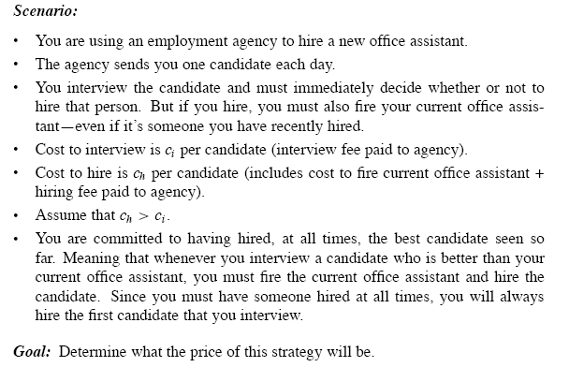
The hiring problem

Slide 4
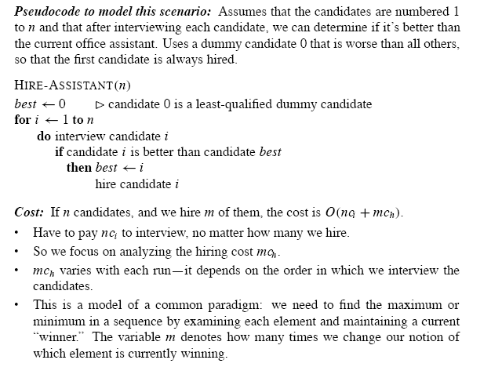

Slide 5
The hiring problem O(nc_{i}+mc_{h})
- Interview & hire
- Point: after interviewing candidate i, determine if candidate i is the best candidate you have seen so far
Worst-case analysis
- We hire every candidate that we interview
- Hiring cost: O(nc_{h})
- We neither have any idea nor have any control over the order of candidates
What we expect to happen in a typical or average case?

Slide 6
Probabilistic Analysis(1)
Usually in the average-case analysis of the algorithm
Use knowledge (make assumption) about the distribution of the inputs
Expected cost/running time
Not applicable to all problems
Random order (imply a total order)-> uniform random permutation: n!

Slide 7
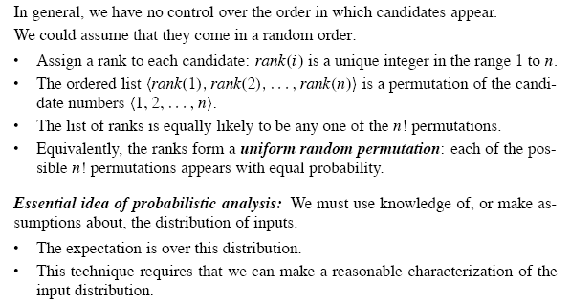
Probabilistic Analysis(2)

Slide 8
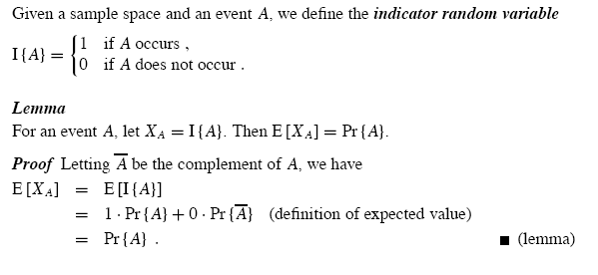
Indicator Random Variables(1)

Slide 9
Indicator Random Variables(2)
Provide a convenient method for converting between probabilities and expectations
Sample space and event A, associated with a indicator random variable I{A}
Lemma:
- The expected value of an indicator random variable associated with an event A is equal to the probability that A occurs
Is very useful and convenient for analyzing situations in which we perform repeated trials

Slide 10
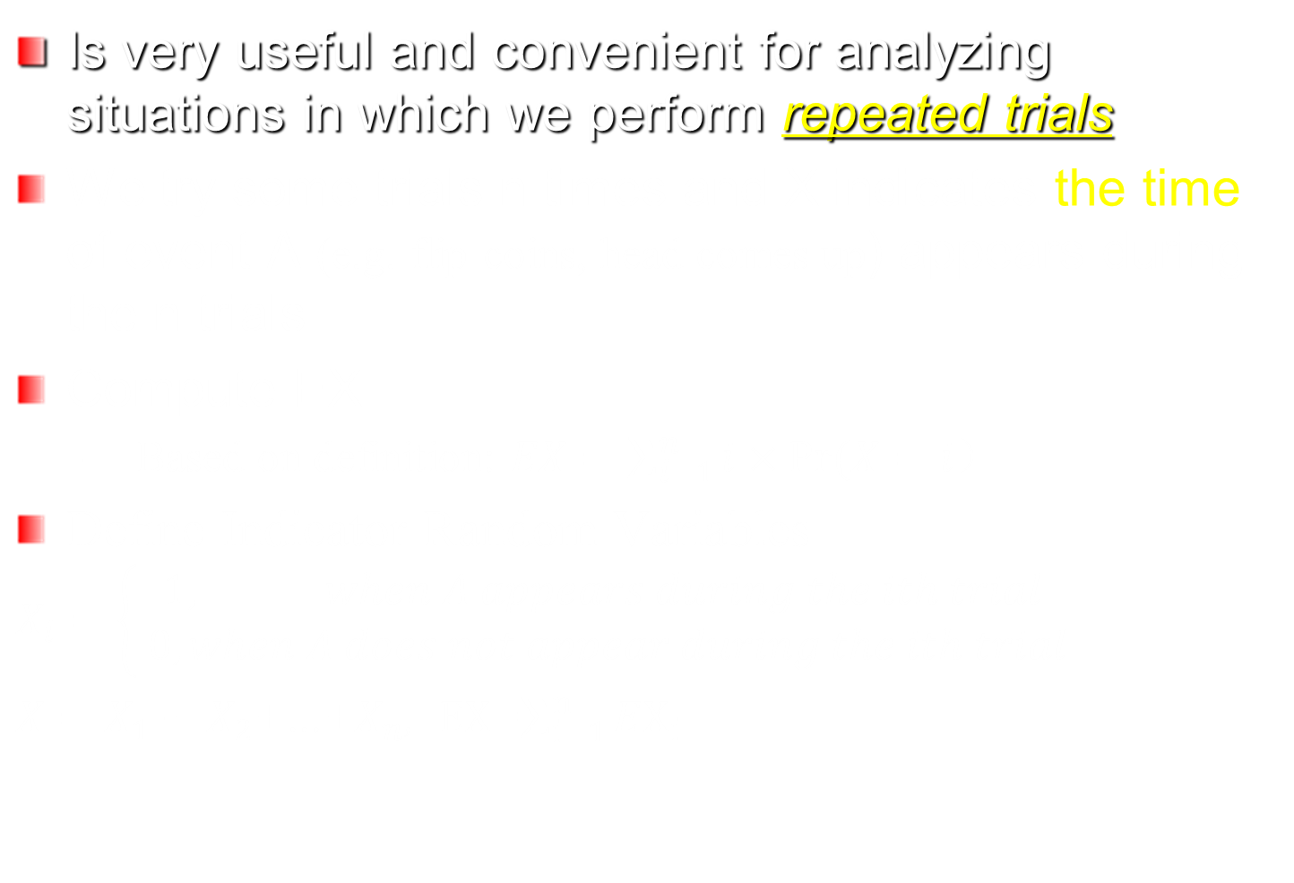
Indicator Random Variables(3)
Is very useful and convenient for analyzing situations in which we perform repeated trials
We try some trials n times and X indicates the time of event A (e.g. flip coins, head comes up) appears during the n trials
Compute EX
Based on definition: $EX=\sum_{i=1}^{n}{i×Pr⁡(X=i）}$
Define Indicator Random Variables
$$X_{i}=\left\{\begin{aligned}1, when A appears during the ith trial \\ 0, when A does not appear during the ith trial\end{aligned}\right.$$
$X=X_{1}+$ $X_{2}$+…+$X_{n}$, $EX$=$\sum_{i=1}^{n}{EX_{i}}$

Slide 11
Indicator Random Variables(2)
Provide a convenient method for converting between probabilities and expectations
Sample space and event A, associated with a indicator random variable I{A}
Lemma:
- The expected value of an indicator random variable associated with an event A is equal to the probability that A occurs
Is very useful and convenient for analyzing situations in which we perform repeated trials

Slide 12
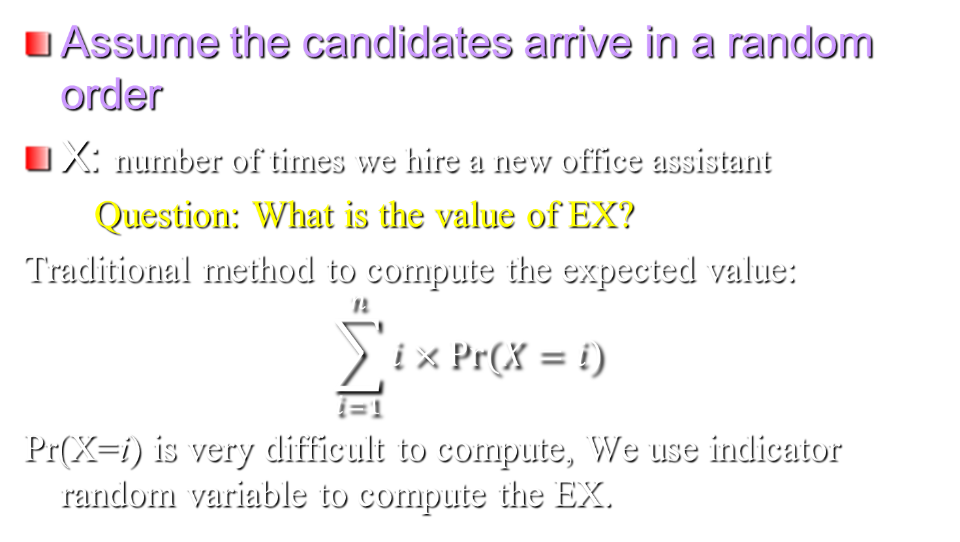
Analysis of the hiring problem using indicator random variable
Assume the candidates arrive in a random order
X: number of times we hire a new office assistant
Question: What is the value of EX?
Traditional method to compute the expected value:
$$\sum_{i=1}^{n}{i×Pr⁡(X=i)}$$
Pr(X=i) is very difficult to compute, We use indicator random variable to compute the EX.

Slide 13
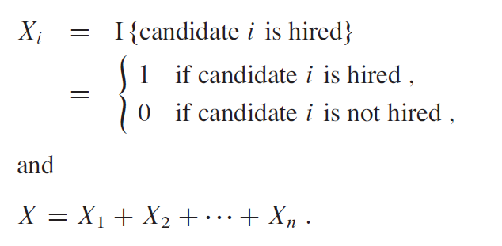
Use Indicator Random Variables to compute EX

Slide 14
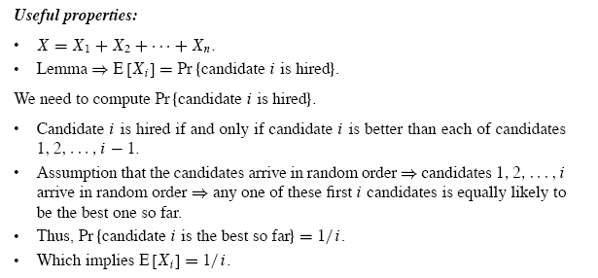

Slide 15
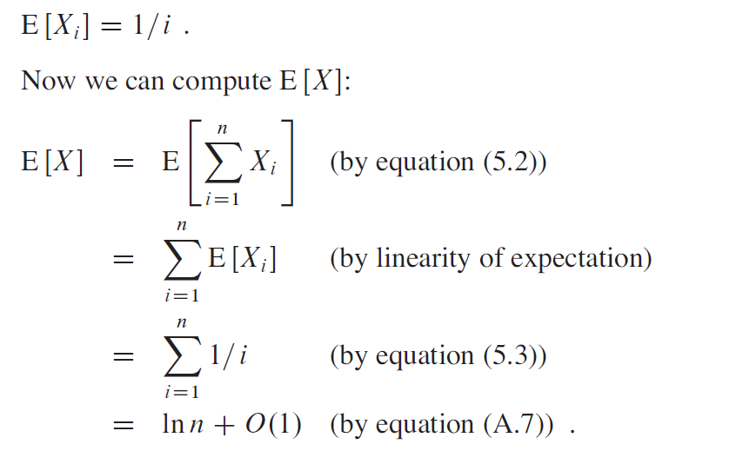
Expected value of hiring times

Slide 16
Hiring Problem
Lemma 5.2
Assuming that the candidates are presented in a random order, algorithm HIRE has a total hiring cost of O(C_{h}lnn)
Worst-case Running time
The worst-case hiring cost is O(nC_{h}). The expected interview cost is a significant improvement over the worst-case cost

Slide 17
Random Algorithms vs. Probabilistic Analysis (1)
Explore the distinction between probabilistic analysis and randomized algorithms
Instead of assuming a distribution, we impose a distribution
For probabilistic analysis, the algorithm is deterministic.
The number of times we hire differs for different inputs (expensive, inexpensive and moderately expensive inputs)
The input A1:<1, 2, 3, 4, 5, 6, 7, 8, 9, 10>--hiring 10 times--expensive
The input A2: <10, 9, 8, 7, 6, 5, 4, 3, 2, 1>-hiring once—---inexpensive
The input A3: <5,2, 1, 8, 4, 7, 10,9, 3, 6>- hiring 3 times: 5, 8, 10---moderately expensive

Slide 18
Random Algorithms vs. Probabilistic Analysis (2)
For randomized algorithm, the randomization is in the algorithm not in the input distribution
For a given input, each time we run the randomized algorithm, we get different updates so as to get different cost
E.g. The first time we run the algorithm on input A3, it may produce permutation A1 and perform 10 updates and the second time we ran the algorithm on A3, it may produce permutation A2 and perform only 1 updates, the third time we run…
No particular input elicits its worst-case behavior. The randomized
algorithm performs badly only if the random-number generator produces an “unlucky” permutation.

Slide 19
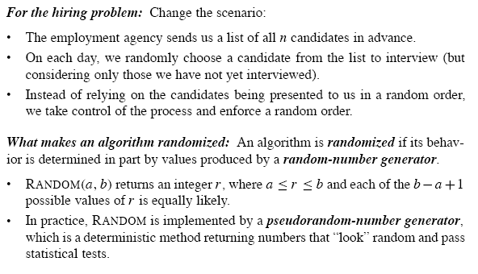
Randomized Algorithms

Slide 20
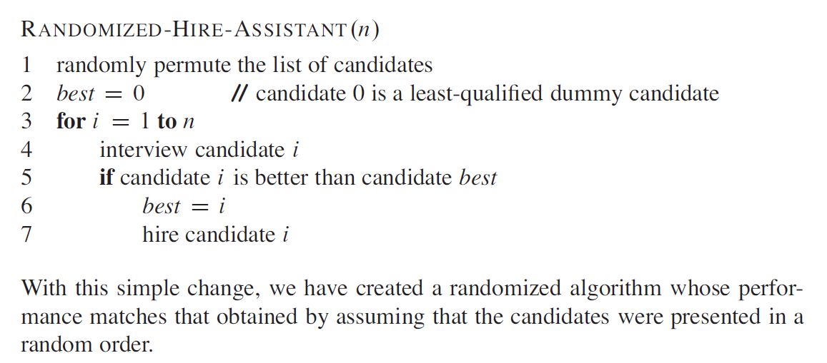
Randomized Algorithm for Hiring Problem
impose a random order

Slide 21
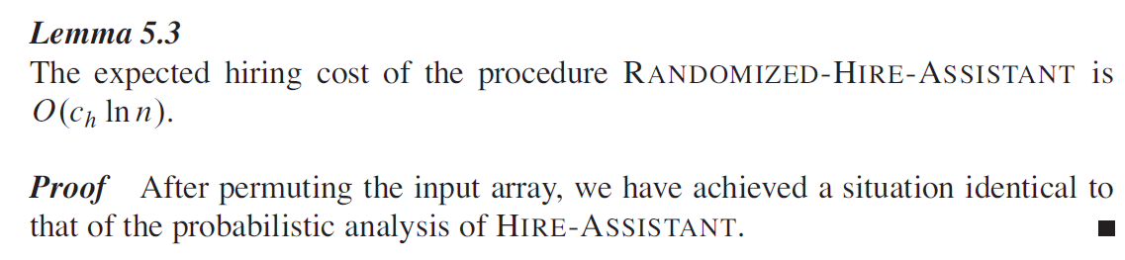
Lemma 5.3
How to guarantee a random order? How to guarantee an uniform random distribution?

Slide 22
Randomly Permuting arrays
Randomize the input by permuting the given input array
Assign each element of the array a random priority p[i] and then sort the array according to these priorities
Randomly permuting produces a uniform random permutation
Permute the given array in place

Slide 23
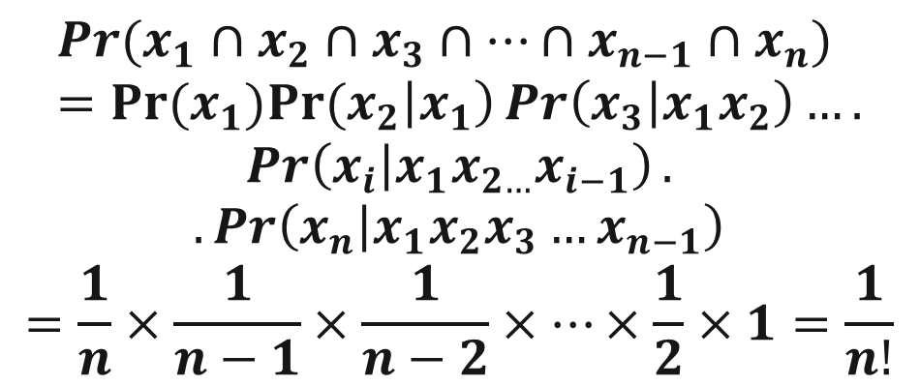
Permute-By-Sorting
Permute-By-Sorting (A)
1 n ← length [A]
2 for i← 1 to n
do P [i] =RANDOM (1, n³)
4. sort A, using P as sort keys
5. return A
Procedure Permute-By-Sorting produces a uniform random permutation of the input in Θ(nlgn), assume all priorities are unique
There are total n! permutations and each permutation appears with 1/n! probability.

Slide 24
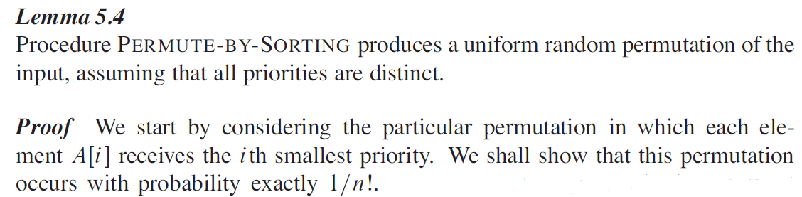
Uniform Random Permutation(1)

Slide 25
Uniform Random Permutation(2)
It is insufficient to show that, for each element A[i], the probability that the element winds up in position j is 1/n.
You need to show there are totally n! possible permutations and each permutation appears with equal probability with 1/n!

Slide 26
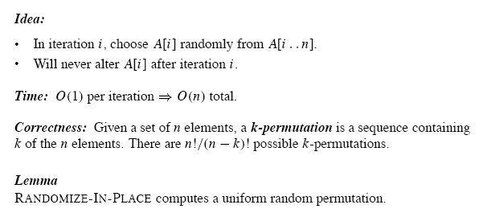
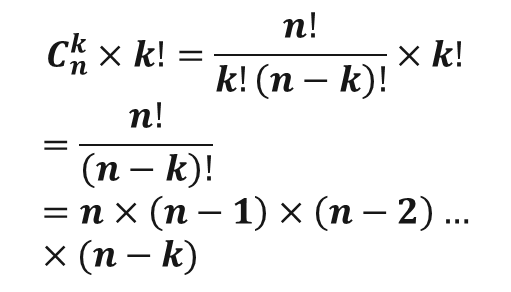
Randomize in Place
1. n ←length [A]
2. for i ←1 to n
3. do swap A [i] ←→A[RANDOM (i,n)]

Slide 27
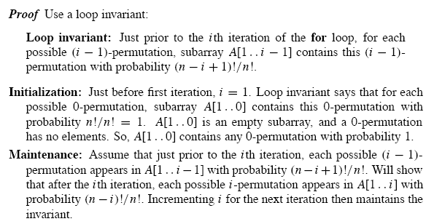
Proof of Lemma 5.5
Procedure RANDOMIZE_IN_PLACE computes a uniform permutation

Slide 28
