Slide 1
Chapter 7.
Quicksort

Slide 2
QuickSort
Divide-and-conquer paradigm
Worst-case running time: O(n²).
Expected running time: Θ (n lg n).
Constants hidden in (n lg n) are quite small.
Sorting in place and works well even in virtual memory environment.
Section 7.3 presents a version of quick sort that uses random sampling.
Is an algorithm based on division

Slide 3
Description of Quicksort
To sort the subarray A[p . . r]:
Divide: Partition A[p..r], into two (possibly empty) subarrays A[p .. q-1] and A[q+1 .. r], such that each element in the first subarray A[p .. q-1] is ≤ A[q] and A[q] is ≤ each element in the second subarray A[q+1 .. r].
Conquer: Sort the two sub-arrays by recursive calls to QUICKSORT.
Combine: No work is needed to combine the sub-arrays, because they are sorted in place.
Perform the divide step by a procedure PARTITION, which returns the index q that marks the position separating the subarrays.

Slide 4
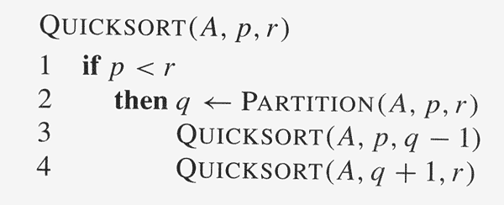

Slide 5
Partitioning
PARTITION always selects the last element A[r] in the subarray A[p .. r] as the pivot—the element around which to partition.
As the procedure executes, the array is partitioned into four regions, some of which may be empty:
Loop invariant:
1. All entries in A[p .. i ] ≤ pivot.
2. All entries in A[i+1 .. j-1] > pivot.
3. A[r] = pivot.
4. All entries in A [j…r-1] have not yet been examined
The 4th region is not needed as part of the loop invariant, and we don’t know how they compare to the pivot.

Slide 6
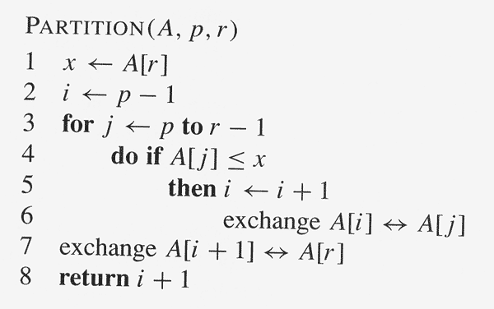
Θ(n)

Slide 7
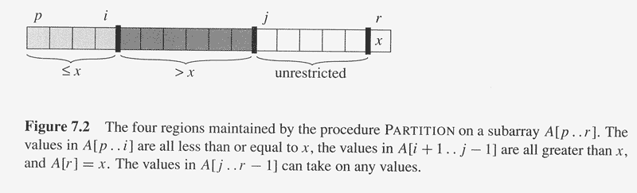
The largest index of element that no bigger than x
j-1 is the largest index of element that bigger than x

Slide 8
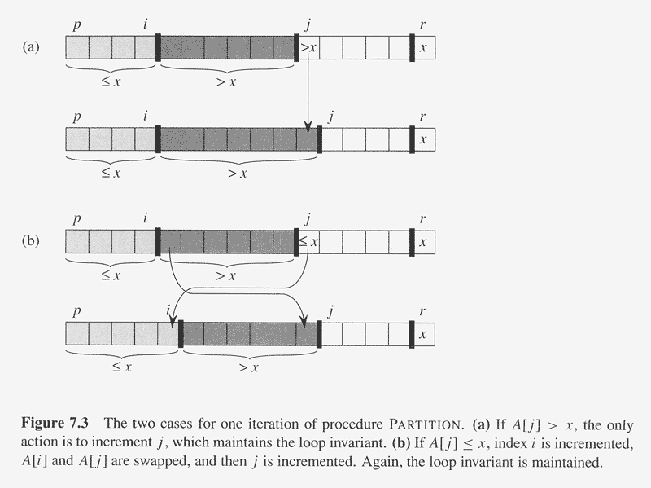

Slide 9
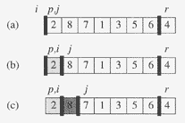
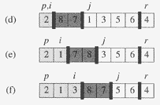
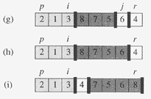

Slide 10
Correctness (1)
Use the loop invariant to prove correctness of PARTITION.
Initialization:
Before the loop starts, all the conditions of the loop invar-
riant are satisfied, because r is the pivot and the subarrays
A[p .. i] and A[i+1 .. j-1] are empty.
Maintenance:
While the loop is running,
if A[ j ] ≤ pivot, then A[ j] and A[i +1] are swapped
and i and j are incremented.
If A[ j ] > pivot, then increment only j .
Termination:
When the loop terminates, j = r,
so all elements in A are partitioned into one of the three cases: A[p . . i ] ≤ pivot, A[i+1 .. r-1] > pivot, and A[r] = pivot.

Slide 11
Correctness (2)
The last two lines of PARTITION move the pivot element from the end of the array to between the two subarrays: swapping the pivot (A[r]) and the first element of the second subarray (A[i + 1]).
Time for partitioning: Θ(n) to partition an n-element subarray.

Slide 12
Performance of QuickSort(1)
The running time of Quicksort depends on the partitioning of the subarrays:
If the subarrays are balanced, then quicksort can run as fast as merge-sort.
If they are unbalanced, then quicksort can run as slowly as insertion sort.
Worst case
Occurs when the subarrays are completely unbalanced.
Have 0 elements in one subarray and n-1 elements in the other subarray.
Get the recurrence :T (n) = T (n-1) + T (0) + Θ(n) = T (n-1) + Θ(n) ( = Θ(n²) ).

Slide 13
Performance of QuickSort(2)
Worst case
Same running time as insertion sort.
In fact, the worst-case running time occurs when quicksort takes a sorted array as input, but insertion sort runs in O(n) time in this case. (increasing order)
Best case
Occurs when the subarrays are completely balanced every time.
Each subarray has ≤ n/2 elements.
Get the recurrence:
T (n) = 2T (n/2) + Θ(n)
solution: Θ(n lg n)

Slide 14
Performance of QuickSort(3)
Balanced Partitioning
QuickSort’s average running time is much closer to the best case than to the worst case.
Imagine that PARTITION always produces a 9-to-1 split.
Get the recurrence
T (n) ≤ T (9n/10) + T (n/10) + Θ(n) = O(n lg n) .
Intuition: look at the recursion tree.
It’s like :T (n) = T (n/3) + T (2n/3) + O(n) in section 4.2.
Except that here the constants are different
We get log₁₀ n full levels and log_{10/9} n levels that are nonempty.
As long as it’s a constant, the base of the log doesn’t matter in asymptotic notation.
Any split of constant proportionality will yield a recursion tree of depth Θ (lg n).

Slide 15
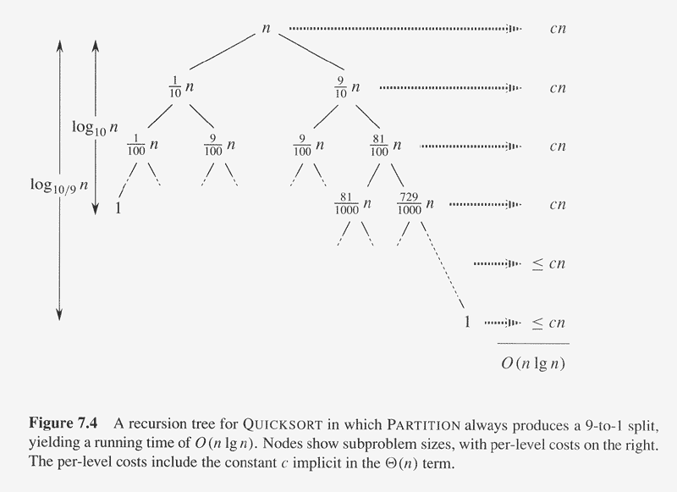

Slide 16
Average Case
Splits in the recursion tree will not always be constant.
There will usually be a mix of good and bad splits throughout the recursion tree.
This doesn’t affect the asymptotic running time of Quicksort; assume that levels alternate between best and worst-case splits.
The extra level in the left-hand figure only adds to the constant hidden in the Θ-notation.
There are still the same number of subarrays to sort, and only twice as much work was done to get to that point.
Both figures(Fig.7.5 a & b) result in O(n lg n) time, though the constant for the figure on the left is higher than that of the figure on the right.

Slide 17
Choice of Pivot
How to choose a good pivot
A good splitting point (splitter) should produce sets S- (elements that no greater than pivot) and S+ (elements that greater than pivot) that are equally in size
“well-centered splitter”
We say a n element is central if at least a quarter of all the elements are smaller than it and at least a quarter of the elements are greater than it
Half of all elements could be “well-centered splitter”

Slide 18
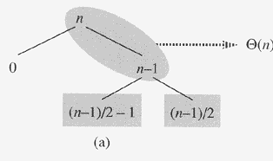
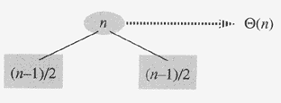
Bad split
Good split

Slide 19
Discussion & Question
What is the difference between QUICKSORT and MERGESORT while both are designed based on divide-and-conquer paradigm?
What is the running time of QUICKSORT when all elements of array A have the same value?
Among all four sorting algorithms introduced so far, which are stable and which are not? Justify your answer or give an counterexample.
Give the results of procedure of QUICKSORT on the arrary <13,19,

Slide 20
Discussion & Question
What is the difference between QUICKSORT and MERGESORT while both are designed based on divide-and-conquer paradigm?
What is the running time of QUICKSORT when all elements of array A have the same value?
Among all four sorting algorithms introduced so far, which are stable and which are not? Justify your answer or give an counterexample.
Give the results of procedure of QUICKSORT on the arrary <13,19,

