Slide 1
Randomized version of QuickSort
The assumption that all input permutations are equally likely is not always true.
Add randomization to QuickSort.
Randomly permute the input array. Instead, use random sampling, or picking one element at random.
Don’t always use A[r] as the pivot. Instead, randomly pick an element from the subarray that is being sorted.
Randomly selecting the pivot element will, on average, cause the split of the input array to be reasonably well balanced.

Slide 2
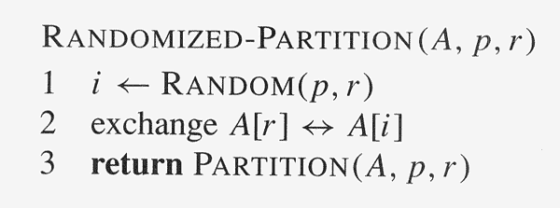
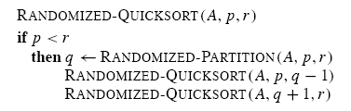
Randomized Version (1)
How many calls to RANDOM?
worst-case
best-case

Slide 3
Randomized Version(2)
Randomization of Quicksort stops any specific type of array from causing worst case behavior.
For example, an already-sorted array causes worst-case behavior in non-randomized QUICKSORT, but not in RANDOMIZED-QUICKSORT.

Slide 4
Question
Why do we analyze the average-case performance of a randomized algorithm and not its worst-case performance?

Slide 5
Analysis of QuickSort(1)
Worst-case Analysis
We will prove that a worst-case split at every level produces a worst-case running time of O(n²).
Recurrence for the worst-case running time of QUICKSORT:
T (n) = max 0≤q≤n-1 (T (q) + T (n-q-1)) + Θ(n).
Because PARTITION produces two subproblems, totaling size n-1, q ranges from 0 to n-1.
Guess: T (n) ≤ cn², for some c.
Substituting our guess into the above recurrence:
T (n) ≤ max 0≤q≤n-1 (cq² + c(n-q-1)²) + Θ(n)
= c · max 0≤q≤n-1 (q² + (n- q-1)²) + Θ(n) .

Slide 6
Analysis of QuickSort(2)
The maximum value of (q² +(n-q-1)²) occurs when q is either 0 or n-1. (Second derivative with respect to q is positive.) This means that
max 0≤q≤n-1 (q² + (n-q-1)²) ≤ (n-1)²= n²-2n+1 .
Therefore, T (n) ≤ cn² - c(2n-1) + Θ(n)
≤ cn² if c(2n-1) ≥ Θ(n) .
Pick c large enough so that c(2n-1) dominates Θ(n).
Therefore, the worst-case running time of quicksort is O(n²).
Can also show that the recurrence’s solution is Ω(n²).
Thus, the worst-case running time is Θ(n²).

Slide 7
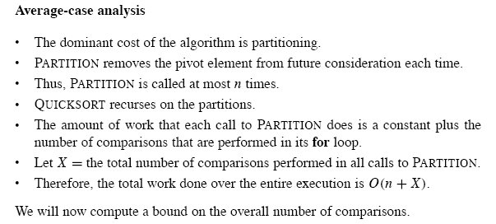
Expected running time

Slide 8
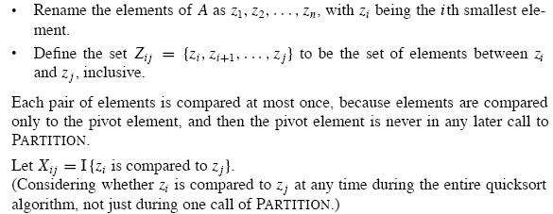
Number of Total Comparisons
Increasing order

Slide 9
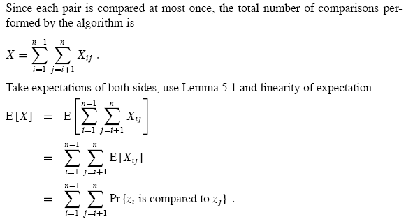
Expected Number of Comparisons

Slide 10
Condition of comparisons
Numbers in separate partitions will not be compared.
Once a pivot x is chosen such that z_{i}<x<z_{j}, then z_{i} and z_{j} will never be compared at later time
If either z_{i} or z_{j} is chosen as pivot before any other element of Z_{ij}, then it will be compared to all the elements of Z_{ij}, except itself
The probability that z_{i} is compared to z_{j} is the probability that either z_{i} or z_{j} is the first element chosen as pivot
There are j-i+1 elements, and pivots are chosen randomly and independently. Thus, the probability that any particular one of them is the first one is 1/(j-i+1)

Slide 11
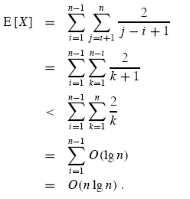
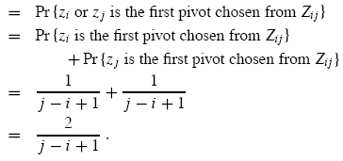
Upper Bound

