Slide 1
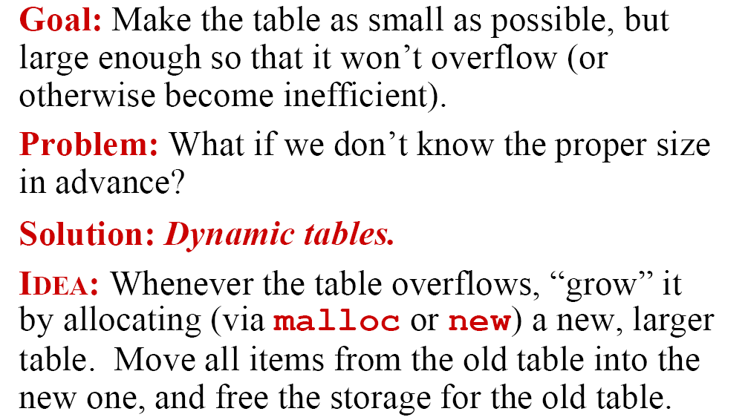
Application: Dynamic Table

Slide 2
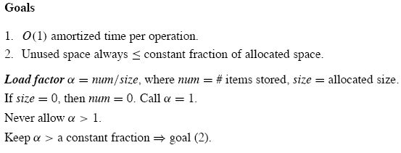
Goal

Slide 3
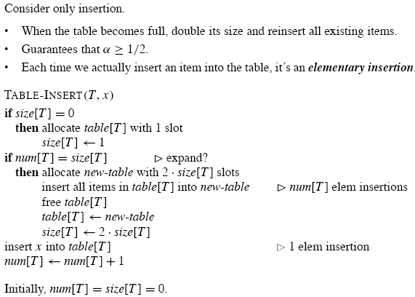
Table Expansion

Slide 4
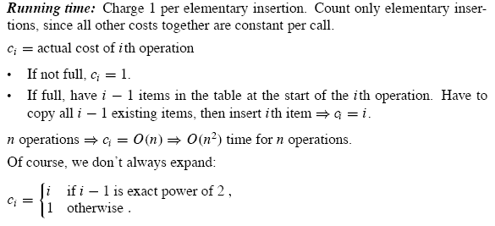
Aggregate Analysis

Slide 5
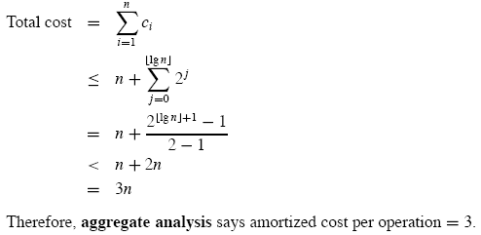
Continue

Slide 6
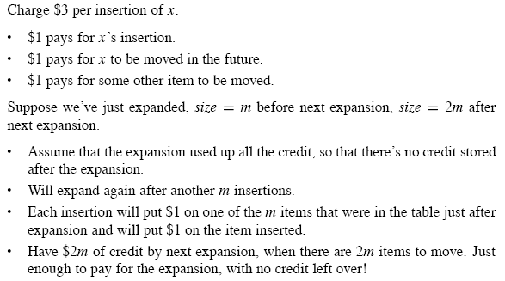
Accounting Method
Another item that has already been moved once when the table is expanded.
When the table is expanded, all stored credits are used up.

Slide 7
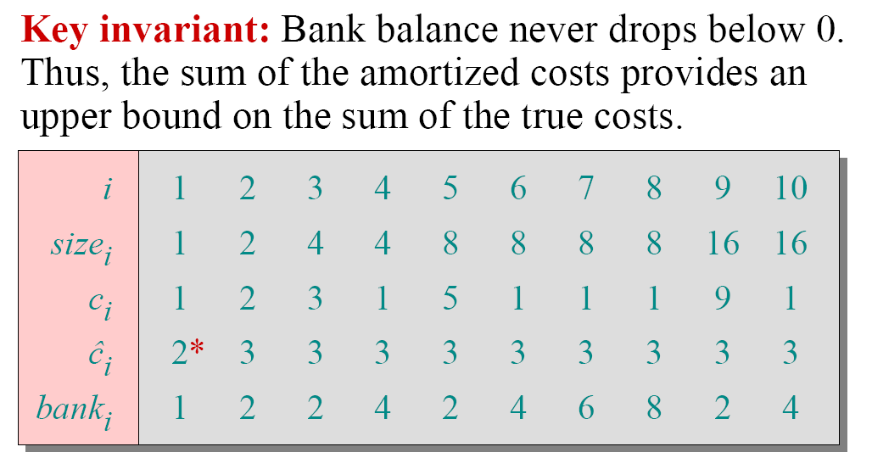
Intuitive Understanding

Slide 8
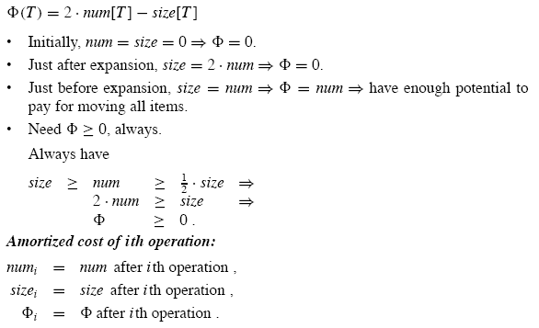
Potential Method
Define a potential function that is 0 immediately after an expansion.
The function is built to the table size by the time the table is full, so that the next expansion can be paid for by the potential.

Slide 9
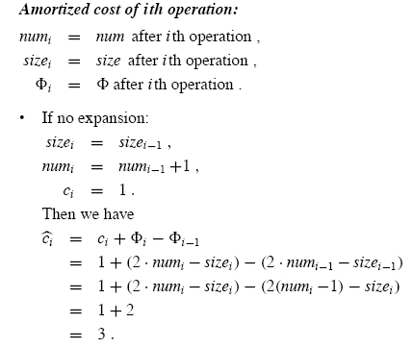
Continue…

Slide 10
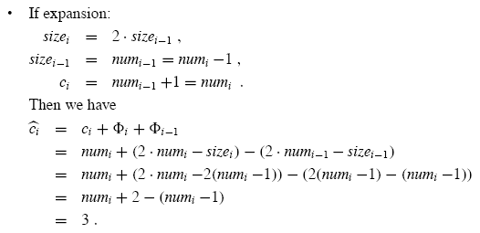
Continue…

Slide 11
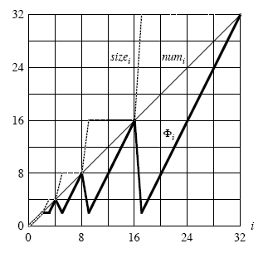
Effect of a sequence of Table-Insert
2

Slide 12
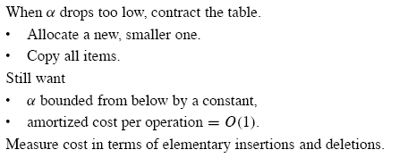
Table Expansion and Contraction

Slide 13
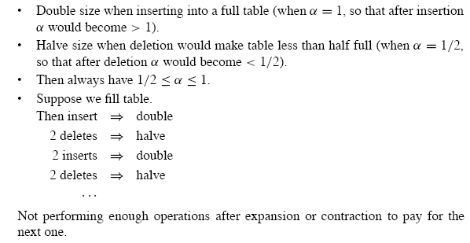
Obvious Strategy
O(n²) for n operations

Slide 14

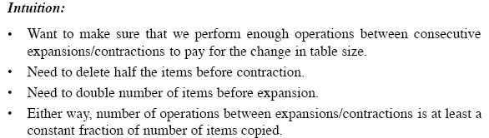
Simple Solution

Slide 15
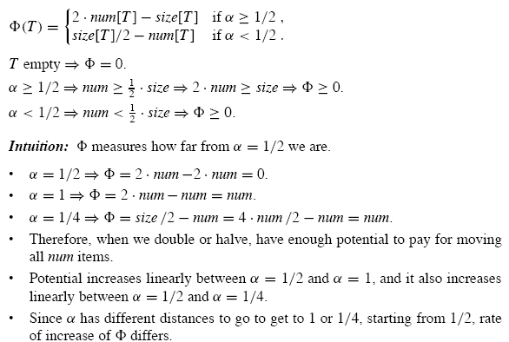
[(0, size[T]=num ]
[(0, size[T]/4=num ]

Slide 16
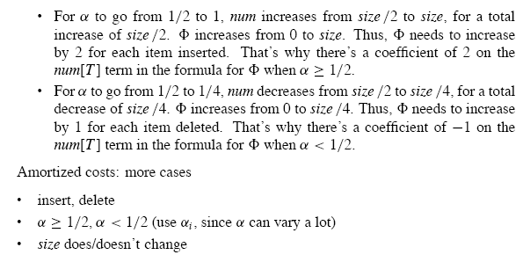
Continue…

Slide 17
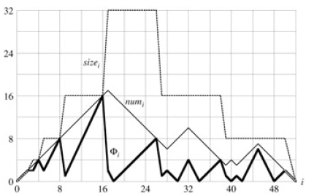
Effect of a sequence of n Table-Insert and Table-Delete

Slide 18

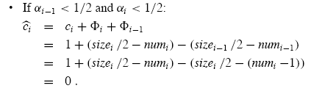
Insert

Slide 19
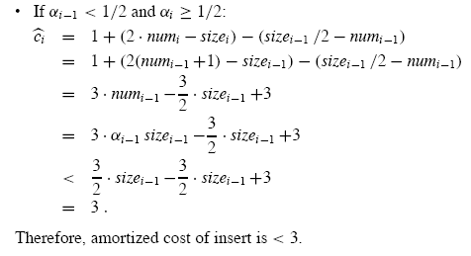
Insert (2)

Slide 20
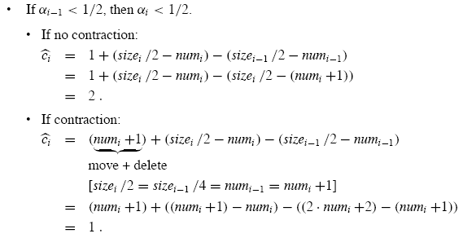
Delete(1)
Same Ø functions

Slide 21
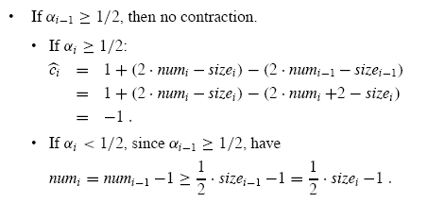
Delete (2)

Slide 22
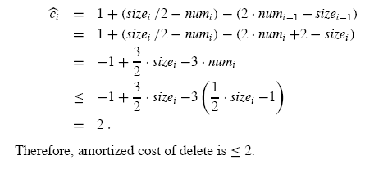
Delete (3)
Different Ø functions

Slide 23
Effect of a sequence of n Table-Insert and Table-Delete

Slide 24
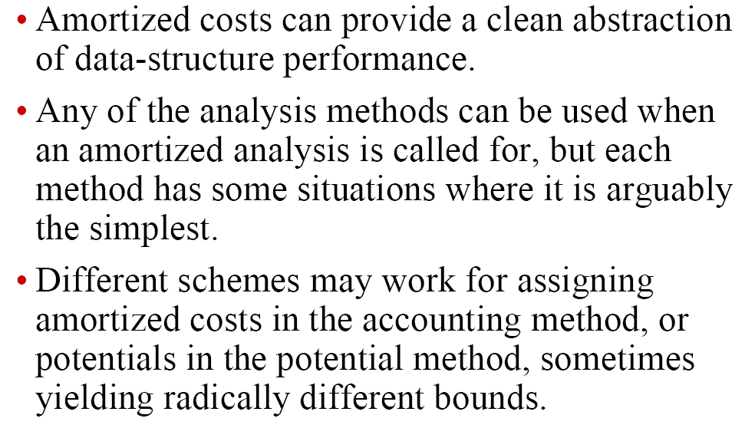
Conclusion

