Slide 1

COMP130177.01 互联网体系结构 1. 互联网回顾与基本架构
赵进
School of
School of Computer Science, Fudan University

Slide 2
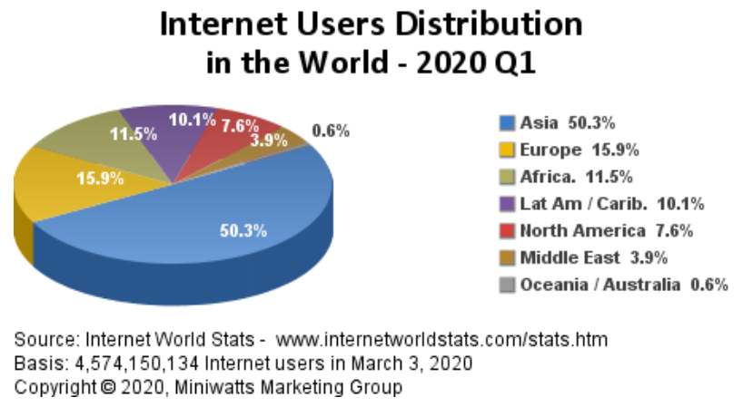
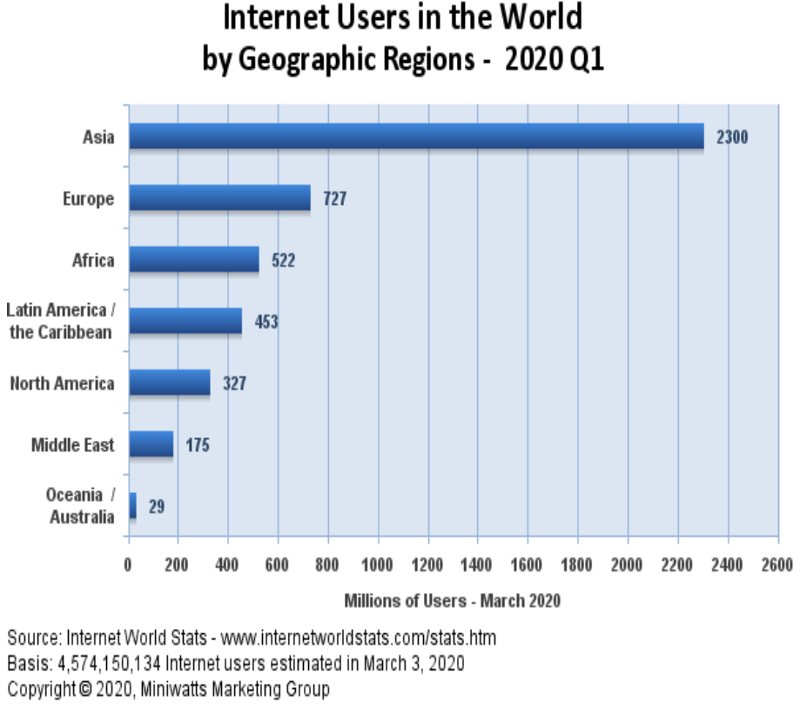
Growth of Internet
In 2020, Total Internet user reach 4.57 billion, Internet penetration rate reach 59.0%.

Slide 3
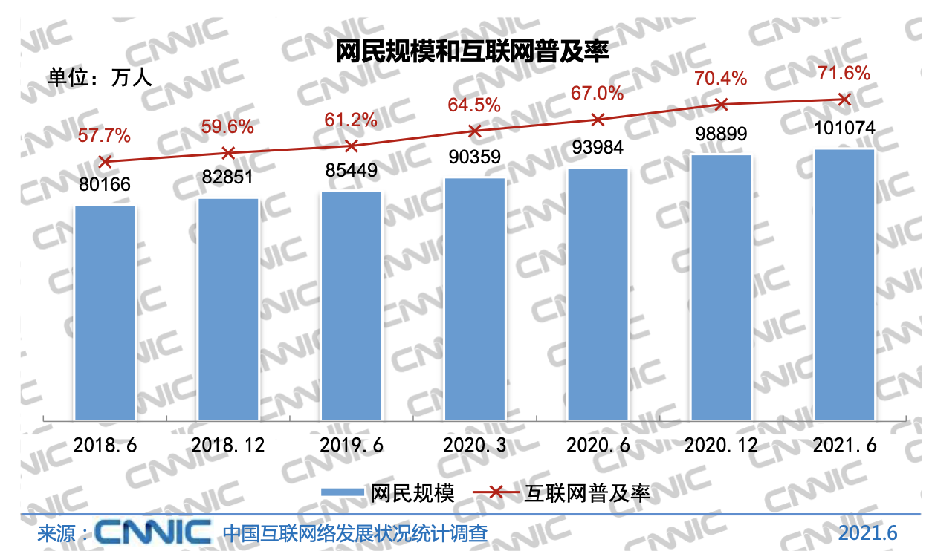
Internet Users in China
截至2021年6月，我国网民规模达10.11亿. (CNNIC 2021.8 第48次《中国互联网络发展状况统计报告》)
互联网普及率达71.6%

Slide 4
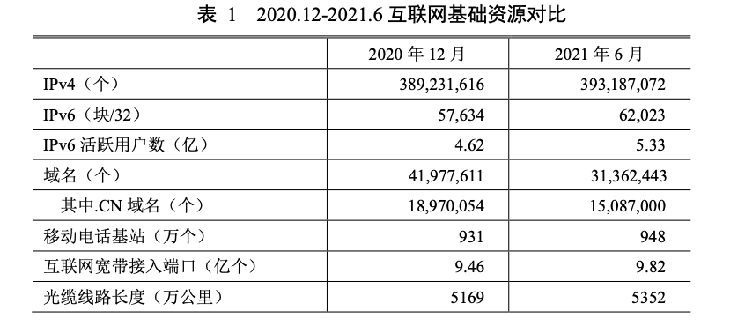
互联网基础资源

Slide 5
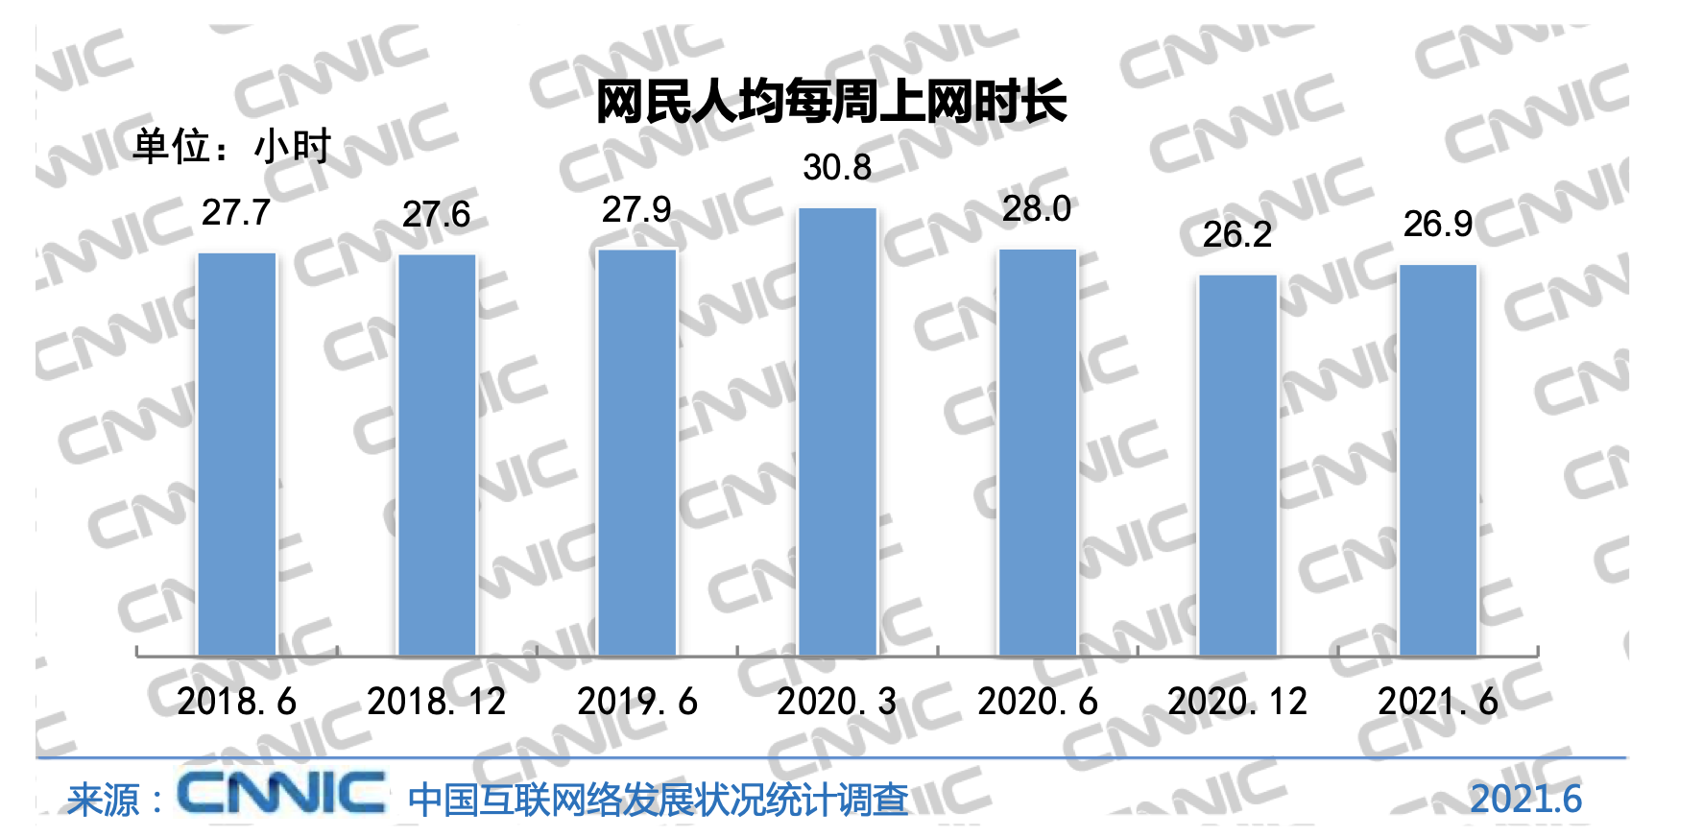

Slide 6
Complex System
The Internet is complex system, Lots of Functions Needed
Links
Multiplexing
Routing
Addressing/naming (locating peers)
Reliability
Flow control
Fragmentation
How do you implement these functions?
Key: under one overall architecture

Slide 7
Architecture
The term ”network architecture” is commonly used to describe a set of abstract principles for the technical design of protocols and mechanisms for computer communication.
A network architecture represents a set of deliberate choices out of many design alternatives, where these choices are informed by an understanding of the requirements

Slide 8
What does it do?
A network architecture must typically specify:
Where and how state is maintained and how it is removed.
What entities are named
How naming, addressing, and routing functions inter-relate and how they are performed.
How communication functions are modularized, e.g., into “layers” to form a “protocol stack”.
How network resources are divided between flows and how end-systems react to this division, i.e., fairness and congestion control.
Where security boundaries are drawn and how they are enforced.
How management boundaries are drawn and selectively pierced.
How differing QoS is requested and achieved.

Slide 9
Architecture vs Techinical Design
Network architecture is a set of high-level design principles that guides the technical design of the network, especially the engineering of its protocols and algorithms.
An architecture is more general than a particular conformant technical design.
The technical design derived from a particular architecture is far from unique, and it may evolve over time in response to detailed changes in requirements;
however, the same architecture may be maintained.

Slide 10
Example
An architecture is expected to be relatively long-lived, applicable to more than one generation of the technology.
A trivial example of this is IPv6, which represents a later generation of technology than IPv4 although both conform to the same Internet architecture.

Slide 11
Summary
Architecture is not the implementation itself
Architecture is how to “organize” implementations
what interfaces are supported
where functionality is implemented
Architecture is the modular design of the network

Slide 12
Why is Architecture Important?
It provides a basis for individual technical decisions, as opposed to a random walk starting from today’s design.

Slide 13
Challenges
Many different network styles and technologies
circuit-switched vs packet-switched, etc.
wireless vs wired vs optical, etc.
Many different applications
ftp, email, web, P2P, etc.
How do we organize this mess?

Slide 14
Layering
A way to deal with complexity
Add multiple levels of abstraction
Each level encapsulates some key functionality
And exports an interface to other components
Example?
Layering: Modular approach to implementing network functionality by introducing abstractions
Challenge: how to come up with the “right” abstractions?

Slide 15
Why layering
Application
Telnet
FTP
NFS
HTTP
Coaxial
cable
Transmission
Media
Coaxial
cable
Fiber
optic
Packet
radio
Do we re-implement every application for every technology?
Obviously not, but how does the Internet architecture avoid this?

Slide 16
Power of Layering
Solution: Intermediate layer that provides a single abstraction for various network technologies
O(1) work to add app/media
variation on “add another level of indirection”
Application
SMTP
SSH
NFS
HTTP
Intermediate
layer
Transmission
Media
Coaxial
cable
Fiber
optic
802.11
LAN

Slide 17
Example of Layering
Software and hardware for communication between two hosts
Advantages:
Simplifies design and implementation
Easy to modify/evolve
Application semantics
Application-to-application channels
Host-to-host connectivity
Link hardware

Slide 18
Layering vs Not
Layer N may duplicate layer N-1 functionality
E.g., error recovery
Layers may need same info (timestamp, MTU)
Strict adherence to layering may hurt performance
Some layers are not always cleanly separated
Inter-layer dependencies in implementations for performance reasons
Many cross-layer assumptions, e.g. buffer management
Layer interfaces are not really standardized.
It would be hard to mix and match layers from independent implementations, e.g., windows network apps on unix (w/o compatibility library)

Slide 19
A Scalable System
Break system into modules:
Well-defined interfaces gives flexibility
can change implementation of modules
can extend functionality of system by adding new modules
Interfaces hide information
allows for flexibility
but can hurt performance

Slide 20
Two Aspects
Implementation distributed across routers and hosts
Must decide both:
how to break system into modules
where modules are implemented

Slide 21
Layering is a particular form of modularization
The system is broken into a vertical hierarchy of logically distinct entities (layers)
The service provided by one layer is based solely on the service provided by layer below

Slide 22
Pros and Cons
Advantages
Modularity – protocols easier to manage and maintain
Abstract functionality –lower layer can be changed without affecting the upper layer
Reuse – upper layer can reuse the functionality provided by lower layer
Disadvantages
Information hiding – inefficient implementations

Slide 23
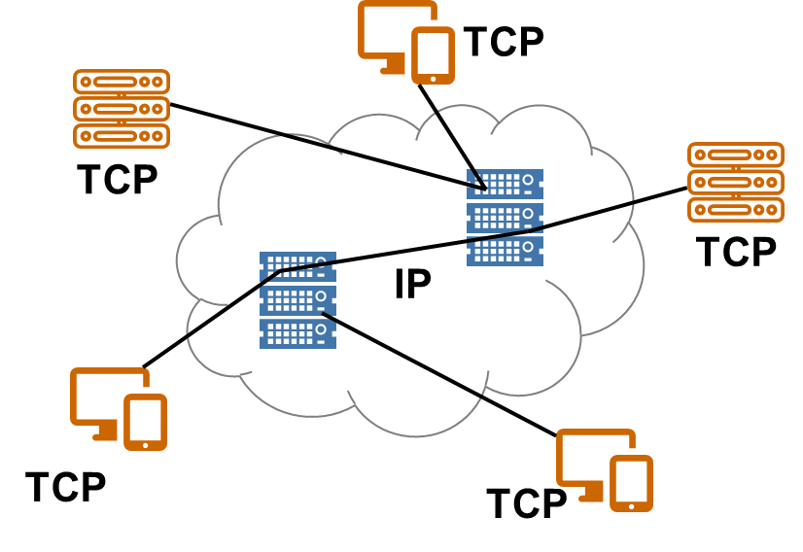
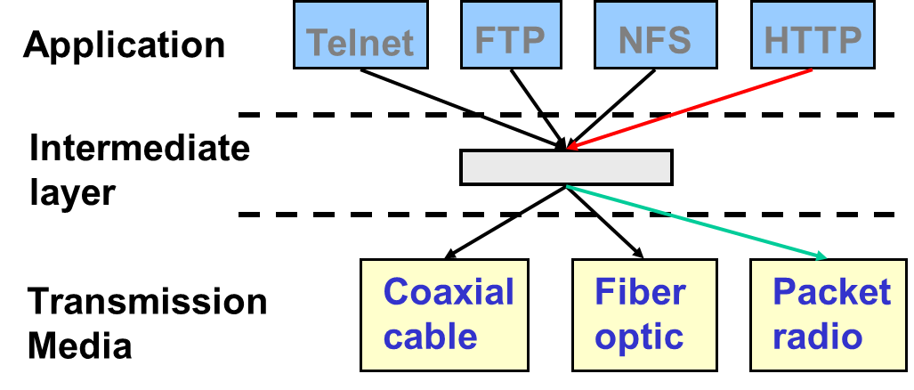
互联网体系结构的两个方面
Layering
how to break network functionality into modules
The End-to-End Argument
where to implement functionality
Layering
End-to-End

Slide 24
分层
Layer N software on the destination computer must receive exactly the message sent by layer N software on the sending computer
Mathematically, if the sender applies a transformation T, the receiver must apply the inverse T⁻¹
Recall the concept of “protocol”

Slide 25
ISO OSI Reference Model
ISO – International Standard Organization
OSI – Open System Interconnection
Started to 1978; first standard 1979
ARPANET started in 1969; TCP/IP protocols ready by 1974
Goal: a general open standard
Allow vendors to enter the market by using their own implementation and protocols

Slide 26
ISO OSI Reference Model
Seven layers
Lower three layers are peer-to-peer
Next four layers are end-to-end
Application
Application
Presentation
Presentation
Session
Session
Transport
Transport
Network
Network
Network
Datalink
Datalink
Datalink
Physical
Physical
Physical
Physical medium

Slide 27
Data Transmission
A layer can use only the service provided by the layer immediate below it
Each layer may change and add a header to data packet
data
data
data
data
data
data
data
data
data
data
data
data
data
data

Slide 28
OSI Model Concepts
Service – says what a layer does
Interface – says how to access the service
Protocol – says how is the service implemented
A set of rules and formats that govern the communication between two peers
protocol does not govern the implementation on a single machine, but how the layer is implemented between machines

Slide 29
OSI vs. TCP/IP
OSI: conceptually define: service, interface, protocol
Internet: provide a successful implementation
Application
Application
Telnet
FTP
DNS
Presentation
Session
TCP
UDP
Transport
Transport
Network
Internet
IP
Datalink
Host-to-
network
LAN
Packet
radio
Physical

Slide 30
OSI模型的问题
Andrew S. Tanenbaum 在 “Computer Networks”第三版中评价OSI:
Bad timing (too late)
Bad technology (both the model and the protocol are flawed)
Bad implementations (huge, unwieldy, and slow)
Bad politics (government and organizations bureaucrats)
Internet 标准化名言 (David Clark of MIT):
“We reject kings, presidents, and voting；we believe in rough consensus and running code”

Slide 31
关键设计决策
End-to-End Arguments
How do you divide functionality across the layers?

Slide 32
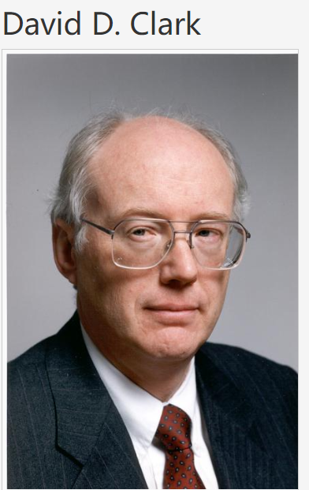
边缘论
Think twice before implementing a functionality that you believe that is useful to an application at a lower layer
If the application can implement a functionality correctly, implement it at a lower layer only as a performance enhancement
“核心简单，边缘复杂”

Slide 33
Example: Reliable File Transfer
Host A
Host B
Appl.
Appl.
OS
OK
OS
Solution 1: make each step reliable, and then concatenate them
Solution 2: end-to-end check and retry

Slide 34
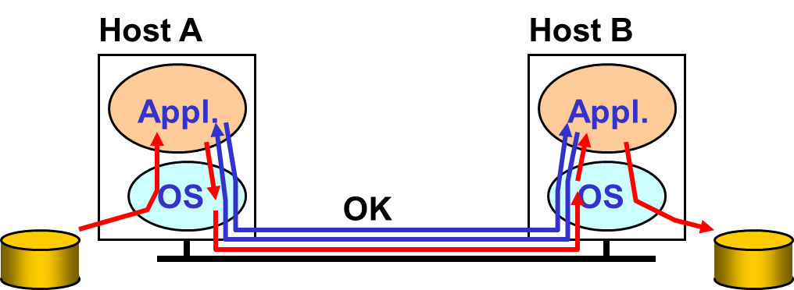
Discussion
Solution 1 is not complete
What happens if any network element misbehaves?
The receiver has to do the check anyway!
Solution 2 is complete
Full functionality can be entirely implemented at application layer with no need for reliability from lower layers
Is there any need to implement reliability at lower layers?

Slide 35
Discussion
Q: Is there any reason to implement reliability at lower layers?
A: YES. “easier” (and more efficient) to check and recovery from errors at each intermediate hop
e.g: faster response to errors, localized retransmissions

Slide 36
Trade-offs
application has more information about the data and semantics of required service (e.g., can check only at the end of each data unit)
lower layer has more information about constraints in data transmission (e.g., packet size, error rate)
Note: these trade-offs are a direct result of layering!

Slide 37
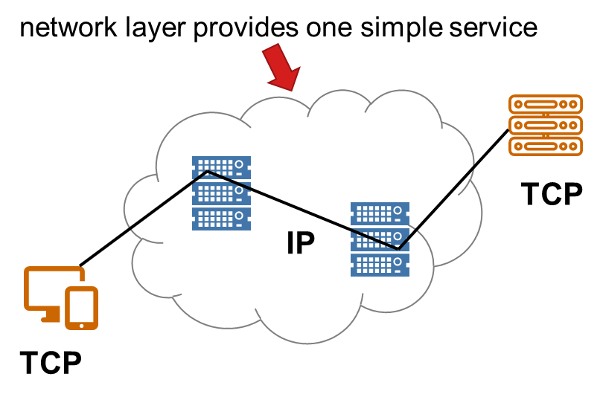
Internet & End-to-End Argument
network layer provides one simple service:
best effort datagram (packet) delivery

Slide 38
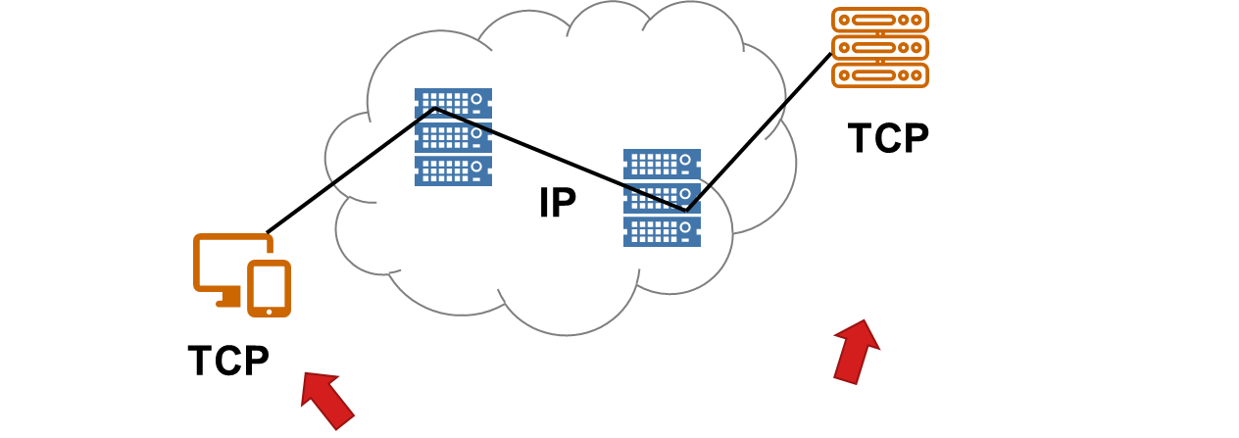
Internet & End-to-End Argument
transport layer at network edge (TCP) provides end-to-end error control

Slide 39
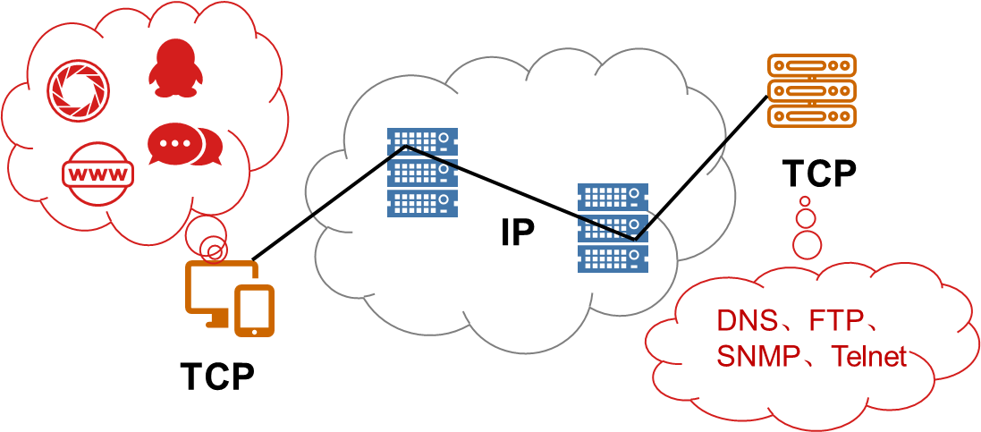
Internet & End-to-End Argument
all other functionality …
all application layer functionality
network services: DNS
implemented at application level

Slide 40
Internet & End-to-End Argument
Discussion: congestion control, flow control: why at transport, rather than link or application layers?
congestion control needed for many application
many applications “don’t care” about congestion control – it’s the network’s concern
consistency across applications- you *have* to use it if you use TCP (social contract – everybody does)
why do it at the application level
Flow control – application knows how/when it wants to consume data
Congestion control – application can do tcp-friendly

Slide 41
Internet & End-to-End Argument
Why not at the link layer
1: not every application needs/want it
2: lots of state at each router (each connection needs to buffer, need back pressure) – it’s hard

Slide 42
E2E Argument: Interpretations
One interpretation:
A function can only be completely and correctly implemented with the knowledge and help of the applications standing at the communication endpoints
Another: (more precise…)
a system (or subsystem level) should consider only functions that can be completely and correctly implemented within it

Slide 43
E2E Argument: Interpretations
Alternative interpretation: (also correct …)
Think twice before implementing a functionality that you believe that is useful to an application at a lower layer
If the application can implement a functionality correctly, implement it a lower layer only as a performance enhancement

Slide 44
End-to-End Argument: Critical Issues
end-to-end principle emphasizes:
function placement
correctness, completeness
overall system costs
Philosophy: if application can do it, don’t do it at a lower layer -- application best knows what it needs
add functionality in lower layers iff
(1) used by and improves performances of many applications
(2) does not hurt other applications
allows cost-performance tradeoff

Slide 45
Internet Design Philosophy
David D. Clark，The Design Philosophy of the DARPA Internet Protocols in Proc. SIGCOMM ‘88, Computer Communication Review
Fundamental Goal：
The top level goal for the DARPA Internet Architecture was to develop an effective technique for multiplexed utilization of existing interconnected networks. （Connect existing networks）

Slide 46
Second Level Goals
1. Internet communication must continue despite loss of networks or gateways. （Survivability）
2. The Internet must support multiple types of communications service.
3. The Internet architecture must accommodate a variety of networks.
4. The Internet architecture must permit distributed management of its resources.
5. The Internet architecture must be cost effective.
6. The Internet architecture must permit host attachment with a low level of effort.
7. The resources used in the internet architecture must be accountable.

Slide 47
谢谢

