Slide 1
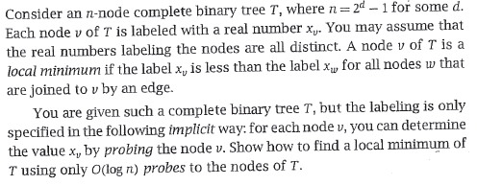
Homework
Problem

Slide 2
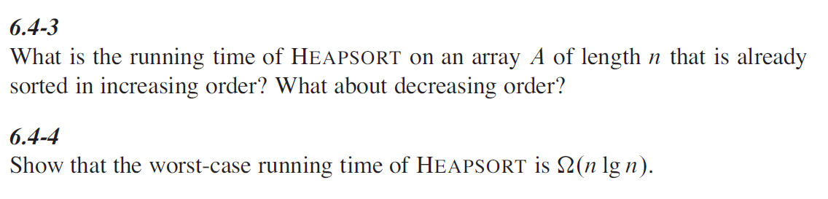
Homework
6.4-3， 6.4-4

