Slide 1
StUDENT House SOLUTION
TEAM 5:
Paa Kow 3574407
Michael 4050630
yani Troev 3596644
Date - 23/06/2020

Slide 2
Outline
Project Description(Yani Troev)
Problems to be solved ( Michael)
Process & Application( Paa Kow)
Git Repository(Yani Troev)
Gann Chart(Michael)
Quick DEMO(Team)

Slide 3
PROJECT DESCRIPTION
Student Housing BV, own a building where students (tenants) can stay during their study in the Netherlands. They have fully furnished apartments, with several rooms which are rented by the students. They also share facilities such as toilets, bathroom, kitchen, hallway, storage space, etc.
But unfortunately the management board of this housing agency has been receiving some problems/complaints as you will see in the next slide, such as :

Slide 4
Problems To be solved
Appointed persons not cleaning the shared facilities.
Groceries are not done or paid for shared items such as toilet paper, dish soap, etc.
Garbage disposal is not done on time.
Unannounced parties, gatherings.

Slide 5

Process
By creating a database to keep a clean track of the students living in the building and a record of their assigned chores and groceries.

Slide 6
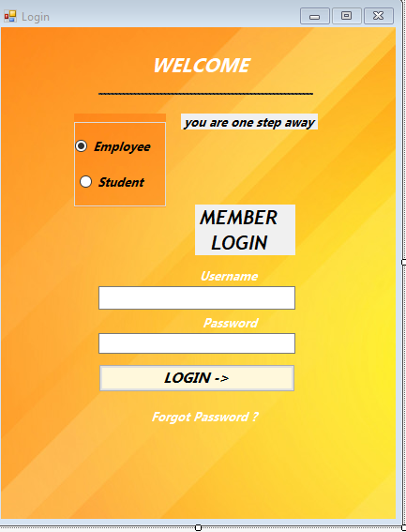
APPLICATION Function
ABLE TO KEEP TRACK OF STUDENTS.
TWO LOG IN OPTIONS
AGREEMENTS COULD BE SEEN
IT IS ABLE TO FILE A COMPLAINT(ANONYMOUSLY)
ABLE TO ASSIGN TASK TO STUDENTS
KEEP TRACK OF PAYMENT OF GROCERIES.

Slide 7
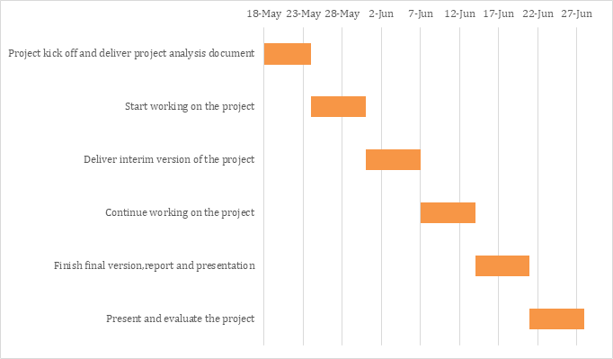
Gann chart

Slide 8
Git Repository
https://git.fhict.nl/I440770/advanced-project-semester-1-group-5

Slide 9
Problems and recommendations
Sometimes the connection to the database gets interrupted (databinding)
Due to corona crisis incidence we needed to adapt the new system of studying.

Slide 10
Quick demo

Slide 11
THANKS FOR LISTEning,any questions ?
<< Thanks for your time >>>

