Slide 1
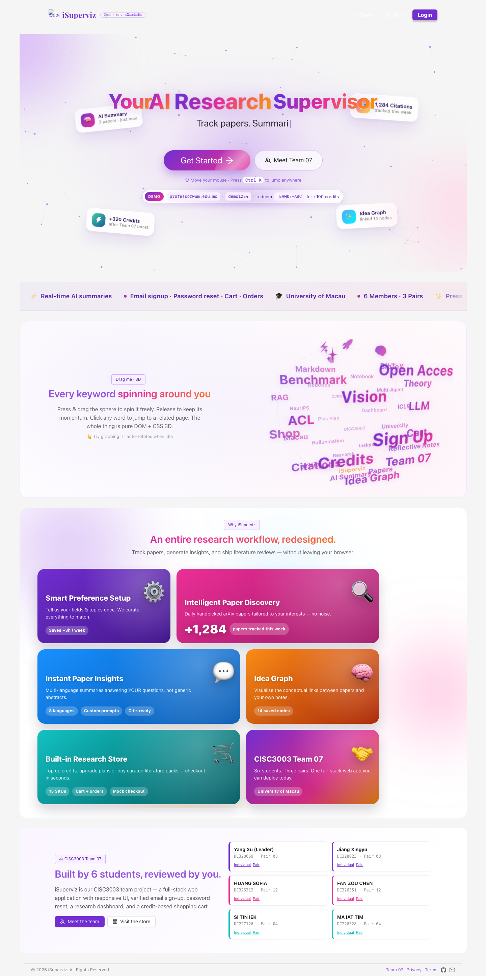
iSuperviz Individual Digital Story
1/10
Si Tin Iek (DC227126), Pair 04, Team 07
Personal focus: frontend/backend support and service integration
Project: AI research supervisor full-stack web application
CISC3003 Team 07 - iSuperviz - Si Tin Iek (DC227126)

Slide 2
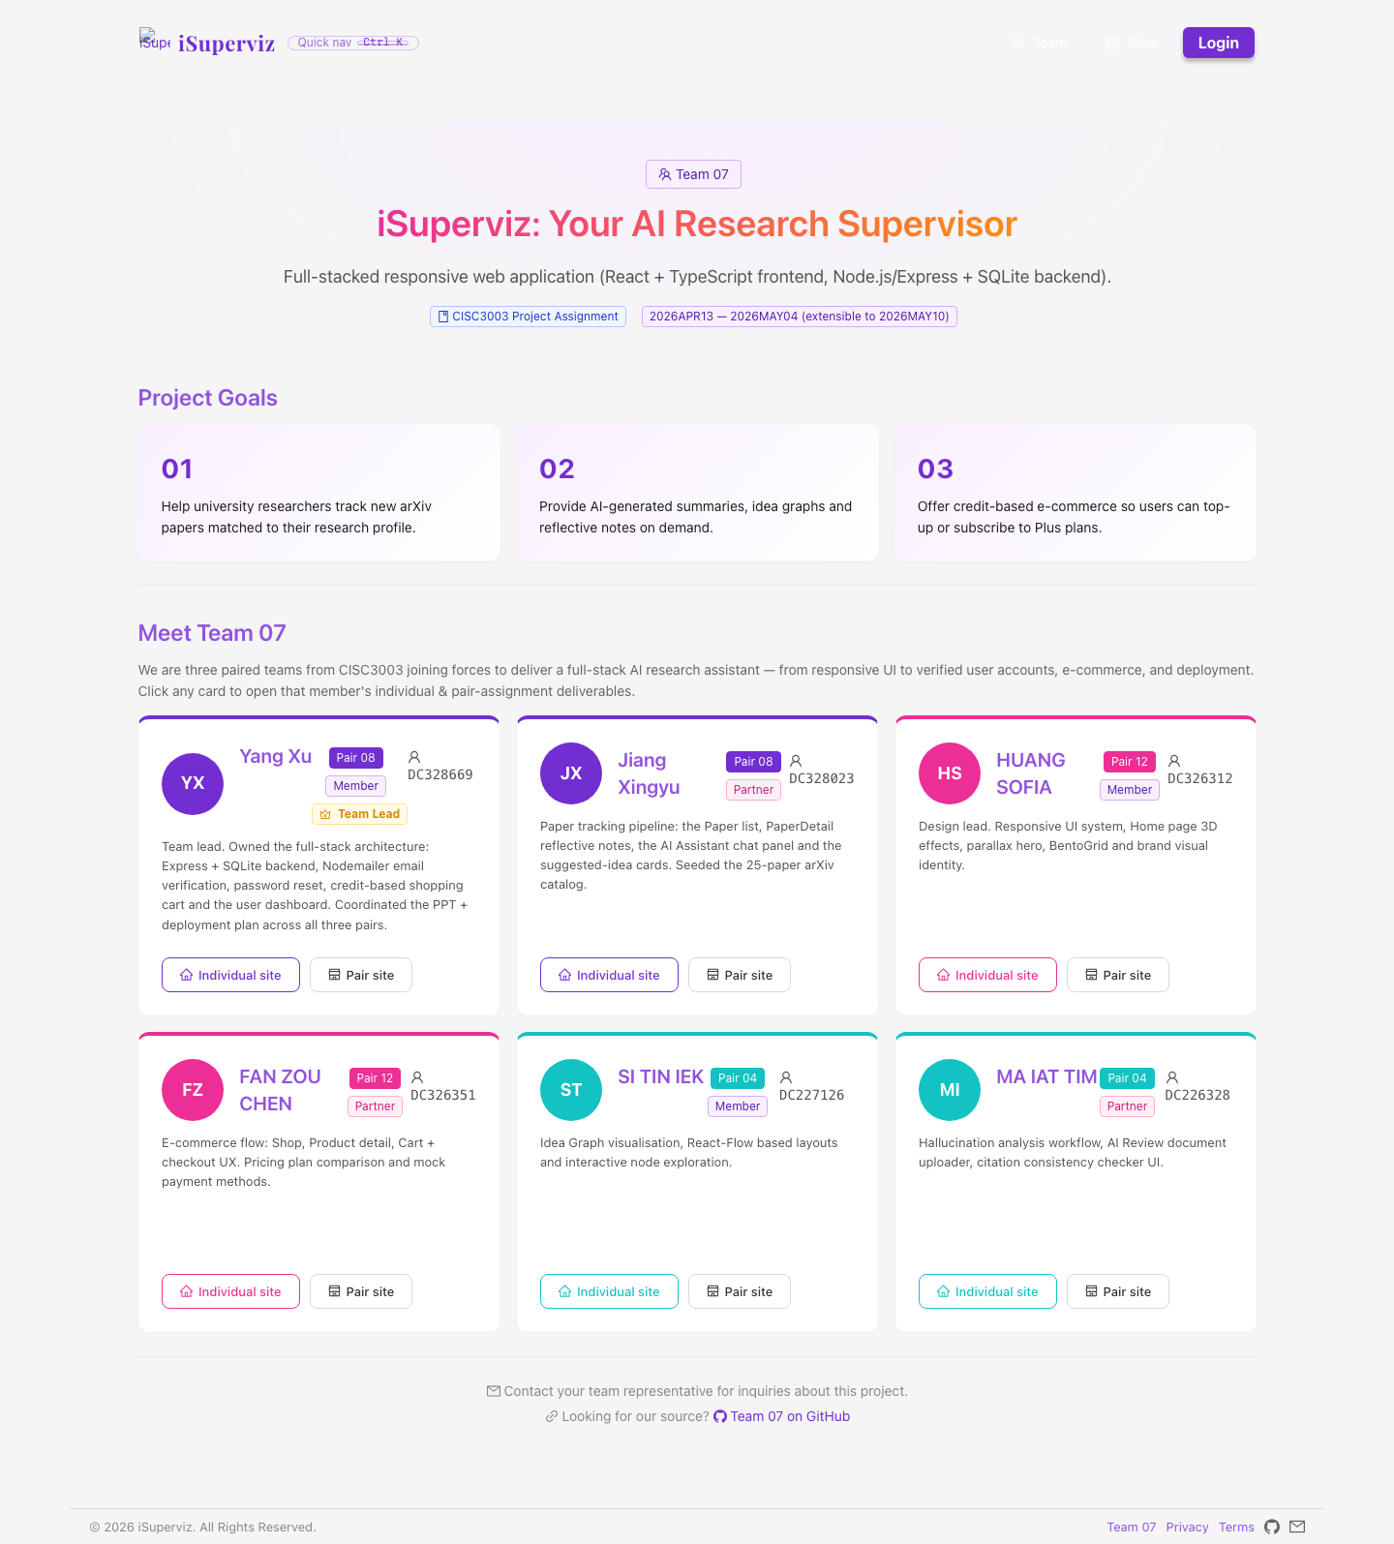
Course Requirements and My Role
2/10
RWD, full-stack services, dashboard, search, history and cart
Worked with Yang Xu on implementation support
Checked that UI pages connect to service logic
CISC3003 Team 07 - iSuperviz - Si Tin Iek (DC227126)

Slide 3
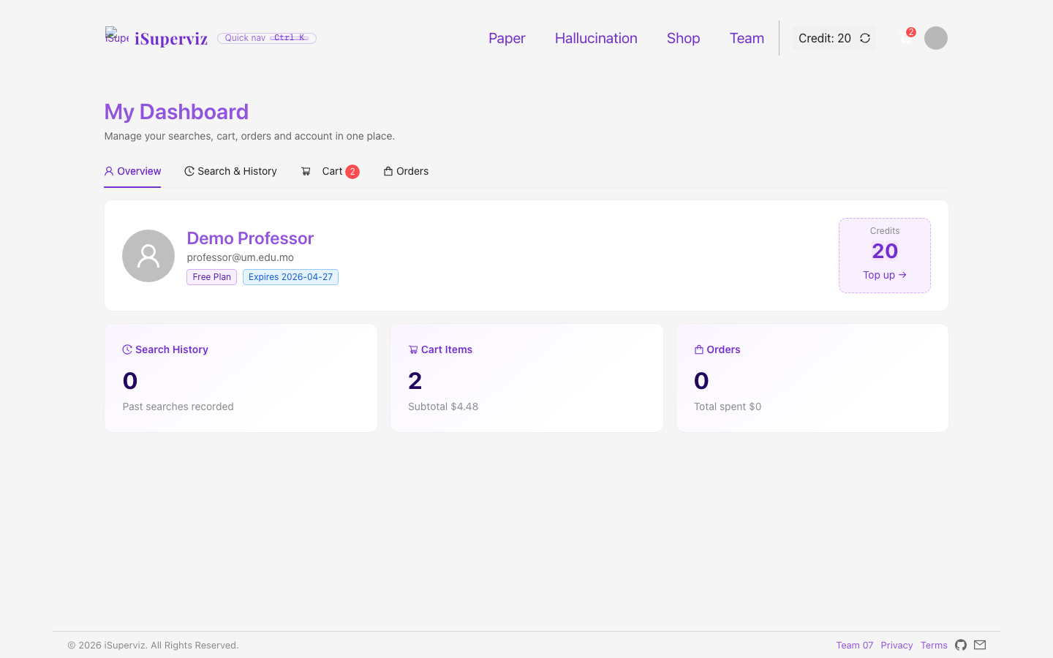
Full-Stack Architecture
3/10
React + TypeScript frontend
Express + SQLite backend in source archive
Mock API parity for GitHub Pages deployment
CISC3003 Team 07 - iSuperviz - Si Tin Iek (DC227126)

Slide 4
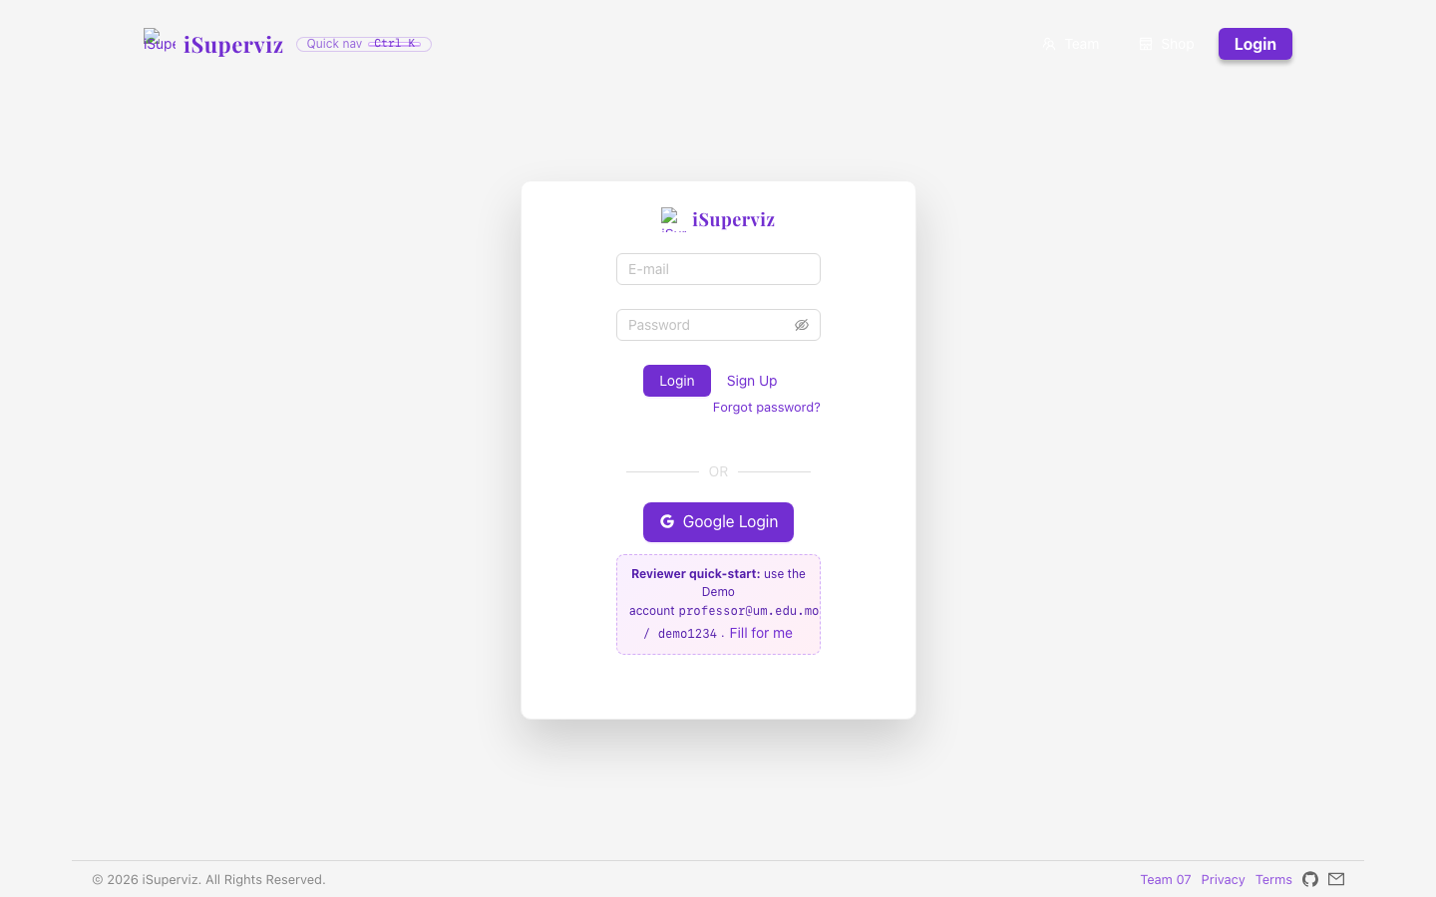
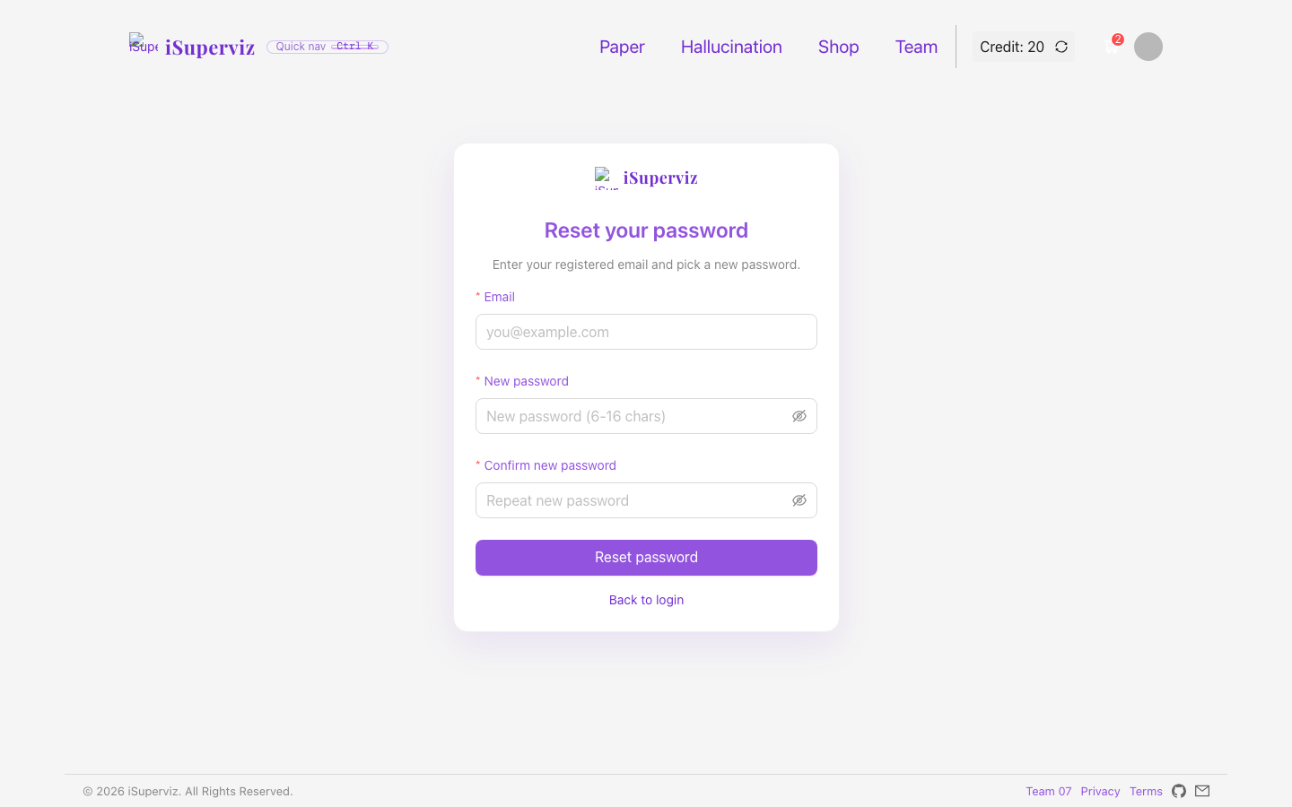
Authentication and Password Recovery
4/10
Login flow uses demo account for assessment
Forgot-password page supports account checking and reset
Backend defines captcha/email verification logic
CISC3003 Team 07 - iSuperviz - Si Tin Iek (DC227126)

Slide 5
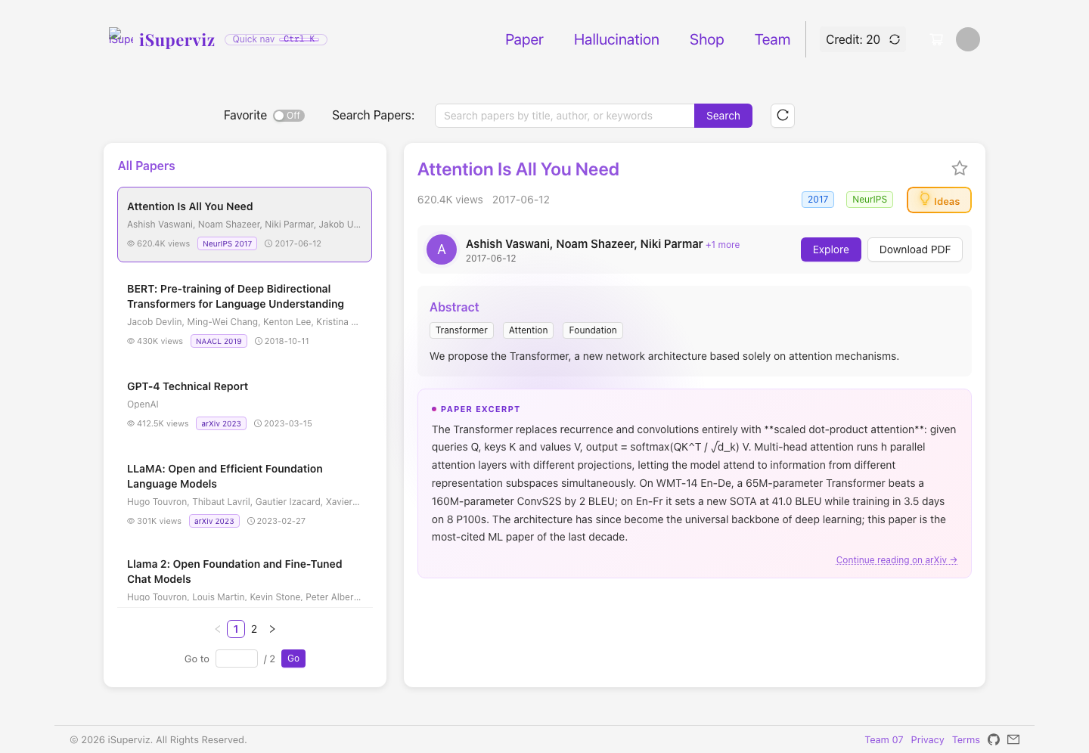
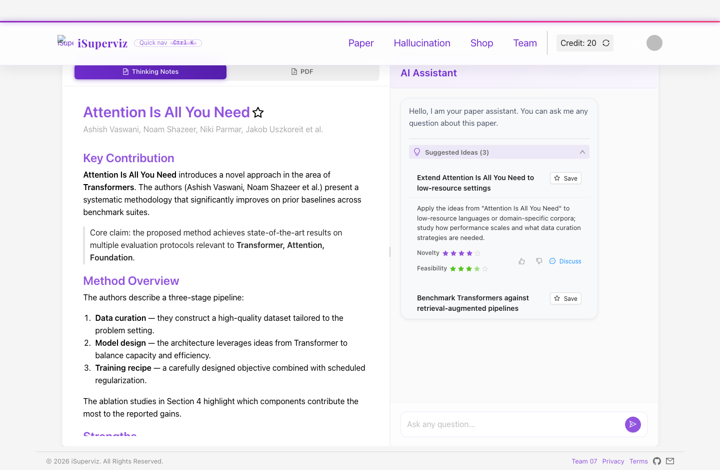
Paper Tracking Workflow
5/10
Paper list supports search, favorites and credit-aware actions
Paper detail shows notes, ideas and AI chat
Credits and state changes make the workflow testable
CISC3003 Team 07 - iSuperviz - Si Tin Iek (DC227126)

Slide 6
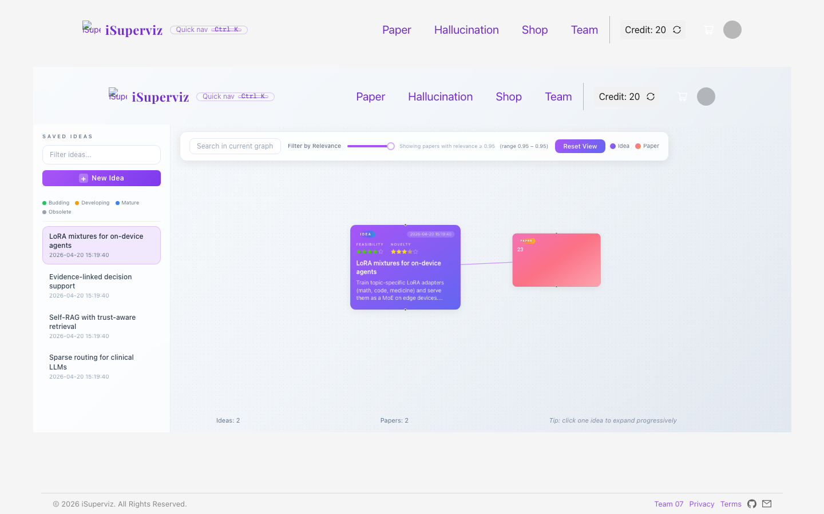
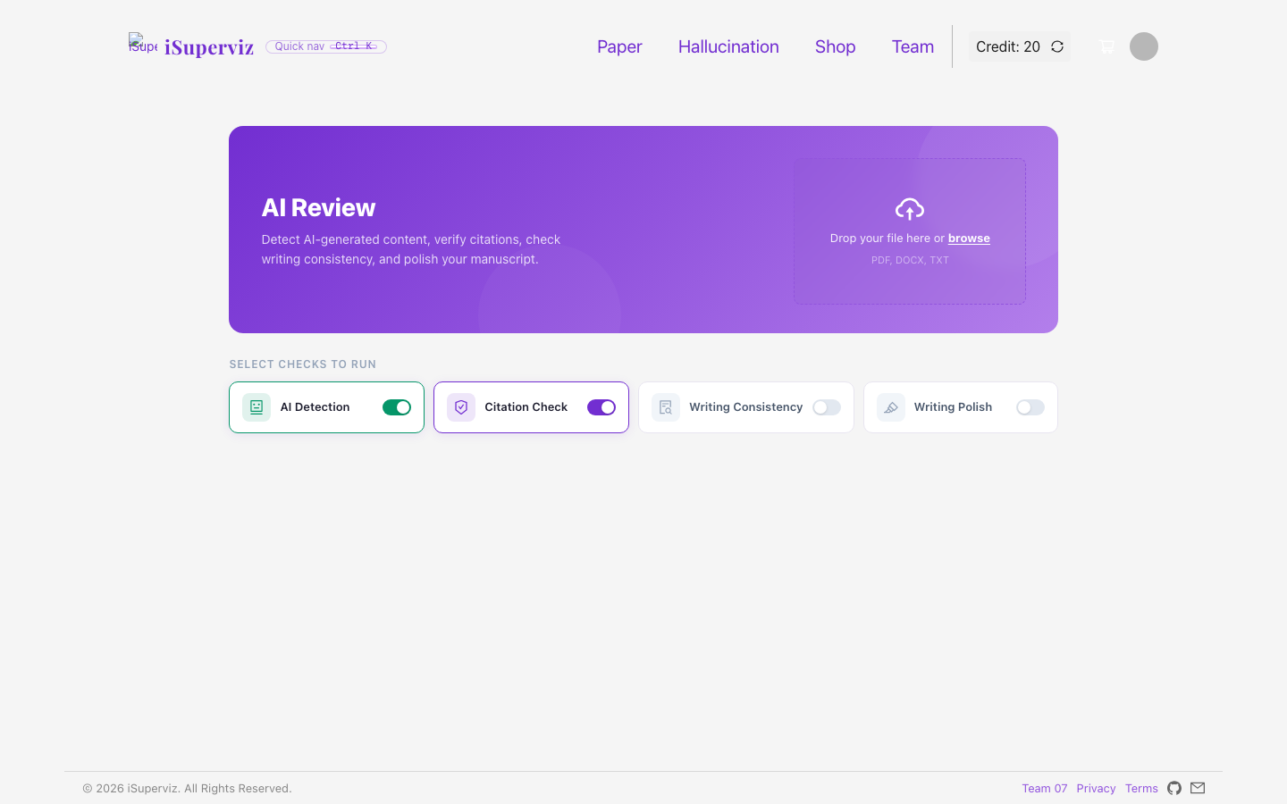
Peculiar Research Services
6/10
Idea Graph visualises saved ideas and related papers
Hallucination Audit demonstrates AI-review service
These features extend the project beyond basic login/cart pages
CISC3003 Team 07 - iSuperviz - Si Tin Iek (DC227126)

Slide 7
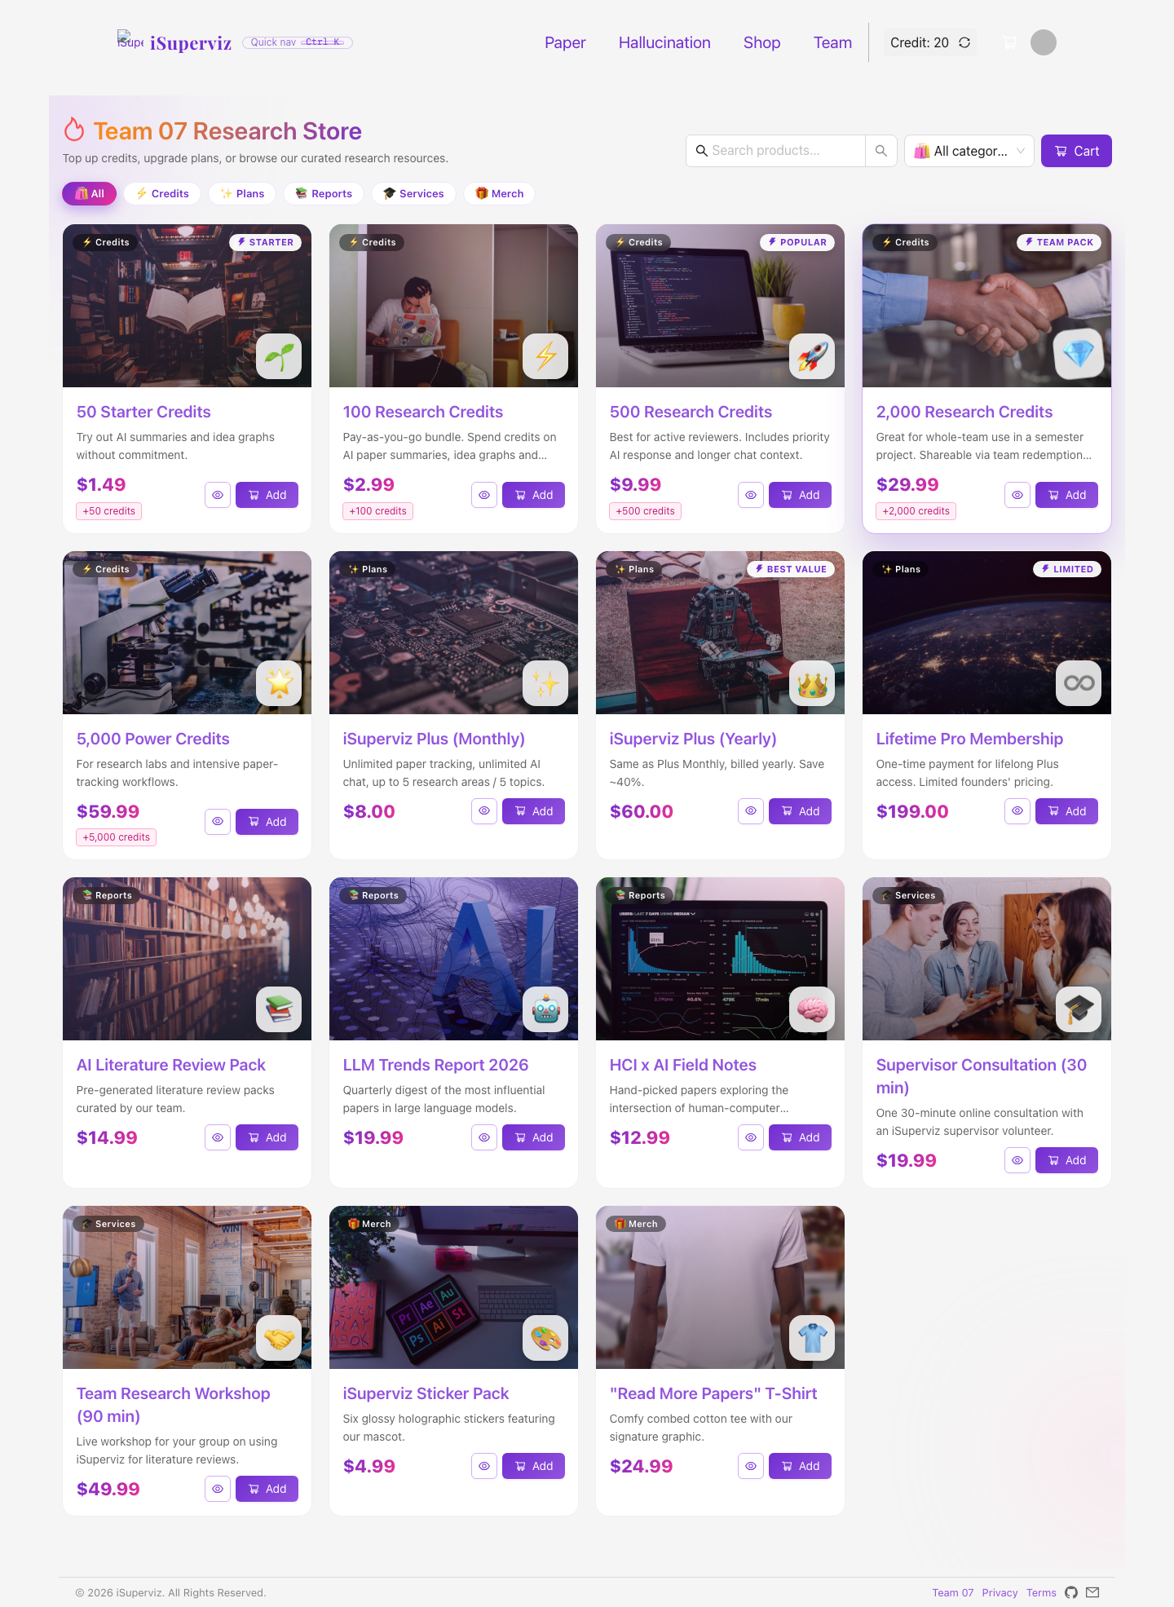
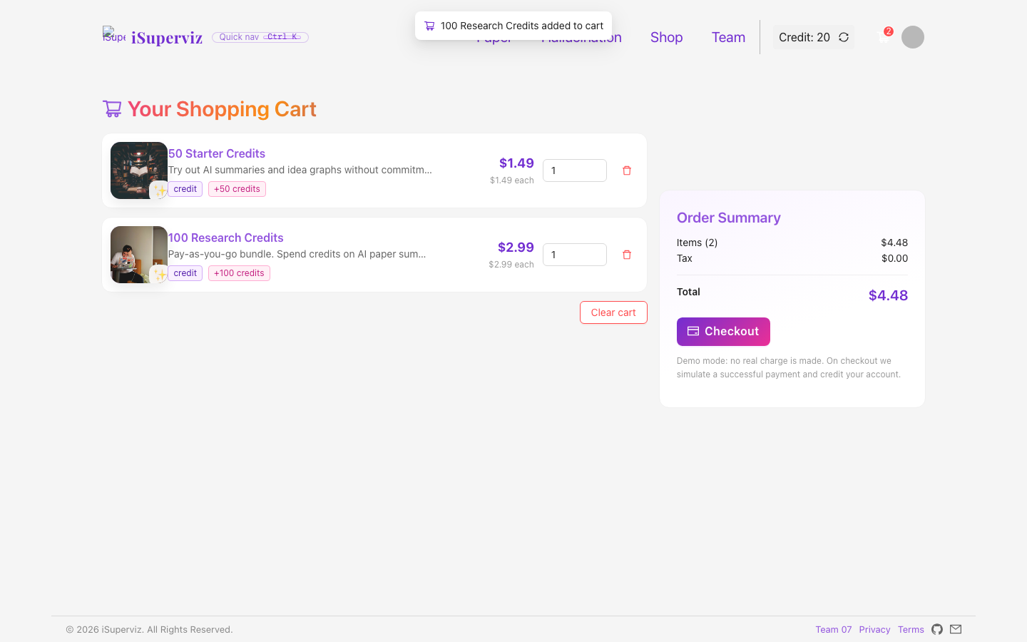
Shopping Cart and Dashboard
7/10
Shop and cart implement e-commerce requirements
Checkout updates order records and credits
Dashboard brings profile, cart, history and orders together
CISC3003 Team 07 - iSuperviz - Si Tin Iek (DC227126)

Slide 8
Testing, Deployment and Evidence
8/10
Team tests covered mock API parity and responsive rendering
GitHub Pages provides public testing URL
Screenshots document the full demo walkthrough
CISC3003 Team 07 - iSuperviz - Si Tin Iek (DC227126)

Slide 9
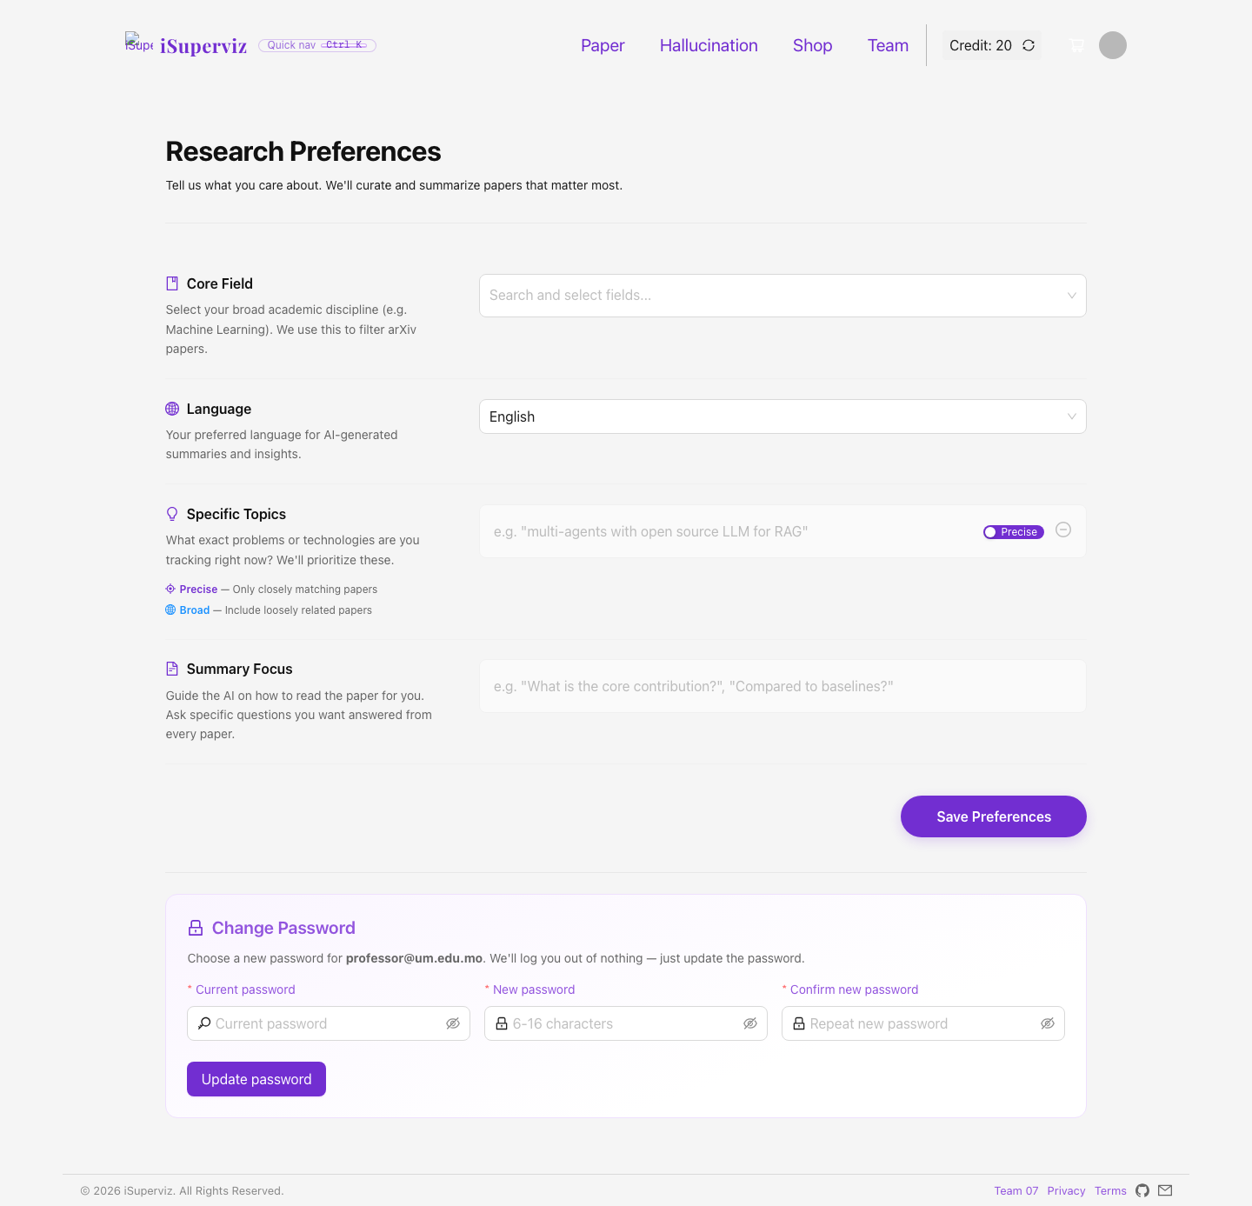
Personal Learning and Challenges
9/10
Learned the importance of shared API contracts
Managed state consistency across credits, cart and history
Practiced explaining full-stack work clearly and honestly
CISC3003 Team 07 - iSuperviz - Si Tin Iek (DC227126)

Slide 10
Submission Wrap-Up
10/10
Prepared individual report, PPT and narration script
Coding archive named cisc3003-Team07-ProjectCode.zip
Digital story should be recorded as 10-15 minute MP4
CISC3003 Team 07 - iSuperviz - Si Tin Iek (DC227126)

