Slide 1

Multi-server agent jobs administration
with happy faces and pigeons
Mikey Bronowski
Southampton Data Platform User Group
2020-02-05

Slide 2
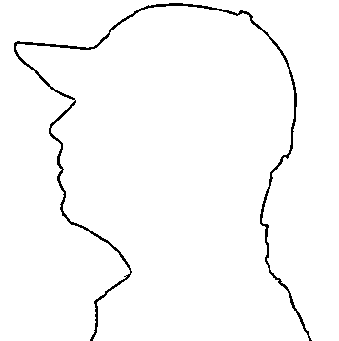



Mikey Bronowski
SQL DBA
Data Community member
Husband and father
AI Tech North ambassador
Southampton Data Platform User Group

Slide 3

Agenda
WHAT ?
WHY ?
HOW ?
Southampton Data Platform User Group

Slide 4
What? - CMS
CMS – Central Managment Server
Server Groups
Southampton Data Platform User Group

Slide 5
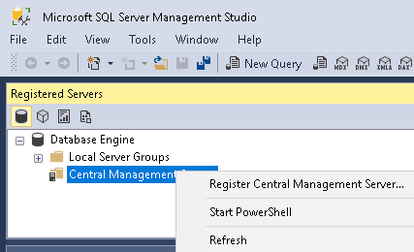
What? - CMS
Southampton Data Platform User Group

Slide 6
What? - CMS - DEMO
Southampton Data Platform User Group

Slide 7



What? - CMS
msdb
AD Auth only ServerGroupAdministratorRole
ServerGroupReaderRole
Southampton Data Platform User Group

Slide 8
What? - MSX
MSX – Master server
TSX – Target server
Hidden feature of SQL Server
Southampton Data Platform User Group

Slide 9






What? - MSX
Definition
One2Many
3…2…1
Southampton Data Platform User Group

Slide 10
What? - MSX
Don’t be a pigeon
Southampton Data Platform User Group

Slide 11
Why?
Challenges
Needs
Southampton Data Platform User Group

Slide 12
How? - DEMO
Southampton Data Platform User Group

Slide 13
Summary
CMS / Registered Servers
GUI / T-SQL / dbatools
Emoji in SQL
Master / Target Servers
Southampton Data Platform User Group

Slide 14
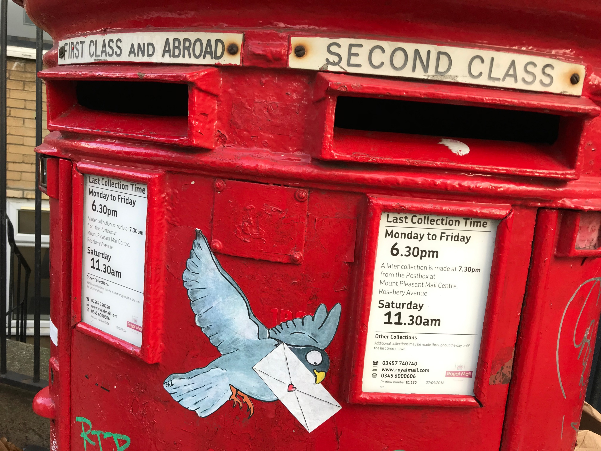
Don’t be a pigeon… really
www.flickr.com/photos/londonmatt/45275167535
Southampton Data Platform User Group

Slide 15
Thank you
Southampton Data Platform User Group

Slide 16
Mikey Bronowski
Linkedin.com / MikeyBronowski
MikeyBronowski @gmail.com
Github.com / MikeyBronowski
Twitter.com / MikeyBronowski
Southampton Data Platform User Group

