Slide 1
Data Cleaning and Preprocessing

Slide 2
Data Quality
Data is said to be of good quality as long as it can satisfy the requirements of its intended use
accuracy, completeness, consistency, timeliness, believability, and interpretability.

Slide 3
Why Data Quality Matters in Data Science, AI and ML
Foundation for Model Training
Ensures Model Performance
Reduces Bias and Variance
Data Driven Insights
Ethical and Resposible AI

Slide 4
Importance of Data Cleaning and Preprocessing:
Enhances Data Quality
Improve Model Performance
Handling Missing Values
Deal with outliers
Handle Categorical Variables
Feature Engineering
Reduce Computational Complexity

Slide 5
Data Exploration
Data exploration is the initial step in the data analysis process, aimed at gaining a preliminary understanding of the dataset.
Understand the structure, content, and quality of the data.
Displaying basic statistics using head(), tail(), info(), describe()
Identifying the structure, types, and summary of data

Slide 6
Data Cleaning
Data cleaning involves identifying and correcting errors, inconsistencies, and missing values within a dataset.
It ensures that the data is accurate, complete, and reliable, laying a solid foundation for further analysis and modeling.

Slide 7
Data Cleaning Techniques
Handling missing values: imputation, removal, or interpolation.
Removing duplicates.
Correcting errors and inconsistencies.
Handling outliers.

Slide 8


Slide 9
Data Preprocessing
After exploratory data analysis and data cleaning
Preparing data for modeling
Data preprocessing involves transforming and organizing raw data into a format suitable for analysis and modeling.
Example: transforming categorical features into numerical features (dummy variables)

Slide 10
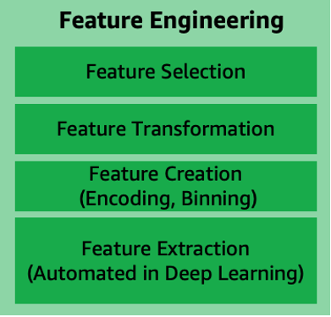
Data Preprocessing Techniques
Feature Engineering
Imbalanced Data Handling
Text Data Preprocessing
Handling Time Series Data
Test Train Split

Slide 11
What is standardization?
Standardization: transform continuous data to appear normally distributed
scikit-learn models assume normally distributed data
Using non-normal training data can introduce bias
Applied to continuous numerical data

Slide 12
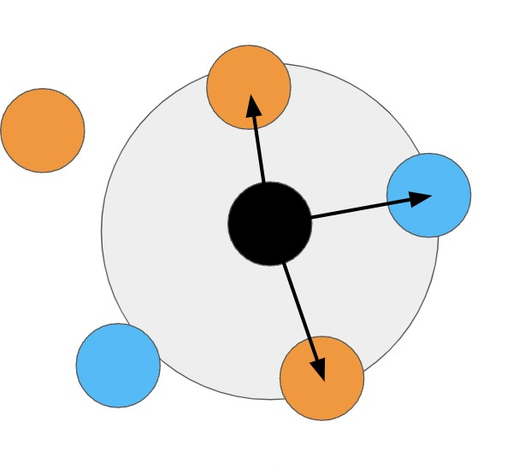
When to standardize
Linear distance
Model in linear Space
Examples:
k-Nearest Neighbors (kNN) Linear regression
K-Means Clustering
high variance
Different scales
Example
Predicting house prices using no. bedrooms and last sale price

Slide 14
Feature scaling
Features on different scales
Model with linear characteristics
Center features around 0 and transform to variance of 1
Transforms to approximately normal distribution

Slide 16
feature engineering
Creatin of new features from existing ones
Improve performance
Insight into relationships between features Need to understand the data first!
Highly dataset-dependent

Slide 17
feature selection
Selecting features to be used for modeling
Doesn't create new features
Improve model's performance

Slide 18
When to select features
Reducing noise
Features are strongly statistically correlated
Reduce overall variance

Slide 19
Redundant features
Remove noisy features
Remove correlated features
Remove duplicated features

Slide 20
Correlated Features
Statistically correlated: features move together directionally
Linear models assume feature independence
Pearson's correlation coefficient

Slide 21
Training and test sets

Slide 22
Why split?
Reduces overfitting
Evaluate performance on a holdout set

Slide 23
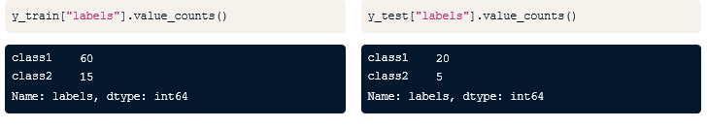
Stratified sampling
Dataset of 100 samples: 80 class 1 and 20 class 2
Training set of 75 samples: 60 class 1 and 15 class 2
Test set of 25 samples: 20 class 1 and 5 class 2

Slide 24
Shuffle and Random State in Train-Test Split
randomness and reproducibility in model evaluation.

