Slide 1

Разработка веб-приложений
Преподаватель: Трубочкина Надежда Константиновна
MIEMcam web
Выполнили:
Куркин Александр
Николенко Михаил
Москва, 2021

Slide 2

MIEM media technology laboratory
Оглавление
Постановка задачи

Slide 3
MIEM media technology laboratory
Постановка задачи
Наша разработка - сайт, объединяющий все медиа-сервисы МИЭМ. На момент презентации проекта реализовано управление камерами в аудиториях, назначение записи лекций и наложение эффектов на фото. Дополнительно реализованы просмотр и управление расписанием
Целевая аудитория проекта – работники медиацентра МИЭМ. Сайт призван помочь упростить их текущий рабочий процесс, а именно проведение записи, сохранения и монтажа видео с различных мероприятий в аудиториях университета. Если раньше для этого нужно было пользоваться множеством различных программ и приложений, то в нашем проекте мы собрали все нужные для работы интрументы в один веб-сервис.

Slide 4

MIEM media technology laboratory
Problem Description
MIEM media center needs an approach to control universities cameras in auditories through a mobile application from all over the world

Slide 5
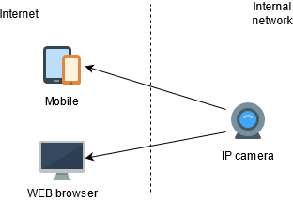
MIEM media technology laboratory
Task demands
Camera placed in the university internal network but its video should be available on the Internet
Camera video should be available in a mobile client and in a browser client without additional plugins
Camera video showing should have the least possible latency

Slide 6
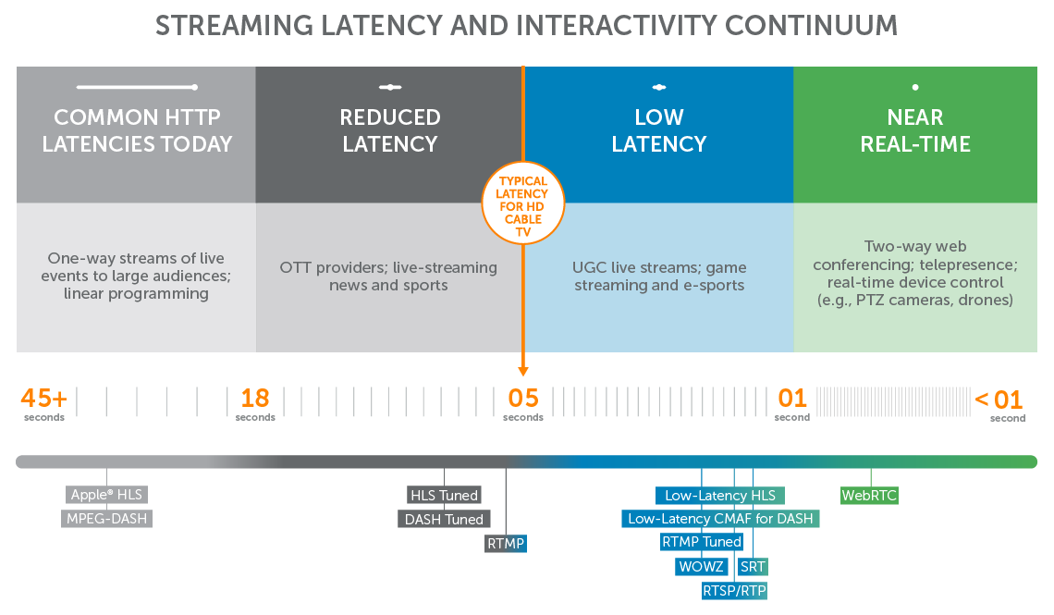
MIEM media technology laboratory
Webrtc
Real time latency
Full browser support (for further development)
Designed to resolve most of the WEB media streaming problems (NAT traversal e.g.)

Slide 7
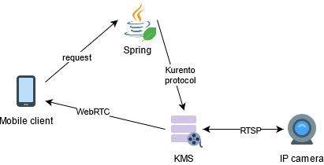
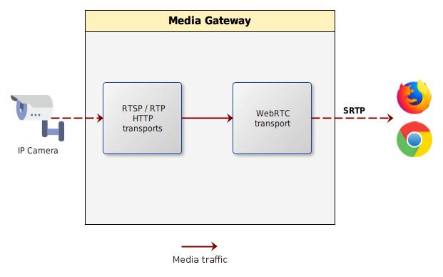
MIEM media technology laboratory
Kurento media server
Swiss-army knife for WebRTC development
Allows to create media pipeline which receives RTSP video and converts it to the WebRTC endpoint
KMS controlled by a special Kurento protocol so it requires an additional server which translates client commands to the language, understandable by KMS

Slide 8
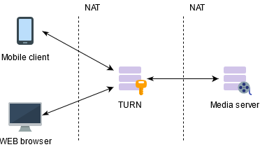
MIEM media technology laboratory
Turn server
Resolve double NAT problem
Allow to host media server on the inner university servers without personal IP addres
Implements different sequrity features such as authorization, protection of media server from attacks and others

Slide 9
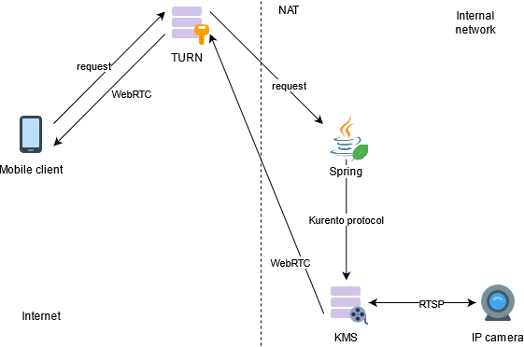
MIEM media technology laboratory
Solution architecture
Client authorizes in TURN server
TURN connects client to the Java Spring server placed in the university network
Java server generate command to Kurento media server to implement pipeline which receive video from particular IP camera and flush it through WebRTC endpoint
Client receive video

Slide 10
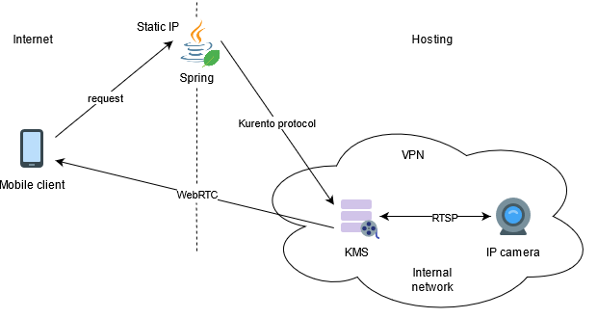
MIEM media technology laboratory
Current temporary architecture
Current features:
KMS and Java server placed in the hosting with personal static IP so client has direct access to the Java server
Hosting connected to the university internal network through VPN
Process:
Client direcly connects to the Java server
Java server generate command to Kurento media server to implement pipeline which receive video from particular IP camera and flush it through WebRTC endpoint
Client receives video

Slide 11
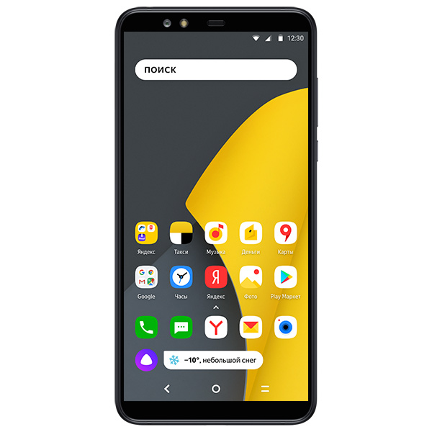
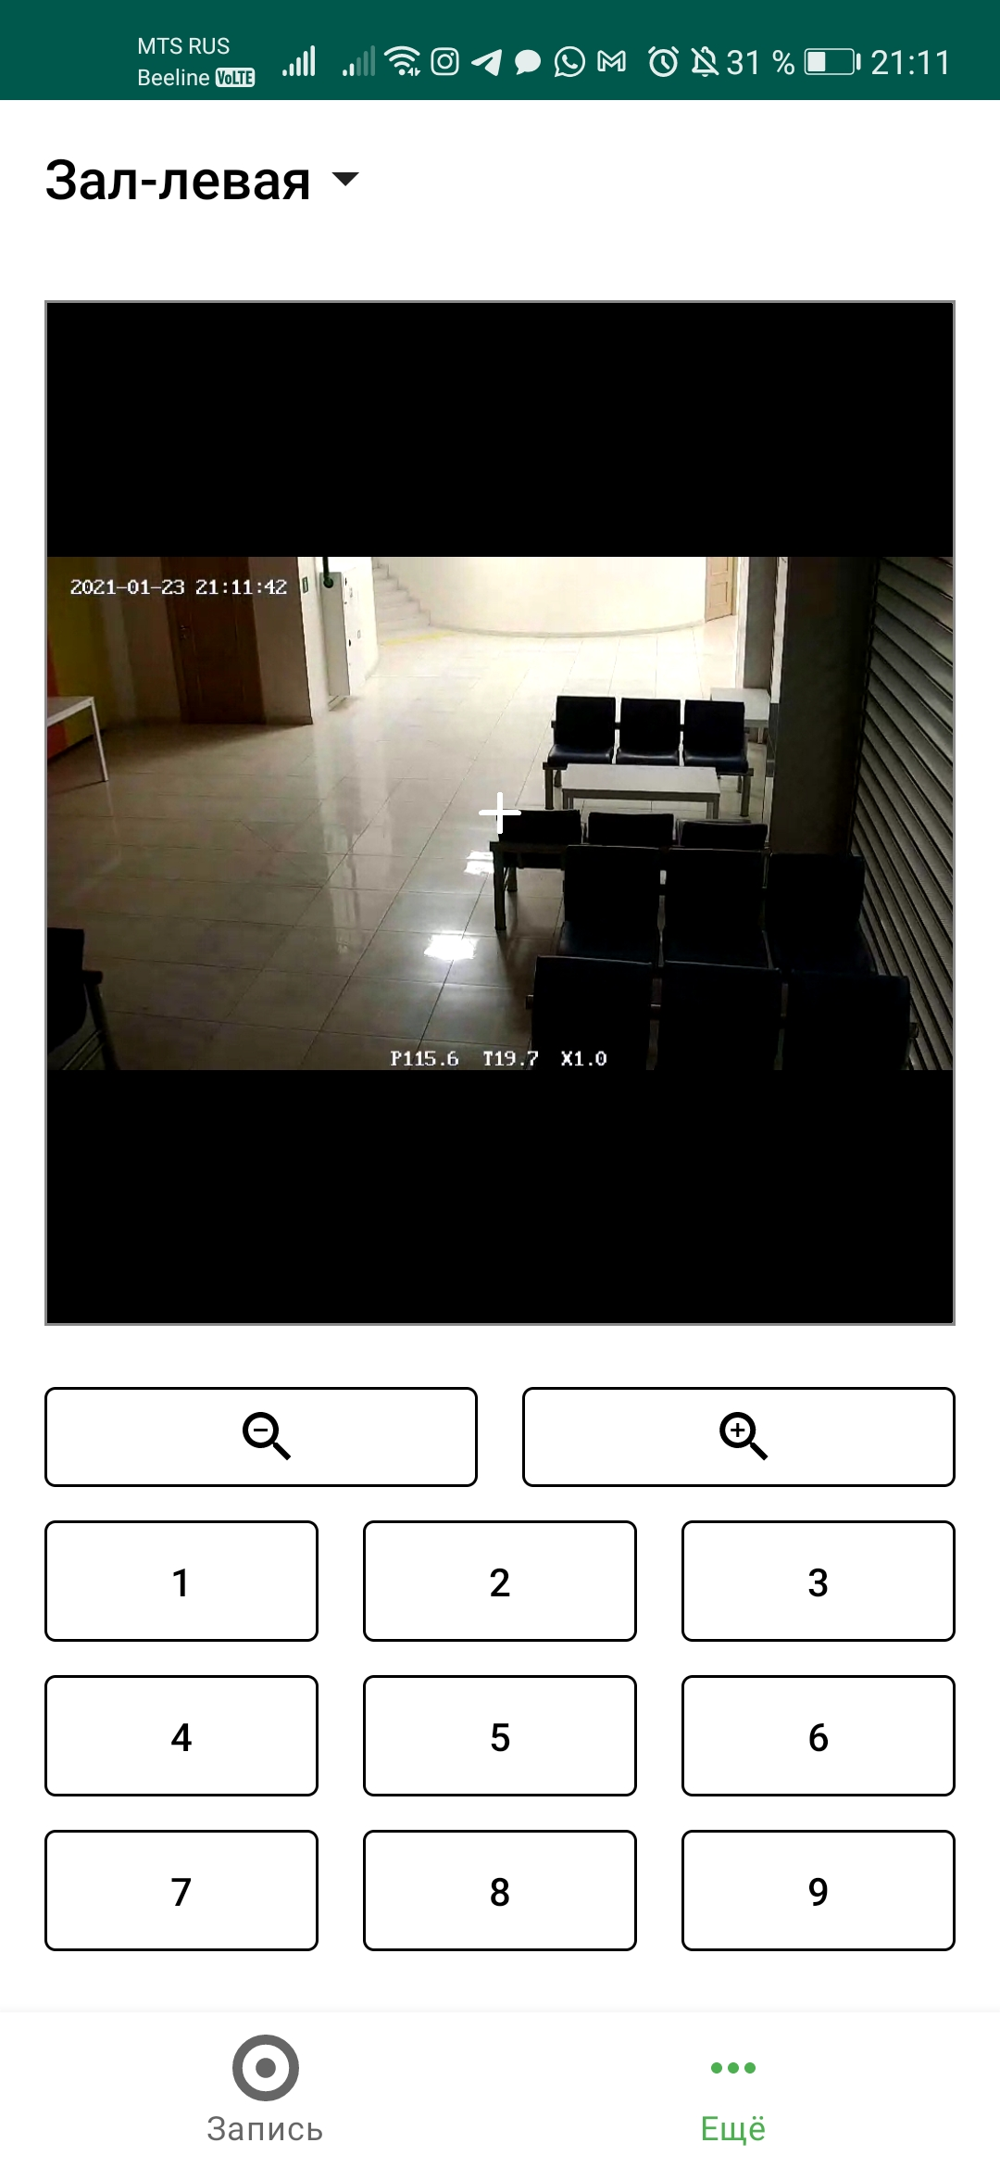
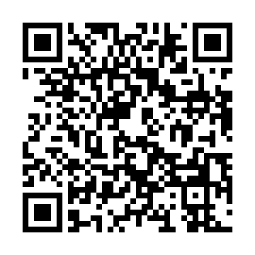
MIEM media technology laboratory
Achieved and anticipate results
Achieved results:
Implemented temporary architecture
Client application is created and embedded into MIEMcam
Video from a camera successfully shows at mobile client of MIEMcam
TODO:
Integrate TURN server
MIEMapp

Slide 12
MIEM media technology laboratory
Conclusion
I strongly believe that MIEMcam application make process of work of MIEM media center becomes more convenient and confident and quality of further media center produced content will rise on a higher level.
Thank you for listening!

