Slide 1
Competency Based Management System for ITMO
University Technopark
Boris Gordeev and Olesya Baraniuc, ITMO University, Alexey Kashevnik, SPIIRAS

Slide 2
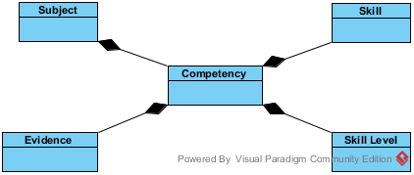
What is it?

Slide 3
How do skill levels work?
Skills have their own scales
Scales start from level 0 (no knowledge or experience)
If you’re gaining experience in the field, you’re gaining levels

Slide 4
What does it give?
Skills are now math!
Push-learning instead of pull-learning.

Slide 5
Working process
Administrators create skills.
Users register (or get registered) and provide information about themselves.
Users’ competencies can be compared against each other.

Slide 6
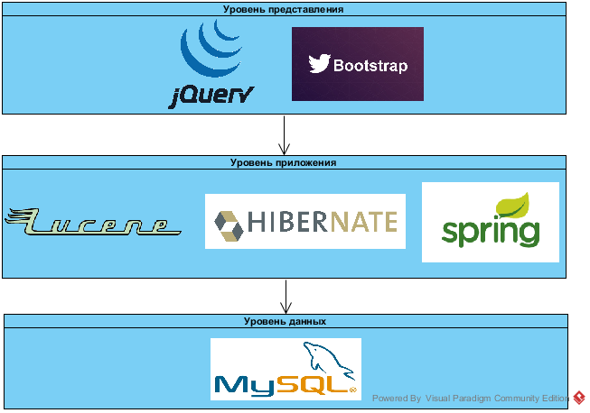
Implementation

