Slide 1
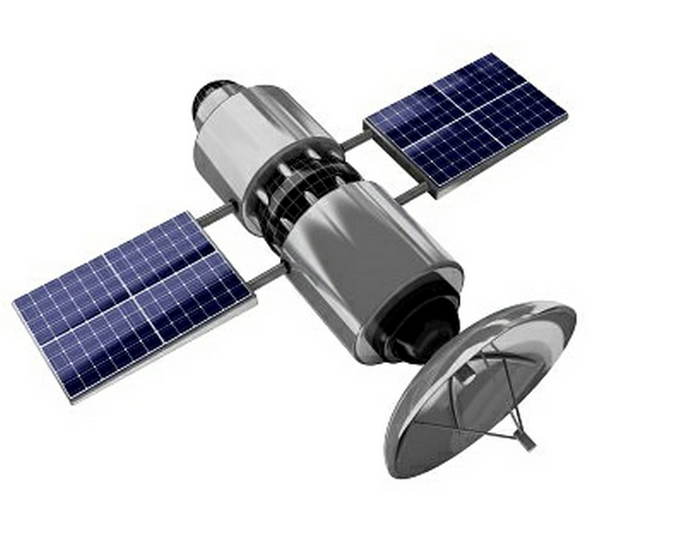









Architecture Overview
Location Awareness
AWS (Amazon Web Services) with ElastiCache
Three Environments:
1. Dev
2. Staging
3. Production
Dev
* Python Django Backend
* PostgreSQL Database
* WebSocket or other messaging service for updating front end and mobile apps interface
Staging
Production

Slide 2

Amazon Web Services – AWS ElastiCache
https://aws.amazon.com/elasticache/
Improves performance for Mobile Apps, Social Media, Games etc
Stores highly important pieces of data in memory for speedy access
Better response times to database queries; higher throughput and lower latency!
CRITICAL FOR SCALING!!!

Slide 3
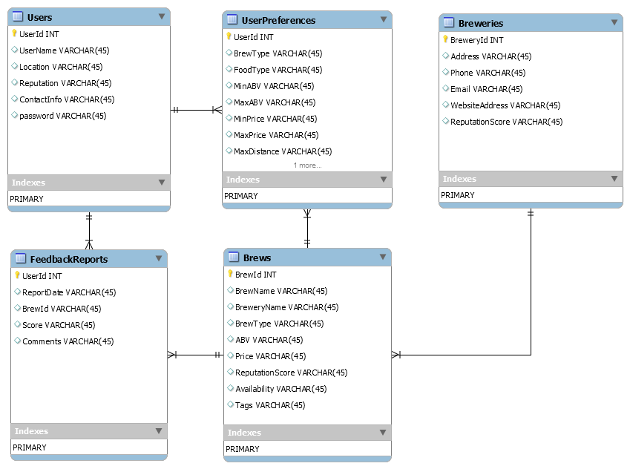



Database Model

Slide 4
User Accounts
Drinkers as well as breweries, pubs/restaurants and liquor stores can all register and create accounts but would have different permissions
Drinkers can rate and provide feedback for breweries/pubs/restaurants/liquor stores
All others have edit permissions for their ‘site’ so that they can add/delete beers and edit prices and such but THEY CANNOT RATE BREWS, THEIR OWN OR OTHERS

Slide 5
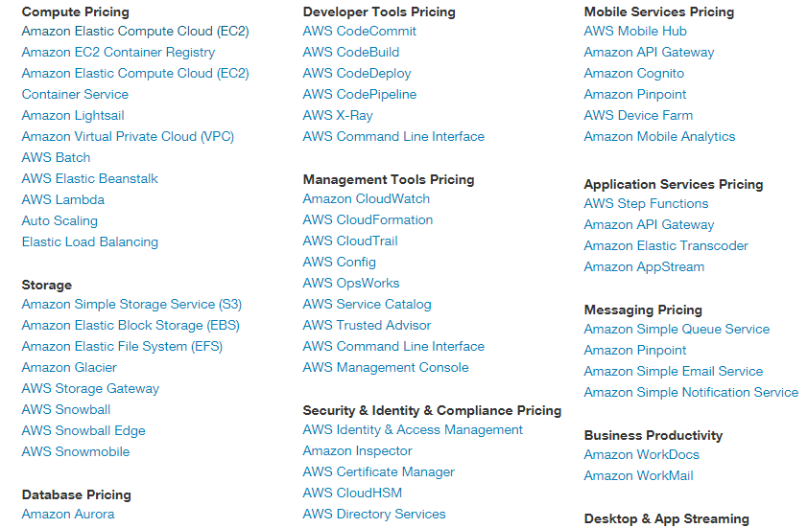
Pricing for Services
Depends on which services we use …

Slide 6
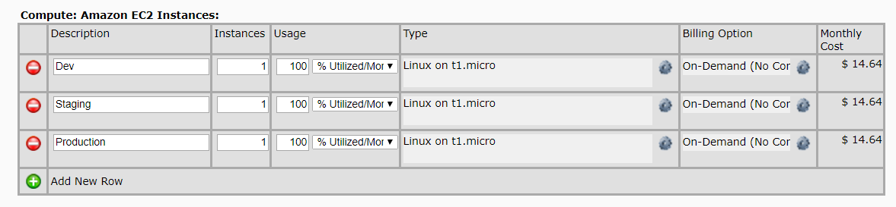
Pricing Examples
Three EC2 (Elastic Computing) Instances

Slide 7
Roadmap
Phase 1 (launch date in Q3 of 2018 – 1 year)
Website and Android/iOS mobile apps
Covers the tri-state (NY/NJ/CT) area microbreweries and pubs/restaurants
Stores user preferences and feedback reports/ratings
Basic location awareness: shows stored breweries/pubs/restaurants that carry craft beers on map, accepts a radius preference
Users build up reputation when they submit ratings/feedback reports
Basic messaging service for users to optionally contact each other and build up a community

Slide 8
Roadmap Continued
Phase 2 (to be completed by Q3 of 2019 – 1 year)
Expand coverage area to other parts of the country by encouraging micro-breweries to register and also create accounts to grow the database and the knowledge base through given user various incentives to provide feedback
Implement the ability to order samples and other brewery products directly through our website
Logistics and distribution are TBD

Slide 9
Software Development Headcount
Director of Software Development
Senior Backend Developer (Python/Django, PostgreSQL, AWS, Redis)
Senior Frontend Developer (HTML5/CSS/Javascript, Google Maps API)
Senior Mobile Developer (Android/iOS, Google Maps API)
Software QA Engineer
DevOps Engineer (AWS/PostgreSQL/Redis/cyber-security)

Slide 10
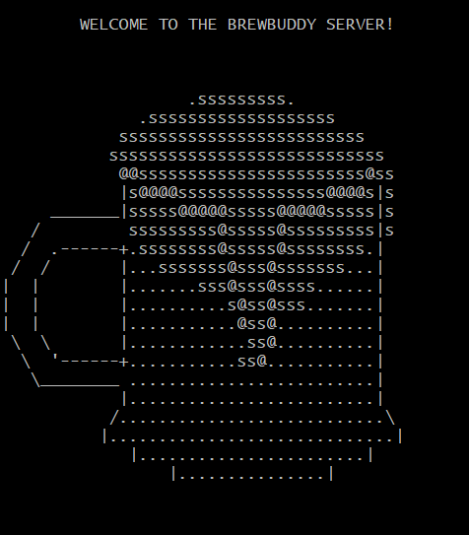
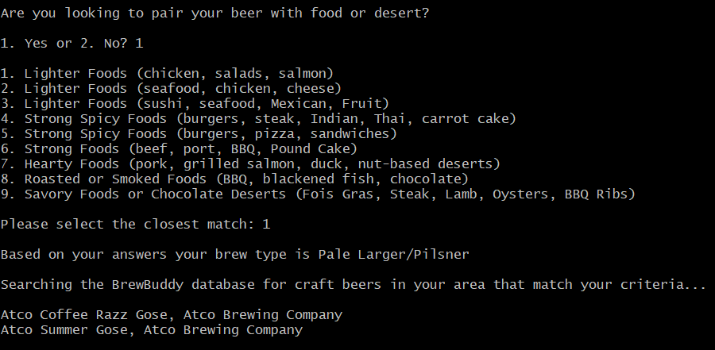
Rapid Prototype – Proof of Concept
A script that queries a sample database of local brews based on preferences:

Slide 11




Wireframes for Android/iOS apps
LOGIN
Type of account:
INCONSIDERATE DAWWG STORTER
DOUBLE PARKED DOUBLE IPA
SPF 13 SUMMER ALE
HEAVEN, HELL OR HOBOKEN AMERICAN IPA
PATH- PALE ALE TRUE HOBOKEN
"BLACK DYNOMITE" BLACK IPA
KIWI KRUSH IPA
SINGLE HOP IPA (ROTATING HOP. AMARILLO CURRENTLY)
View Details
o Beer-lover
Create Account
o Brewery
Submit a Review
o Pub/restaurant
Find it!
o Liquor Store
Add to Favorites

Slide 12

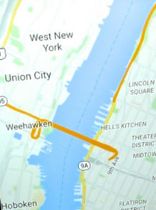

Wireframes for Android/iOS apps
* Take our survey
7 Mile Brewery
INCONSIDERATE DAWWG STORTER
DOUBLE PARKED DOUBLE IPA
SPF 13 SUMMER ALE
HEAVEN, HELL OR HOBOKEN AMERICAN IPA
PATH- PALE ALE TRUE HOBOKEN
"BLACK DYNOMITE" BLACK IPA
KIWI KRUSH IPA
SINGLE HOP IPA (ROTATING HOP. AMARILLO CURRENTLY)
* Browse Local Breweries
902 Brewing
* Checkout Featured Beers
Angry Erik Brewing
* Checkout Recommnded
Ashbury Park Brewery
* View BrewBuddy Map
Atco Brewing Company
* Settings
902 Brewing

