Slide 1
Time series modeling and forecasting based on a Markov chain with changing transition matrices
Summary

Slide 2
Main ideas
Subject: prediction in a financial time series based on a model in the form of Markov chains
Optimization aim: finding the best window length, the number of windows and the number of intervals is to increase the predictive efficiency of the transition matrices
State: we should cluster time series in some uniformly distributed states and then predict the next state by Markov Chain
Trading: we should open long position for asset when the probability of the higher state is more, according to the Markov predictions, than the lower state. Vice versa – if this probability is less, we should open the short position

Slide 3
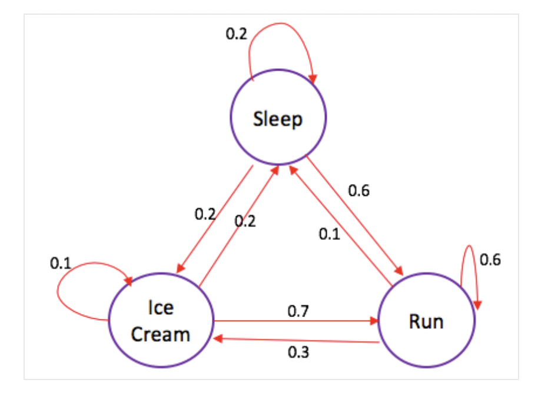
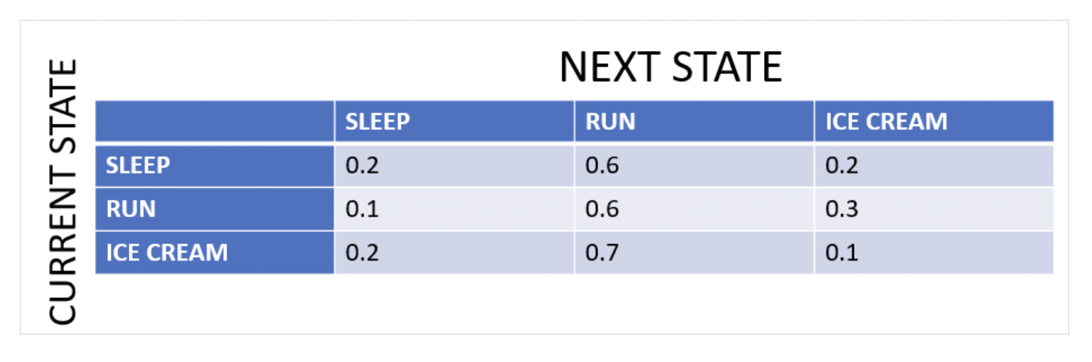
How do Markov Chains work
We have some states and want to predict next state according to current state
Principle: probability of the next state depends ONLY on the current state
We should form transition matrices like that

Slide 4
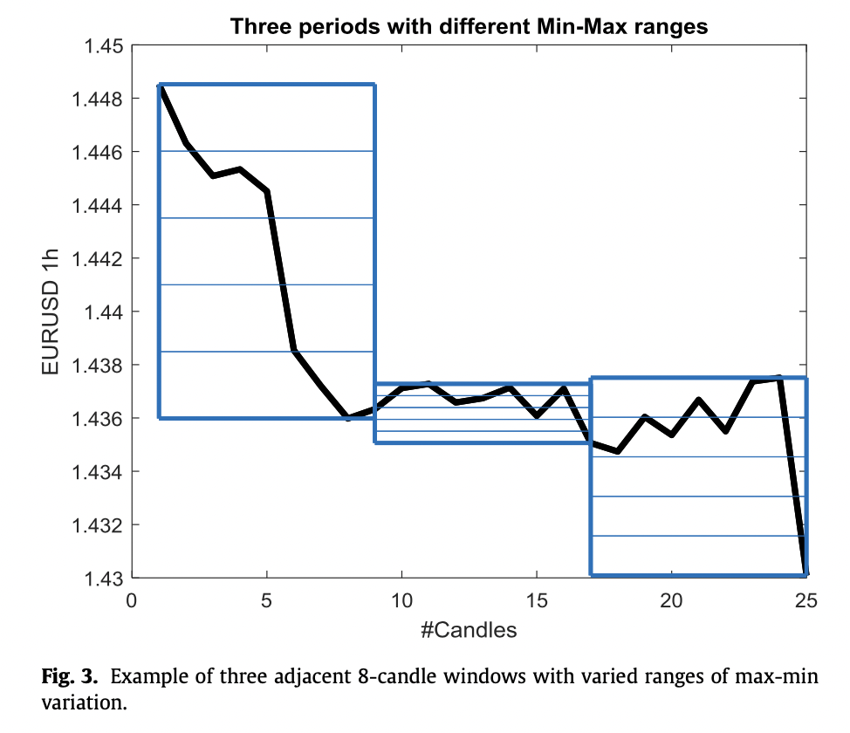
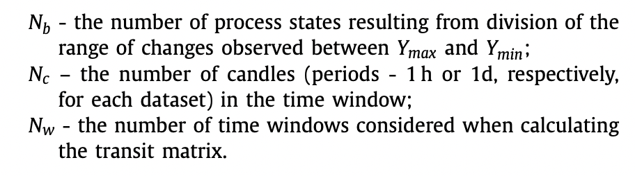
Objects and graphs
Windows
The main task is to determine number of windows, states and candles and then predict next states and realize trading strategy
Let the process be in the state Si |q(t), then in the state Sk |q( t + 1) . We are interested in the probability of achieving "neighbor- ing" states Si-1 | q(t + 1) and Si+1 | q(t + 1).
States

Slide 5
Trading strategy
−If Pi,i−1 < Pi,i+1 open long positions;
−If Pi,i−1 > Pi,i+1 open short positions
The risk was studied through the Calmar Ratio. This is the ratio of the final profit Z (J) to the maximum drawdown during the simulation - MDD:
CR = Z(J)/MDD; Simultaneous consideration of both factors requires a bicriteria
approach, which is proposed here by using appropriate weights: C = wc · CRlearn + wp · Z( j)/Jlearn, Z(J)/Jlearn is a cumulative profit per candle at the end of the
learning period
We alsp shoud make stop losses
Z(j)=Cj+1 −Cj, (21) but if Lj –Cj <-SL,then Z(j) = −SL; where Lj – Low value in j-th candle;

Slide 6
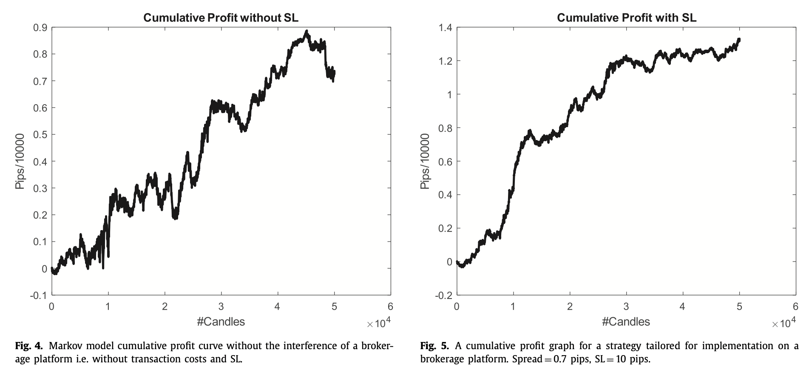
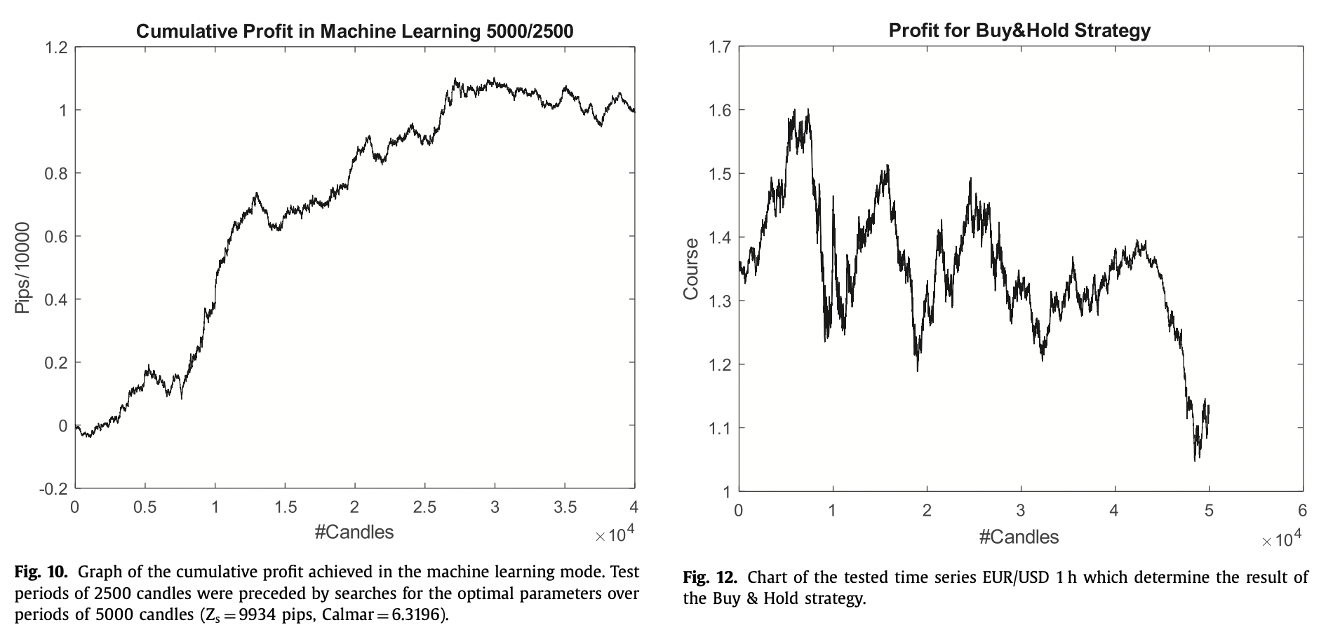
Results

