Slide 1
Development of Machine Learning Methods for Radiology in Brain Evolution Research
Do not adjust the width of this textbox, just type within it
Student: Bair Mikhailov
Research Advisor: Dmitry Dylov
Data Science
April, 2025
1
Notes:
Remember about the timing!
10 min to present at Thesis Status Review
10-15 min to present at MSc pre-defense
15 min to present at MSc defense

Slide 2
General problem / Introduction / Background
One of the challenges in studying brain evolution is the inherent fragility of the brain itself.
To overcome this issue, scientists use endocasts—natural molds of the brain's shape that form in the space within the skull.
By examining these endocasts, researchers can study the brains of extinct animals and compare them with those of modern species.
Consequently, applying machine learning techniques to analyze endocasts can be a highly effective approach for investigating brain evolution.
Notes:
Phrases you may find useful:
The area of my research covers …
Today … has been already studied in the field.
(To update the footer ON ALL SLIDES, go to the Insert tab, click Header & Footer button. On the Slide tab, select the Footer check box, and then type the footer text that you want, i.e. with your Name Surname and Thesis Title. Click Apply to All)

Slide 3
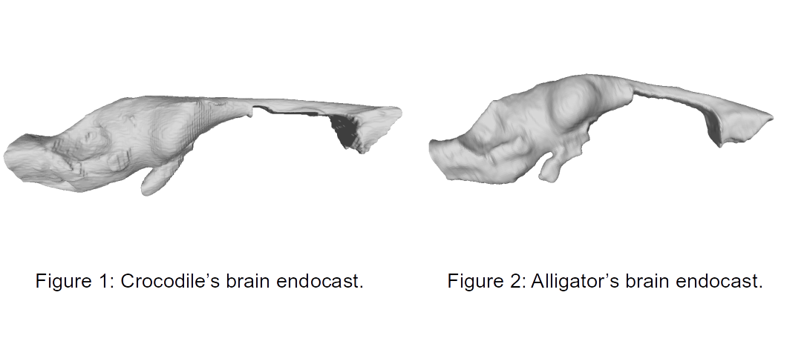
General problem / Introduction / Background
Notes:
Phrases you may find useful:
The area of my research covers …
Today … has been already studied in the field.
(To update the footer ON ALL SLIDES, go to the Insert tab, click Header & Footer button. On the Slide tab, select the Footer check box, and then type the footer text that you want, i.e. with your Name Surname and Thesis Title. Click Apply to All)

Slide 4
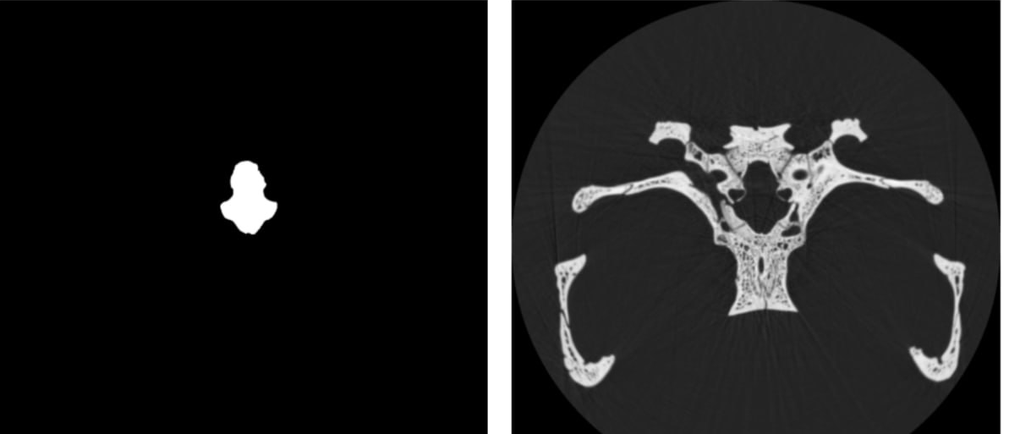
General problem / Introduction / Background
Figure 3: Segmentation of crocodile’s brain endocast.
Figure 4: CT of crocodile’s brain
Notes:
Phrases you may find useful:
The area of my research covers …
Today … has been already studied in the field.
(To update the footer ON ALL SLIDES, go to the Insert tab, click Header & Footer button. On the Slide tab, select the Footer check box, and then type the footer text that you want, i.e. with your Name Surname and Thesis Title. Click Apply to All)

Slide 5
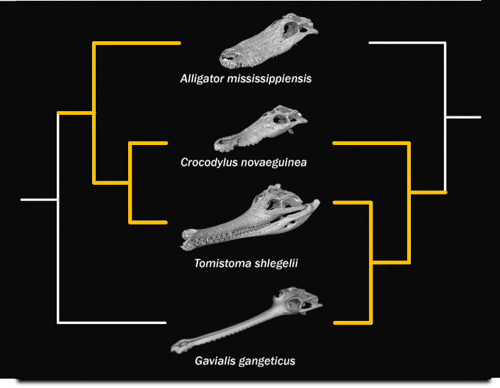
General problem / Introduction / Background
Figure 5: 2 hypothesis of familiar connections of crocodiles.
Notes:
Phrases you may find useful:
The area of my research covers …
Today … has been already studied in the field.
(To update the footer ON ALL SLIDES, go to the Insert tab, click Header & Footer button. On the Slide tab, select the Footer check box, and then type the footer text that you want, i.e. with your Name Surname and Thesis Title. Click Apply to All)

Slide 6
Aim
The main goal of the work is to develop a machine learning model for the segmentation of of 3D braincase cast, then its classification, after that application of this model to classify braincase casts of debatable species and interpret its results.
Notes:
The overall purpose of the work is to …

Slide 7
Objectives
The objectives of the present research run as follows:
To segment the endocasts of all available crocodilians
To classify the debatable species of crocodilians using their endocasts
To interpret the results of the classification above
Notes:
The objectives of the present research run as follows:
1…
2…
3…

Slide 8
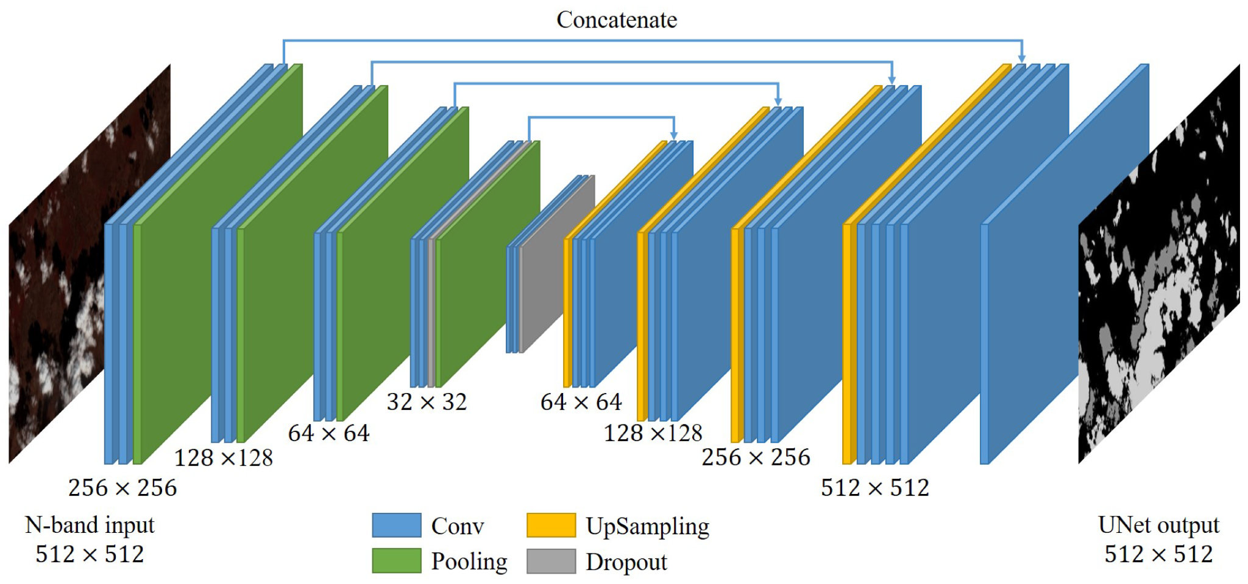
Theory and Algorithms

Slide 9
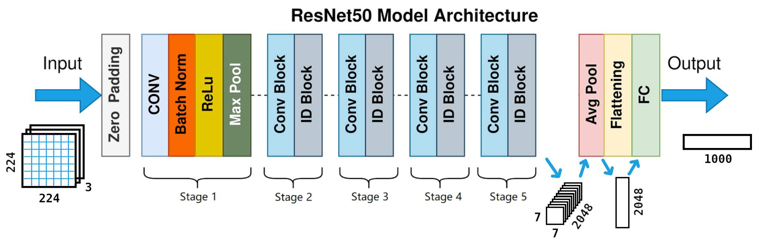
Theory and Algorithms

Slide 10
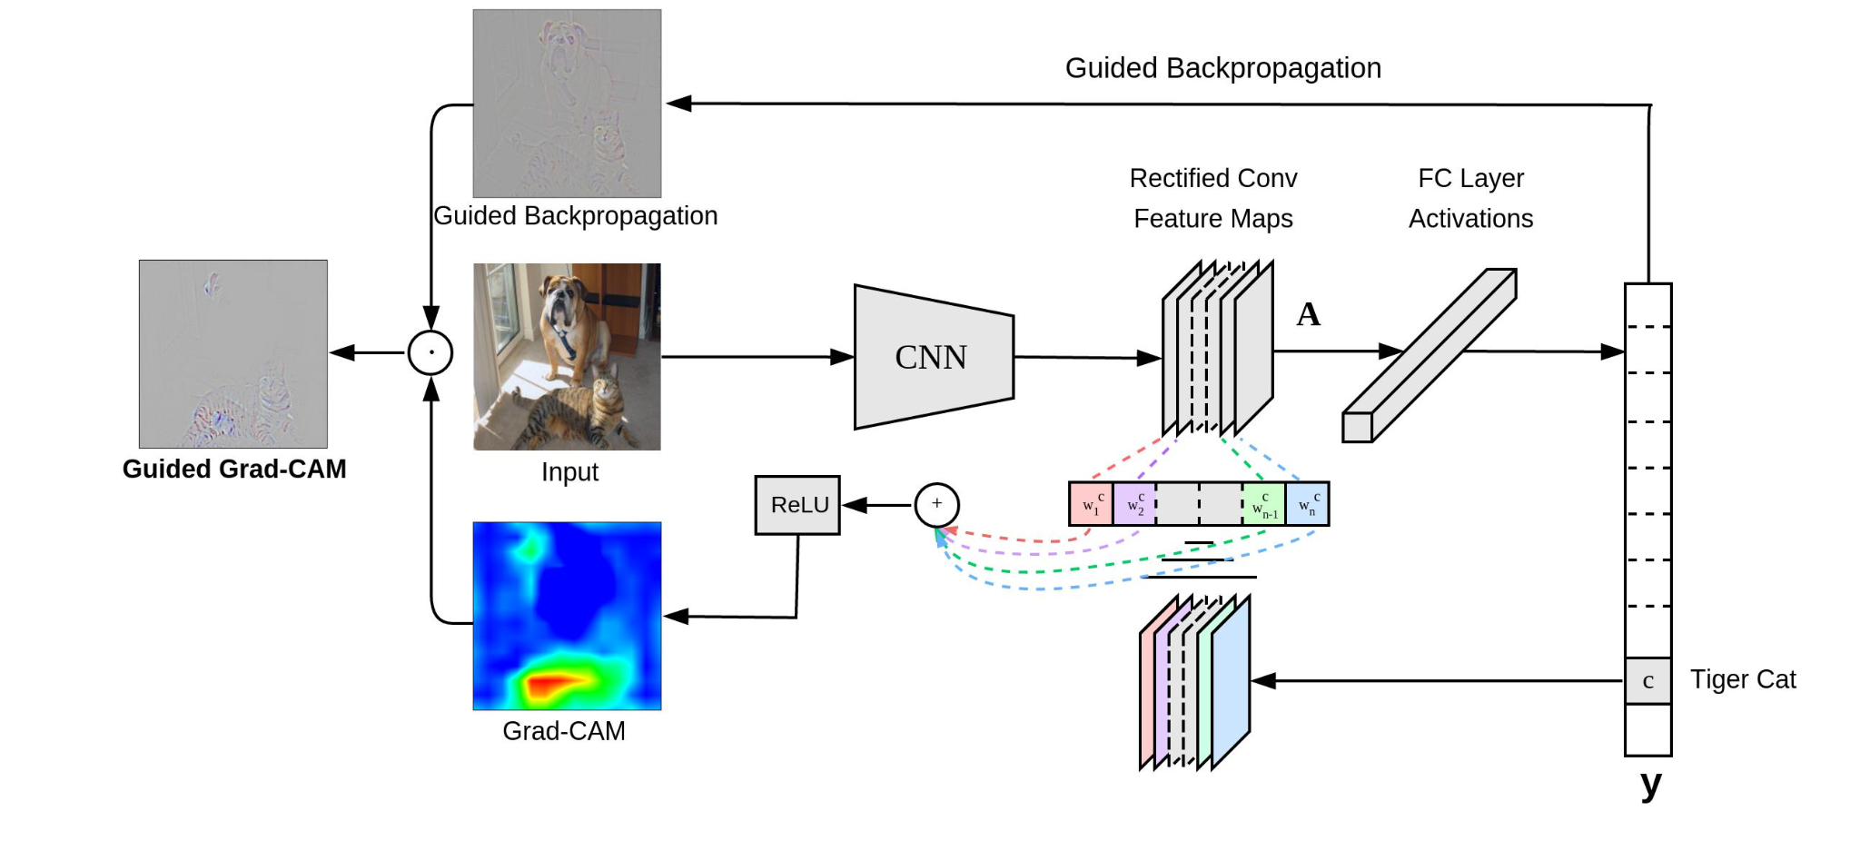
Theory and Algorithms

Slide 11
Methodology / Experimental setup
Data description:
36 3D CT images of alligators (.dcm), 24 images of crocodiles, 7 images of tomistomas and gavials.
Among them:
29 3D CT images of crocodilians with brain endocast segmentation (.tif)

Slide 12
Methodology / Experimental setup
1. Data Preparation
Dataset: 29 3D CT scans (24 train / 5 validation)
Preprocessing:
Resampled to 256×256 2D slices
Augmentations: Random flips, rotations (±60°), intensity scaling
2. Segmentation Model
Architecture: 2D U-Net (PyTorch)
Encoder-Decoder with skip connections
Output: Binary mask (sigmoid activation)
Training:
Loss: DiceLoss + BCELoss
Optimizer: AdamW (lr=1e-5)
Scheduler: CosineAnnealingLR (T_max=10)
Epochs: 480

Slide 13
Methodology / Experimental setup
3. Classification & Interpretation
Model: ResNet-50 (pretrained on ImageNet)
Input: 224×224 endocast slices
Output: 2-class probabilities
Explainability: Grad-CAM heatmaps
Highlights neuroanatomical discriminators

Slide 14
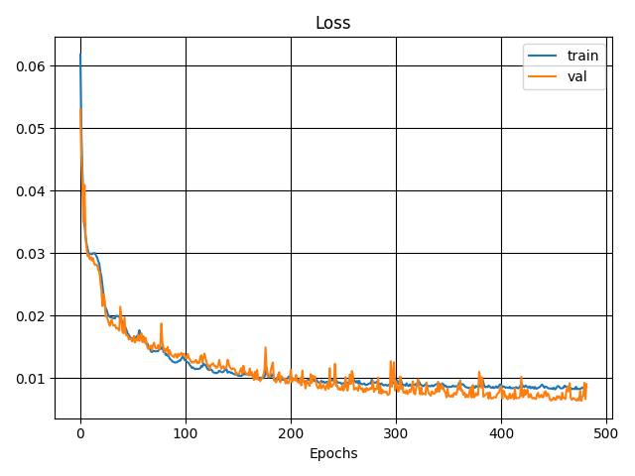
Results of the Experiment
Notes:
Primary and processed results of research in the form of graphs, tables, pictures, and charts.

Slide 15
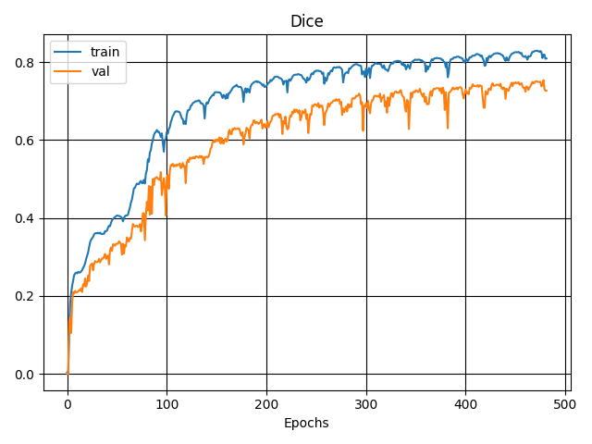
Results of the Experiment
Notes:
Primary and processed results of research in the form of graphs, tables, pictures, and charts.

Slide 16
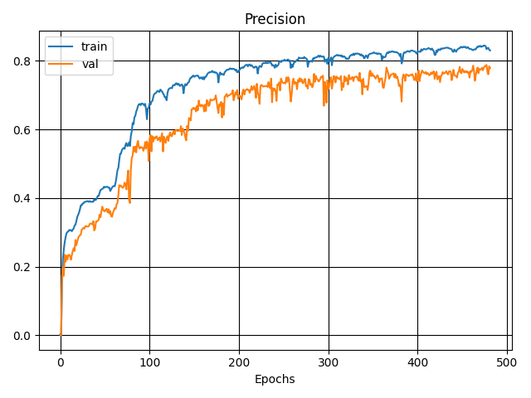
Results of the Experiment
Notes:
Primary and processed results of research in the form of graphs, tables, pictures, and charts.

Slide 17
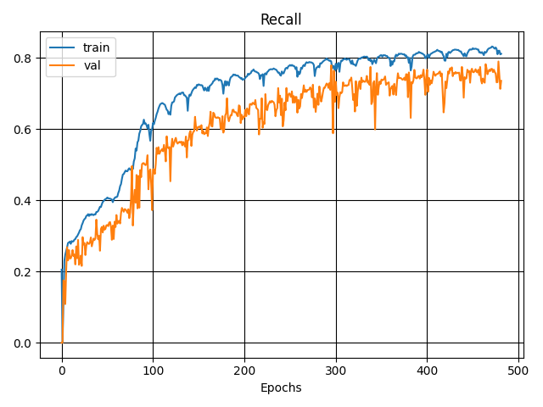
Results of the Experiment
Notes:
Primary and processed results of research in the form of graphs, tables, pictures, and charts.

Slide 18
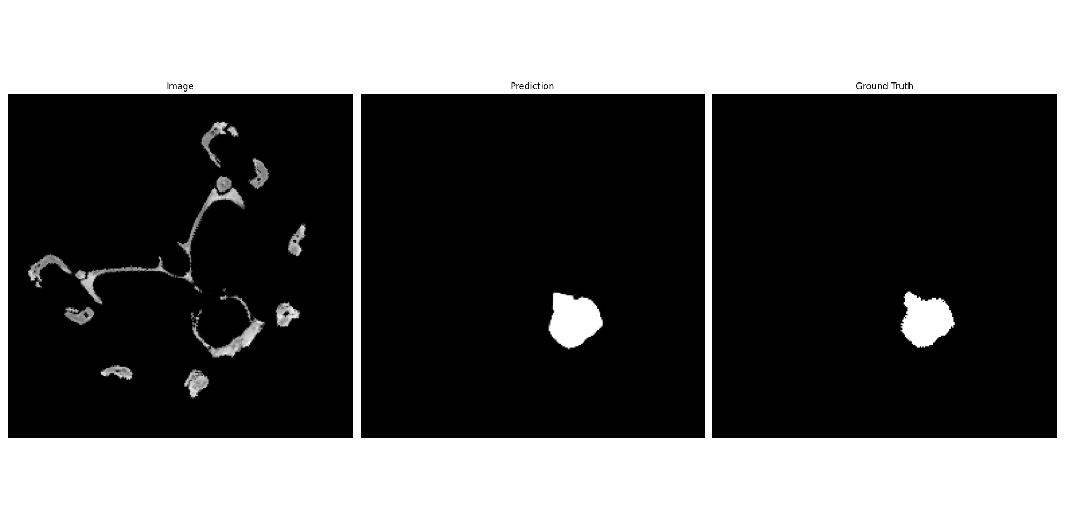
Results of the Experiment
Notes:
Primary and processed results of research in the form of graphs, tables, pictures, and charts.

Slide 19
Scientific novelty
The State-of-the-art component of my research project is the application of Machine Learning for classification (and its reasoning) of the debatable species.

Slide 20
Conclusions
The results of this project can serve as valuable evidence in the determination and classification of species whose categorization has been subject to debate among experts. This adds a new dimension to the ongoing discussions and provides a scientifically grounded perspective.
This project stands out as one of the pioneering applications of machine learning in the field of paleoneurobiology
Notes:
Phrases you may find useful:
All these results suggest that …
We can conclude that …
Taken together, these results point to three conclusions …
To sum up, …
Although it is still too early to draw a definite conclusion, it can be stated that …
Although the obtained data are limited, we may conclude that …

Slide 21
Current Status
Finished with endocast segmentation
Almost finished with classification
Started working on interpretation
Started working on 3D implementation

Slide 22
Outlook
The achieved results indicate that the work along the same line should proceed. Thus, the long-term results of the project are to:
Apply the pipeline to the fossils
Test the pipeline on other species of animals
Notes:
Phrases you may find useful:
The achieved results indicate that the work along the same line should proceed. Thus, the long-term results of the project are to …

Slide 23
Acknowledgements
I would like to express my sincere gratitude to researchers of SPbSU Department of Vertebrate zoology Ivan Kuzmin and Evgenia Mazur for suggesting the initial project and providing the required data
Notes:
Phrases you may find useful:
I would like to express my gratitude to … who <provided smth /assisted in smth/ conducted smth/ etc.>
Thank you for your attention. Now I’m ready to answer your questions.

