Slide 1

Development of Machine Learning Methods for Radiology in Brain Evolution Research
Do not adjust the width of this textbox, just type within it
Student: Bair Mikhailov
Research Advisor: Dmitry Dylov
Co-Advisor: Victor Gombolevskiy
Data Science
January, 2025
1
Notes:
Remember about the timing!
10 min to present at Thesis Status Review
10-15 min to present at MSc pre-defense
15 min to present at MSc defense

Slide 2
General problem / Introduction / Background
One of the challenges in studying brain evolution is the inherent fragility of the brain itself.
To overcome this issue, scientists use endocasts—natural molds of the brain's shape that form in the space within the skull.
By examining these endocasts, researchers can study the brains of extinct animals and compare them with those of modern species.
Consequently, applying machine learning techniques to analyze endocasts can be a highly effective approach for investigating brain evolution.
Notes:
Phrases you may find useful:
The area of my research covers …
Today … has been already studied in the field.
(To update the footer ON ALL SLIDES, go to the Insert tab, click Header & Footer button. On the Slide tab, select the Footer check box, and then type the footer text that you want, i.e. with your Name Surname and Thesis Title. Click Apply to All)

Slide 3
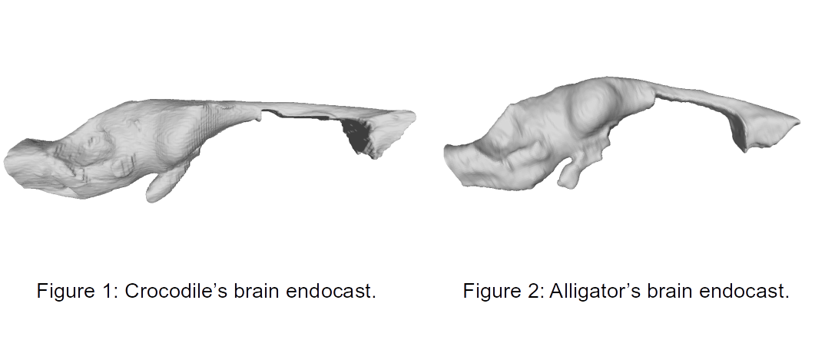
General problem / Introduction / Background
Notes:
Phrases you may find useful:
The area of my research covers …
Today … has been already studied in the field.
(To update the footer ON ALL SLIDES, go to the Insert tab, click Header & Footer button. On the Slide tab, select the Footer check box, and then type the footer text that you want, i.e. with your Name Surname and Thesis Title. Click Apply to All)

Slide 4
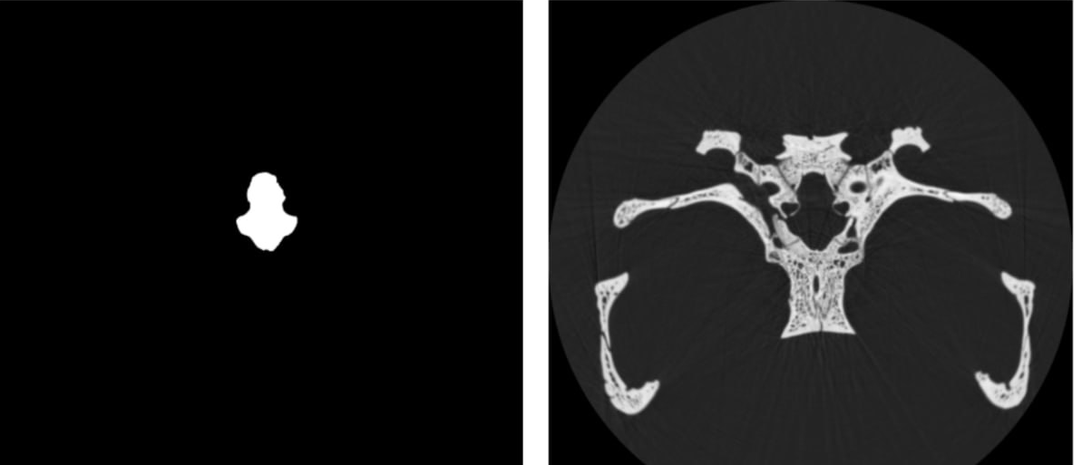
General problem / Introduction / Background
Figure 3: Segmentation of crocodile’s brain endocast.
Figure 4: CT of crocodile’s brain
Notes:
Phrases you may find useful:
The area of my research covers …
Today … has been already studied in the field.
(To update the footer ON ALL SLIDES, go to the Insert tab, click Header & Footer button. On the Slide tab, select the Footer check box, and then type the footer text that you want, i.e. with your Name Surname and Thesis Title. Click Apply to All)

Slide 5
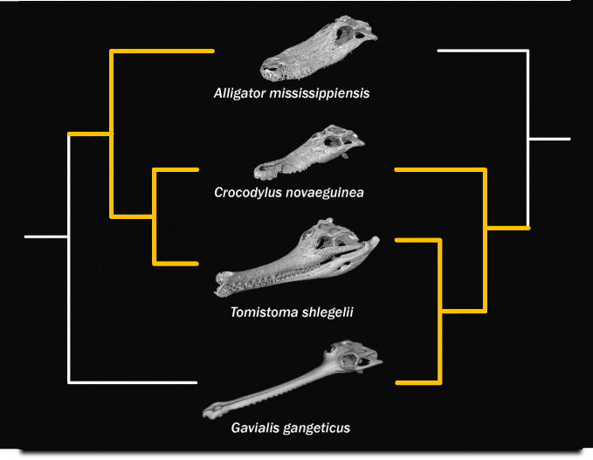
General problem / Introduction / Background
Figure 5: 2 hypothesis of familiar connections of crocodiles.
Notes:
Phrases you may find useful:
The area of my research covers …
Today … has been already studied in the field.
(To update the footer ON ALL SLIDES, go to the Insert tab, click Header & Footer button. On the Slide tab, select the Footer check box, and then type the footer text that you want, i.e. with your Name Surname and Thesis Title. Click Apply to All)

Slide 6
Aim
The main goal of the work is to develop a machine learning model for the classification of 3D braincase cast, then apply this model to classify braincase casts of debatable species and interpret its results.
Notes:
The overall purpose of the work is to …

Slide 7
Objectives
The objectives of the present research run as follows:
To classify the debatable species of crocodiles using their endocasts
To interpret the results of the classification above
Notes:
The objectives of the present research run as follows:
1…
2…
3…

Slide 8
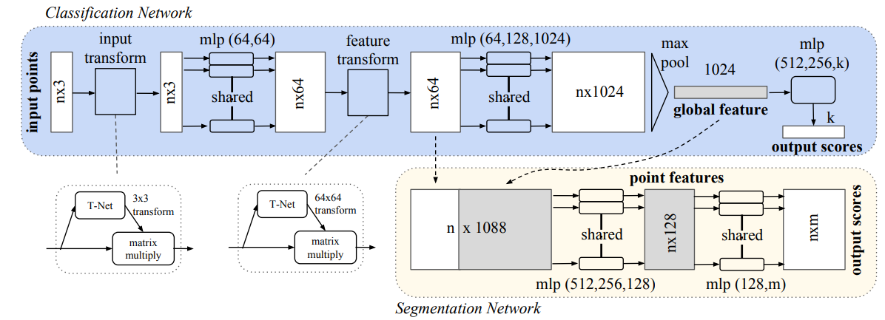
Theory and Algorithms
Open3D
PointNet
ResNet 3D
GradCAM
SHAP
Qi, Charles R., et al. "Pointnet: Deep learning on point sets for 3d classification and segmentation." Proceedings of the IEEE conference on computer vision and pattern recognition. 2017.

Slide 9
Methodology / Experimental setup
Data description:
Endocast – high resolution mesh files (.stl format)
Skull – 3D CT images of the head (.tif)
Overall:
Crocodiles: 27
Alligators: 16
Gavials: 8

Slide 10
Methodology / Experimental setup
First, I prepared the dataset by converting the scans into a manageable format, reducing their “resolution” to make them more computationally efficient, and splitting the data into training and validation subsets. Additionally, I removed the endocasts of juvenile specimens, as they are particularly difficult to classify.
Next, I utilized this refined dataset to fine-tune a pretrained PointNet model, which is specifically designed for processing 3D point cloud data. During this fine-tuning phase, I addressed the issue of class imbalance by modifying the cross-entropy loss function. This adjustment ensured that the model did not become biased towards the more prevalent class in the dataset.
After successfully training the model, I applied it to a set of debatable species whose classification between crocodiles and alligators has been uncertain.

Slide 11
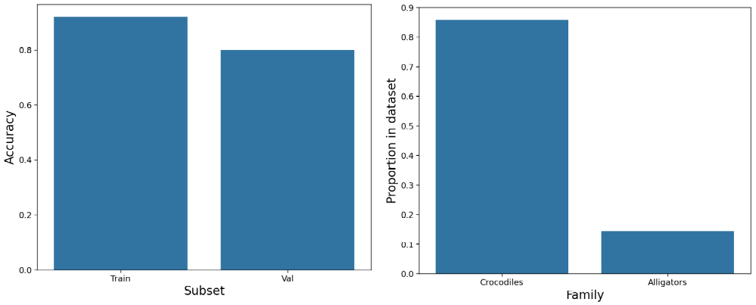
Results of the Experiment
Figure 6: Accuracy on test and validation subsets.
Figure 7: Debatable species classification.
Notes:
Primary and processed results of research in the form of graphs, tables, pictures, and charts.

Slide 12
Discussion of results
On the training data (Figure 6), the model achieved an accuracy of 92%, primarily misclassifying alligators as crocodiles.
On the validation data (Figure 6), the model demonstrated an accuracy of 80%, again with a tendency to incorrectly classify alligators as crocodiles.
One of the main reasons for these issues is the overall lack of data and the skewed distribution within the dataset.
For the debatable species (Figure 7), the model classified more than 86% of the dataset as crocodiles. This result aligns with certain hypotheses about species classification.
However, the model showed relatively low confidence in its predictions for each individual case.

Slide 13
Scientific novelty
The State-of-the-art component of my research project is the application of Machine Learning for classification (and its reasoning) of the debatable species.

Slide 14
Conclusions
The results of this project can serve as valuable evidence in the determination and classification of species whose categorization has been subject to debate among experts. This adds a new dimension to the ongoing discussions and provides a scientifically grounded perspective.
This project stands out as one of the pioneering applications of machine learning in the field of paleoneurobiology
Notes:
Phrases you may find useful:
All these results suggest that …
We can conclude that …
Taken together, these results point to three conclusions …
To sum up, …
Although it is still too early to draw a definite conclusion, it can be stated that …
Although the obtained data are limited, we may conclude that …

Slide 15
Current Status
Done with the initial endocast classification
Currently working on its interpretability
After that will work on raw CT classification and its interpretability

Slide 16
Outlook
The achieved results indicate that the work along the same line should proceed. Thus, the long-term results of the project are to:
Apply the pipeline to the fossils
Test the pipeline on other species of animals
Train the segmentation model for endocasts to allow biologists to process more CTs and apply their standard methods
Notes:
Phrases you may find useful:
The achieved results indicate that the work along the same line should proceed. Thus, the long-term results of the project are to …

Slide 17
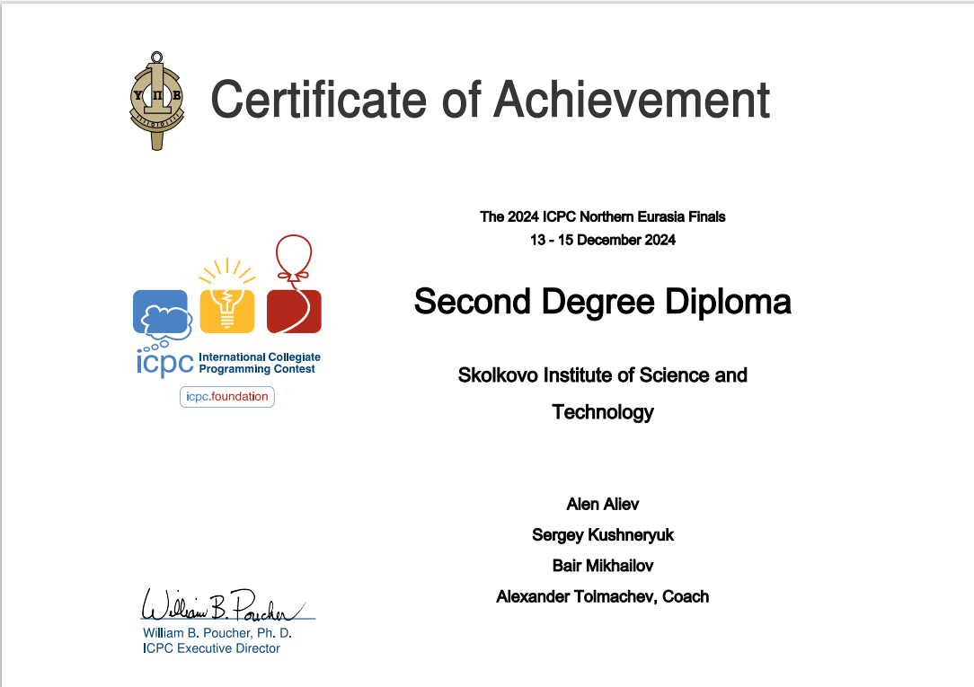
Acknowledgements
I would like to express my sincere gratitude to researchers of SPbSU Department of Vertebrate zoology Ivan Kuzmin and Evgenia Mazur for suggesting the initial project and providing the required data
Notes:
Phrases you may find useful:
I would like to express my gratitude to … who <provided smth /assisted in smth/ conducted smth/ etc.>
Thank you for your attention. Now I’m ready to answer your questions.

