Slide 1

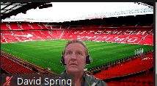
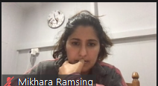

Why Invest in Collectables?
Because they are low stress and a Good Yield

Slide 2
Our Hypothesis and Why
Our Hypothesis:
An Alternative Investment Portfolio (Trading Cards and Bitcoin) provides a higher risk /return investment option, assessed over the last five years, than a Traditional Investment Portfolio (ASX200, Property, ASX Bonds); and,
Pubic sentiment affects the Alternative Investment and Traditional Investment Portfolios differently and is an important consideration when developing a personal investment portfolio.
Why:
Our individual group members invest in a variety of these strategies from trading cards to crypto and property. We were thus motivated to explore our own personal investments when grouped into an Alternative vs what some might consider a more Traditional portfolio.
We were also just really interested in the results for future investment purposes #tradingcards

Slide 3
Our Questions
Our Questions:
What is the risk/return ratio for an Alternative Investment Portfolio versus a Traditional Investment Portfolio
How influential is social sentiment and,
Over the last 5 years what is the comparable returns between portfolios
Challenges to answering our questions:
Sufficient data in all portfolio types to allow a worthwhile assessment
Interpreting Public Sentiment data is complex and may not be directly correlatable to portfolio performance
Each portfolio and cost of entry is different so returns not directly comparable
How to interpret and compare Bond data with other portfolios

Slide 4
Data Utilised
Data
Trading cards (high liquidity cards) - https://www.mtggoldfish.com/sets/Unlimited+Edition
Bitcoin current price - https://api.alternative.me/v2/ticker/Bitcoin/?convert=CA
Bitcoin historical data - https://www.google.com/finance/quote/BTC-AUD
Government bond (baseline) - https://www.google.com/finance/quote/GOVT:ASX?window=5Y
ASX200 (general stock market) - https://www.google.com/finance/quote/XJO:INDEXASX
Property - ABS data in 8 capital cities- https://www.abs.gov.au/statistics/economy/price-indexes-and-inflation/residential-property-price-indexes-eight-capital-cities/latest-release
Methods
Google Finance
ASX data
Bitcoin API
Scraped data from https://www.mtggoldfish.com/sets/Unlimited+Edition to obtain trading card prices.
Scraped data from https://redditsearch.io/ to obtain post id to iterate comments on the Reddit API over a specified timeframe. We made a function to change datetime into unix timestamp.
Explored what search terms enabled quality data for public sentiment

Slide 5
Data Insights
Risk/Return Analysis by way of:
Standard Deviation
Correlation
Sharpe Ratios
We employed a variety of Graphs:
1. Line plot
2. Box plots
3. Bar Graphs
Sentiment Analysis by way of:
Defined a function to allocate a score to each of the Reddit comments scraped in various relevant sub-reddit groups.
We subtracted the negative from the positive score to provide a value of the sentiment.

Slide 6
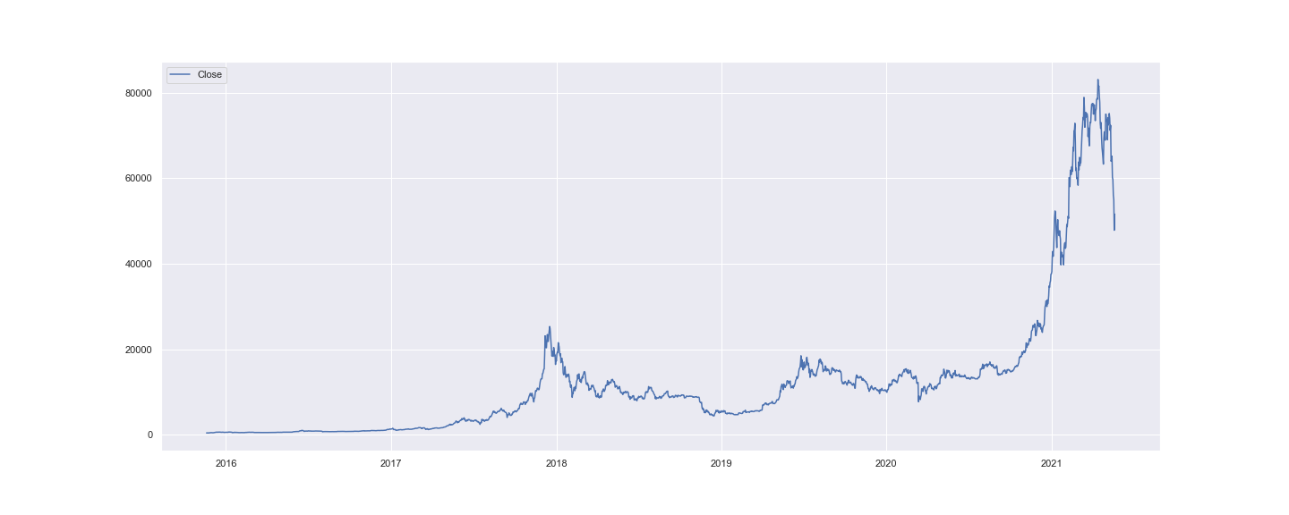
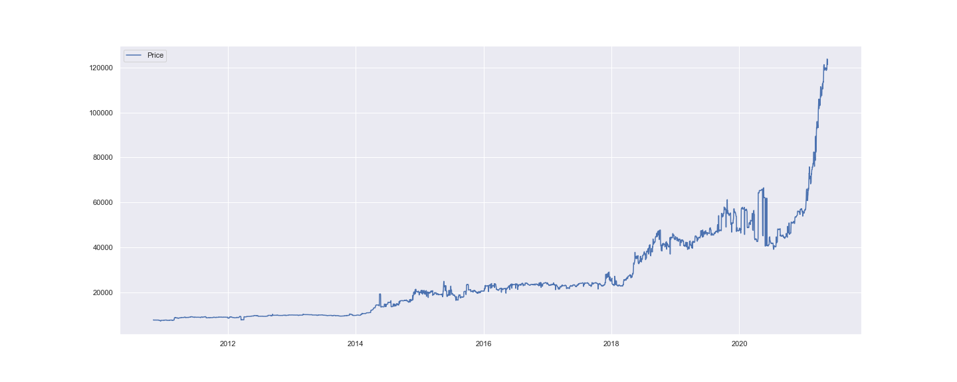
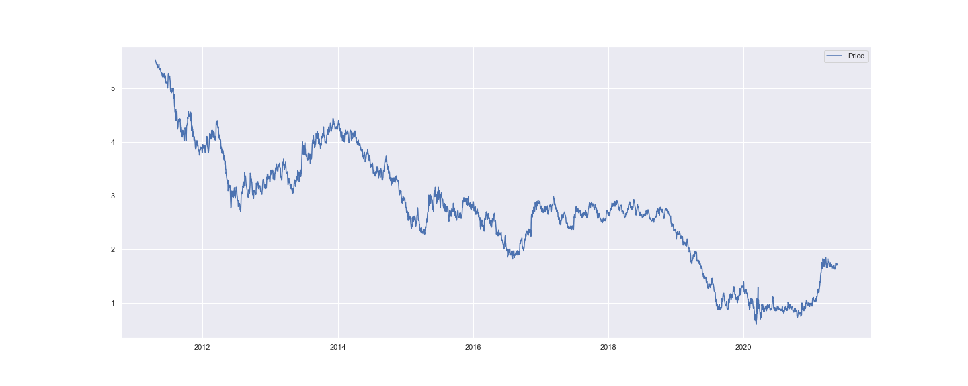
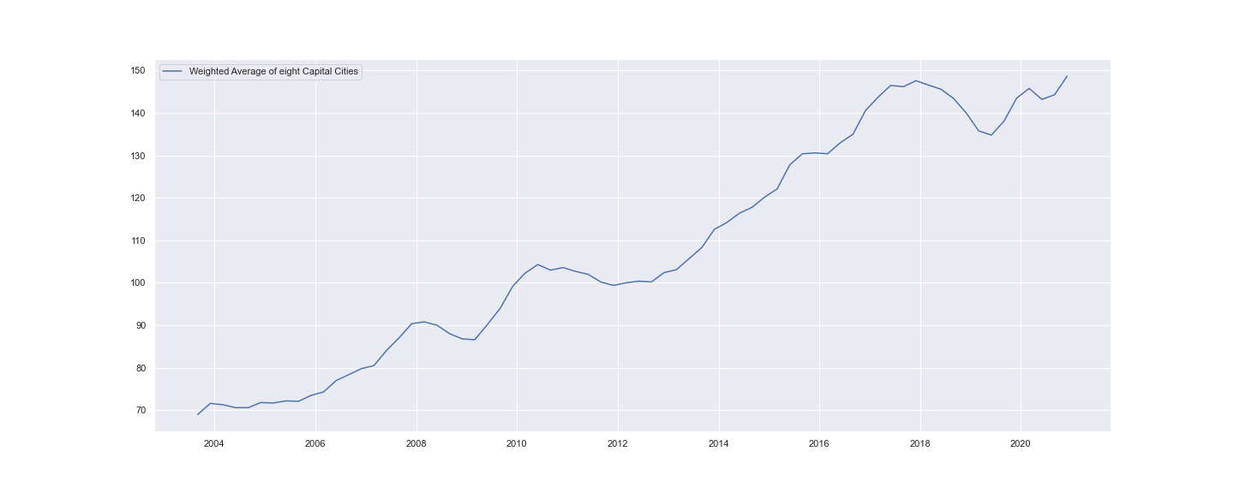
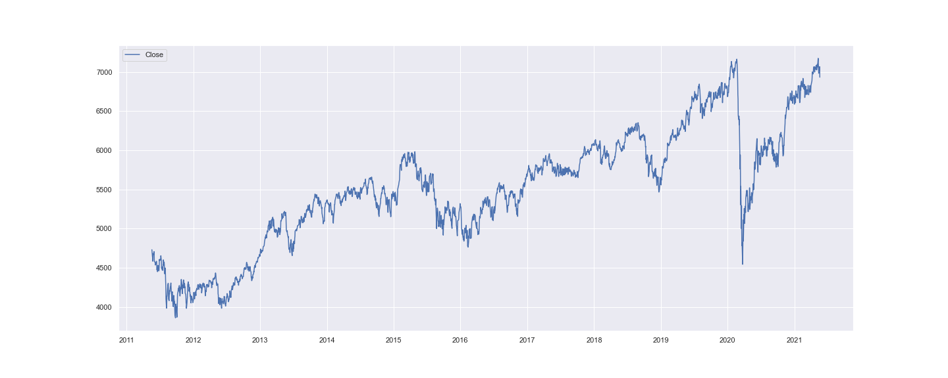
5 Year Performance / Close
BTC
Cards
Bonds
Property
ASX 200
Traditional and Alternative investment portfolios have shown growth over the last 5 years, but

Slide 7
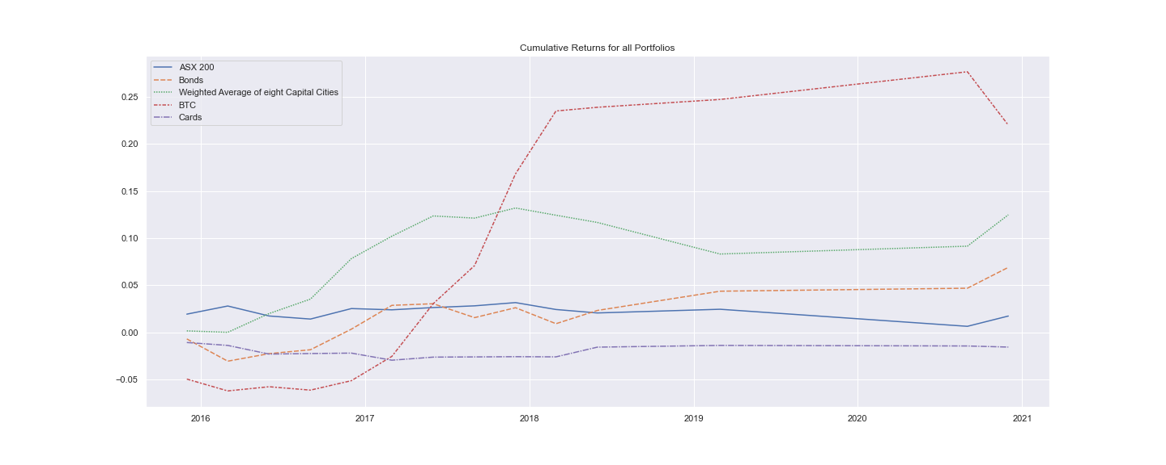
Cumulative Returns
In terms of cumulative returns, BTC and property out perform other portfolios, with

Slide 8
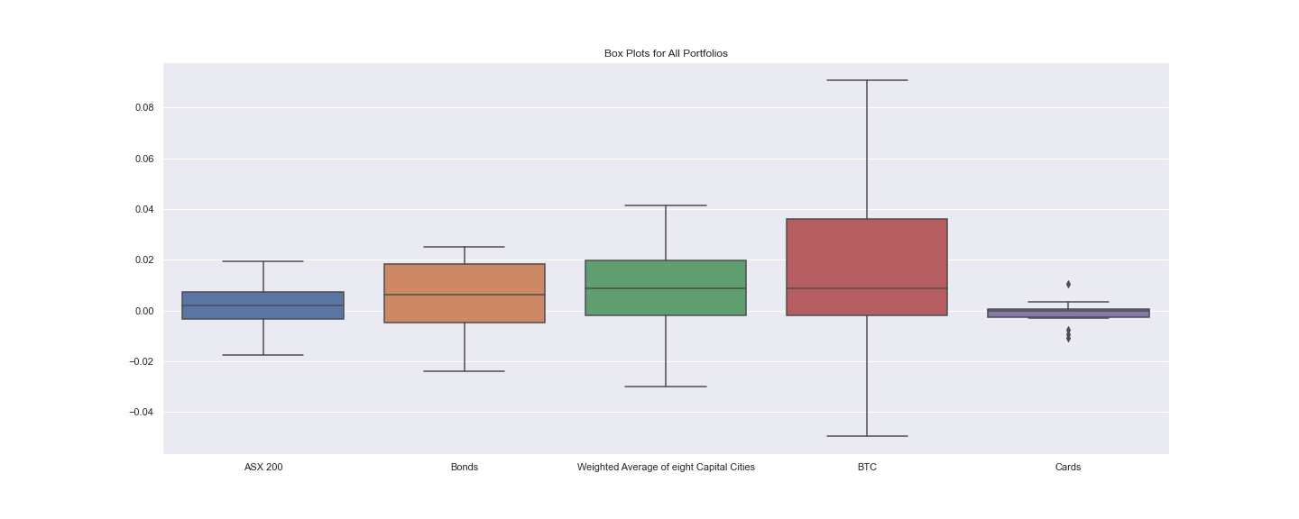
Box Plot Analysis
Higher risk profile and range of results

Slide 9
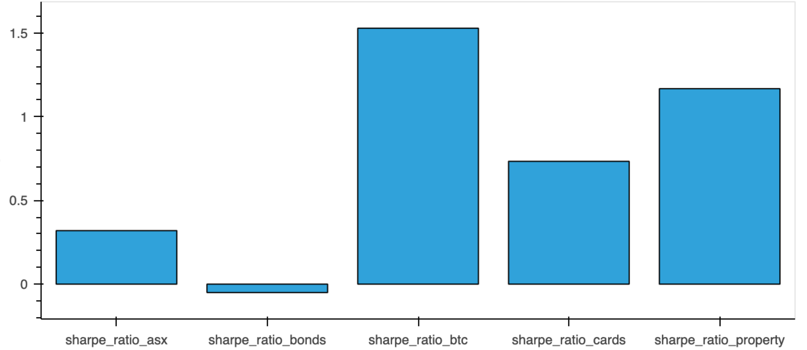
Sharpe Ratio Analysis
BTC has the best return relative to risk with Property second and Cards third

Slide 10
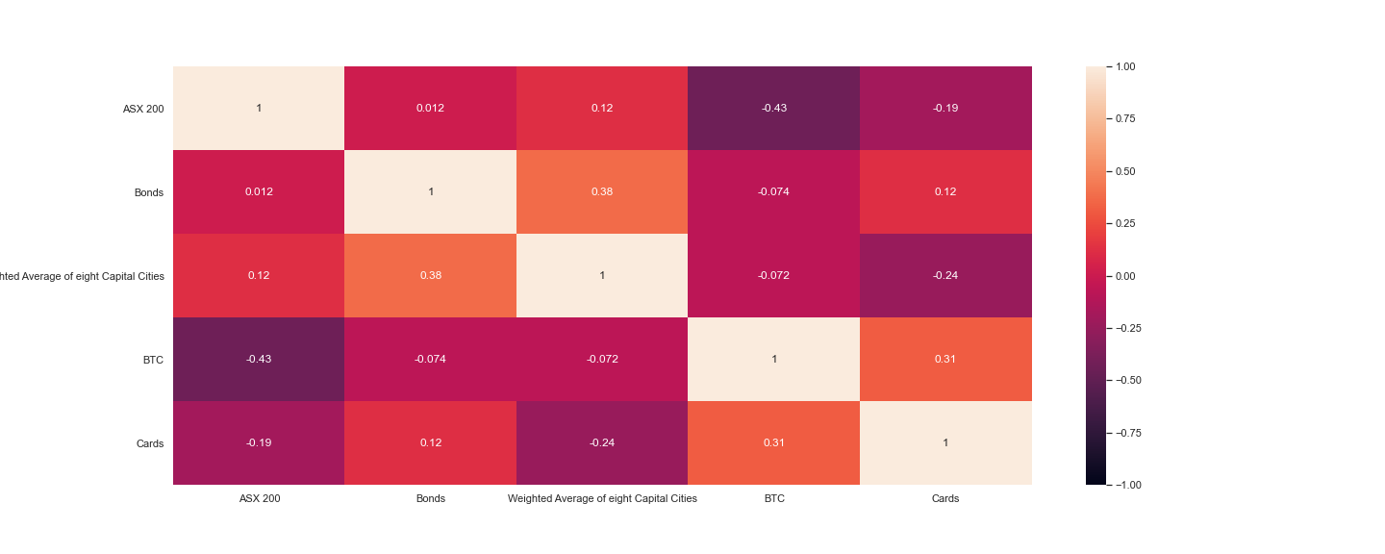
Heat Map Analysis
There is little correlation between portfolios although it can be concluded that there is a higher correlation within each portfolio type, i.e. within traditional and alternative portfolios.

Slide 11
Implications of Our Findings - Risk
Based on a Sharpe Ratio Analysis, investing in Bitcoin has the best return relative to risk, this is closely followed by Property. Interestingly, trading cards has the next best Sharpe Ratio thereby proving our Hypothesis **True** where an Alternative Investment Portfolio provides a higher Sharpe ratio of the last 5 years compares to a Traditional Investment Portfolio.
If we exclude Bitcoin, property had the best risk to return.
Interesting to note the least correlation occurs between BTC and ASX200 with the most correlation occurring between Weighted Average of Capital Cities and Bonds. We think this may be the case because there is a correlation between people who favour bonds, tend to be conservative investors, hence invest in property.

Slide 12
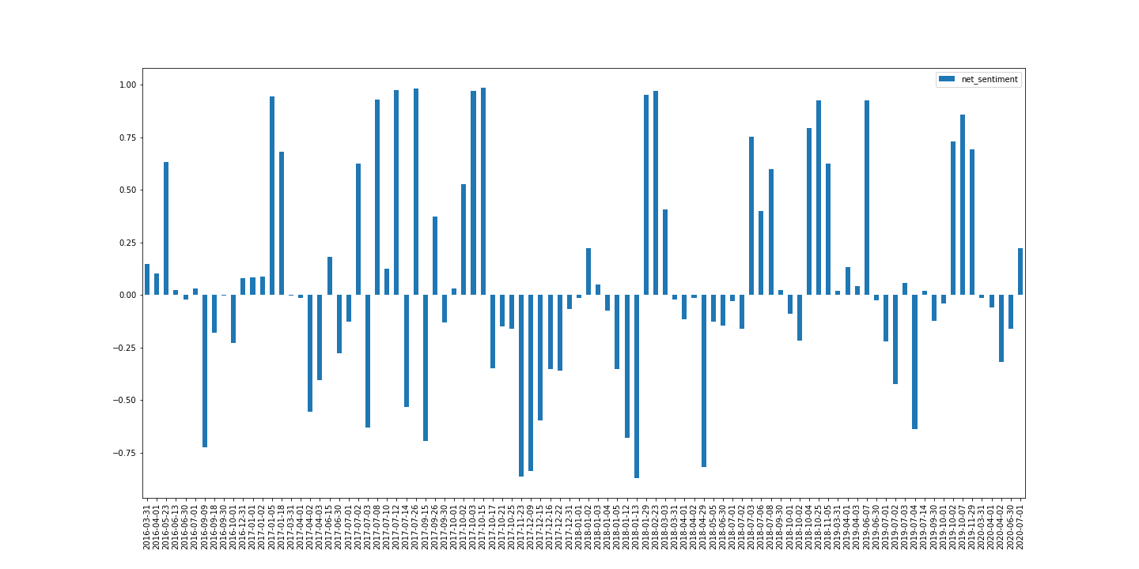
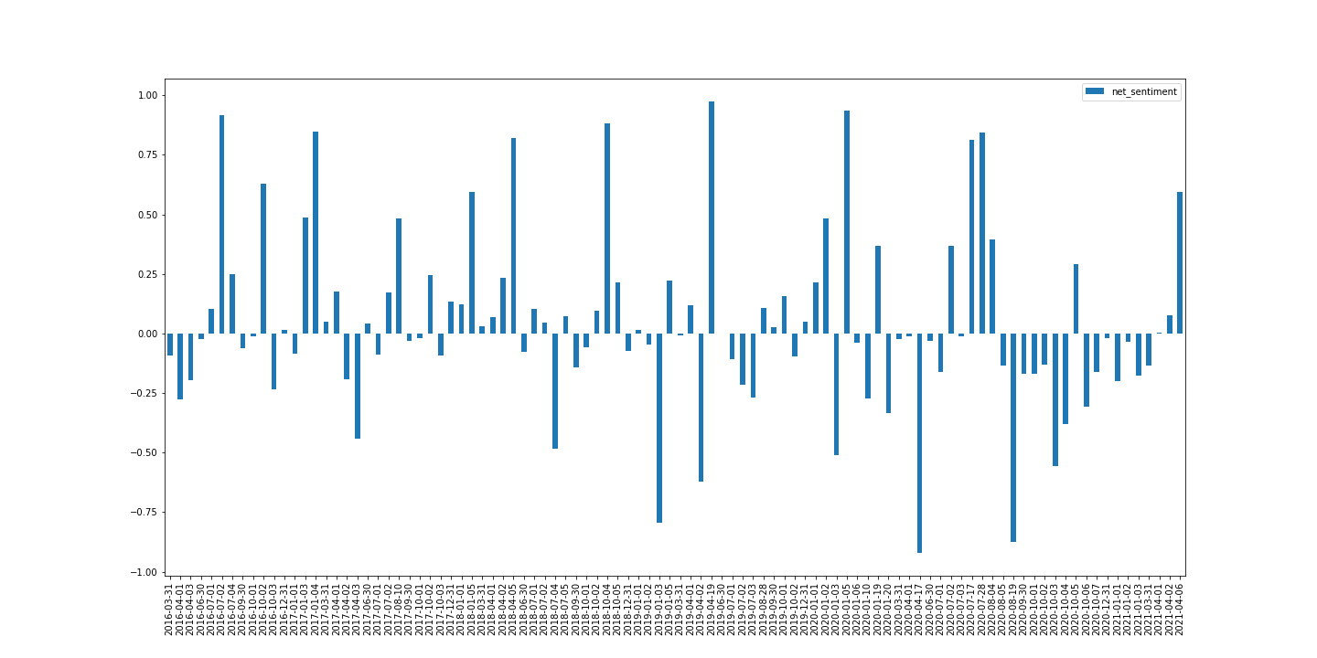
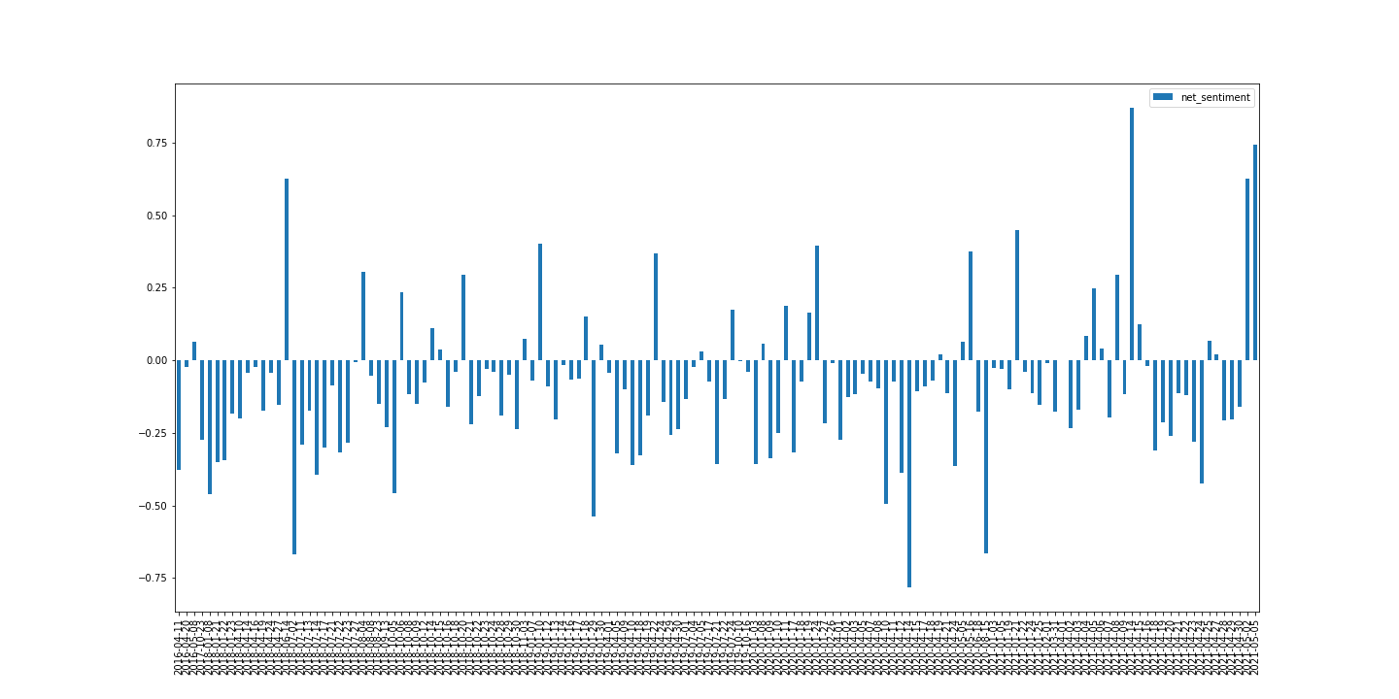
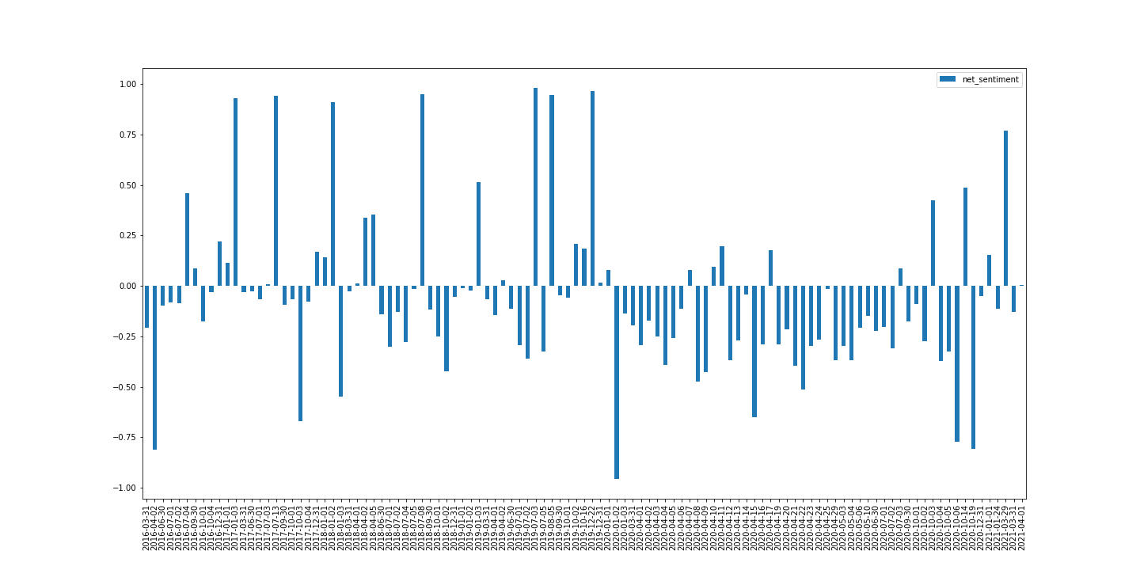
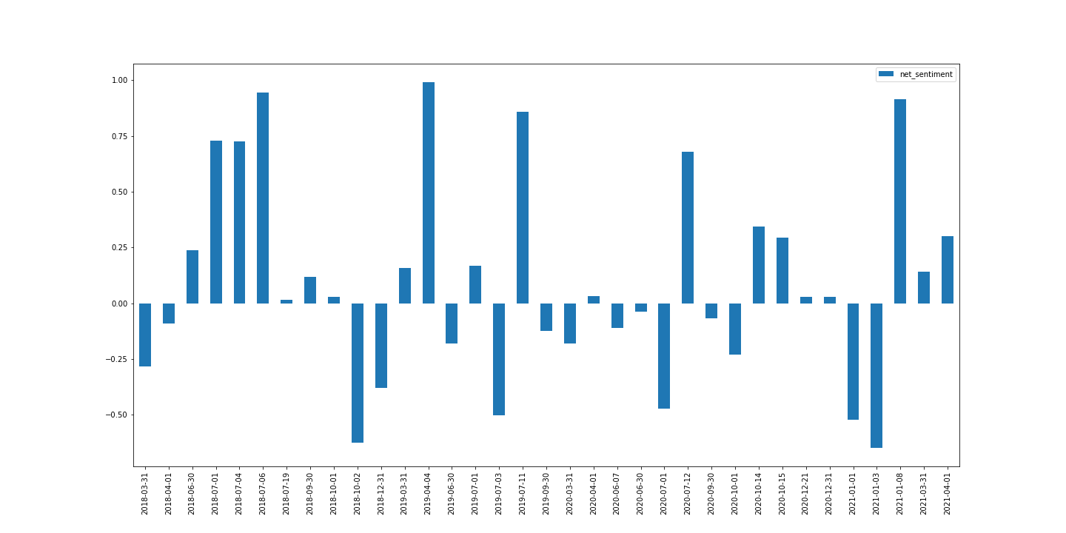
4 Year Public Sentiment by Portfolio
BTC
Cards
Bonds
Property
ASX 200

Slide 13
Implications of Our Findings – Public Sentiment
General sentiment behind bonds over the time period has been negative. This correlates to the downward closing price trend of bonds over this same time period.
ASX sentiment generally seemed optimistic, with some very high 'highs' and not as low 'lows', which correlates with closing upward trend data of ASX 200.
Generally some high spikes in optimism but between COVID-19 time, a lot of pessimism in property, problems with tenants due to COVID etc. This spiked in 2021. However, the property price trends has steadily increased over this time period, with property providing a high Sharpe ratio; although Cumulative Returns are lowest during the 2019-2020 period of low public sentiment.
Bitcoin has the highest swings in sentiment, with really high 'highs' and very low 'lows'. Never neutral, always either very bullish or bearish. This correlates to the daily closes of BTC over time, with its high volatility.
Cards in the last year has had a larger proportion of negative sentiment and in last month, had spike in positivity. However, the closing price of cards has had a strong upward trend.

Slide 14
Conclusions
Our main hypothesis holds **true**. With a nuance that Property provides the best risk/return, when not trumped by Bitcoin (we expected Bitcoin unprecedented growth to skew results when added to the pool).
Transactional costs being factored in, i.e. the cost of initial investment, renters/maintenance of property would outweigh the transactional costs associated with cards (storing them in a shoebox).
Sentiment analysis provided an interesting context to understanding trends in returns and risk. However, in general it looks like sentiment is not correlated to price thereby proving our secondary hypothesis **False**.
Sentiment, we hold, affected Bitcoin yet was not correlated to Cards.

Slide 15

* Questions
* Open-floor Q&A with the audience

