Slide 1

Visualizations
Created by Mikheil Kvizhinadze

Slide 2

Leveraging the Google Maps Directions API
Route Planning: We utilized the Google Maps Directions API to obtain an optimized route between a specified origin and destination.
Simulation Foundation: We used the API's route information as a baseline to build our movement simulation, which factored in the ego's specific speed.

Slide 3
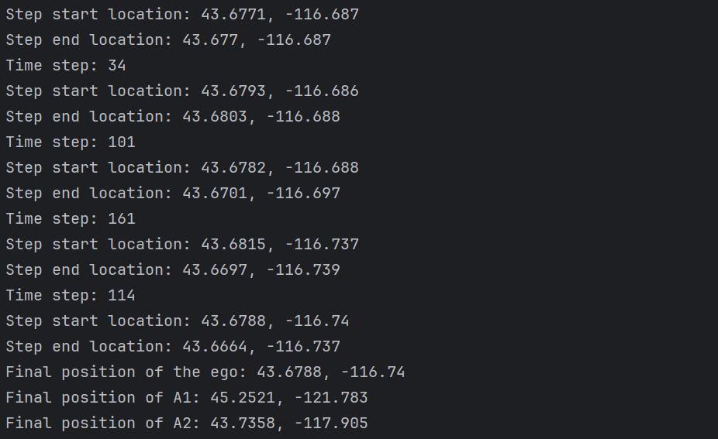
Console output and explanation
Step Division: The route provided by the Directions API consists of steps with durations exceeding 3 seconds. To accurately check the special condition (function value being 100% higher), we need finer-grained movement simulation.
1-Second Substeps: We divide each route step into 1-second substeps. This enables us to:
Track the ego's position with higher precision and
evaluate the special condition (f_c, f_1, f_2) at a frequency consistent with the 3-second requirement.
Part of console output
Improved Accuracy: Subdividing steps enhances the simulation's realism by modeling the ego's continuous movement rather than assuming instantaneous jumps at the start and end of each step.
Data Granularity: The 1-second substeps provide a consistent time interval between data points (ego position, function values).

Slide 4
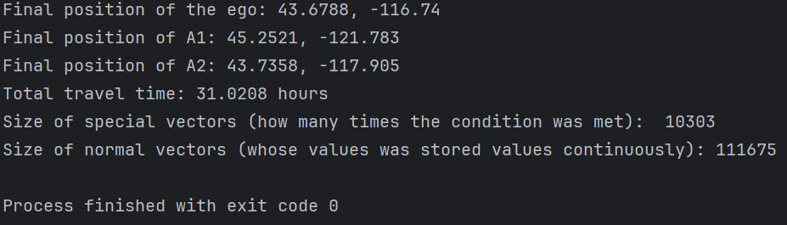
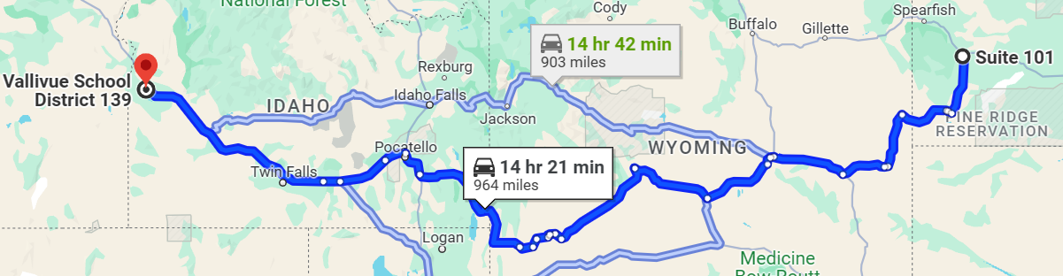
Values of ego location, function values, and distances to, destination, center of C, center of A1 and center of A2 are stored every second, so we have 111675 values and total travel time is 111675 / 3600 = 30.02 hours. Moreover, total travel time is consistent with predicted value, 964 * 1.6 / 50 = 30.85 hours. We will get this value if we follow one of the routes suggested by Google Maps and if our velocity will be 50km/hour (constant)
Console output and explanation
last part of console output

Slide 5
Choice of tools for visualizations
Python:
Data-centric: Offers robust libraries ( like Pandas) for efficient data manipulation and analysis.
Visualization Libraries: Provides mature plotting libraries like Matplotlib, enabling the creation of clear and informative visualizations.
Jupyter Notebook:
Interactive Development: Streamlines visualization development with the ability to iteratively code, plot, and refine visualizations within the same environment.
Enhanced Storytelling: Eases communication of analysis and results by combining code, visualizations, and explanatory text.
Folium:
Simplifies the creation of interactive maps directly within Python, seamlessly integrating route and location data visualization.
Provides flexibility in customizing map elements to effectively communicate findings and highlight spatial relationships.
Next slide shows screenshot of routes on a map obtained using folium library

Slide 6
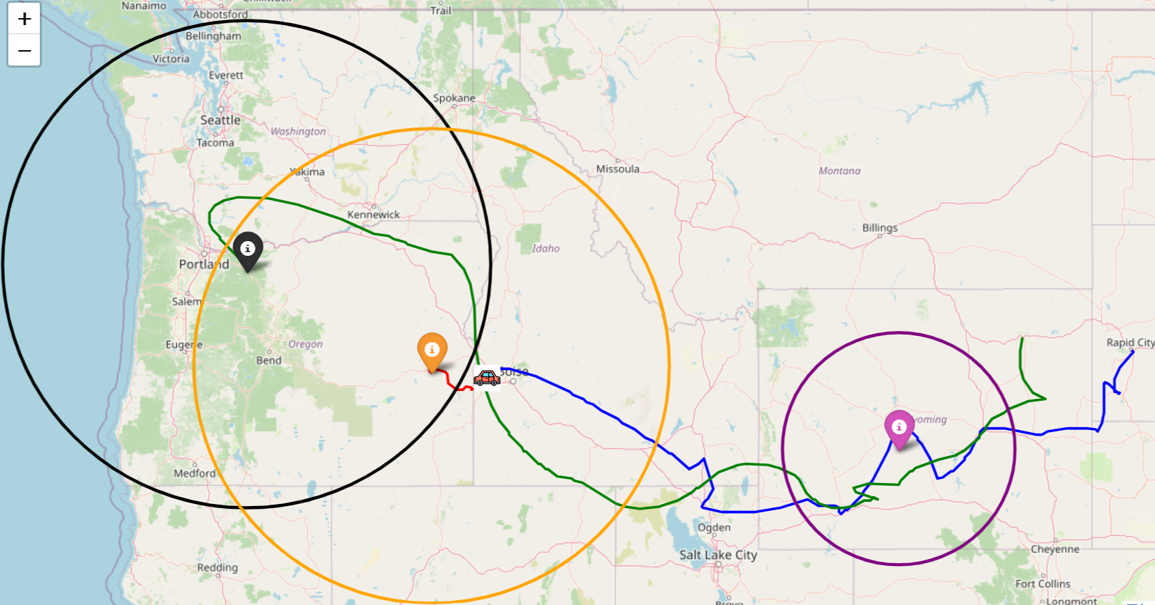
01
Name of
the section
Screenshot of interactive map which shows trajectories using folium
Centre of A1
Centre of A2
Starting point of A1
Final position of ego
Starting point of ego
400km
Radius
Starting point of A2
Centre of C
400km
Radius
200km
Radius

Slide 7
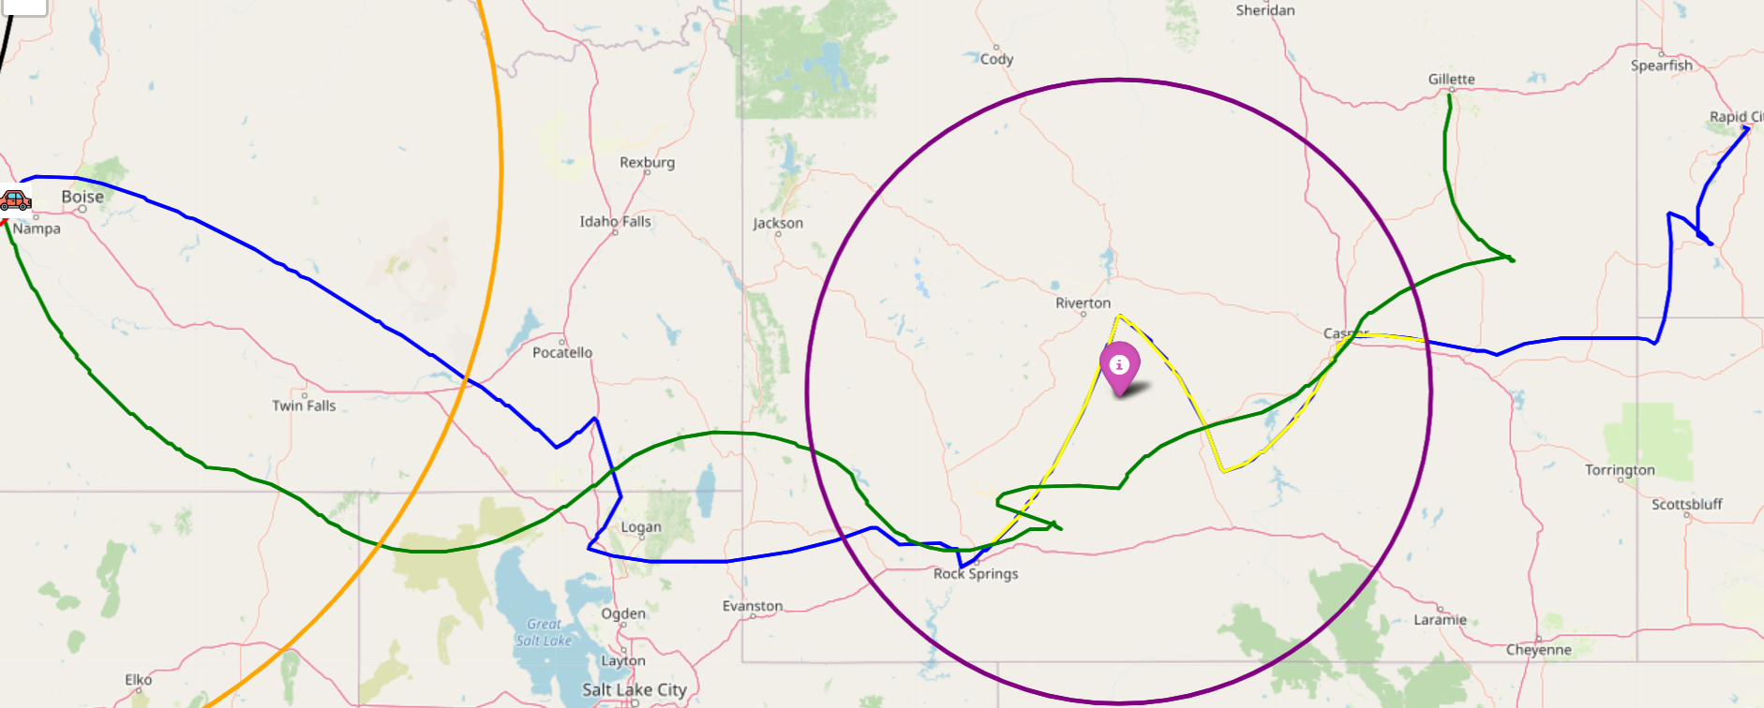
Starting point of A1
Starting point of ego
Segment of ego’s route which satisfied the condition highlighted in yellow
Centre of C
200km
Radius

Slide 8
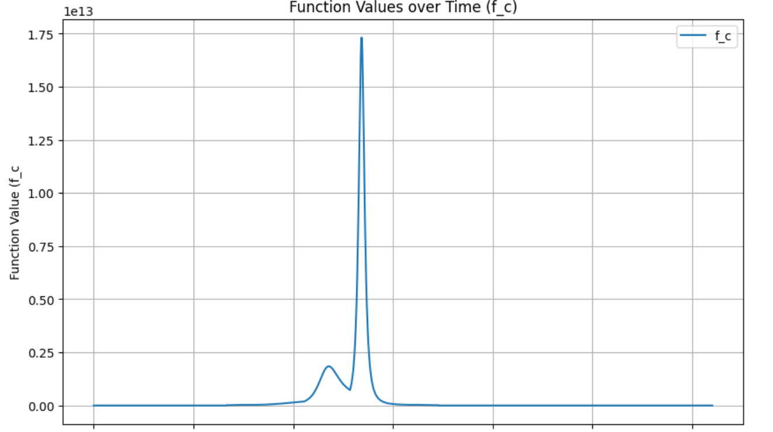
Function values over time(f_c)
The circle denoted as 'C' remains static throughout the scenario. Consequently, non-zero values are observed only when the ego vehicle enters into the circle ‘C’. Outside of these instances, the recorded values revert to zero.

Slide 9
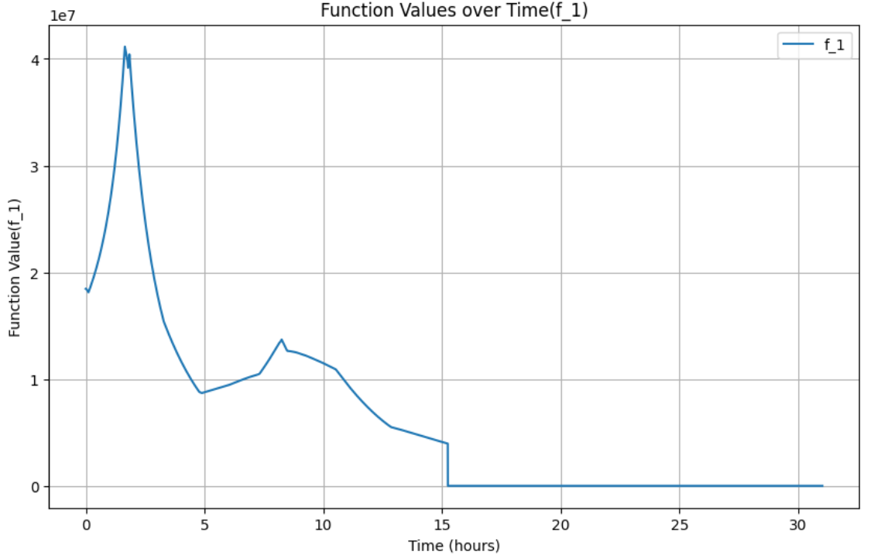
Function values over time(f_1)
Initially, the ego vehicle resides within the confines of Circle A1, resulting in a non-zero function output. However, as Circle A1 outpaces the ego vehicle, the function steadily declines over time until it reaches zero.

Slide 10
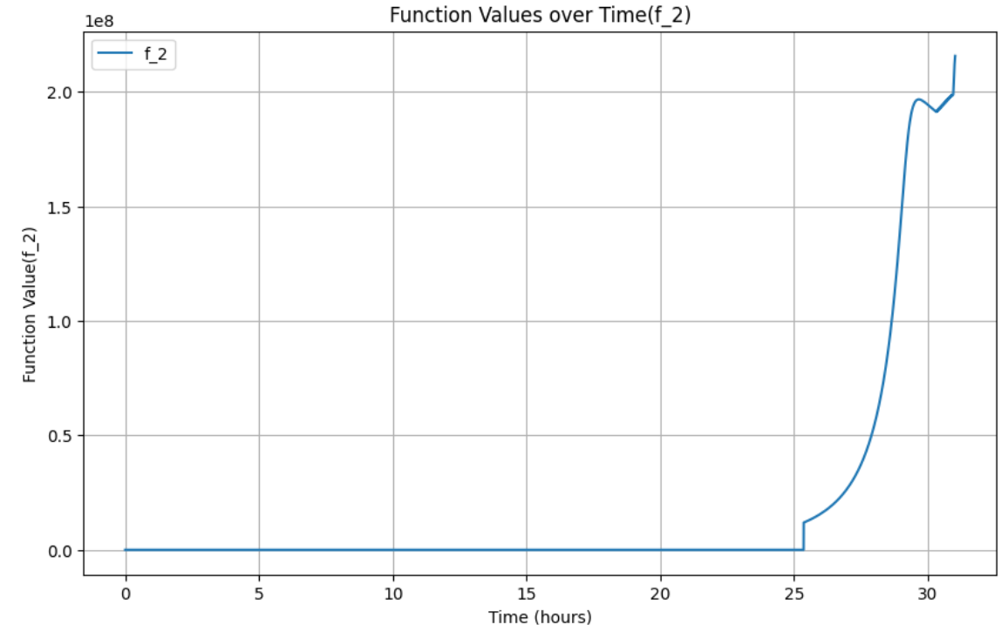
Function values over time(f_2)
In the beginning, the Circle A2 and the ego vehicle are considerably distant from each other. So, the function remains at zero for the majority of the duration. However, as Circle A2 moves much slowly, than the ego vehicle, so eventually, ego vehicle enters Circle A2 and function f2 becomes non-zero, as expected.

Slide 11

Mikheil Kvizhinadze

