Slide 1

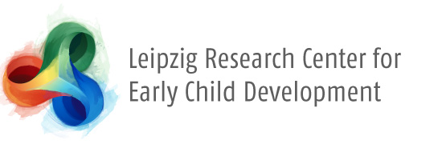



The Role of the Mother in Feeding Skill Acquisition in Immature Sumatran Orangutans
Supervisor : Dr. Caroline Schuppli
Author: Mikeliban Mulati

Slide 2
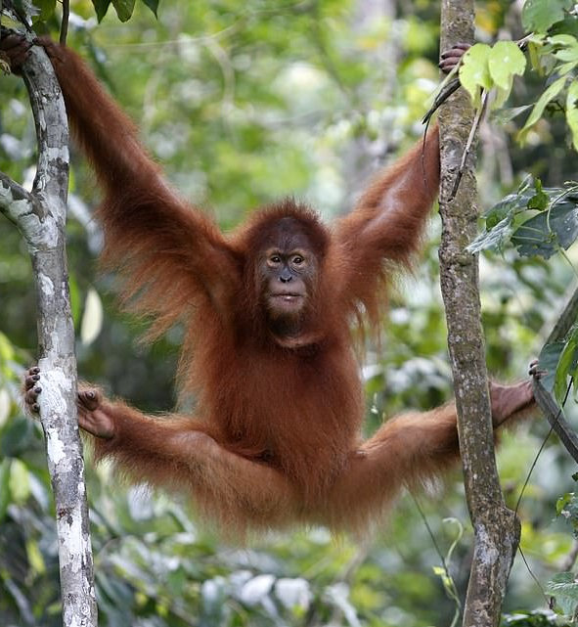
Content
Theoretical background
Research question
Hypotheses
Predictors
Methods
Analyses
https://www.dailymail.co.uk/news/article-7154111/Orangutan-released-wild-Sumatra.html

Slide 3
Theoretical Background (What we know)
Immature orangutans need to acquire a broad range of feeding skills:
More than 200 different food items ¹
Food items differ in complexity and frequency ^{2,3}
How do immature orangutans acquire feeding skills?
Peering: observing their mothers (and to some extent other role models) ²
Begging: soliciting food from their mothers ^{3,4}
​During begging, mothers are usually passively tolerant ³
Orangutan mothers don’t teach ⁴
the complexity of the food item, the age of the offspring, and the foraging skills of the offspring affect its begging behavior ³ (offspring’s perspective)
1: Schuppli et al. 2016 a; 2: Schuppli et al. 2016 b; 3: Jaeggi et al. 2008; 4: Jaeggi et al. 2010

Slide 4
Novelty of the study (What we don’t know)
From the mother’s perspective: what impacts the level of her tolerance during the begging behavior?
Prediction: orangutan mothers contribute to the acquisition of their offspring's feeding skills
According to Trivers’ Parent-Offspring Conflict (POC) theory (1974): In order to help the offspring grow fast, the mothers are expected to invest in their offspring.

Slide 5
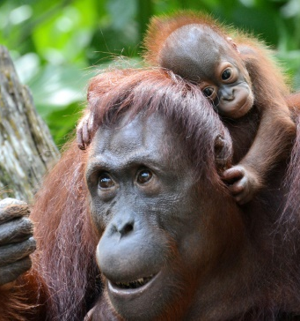

Research Question
What is the role of the mother in the feeding skill acquisition in immature Sumatran orangutans?
https://phys.org/news/2016-07-group-bornean-orangutan-critically-endangered.html

Slide 6
Hypotheses
Age ~ mother’s tolerance (whether the mother accepts or refuses)
Older offspring, less parental investment (PI) is selected (Trivers, 1974)
The orangutan mother is less tolerant to the older infant than to the younger one, when begging occurs

Slide 7
Hypotheses
2. Feeding Competence of the subject ~ mother’s tolerance
Measure of feeding competence: how much time it takes an immature individual to process a food item from picking to ingestion (relative to adults’ speed) (Schuppli et al., 2016)
If the offspring is well competent in foraging, the PI in foraging skill decreases (Trivers, 1974)
Conflict in feeding more likely to occur

Slide 8
Hypotheses
3. Difficulty of the food item ~ mother’s tolerence
Measure of complexity: how many steps does it take to process a food item? (Schuppli et al., 2016)
more complex items are more difficult to process.

Slide 9
Hypotheses
4. Rarity of the food item ~ mother’s tolerance
“conflict frequencies increase with decreasing food availability” (Falkner, 2015, p. 77)

Slide 10
Hypotheses
5. Physical condition of the subject ~ mother’s tolerence
Measure of physical condition: body size (e.g. lower than the mean)
POC: “the weaker and more vulnerable the offspring is, the more effort is selected from the parent to take care of it.” (Trivers, 1974, p.257)

Slide 11
Hypotheses
6. mother’s tolerance in the wild < mother’s tolerance in the zoo
More frequent food resource in the zoo than in the wild
Smaller variety of the food item in the zoo than in the wild (hypothesis 4)

Slide 12
IVs & DM
Mother’s Tolerence (yes/no)
Offspring’s age
Offspring‘s feeding competence
Complexity of the food item
Rarity of the food item
Condition (zoo/wild)
Physical condition of the offspring

Slide 13
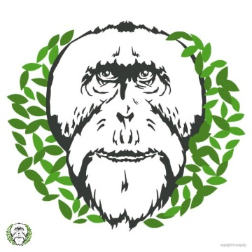
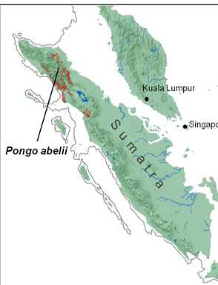
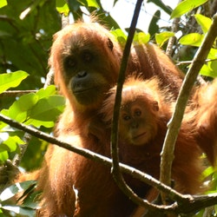
Methods
Data from Suaq Balimbing
Extend the existing data set on begging behavior
Coding videos of begging events from the wild
Transfer data on begging events from paper data to the data set
Amount of Data:
750 existing begging events
Around 550 will be added
Planned sample size: ~ 1300 begging events
Longitudinal & cross-sectional data set
12 mother-immature dyads
Aged 0 – 15 Y
Within - & across -subject design
Data collection
Standardized orangutan focal follows since 2007
More than 21’000 observation hours
Subjects
16 immatures, 12 mothers
https://suaq.org/
https://twitter.com/suaqorangutans

Slide 14
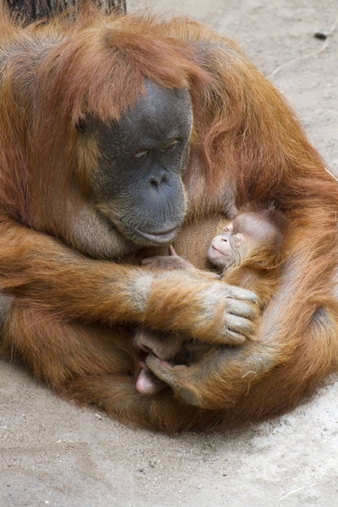
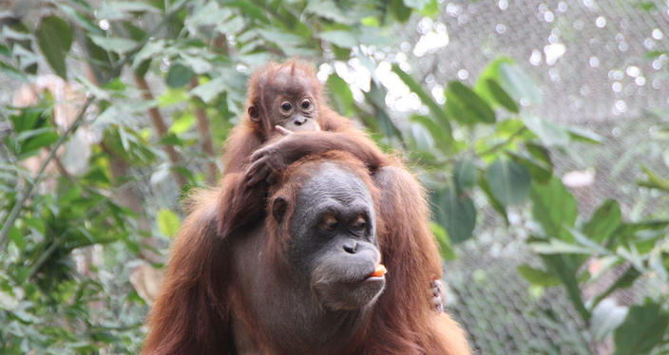
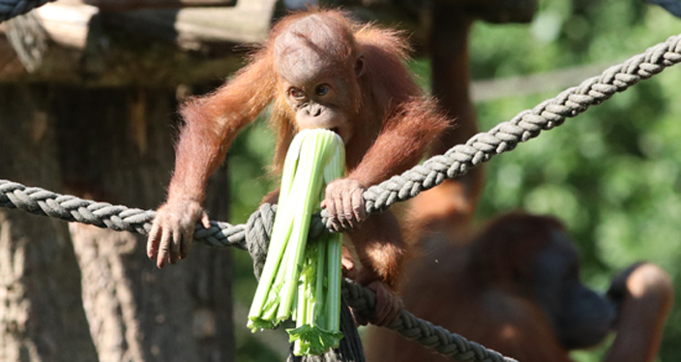
Methods
Data from Zoo Leipzig
Food transfer & begging data will be collected at the Leipzig Zoo
2 Mother-offspring dyads (and potentially other interaction partners) – is the mother the main begging target in the zoo (as in the wild) ?
Targeted sample size:
100 begging events
Data Collection
Planned period for observations
January – March 2020
Subjects
2 infants, 8 adults
https://www.zoo-leipzig.de/en/our-animals/animal-detail/sumatra-orangutan/
Notes:
The data I will present were collected at the SB OU reserach site. Suaq is home to the Sumatran OU. The research area is peat swamp forest. I collected data on 12 different immatures and their mothers. And I followed them over multiple years, starting in 2101
As a behavioral measure of cognitive pervormance we took rates of exploration behavior. Exploration is prolonged, non-repetitive, usually destructive manipulation of or feeding attempts on objects, during which the individuals focus is on the object, like the guys are doing on these pics here.
One age individual data point, so all the dots you will see in the graphs that follow is always data collected on one individual, within a max of 4 months for the immatures, to capture one specific developmental state. Each data point is based on a min of 70 high quality follow hours during which we collected all occurrence data of exploration events.

Slide 15
Analyses
R x64 3.5.2
GLMM
Random intercepts: Subject & Food Item
Random slope: Age
glmer(Mother’s Tolerence ~ Feeding Competence + Difficulty + Rarity + Body_Condition + Condition + (1|Subject) + (1|Fitem) + (0+ Age|Subject) + (0+ Age|Fitem), family="binomial")
library(lme4)

Slide 16
References
Dunkel, L. P. (2006). Development of Ecological Competence in Bornean Orangutans (Pongo pygmaeus): with special reference to difficult-to-process food items (Doctoral dissertation, Universität Zürich).
Estienne, V., Cohen, H., Wittig, R. M., & Boesch, C. (2019). Maternal influence on the development of nut‐cracking skills in the chimpanzees of the Taï forest, Côte d'Ivoire (Pan troglodytes verus). American journal of primatology, e23022.
Estienne, V., Robira, B., Mundry, R., Deschner, T., & Boesch, C. (2019). Acquisition of a complex extractive technique by the immature chimpanzees of Loango National Park, Gabon. Animal behaviour, 147, 61-76.
Falkner, S. Short Report of the Master Thesis: Mother-Offspring Conflict in Orangutans-Disentangling different contexts of mother-offspring conflict in Sumatran and Bornean orangutans.
Field, A., Miles, J., & Field, Z. (2012). Discovering statistics using R. Sage publications.
Jaeggi, A. V., Dunkel, L. P., Van Noordwijk, M. A., Wich, S. A., Sura, A. A., & Van Schaik, C. P. (2010). Social learning of diet and foraging skills by wild immature Bornean orangutans: implications for culture. American Journal of Primatology: Official Journal of the American Society of Primatologists, 72(1), 62-71.
Jaeggi, A. V., Van Noordwijk, M. A., & Van Schaik, C. P. (2008). Begging for information: mother–offspring food sharing among wild Bornean orangutans. American Journal of Primatology: Official Journal of the American Society of Primatologists, 70(6), 533-541.

Slide 17
References
Jäggi, A. V., van Schaik, C. P., Fischer, J., & Burkart, J. M. (2010). Building Blocks of Morality: Reciprocal Altruism and Food Sharing among Chimpanzees (Pan troglodytes), Bonobos (Pan paniscus) and other Primates.
Lonsdorf, E. V. (2005). Sex differences in the development of termite-fishing skills in the wild chimpanzees, Pan troglodytes schweinfurthii, of Gombe National Park, Tanzania. Animal Behaviour, 70(3), 673-683.
Lonsdorf, E. V. (2006). What is the role of mothers in the acquisition of termite-fishing behaviors in wild chimpanzees (Pan troglodytes schweinfurthii)?. Animal cognition, 9(1), 36-46.
Schuppli, C., Forss, S. I., Meulman, E. J., Zweifel, N., Lee, K. C., Rukmana, E., ... & van Schaik, C. P. (2016). Development of foraging skills in two orangutan populations: needing to learn or needing to grow?. Frontiers in zoology, 13(1), 43.
Schuppli, C., Meulman, E. J., Forss, S. I., Aprilinayati, F., Van Noordwijk, M. A., & Van Schaik, C. P. (2016). Observational social learning and socially induced practice of routine skills in immature wild orang-utans. Animal Behaviour, 119, 87-98.
Trivers, R. L. (1974). Parent-offspring conflict. Integrative and Comparative Biology, 14(1), 249-264.
Van Noordwijk, M. A., & van Schaik, C. P. (2005). Development of ecological competence in Sumatran orangutans. American Journal of Physical Anthropology: The Official Publication of the American Association of Physical Anthropologists, 127(1), 79-94.
Van Noordwijk, M. A., Sauren, S. E., Abulani, A., Morrogh-Bernard, H. C., Utami Atmoko, S. S., Van Schaik, C. P., ... & Mitra Setia, T. (2009). Development of independence: Sumatran and Bornean orangutans compared.

Slide 18
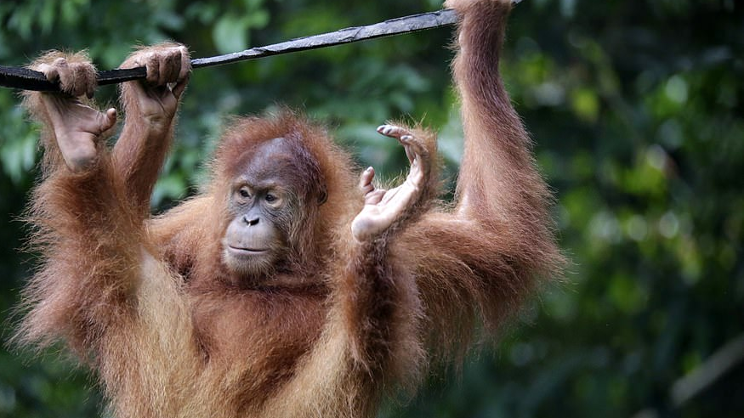
Questions?
https://www.dailymail.co.uk/news/article-7154111/Orangutan-released-wild-Sumatra.html

