Slide 1
OOP COURSE PROJECT PRESENTATION
Presentation Subject: Database where we can add object, remove object, sum up objects etc. in Java

Slide 2
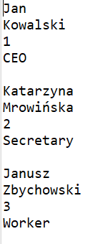
What have you created?
A database for company to add, remove and show workers.
Example:

Slide 3

Did you have any problems?
Learning new programming language is always hard
Communication with a new compiler (connected with the first point)
The compiler logo:

Slide 4
Did you learn anything new?
New programming language (Java)
The compiler logo:

Slide 5
What could be improved?
Save and read database option
More variable for each person
More option to edit/read database

