Slide 1

AgroPeace
A GIS-based early warning and real-time response framework for farmer/herder conflict resolution
Case study: Guma, Agatu, Logo and Gwer West LGAs, Benue State
[Your Name] · [Matric No] · CMP 468: Computer Security · [Date]
Notes:
Good morning. My second project answers the question: develop a GIS-based early warning and real-time framework for farmer/herder conflict resolution. I built AgroPeace and used Benue State as the case study, because Benue has suffered some of the worst of this conflict.

Slide 2
THE PROBLEM
Hours separate a stray herd from a killing
~2,500
2017
Hours
people killed in farmer/herder violence in 2016 (International Crisis Group, 2017)
Benue bans open grazing, yet clashes over farms, water and routes continue
between crops being destroyed and a reprisal: long enough to act, if the right people know
The information to act early exists: herd movements, crop seasons, past incidents, community warnings. It is scattered, unverified and slow.
CMP 468 · AgroPeace | 2
Notes:
The Crisis Group estimated about 2,500 deaths in 2016 alone. Benue banned open grazing in 2017, but clashes continue. My key observation: most incidents take hours to escalate. That gap is the opportunity.

Slide 3





HOW A DISPUTE BECOMES A MASSACRE
Break the chain early
→
→
→
→
Herd heads
for farms
Crops
destroyed
Rumour
spreads
Youths
mobilise
Reprisal
Forecast + SMS to herder
Case to peace committee
Trust scoring holds rumours
Escalate to Agro Rangers
AgroPeace steps in at four points
CMP 468 · AgroPeace | 3
Notes:
This is the chain. AgroPeace intervenes at four points: it warns the herder before the herd reaches the farm, it opens a case for the peace committee when damage starts, it holds back unverified rumours, and it escalates to the Agro Rangers when nobody acts.

Slide 4
AIM AND OBJECTIVES
Warn early, verify, respond, protect
1
GIS engine and explainable risk model
2
Signed herd tracking with forecast and geofences
3
USSD and web reporting with trust scoring
4
LGA-based routing and escalation
5
Security against forgery, replay, exposure and tampering
6
Evaluation by tests, demo and benchmarks
CMP 468 · AgroPeace | 4
Notes:
Six objectives, all met.

Slide 5
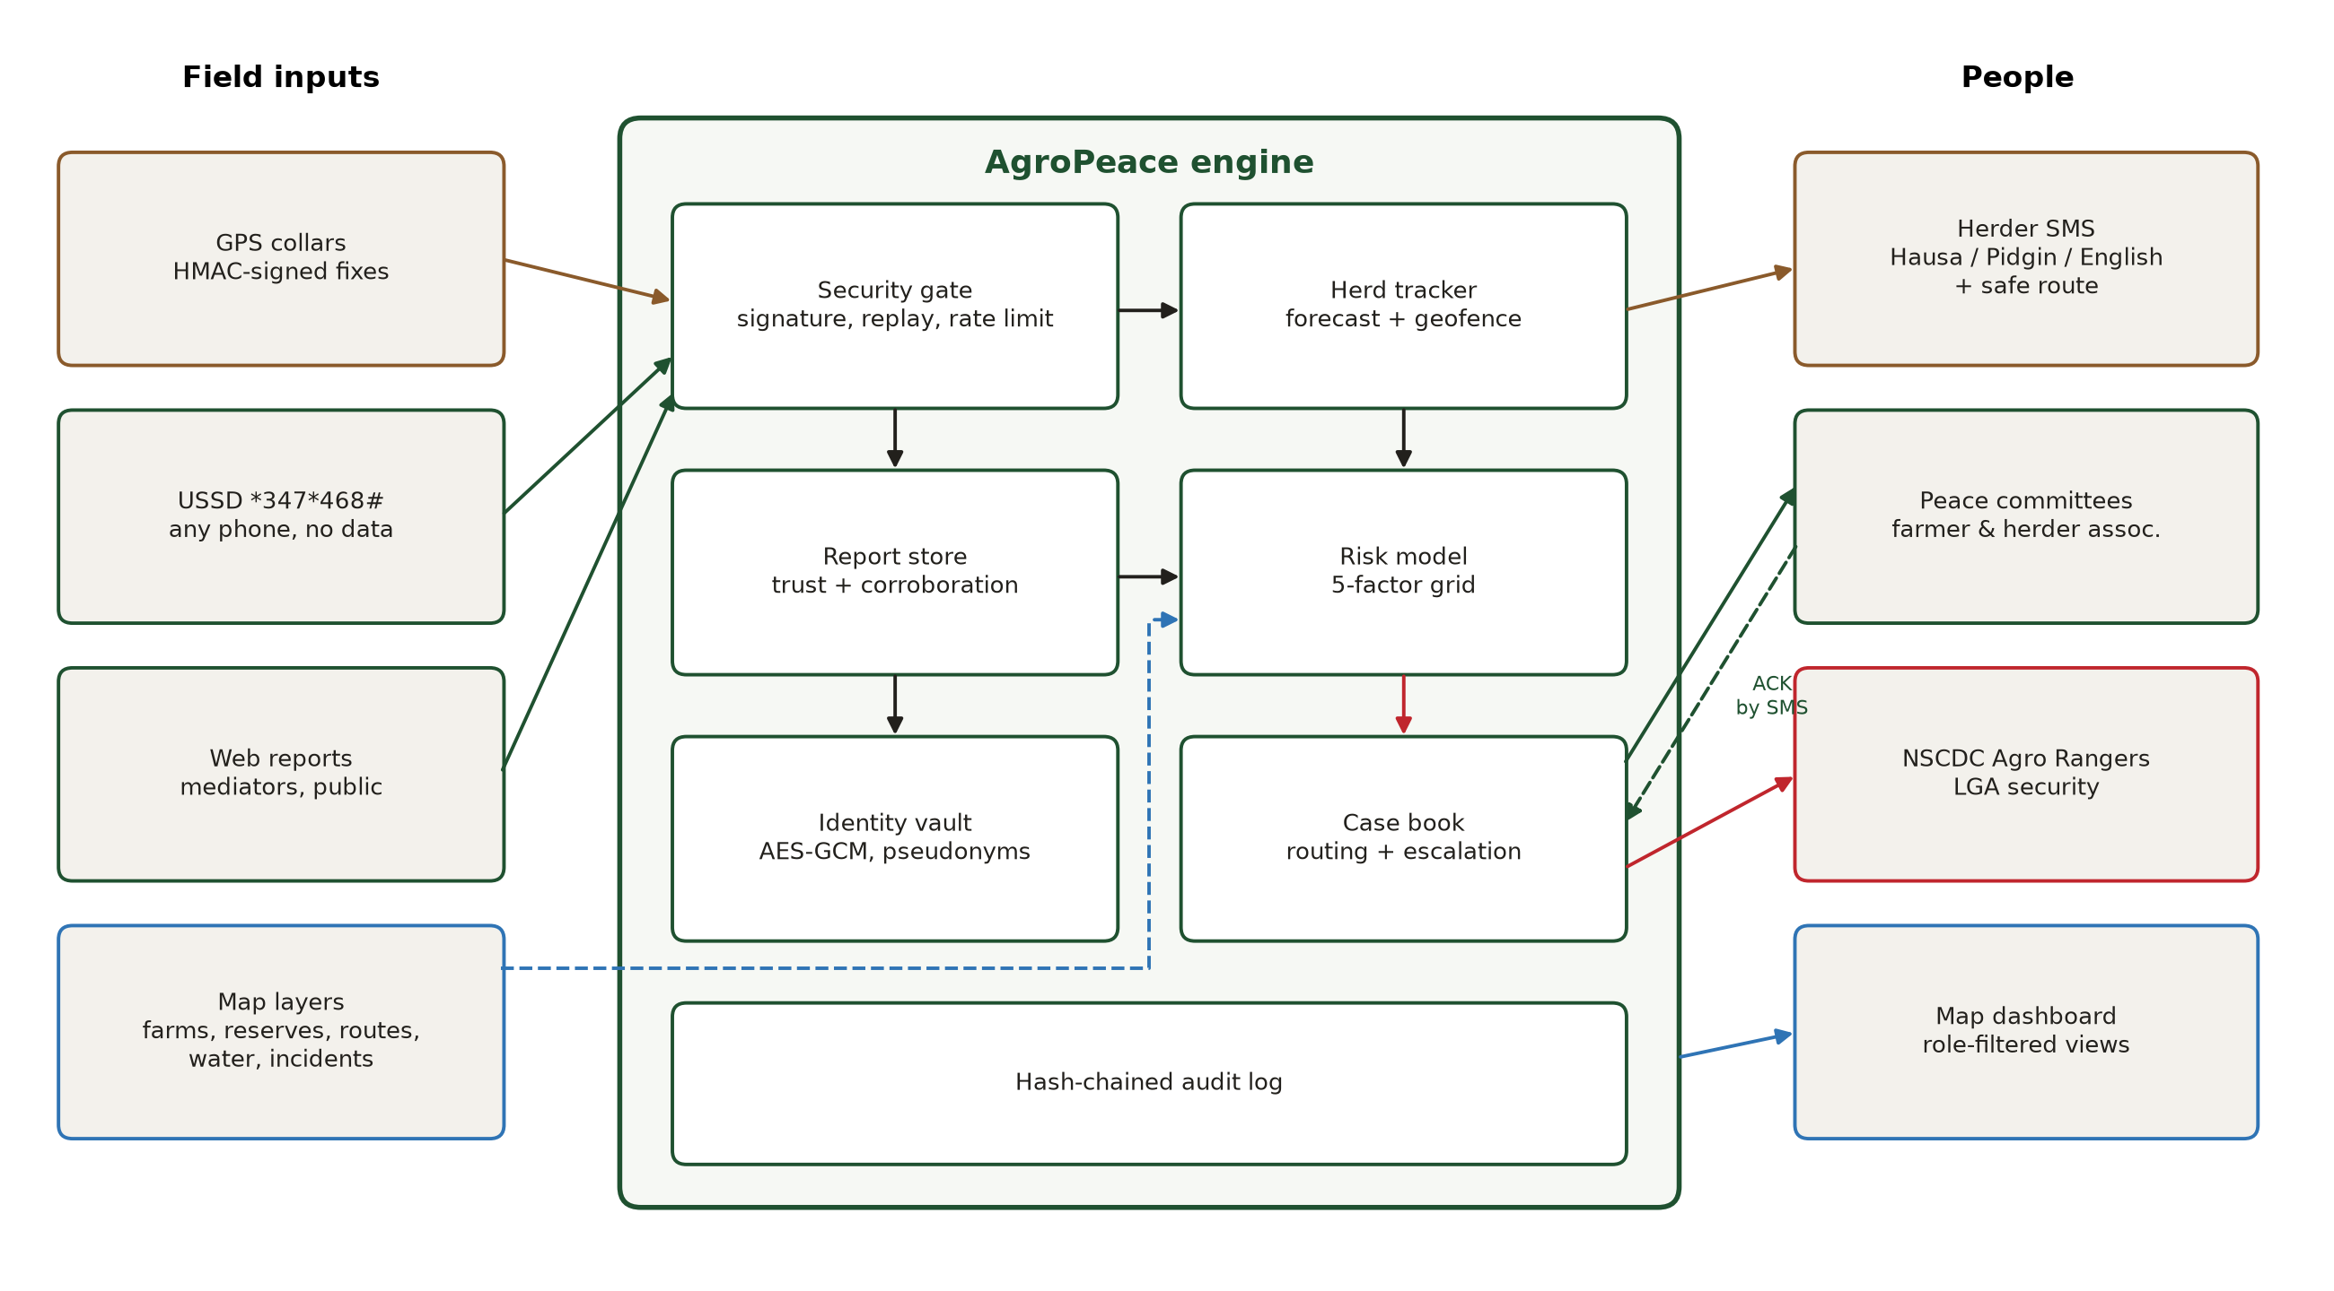
DESIGN
Architecture
CMP 468 · AgroPeace | 5
Notes:
Field inputs on the left: signed GPS collars, USSD from any phone, web reports and map layers. Everything passes a security gate first. The tracker and report store feed the risk model and case book. Outputs go to herders by SMS, to peace committees and associations, to the Agro Rangers, and to a role-filtered dashboard. Every step is written to a hash-chained audit log.

Slide 6
GIS RISK MODEL
Five factors every mediator can understand
2,010 cells of 2.8 km
Low < 0.20 · elevated · high · severe ≥ 0.50
Seasons built in: rains April to October, harvest to December, dry-season water stress
Every score names its drivers, e.g. "past incidents nearby, herds close to crops"
Weights to be calibrated with ACLED data
CMP 468 · AgroPeace | 6
Notes:
Each grid cell gets a score from five factors. The two biggest are past incidents, using kernel density with age decay, and herds close to crops. Explainability matters: a peace committee will not act on a black box, so every score names its drivers. The weights are starting values; a real deployment would calibrate them with ACLED conflict data.

Slide 7
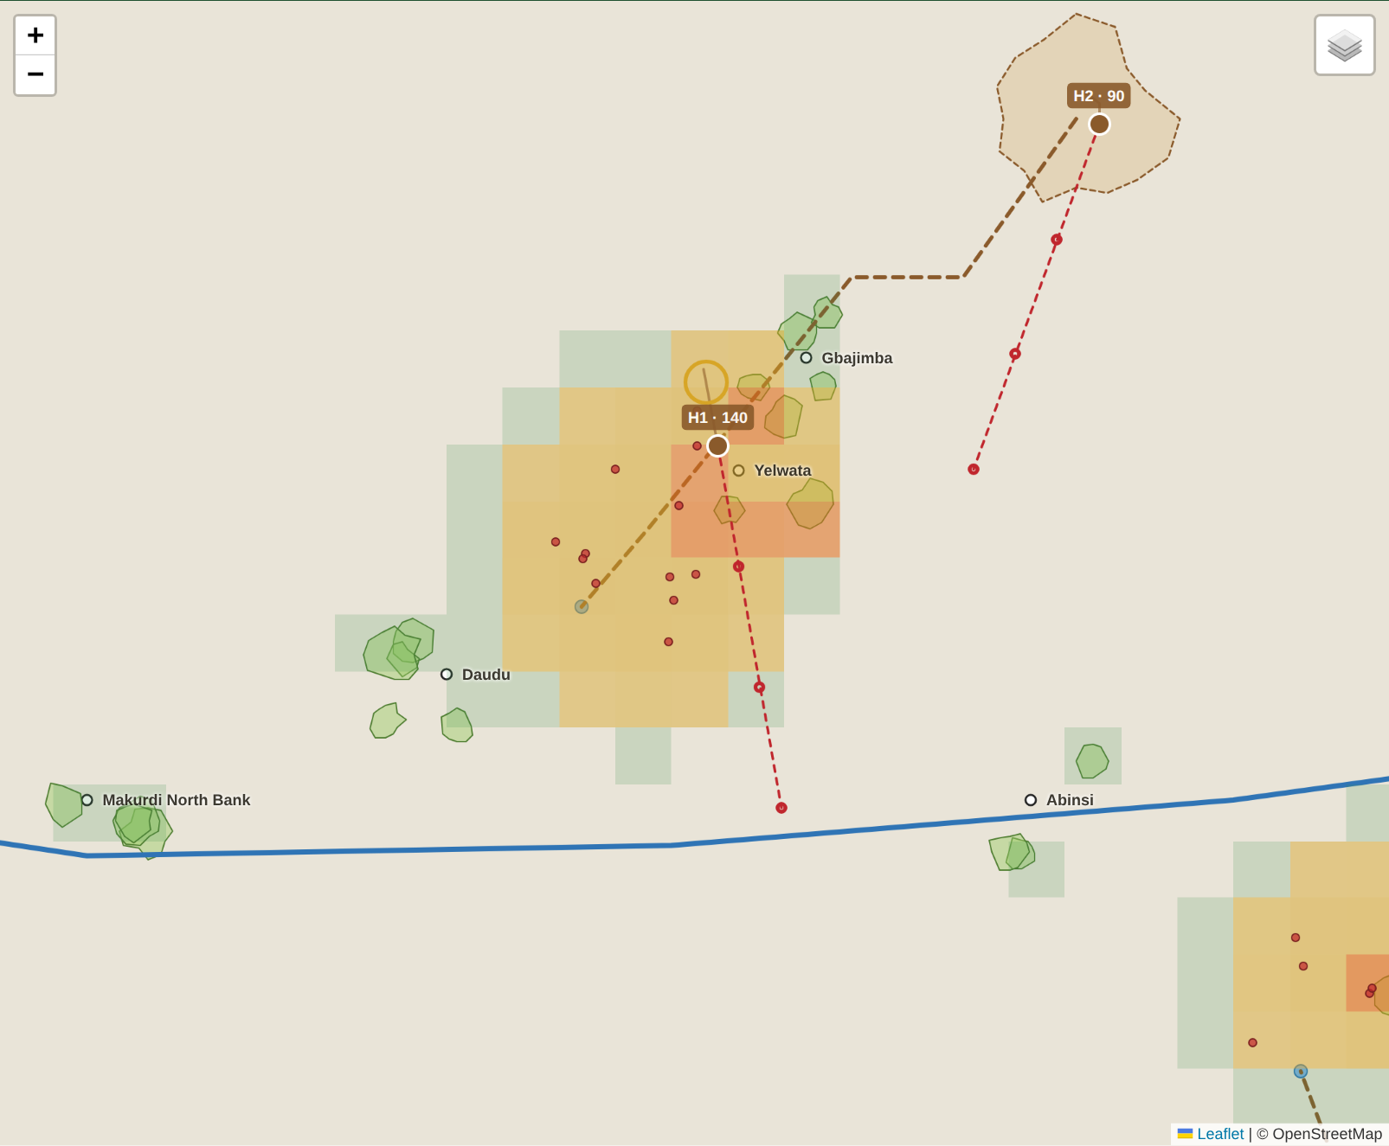



REAL TIME
See the herd coming, three hours ahead
Forecast
position at +1, +2, +3 h from speed and heading
Early warning
forecast enters a farm: SMS to herder with safe route
Incursion
herd inside farm: case to peace committee
No repeats
events fire only when the zone changes
CMP 468 · AgroPeace | 7
Notes:
Each signed GPS fix updates the herd's speed and heading. The dashed red line is the three-hour forecast. When a forecast point falls inside a farm during crop season, the herder is warned while there is still time to turn. The state machine only raises an event when the herd's zone changes, so responders are not spammed.

Slide 8
EARLY WARNING TO THE HERDER
Tell them where to go, in their language
English meaning
AgroPeace
Warning: your herd H1 will reach farms near Yelwata in about 3 hours. Turn toward Guma East Grazing Reserve (north-east) along Route R2.
AgroPeace gargadi: garken ku H1 zai kai gonaki kusa da Yelwata cikin awa 3. Ku juya zuwa Guma East Grazing Reserve (NE) ta hanyar Route R2.
Hausa, Nigerian Pidgin and English templates; Tiv, Idoma and Fulfulde to add with native speakers
Nearest reserve, compass direction and stock route come from the GIS layers
Plain SMS: works on any phone, no data
Outbox never stores phone numbers
CMP 468 · AgroPeace | 8
Notes:
This is the actual message the system sent in my demo. It is in Hausa because the herder registered Hausa. It does not just say 'stay away'; it tells the herder where to go and which route to take. The Hausa must be checked by a native speaker before field use, and I say so in the report.

Slide 9
COMMUNITY REPORTING
Every phone can report, rumours stay put
Channel base
mediator 0.85 · USSD 0.40 · anonymous web 0.30
*347*468#
AgroPeace (Benue)
1. Cattle on my farm
2. Threat or attack
3. Cattle stolen
4. Check risk in my area
+ independent reporters
+0.15 each within 3 km and 6 h (max +0.30)
+ GPS confirmation
+0.25 if a collar shows a herd within 2 km
± reputation
+0.10 per confirmed report, -0.20 per false one
Type, LGA, community, confirm
Below 0.45 = unverified: never broadcast, never public, never triggers security. A lone "they are coming tonight" stays quiet until someone else confirms it.
CMP 468 · AgroPeace | 9
Notes:
USSD works on the cheapest phone without data, and rural Nigerians already use it for banking. Ushahidi in Kenya showed crowdsourcing works, but anyone can report anything. So every report gets a trust score. The key rule: unverified reports are never broadcast. That is how the system avoids becoming a rumour amplifier.

Slide 10
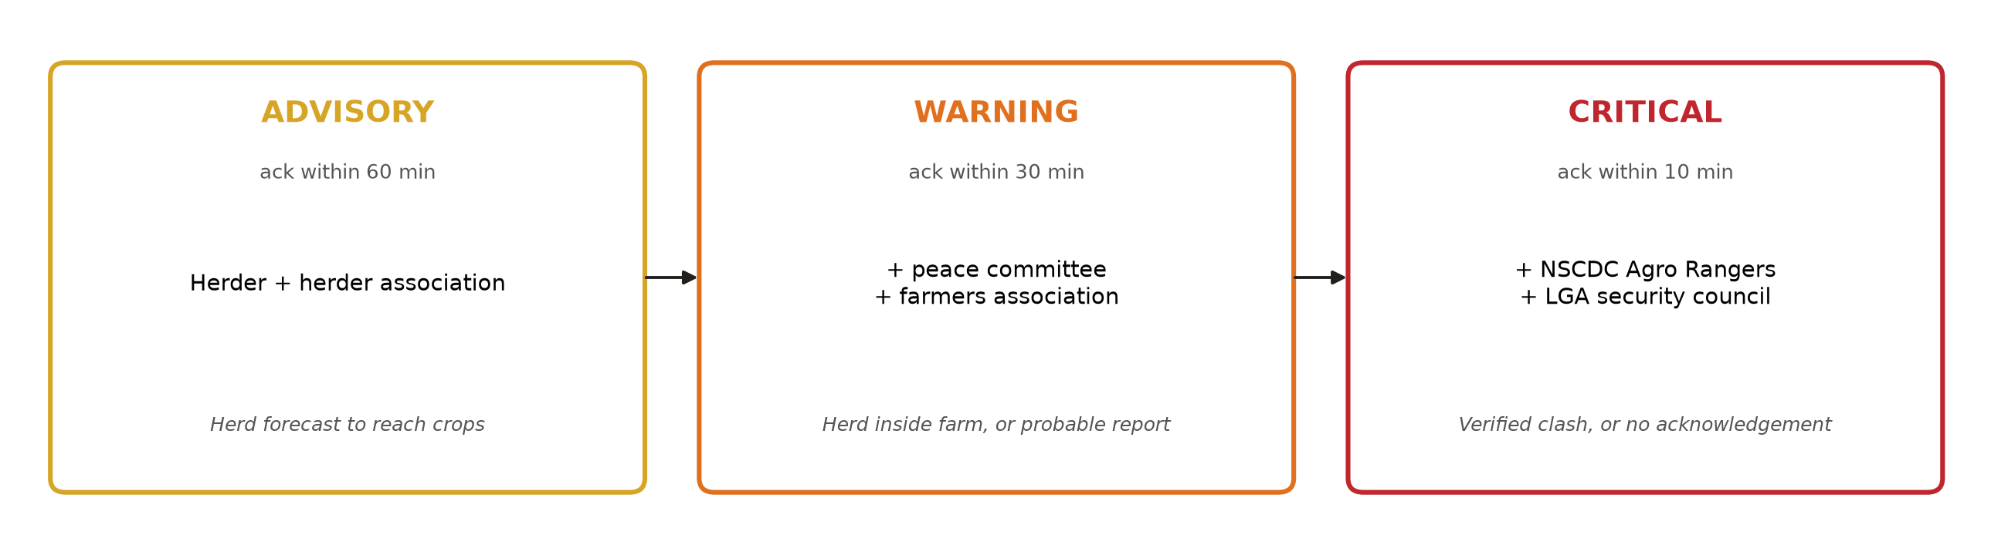
CONFLICT RESOLUTION WORKFLOW
Mediation first, force last
Responders chosen by LGA from the directory
Reply "ACK C-001" by SMS from a registered number to acknowledge
No acknowledgement before the deadline: the case climbs a rung automatically
Cases close with an outcome: herd rerouted, dialogue held, compensation agreed, security deployed, false alarm
CMP 468 · AgroPeace | 10
Notes:
The ladder puts herders and associations first, then peace committees and farmers, and only then the Agro Rangers and LGA security. Responders acknowledge by plain SMS. If nobody acknowledges in time, the case escalates by itself. Recorded outcomes build evidence of what works.

Slide 11





COMPUTER SECURITY
Here, bad data can get people killed
Forged GPS
Replayed message
Informant exposure
HMAC-SHA256 per-device signature
120 s window + nonce cache
AES-256-GCM phone numbers, keyed pseudonyms
Herds targeted
Rumour flooding
Covering tracks
public never sees herd positions
trust scoring + 3 reports/hour limit
hash-chained audit log
CMP 468 · AgroPeace | 11
Notes:
This is where the course comes in. A forged GPS message could place a herd in a farm and start a reprisal, so every collar signs its messages. Old messages are rejected by timestamp and nonce. Phone numbers of informants are encrypted; records carry only a keyed pseudonym. The public never sees herd positions. Trust scoring and rate limits stop flooding. And every action is in a hash-chained log.

Slide 12
LEAST PRIVILEGE
Each role sees only what it needs
Public
Community risk levels only. No herds, no cases, no unverified reports.
Mediator
Precise herds, cases and reports in their own LGA. Acknowledge, resolve, confirm or reject reports.
Coordinator
All LGAs, unverified reports and audit trail. All case actions.
Protection officer
Can reveal an informant's number only with a written reason. Every attempt is audited.
CMP 468 · AgroPeace | 12
Notes:
Least privilege, applied. A Guma mediator cannot see Logo cases. Even the coordinator cannot unmask an informant; only the protection officer can, with a reason, and it is logged.

Slide 13
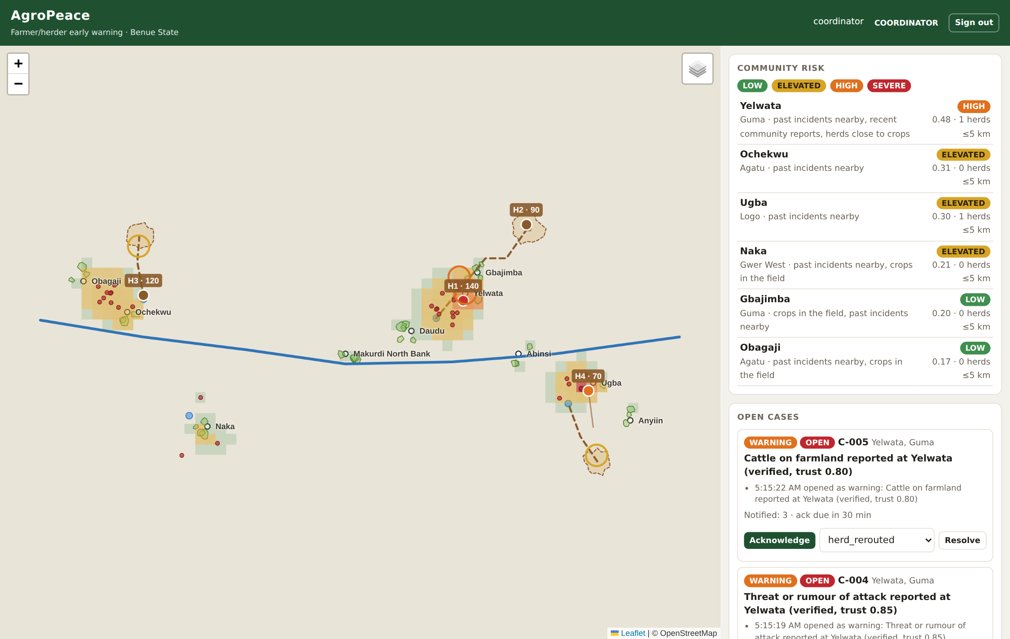
IMPLEMENTATION
The coordinator's live map
Risk grid green to red
Herd trails and dashed 3-hour forecasts
Rings mark open cases
Case controls: acknowledge, resolve
USSD phone simulator for the demo
Leaflet bundled: works offline
CMP 468 · AgroPeace | 13
Notes:
Built with Leaflet, bundled locally so it works without internet during this presentation. It updates live through server-sent events.

Slide 14
EVALUATION
Results
30/30
3.3 ms
0.08 s
4/4
automated tests pass
per signed GPS message incl. geofencing
to recompute 2,010 risk cells
attacks blocked in demo: forgery, replay, unmasking, flooding
Early warning reached the herder 90 minutes before the herd entered the farm
A lone anonymous rumour stayed unverified (trust 0.30) and was never broadcast
No acknowledgement in 30 minutes: case escalated to NSCDC Agro Rangers automatically
Editing one audit row was detected at the exact row
CMP 468 · AgroPeace | 14
Notes:
The tests prove the security properties, not only that the code runs. In the demo, the herder got the warning 90 minutes before the herd reached the farm.

Slide 15
LIVE DEMONSTRATION
Let me show you
1
Public view: risk only, no herds
2
Sign in as coordinator: herds, forecasts, cases appear
3
Start the collar simulator: H1 gets an early warning, then enters a farm
4
USSD phone: report cattle on a farm at Yelwata; watch the trust score
5
Acknowledge and resolve the case; show the audit chain
Backup plan if the laptop misbehaves: python demo/run_demo.py
Notes:
Terminal 1: python -m agropeace -c demo/demo_config.json run. Browser: 127.0.0.1:8090. Show public view, sign in as coordinator. Terminal 2: python demo/simulator.py. Use the USSD panel: dial, 1, choose Guma, Yelwata, 1 to send. If anything fails, run demo/run_demo.py --fast.

Slide 16
HONEST ASSESSMENT
Limitations and ethics
Limitations
Do no harm
Synthetic data; weights not yet calibrated
Herders must agree to collars
Straight-line forecasts ignore terrain
One server is a single point of failure
Hausa text needs native review
Never broadcast unverified claims
Never show herd positions publicly
Protect informants by design
Farmer and herder bodies co-govern the data
Follow the Nigeria Data Protection Act 2023
CMP 468 · AgroPeace | 16
Notes:
The biggest risk is misuse: the same data that warns a herder could be used to find one. That is why governance must be shared and why the public never sees herds.

Slide 17
Use the hours before violence
GIS sees the herd coming and tells the herder where to go
Trust scoring stops rumours from spreading
Cases reach the right people, and escalate if nobody acts
Security keeps warnings true and informants safe
Thank you. Questions?
Notes:
To conclude: the time between a stray herd and a killing is often hours. AgroPeace uses those hours. Thank you. I welcome your questions.

