Slide 1

UniGuard
Automated monitoring, backup and recovery for university digital infrastructure
Built for Nigerian campus conditions: unstable power, costly bandwidth, small budgets and result tampering
[Your Name] · [Matric No] · CMP 468: Computer Security · [Date]
Notes:
Good morning. My project answers question one: develop an automated monitoring, backup and recovery system for university digital infrastructure. I called it UniGuard. I designed it around the real conditions of a Nigerian university, and I will show it working live.

Slide 2
THE PROBLEM
Campus records can vanish in minutes
39%
72 hrs
1 drive
of surveyed staff at Nigerian tertiary institutions face 4 to 6 hours of power outage daily (Ibrahim et al., 2026)
to report a personal data breach to the NDPC under the Nigeria Data Protection Act 2023, s.40
is all many departments use for backup, and it sits beside the server ransomware attacks
Admissions (CAPS), fees (Remita), course registration, results and transcripts now all run on campus servers. Most have no monitoring, no tested restore, and no record of who changed what.
CMP 468 · UniGuard | 2
Notes:
Three numbers frame the problem. In a 2026 survey across Nigerian universities, polytechnics and research institutes, 39 percent of respondents faced 4 to 6 hours of power outage every day, so abrupt power cuts are routine. The Data Protection Act gives us 72 hours to report a breach, so we must know quickly. And many departments back up to one drive kept next to the server, which ransomware encrypts along with everything else.

Slide 3





THREAT MODEL
Five ways a university loses its data
Ransomware
encrypts the file server and every attached drive
Insider tampering
raises a grade after Senate approval
Power failure
generator switch-over corrupts a file mid-write
Disk failure
destroys data that was never copied
Service outage
portal down during registration, noticed hours later
CMP 468 · UniGuard | 3
Notes:
These map to the classes of attack from our course: ransomware is interruption, grade tampering is modification, and power and disk failure threaten availability. UniGuard has a specific control for each one.

Slide 4
AIM AND OBJECTIVES
Protect the CIA triad, automatically
1
Encrypted, incremental backups where every snapshot restores on its own
2
Continuous monitoring of servers, campus services and power
3
Detection of ransomware and unauthorised result changes
4
Automatic, verified recovery with evidence preserved
5
Tamper-evident audit trail of every action
6
Evaluation by tests, live demo and benchmarks
CMP 468 · UniGuard | 4
Notes:
Six objectives. All six were met, and I will show evidence for each one.

Slide 5
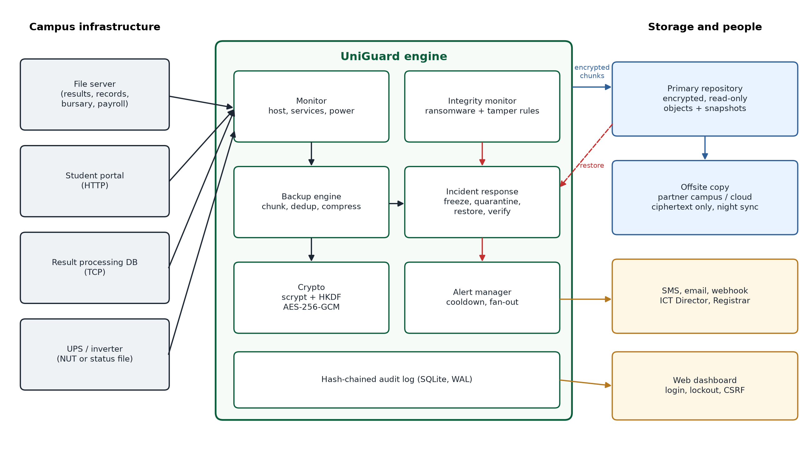
DESIGN
Architecture
CMP 468 · UniGuard | 5
Notes:
On the left, what we protect: the file server with results, records, bursary and payroll; the student portal; the result database; and the UPS. In the middle, the engine: a monitor, an integrity monitor, a backup engine, an incident responder, the crypto layer and an alert manager, all writing to a hash-chained audit log. On the right: an encrypted primary repository, an offsite copy that only ever holds ciphertext, SMS and email alerts, and the dashboard.

Slide 6
ENCRYPTION AND DECRYPTION
A stolen backup drive reveals nothing
Passphrase
scrypt
HKDF
AES-256-GCM
12+ chars, sealed with Registrar
→
memory-hard: slows guessing
→
splits into 2 independent keys
→
encrypts and authenticates every chunk
Chunk names are HMAC-SHA256 with a secret key, so an attacker cannot test whether a known file is inside
Chunk name is bound as associated data: swapping two encrypted chunks is detected
Fresh random 96-bit nonce for every chunk; no nonce reuse
On restore: GCM tag, chunk HMAC and whole-file SHA-256 are all checked
CMP 468 · UniGuard | 6
Notes:
This covers encryption and decryption from our outline. The passphrase goes through scrypt, which needs lots of memory per guess, so graphics-card cracking is expensive. HKDF splits the result into an encryption key and a naming key. Every chunk is encrypted with AES-256-GCM, which also detects any change. Tests confirm that flipping one bit, swapping two chunks, or using the wrong passphrase all fail safely.

Slide 7
BACKUP ENGINE
Incremental speed, full-backup safety
Files split into 1 MiB chunks, compressed, encrypted
A chunk already stored is never stored again
Every snapshot is a complete list of chunks, so there is no fragile backup chain
Backup files written atomically and made read-only
Retention keeps daily, weekly and monthly copies, and always the last clean one
Benchmark: 2,000 records, 195 MB
6.2 s
0.1 s
first full backup
next backup after 1% of files changed (224 KiB stored)
1.7 s
23/23
full restore, every file SHA-256 verified
automated tests passing
CMP 468 · UniGuard | 7
Notes:
Classic incremental backups are fast but need the whole chain to restore. Deduplication gives us both: each backup only writes new chunks, but each snapshot still restores on its own. On 195 megabytes, the second backup took a tenth of a second.

Slide 8
DETECTION
Ransomware leaves fingerprints on files
Mass change
5+ files and 20%+ of all files modified or deleted
40 pts
High entropy
3+ changed files near 8 bits/byte (random-looking)
30 pts
Ransom extension
.locked, .encrypted, .lockbit and others
20 pts
Ransom note
README / DECRYPT / RECOVER text files appear
20 pts
50+ points = critical. No single signal is enough, so a lecturer replacing many handouts gets a warning, not a lockdown.
CMP 468 · UniGuard | 8
Notes:
Recent studies, such as Lee and colleagues in 2023 and Davies and colleagues in 2022, detect ransomware from file entropy: encrypted files look random, so their Shannon entropy jumps close to 8 bits per byte. Bang and colleagues showed in 2024 that attackers can disguise entropy, which is why I never rely on entropy alone. I combine four signals. It needs two or more to go critical, which keeps false alarms down. Compressed formats like PDF and DOCX are excluded from the entropy signal.

Slide 9
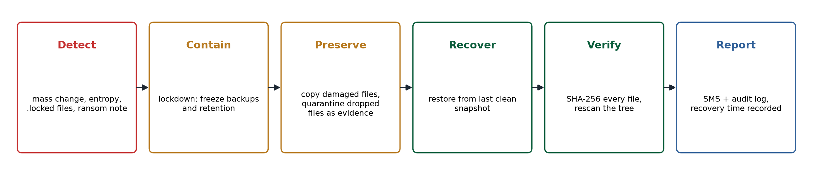
INCIDENT RESPONSE (NIST SP 800-61)
From attack to verified recovery in seconds
2.7 s
600/600
0
to detect, quarantine, restore and verify 600 encrypted files
files restored, every one checked with SHA-256
clean snapshots lost: backups freeze during the attack
CMP 468 · UniGuard | 9
Notes:
When the score crosses 50, UniGuard locks down backups so encrypted files never overwrite good ones. It copies damaged files and moves the attacker's files into quarantine as evidence. It restores from the last clean snapshot, checks every file's hash, then sends SMS alerts and records the recovery time. In my benchmark, 600 files came back in 2.7 seconds.

Slide 10




RECORDS INTEGRITY
Catching a changed grade
Protected path watch
The insider
results may only change inside Senate-approved windows
CMP/2022/002, CMP468
43 (E) → 88 (A)
changed after Senate approval
Instant SMS
to Registrar and ICT Director, naming the file
SUSPECT backups
later snapshots never used for recovery
Hash-chained audit log
editing the log to hide it breaks the chain
CMP 468 · UniGuard | 10
Notes:
This is the feature I think matters most for a Nigerian university. The Registry marks the results folder as protected and gives it approval windows. Any change outside a window raises a critical alert. Backups after that are marked suspect, so the approved copy stays available as evidence. And if someone edits the audit log to cover it up, the hash chain breaks at the exact row.

Slide 11




LOCAL ADAPTATION
Built for how Nigerian campuses actually run
NEPA takes light
Costly bandwidth
Internet down too
Reads the UPS. Emergency backup the moment mains fails. Alert before the battery dies.
Only changed chunks go offsite, at night, under a data cap. Resumes after link loss.
SMS through Africa's Talking or Termii reaches phones without data.
Exam season
Small budget
NDPA 2023
Backups every 15 minutes instead of hourly during result upload.
Free software. Runs on an old PC. One command to start.
Encryption and timely restore (s.39). Audit trail for the 72-hour report (s.40).
CMP 468 · UniGuard | 11
Notes:
Most backup tools assume steady power and fast internet. UniGuard assumes the opposite. It knows when we are on inverter, it sends offsite copies at night under a data cap, and it alerts by SMS because the internet often fails at the same moment as the incident.

Slide 12
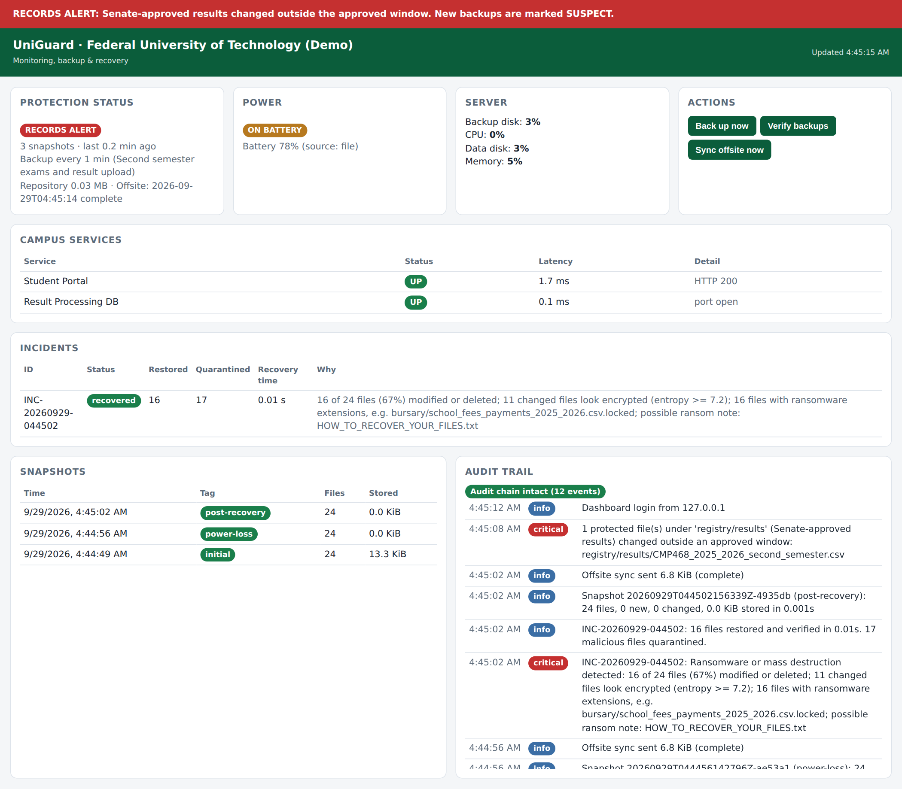
IMPLEMENTATION
The ICT unit's view
Red banner: a result file changed outside its window
Power card: running on inverter
Incident: 16 files restored, 17 quarantined, 0.01 s
Audit chain status on every refresh
Login with lockout after 5 failures, CSRF protection, security headers
CMP 468 · UniGuard | 12
Notes:
This is the dashboard after three staged incidents. It refreshes every three seconds. The dashboard itself is protected: login with lockout, a CSRF header on every action, and security headers against clickjacking.

Slide 13
EVALUATION
Results on 2,000 files (195 MB)
23 of 23 tests pass
Tampered ciphertext rejected
Wrong passphrase rejected
No plaintext in repository
Ransomware fully reversed
Lecturer edits not flagged
Audit log edits caught
Dashboard lockout works
CMP 468 · UniGuard | 13
Notes:
Recovery time objective under three seconds, compared with days of manual rebuilding. The recovery point objective is the backup interval: one hour normally, fifteen minutes in exam season. The tests prove the security properties, not just that the code runs.

Slide 14
LIVE DEMONSTRATION
Let me show you
1
NEPA takes light: power card turns amber, emergency backup, SMS
2
Student Portal goes down: critical alert within 3 seconds
3
Insider changes a CMP468 grade: red records banner
4
Ransomware scrambles the file server: watch it recover itself
5
Verify backups and check the audit chain
Backup plan if the projector laptop misbehaves: python demo/run_demo.py
Notes:
Switch to the terminal and browser now. Terminal 1 runs the dashboard, terminal 2 the fake portal, terminal 3 the incident simulator. Run: simulate_incident.py power-off, then Ctrl+C the portal, then tamper, then ransomware. If anything fails, run demo/run_demo.py --fast which tells the same story in the terminal.

Slide 15
HONEST ASSESSMENT
Limitations and future work
Limitations
Next steps
Work since the last clean backup is lost (RPO = backup interval)
Very slow ransomware may stay under the mass-change threshold
An admin-level attacker on the same server can delete local backups; the offsite copy covers this
Lost passphrase = unreadable backups
Watches files, not rows inside a database
Row-level auditing for result databases
Immutable (object-lock) offsite storage
Per-process detection on staff PCs
Split passphrase between Registrar and ICT Director
One-semester pilot on a faculty server
CMP 468 · UniGuard | 15
Notes:
I want to be clear about limits. The biggest one: changes made after the last backup are lost, so exam season uses a 15-minute interval. The offsite copy on a separate machine is the answer to an attacker who gets administrator rights on the main server.

Slide 16

Strong protection does not need expensive software
Encrypted, deduplicated backups that restore on their own
Ransomware reversed and verified in under 3 seconds
Result tampering caught, evidence preserved, log tamper-evident
Designed for power cuts, thin bandwidth and small budgets
Thank you. Questions?
Notes:
To conclude: UniGuard shows that a university can protect its records against ransomware, tampering and power failure with free software on ordinary hardware. Thank you. I welcome your questions.

